Slide 1

Reciprocal Teaching
This work is licensed under a Creative Commons Attribution-NonCommercial-NoDerivatives 4.0 International License.
Notes:
A few days before the training send participants the short article, “Strategies for Reading Comprehension” from Reading Quest, which briefly explains the reciprocal teaching practice. http://www.readingquest.org/strat/rt.html. While this is an old article, it is a seminal work regarding reciprocal teaching that helps establish the rationale for why we use a reciprocal teaching practice with students who struggle with reading comprehension.

Slide 2
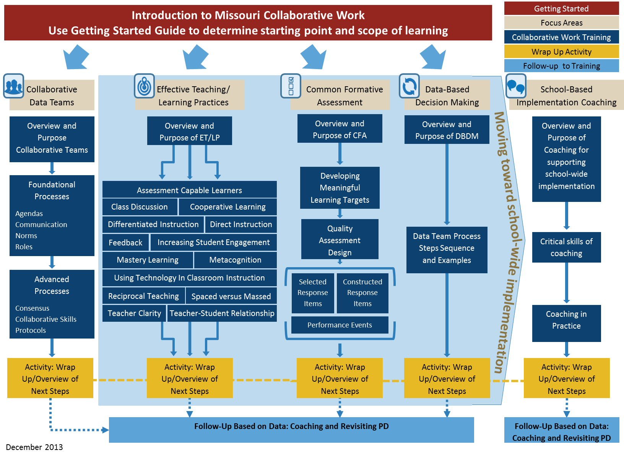

Slide 3
Reciprocal Teaching

Slide 4
Suggested Handouts Needed
Cover Page
Slide 13 – What is reciprocal teaching? With the bottom “fill in the blanks” also on the sheet.
1 per participant
1 each per 4 participants (first 3 are available in articles folder)
  Stricklin, Kelly Hands-on Reciprocal Teaching: A Comprehension Technique
  Marzano, Robert Classroom Instruction That Works (p. 42-43)
  Hattie, John Visible Learning 2009 (p. 203-204)
  Pilonieta, P., & Medina, A.L. (2009) Reciprocal teaching for the primary grades: “We can do it, too!” www.readingrockets.org/article/40008/?theme=print
4. Slide 26 – Jigsaw Protocol 1 per participant
Slide 27- 4 box graphic organizer “Why Use RT?” 1 per participant
Slide 30- RT Overview 1 per participant
Slide 31-32 - RT Implementation Scoring Guide 1 per participant
http://www.timeforkids.com/news/unsolved-ocean-mystery/42576 (grades 4-6) 1 per participant
9. Slide 43 – 4 Roles Cards 1 per participant
Reciprocal Teaching Protocol for Demonstration Lessons and Coaching 1 per participant
Slide 51 1 per participant
Reference page 1 per participant

Slide 5
Preparation
PURPOSE: Provide opportunity for learners to engage in the content prior to the formal training
CONTENT:
  Learning objectives
  Expectations for the training
  Preparatory reading Reflection exercise
Notes:
These yellow slides are not to be viewed by the audience. They were the outline provided to content development teams.

Slide 6
How am I currently teaching my students to predict, learn words, question, and summarize to become independent thinkers and readers?
Notes:
When staff walks in have the following question showing on the power-point show: How am I currently teaching my students to predict, learn words, question, and summarize to become independent thinkers and readers?
Staff responds to the question individually on an index card.
Do a line up and fold the line to find partner. Partner Share responses and then presenter collects the cards.

Slide 7
Expectations
During the training, participants will be exposed to the concept of reciprocal teaching and how it can be used in their classroom to increase comprehension.

Slide 8
Opening & Introductions
PURPOSE: Provide an overview of the day, including reviewing learner objectives, outcomes, and essential questions
CONTENT:
  Session at-a-glance
  Introductions
  Essential questions
  Norms
  Pre-assessment

Slide 9
Learning Objectives
In this training, the participants will:
Use reciprocal teaching terminology and strategies (predicting, clarifying, question generating, summarizing) to discuss text.
Explore how the implementation of reciprocal teaching improves learning for all students.

Slide 10
Questions We Will Address
During This Session
1. Why is reciprocal teaching an important instructional practice?
2. What are the core components and implementation steps?
3. How does this look and feel when I use this practice in my classroom?
Notes:
SESSION AT A GLANCE : Today we will address the answers to these questions as they relate to reciprocal teaching.

Slide 11
Questions We Will Address
During This Session
4. What resources are available to support the teacher?
5. How does the teacher assess reciprocal teaching?
6. What are the teacher’s next steps?

Slide 12

Essential Question
How does reciprocal teaching improve students’ comprehension?

Slide 13
Training Norms
Be an engaged participant and active learner.
Be an active listener—open to new ideas.
Use notes for side bar conversations.
Ask questions.
Use electronics respectfully.
Notes:
Norms may be added, as needed, for schools with specific requirements or issues.
Some schools might have established norms for all their professional development. In that case adapt to their norms.
Possible table discussion: which norm is hardest for you? Which has the biggest impact? What does “use electronics respectfully mean?” How might we remind someone to follow the norms in a fun way. As an example, a card with a photo of Norm Peterson can be on the table for people to raise as needed.
Consider including a check mid way through training to assess a norm or norms.
It may be that we want to use norms printed on all agendas for trainings, rather then in powerpoint, so people will always see them on paper.

Slide 14
Why Topic is Important
PURPOSE: Review the basics and relevance to student learning
CONTENT:
  Implications for student learning
  Ways implementation aligns with common core standards

Slide 15

What is reciprocal teaching?
Reciprocal teaching is _______________________________________and is defined as students____________________________________________; they take turns __________________________.
Notes:
WRITE-PAIR- SHARE:
Based on your prior knowledge and the reading we sent you before our training, individually write a definition or description of reciprocal teaching.
Pair with a shoulder partner and share your definitions.

Slide 16
Definition
Reciprocal teaching is an effective teaching/ learning practice and is defined as students summarizing, questioning, clarifying, and predicting; they take turns being the teacher.
Hattie, J. (2009). Visible Learning: A Synthesis of Over 800 Meta-Analyses Relating to Achievement. New York: Routledge.
Oczkus, L.D. (2010). Reciprocal Teaching at Work K-12: Powerful Strategies for Improving Reading Comprehension 2nd ed. Newark DE: International Reading Association.
Notes:
Compare your definition to this one. This is the definition we’re using during this training. It was adopted from the Missouri Educator Evaluation Standards.

Slide 17
Reciprocal Teaching Benefits
“Reciprocal teaching (RT) is an instructional procedure developed by Palincsar and Brown (1984) to improve students’ text comprehension skills through scaffolded instruction of four comprehension-fostering and comprehension-monitoring strategies (Palincsar & Brown, 1984; Palincsar, David, & Brown, 1989; Rosenshine & Meister, 1994), that is, (a) generating one’s own questions, (b) summarizing parts of the text, (c) clarifying word meanings and confusing text passages, and (d) predicting what might come next in the text. These four strategies are involved in RT in ongoing dialogues between a dialogue leader and the remaining students of the learning group.”
Spörer, N., Brunstein, J. C., & Kieschke, U. (2009)
Notes:
Here is a more elaborate definition as defined by Sporer, Brunstein, and Kieschke.
Read aloud or have them read it to themselves. Summarize using the bold red words.

Slide 18
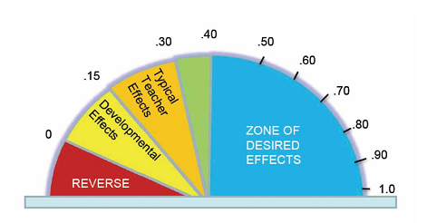
Reciprocal Teaching
2 meta-analyses, 38 studies, Rank 9th
(Self-Reported Grades)
(.74 effect size)
Notes:
*Reciprocal teaching was devised as an instructional process to teach students cognitive strategies that might lead to improved learning outcomes.
*The emphasis is on teachers enabling their students to learn and use cognitive strategies such as summarizing, questioning, clarifying, and predicting.
*The effect size from both meta-analyses is very high (.74) . The effects were highest when there was explicit teaching of cognitive strategies before beginning reciprocal teaching dialogue, showing the importance of modeling and practice as well as giving instruction in the use of the strategies close to the time students used them.
(Notes are taken from Visible Learning: A Synthesis of Over 800 Meta-Analyses Relating to Achievement by John Hattie)

Slide 19
Reciprocal Teaching and
Missouri Educator Evaluation Standards
Reciprocal Teaching aligns with the following Missouri Educator Evaluation Standards: http://dese.mo.gov/eq//documents/TeacherStandards.pdf
Standard 1, Quality Indicator 1
Standard 1, Quality Indicator 4
Standard 4, Quality Indicator 3
Standard 6, Quality Indicator 3
Standard 6, Quality Indicator 4
Standard 7, Quality Indicator 3
Notes:
When you look at the Missouri Educator Evaluation Standards, you will find that reciprocal teaching aligns with these standards. These are explained in more detail on the next slide.
(If teachers have not seen this document, you can open the hyperlink to show them what it looks like) or take it out if you don’t want it in there.

Slide 20
Reciprocal Teaching and
Missouri Educator Evaluation Standards
Standard 1: Content knowledge aligned with appropriate instruction.
  1.1: Content knowledge and academic language
  1.4: Interdisciplinary instruction
Standard 4: Teaching for Critical Thinking
  4.3: Cooperative, small group and independent learning
Standard 6: Effective Communication
  6.3: Learner expression in speaking, writing and other media
  6.4: Technology and media communication tools
Standard 7: Student Assessment and Data Analysis
  7.3 Student-led assessment strategies

Slide 21
Reciprocal Teaching and
Common Core Reading Anchor Standards
Standard 1: Read closely to determine what the text says explicitly and to make logical inferences from it; cite specific textual evidence when writing or speaking to support conclusions drawn from the text.
Standard 2: Determine central ideas or themes of a text and analyze their development; summarize the key supporting details and ideas.
Notes:
Reciprocal Teaching is aligned with CCSS in Reading, specifically with Anchor Standards 1,2, 3, & 4

Slide 22
Standard 3: Analyze how and why individuals, events, and ideas develop and interact over the course of a text.
Standard 4: Interpret words and phrases as they are used in a text, including determining technical, connotative, and figurative meanings, and analyze how specific word choices shape meaning or tone.

Slide 23
Reciprocal Teaching and Common Core Speaking and Listening Anchor Standards
Standard 1: Prepare for and participate effectively in a range of conversations and collaborations with diverse partners, building on others’ ideas and expressing their own clearly and persuasively.
Standard 4: Present information, findings, and supporting evidence such that listeners can follow the line of reasoning and the organization, development, and style are appropriate to task, purpose, and audience.
Notes:
RT is also aligned with Speaking and Listening Standards 1 and 4.
Read and elaborate a little as needed.

Slide 24
Reciprocal Teaching
MO Teaching Standards
Standard ___ _____ _____
Standard ___
_____
Standard ___
_____ _____
Standard ___
_____
Common Core Reading
Anchor Standards
Standard ____
Standard ____
Standard ____
Standard ____
Common Core Speaking and Listening Anchor Standards
Standard ____
Standard ____
Notes:
Guided Notes page for participants
Aligns with slides 17-21

Slide 25
Sum It Up
Using information presented so far in this session as well as from the pre-reading article: Imagine you are placing a classified ad or sending a telegram, where every word used costs money. Each word costs 10 cents, you may spend up to$2.00 to write your summary in response to the question: What are the benefits of reciprocal teaching?
Notes:
Pat Widdowson of Surry County Schools in North Carolina shared this very cool strategy. How's it work? You have students imagine they are placing a classified ad or sending a telegram, where every word used costs them money. Tell them each word costs 10 cents, and then tell them they can spend "so much." For instance, if you say they have $2.00 to spend, then that means they have to write a summary that has no more than 20 words. You can adjust the amount they have to spend, and therefore the length of the summary, according to the text they are summarizing. Consider setting this up as a learning station, with articles in a folder that they can practice on whenever they finish their work early or have time when other students are still working.

Slide 26
Overview
PURPOSE: Provide learner with core concepts, terms, and vision for implementation.
CONTENT:
  Core concepts
  Glossary of terms
  Implementation example

Slide 27
Definition
Reciprocal teaching is an effective teaching/ learning practice and is defined as students summarizing, questioning, clarifying, and predicting; they take turns being the teacher.
Hattie, J. (2009). Visible Learning: A Synthesis of Over 800 Meta-Analyses Relating to Achievement. New York: Routledge.
Oczkus, L.D. (2010). Reciprocal Teaching at Work K-12: Powerful Strategies for Improving Reading Comprehension 2nd ed. Newark DE: International Reading Association.
Notes:
Again, this is the “Missouri” definition of reciprocal teaching. It was taken from the Missouri Educator Evaluation Standards.

Slide 28
Additional Articles for slide 28
These articles could be added to the notes for the previous slide as articles for specific content areas or for background as presenters prepare for a specific audience:
Reilly, Yvonne, Parsons,Jodie and Bortolot, Elizabeth Reciprocal Teaching in Mathematics. Sunshine College, Victoria. (p 182-189). Spelling in this article may be different from what is commonly used in U.S. Publications as it is from Australia. Presenters need to be aware that the words used to describe each of the 4 components of Reciprocal Teaching have been adapted to the needs of mathematics instruction. http://www.mav.vic.edu.au/files/conferences/2009/13Reilly.pdf

Slide 29

Jigsaw
Notes:
Now, let’s learn more about this practice. We have selected 4 articles of reading to help us learn about reciprocal teaching.
We will be using the Jigsaw structure for reading and processing these articles.
Use these 4 sources for participants to read to build background knowledge about reciprocal teaching: HANDOUTS
Stricklin, Kelly Hands-on Reciprocal Teaching: A Comprehension Technique
Marzano, Robert Classroom Instruction That Works (p. 42-43)
Hattie, John Visible Learning 2009 (p. 203-204)
Pilonieta, P., & Medina, A.L. (2009) Reciprocal teaching for the primary grades: “We can do it, too!”
Use the Jigsaw protocol to process the learning: Directions available on next slide
Number off 1-4 to form groups. (If you don’t use 4 articles, have a group for each article read.) Reorganize people putting all the 1’s together, 2’s together, etc.
Assign each group a particular article to read. Individually they read and highlight key points.
Within their expert group they discuss the important points from their reading and plan ways to share/teach .
Next regroup back into your base teams that contain a 1, 2, 3, 4 reader. Each person shares the key points from the article they read.
As a team, chart similarities of the articles on why reciprocal teaching is an effective teaching and learning practice. Post charts.

Slide 30
Jigsaw Protocol
Number off 1-4 to form groups. (If you don’t use 4 articles, have a group for each article read.) Reorganize people putting all the 1’s together, 2’s together, etc.
Assign each group a particular article to read. Individually they read and highlight key points.
Within their expert group they discuss the important points from their reading and plan ways to share/teach .
Next, regroup back into your base teams that contain a 1, 2, 3, 4 reader. Each person shares the key points from the article they read.
As a team, chart similarities of the articles on why reciprocal teaching is an effective teaching and learning practice. Post charts.
Notes:
HANDOUT

Slide 31
Why use reciprocal teaching? | What are you currently doing with reciprocal teaching in your classroom?
Questions about the reading | Steps for Implementation
Notes:
Print this page full size for each participant to use.
As groups share from their charts, use the “Focused Reading Organizer” and record responses under “Why use reciprocal teaching?” and write your personal questions under “Questions about the reading” on the handout.
Once the charts have been shared, think about and record ways you currently implement reciprocal teaching in your classroom. Share this with team members.
Collectively, as a team, see if you can answer any of the questions.
Using the section titled, “STEPS FOR IMPLEMENTATION” will come later in the presentation.

Slide 32
Implementation Fidelity
Students cannot benefit from educational practices they do not experience. Research clearly shows that in order to obtain the desired impact of effective evidence-based programs and practices, the implementation process must be intentionally and actively managed. Minnesota Department of Education
Notes:
http://education.state.mn.us/MDE/EdExc/BestPrac/ImpleEffecPrac/

Slide 33
Defining and Monitoring Implementation Practice Profile
Practice Profile
    Implementation with fidelity requires clearly described implementation criteria. The Practice Profile framework has recently been developed by the National Implementation Research Network (NIRN) as a way of outlining implementation criteria using a rubric structure with clearly defined practice-level characteristics (NIRN, 2011). According to NIRN, the Practice Profile emerged from the conceptualization of the change process outline in the work of Hall and Hord’s (2006) Innovation Configuration Mapping (NIRN, 2011).
Why practice profiles are effective
    Practice profiles describe the essential functions and implementation. The MOSPDG template used four implementation levels for each essential function. The rubric format gives examples of what expected implementation looks like as well as emerging or growing levels of implementation.

Slide 34
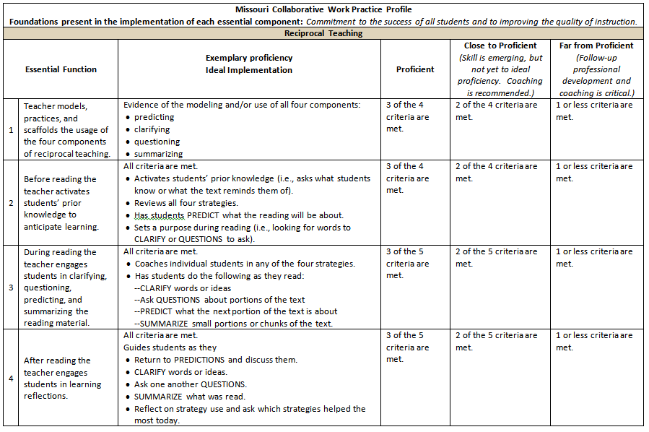
Missouri Collaborative Work Practice Profile
Notes:
The Practice Profile template includes four pieces and is anchored by the essential functions. Then moving from left to right across the template are (click 1,2) the essential functions of the practice; (click 3-10) implementation performance levels.
Handout: Participants should have a copy of the Practice Profile.
Following slides will share a video or an activity to help participants think about the work of teachers that needs to be done prior to asking students to participate in activities.

Slide 35
Defining and Monitoring Implementation Practice Profile
The Reciprocal Teaching Practice Profile:
  clearly and consistently defines teacher actions that facilitate changes in student behavior
  Allows for deeper knowledge of the process of reciprocal teaching, the role of the teacher and the intended outcomes for student behavior
  may be used to determine timeline for individual, team or building implementation
  are useful as tools for reflection and goal setting
  When used in tandem with teacher evaluation can help determine coaching conversations or professional development needs
  Allows acknowledgement of components that need support
  De-personalizes feedback-conversations can focus on the components of the teacher practice
Notes:
Information for this slide comes from:1. MO SPDG’s Collaborative Work Magazine (released spring 2014),2. Reciprocal Teaching Profile provided to CW consultants July 2013 and 3. MiBLSi MTSS Coordinator Practice Profile 4/10/14. Michigan’s Integrated Behavior and Learning Support Initiative.

Slide 36
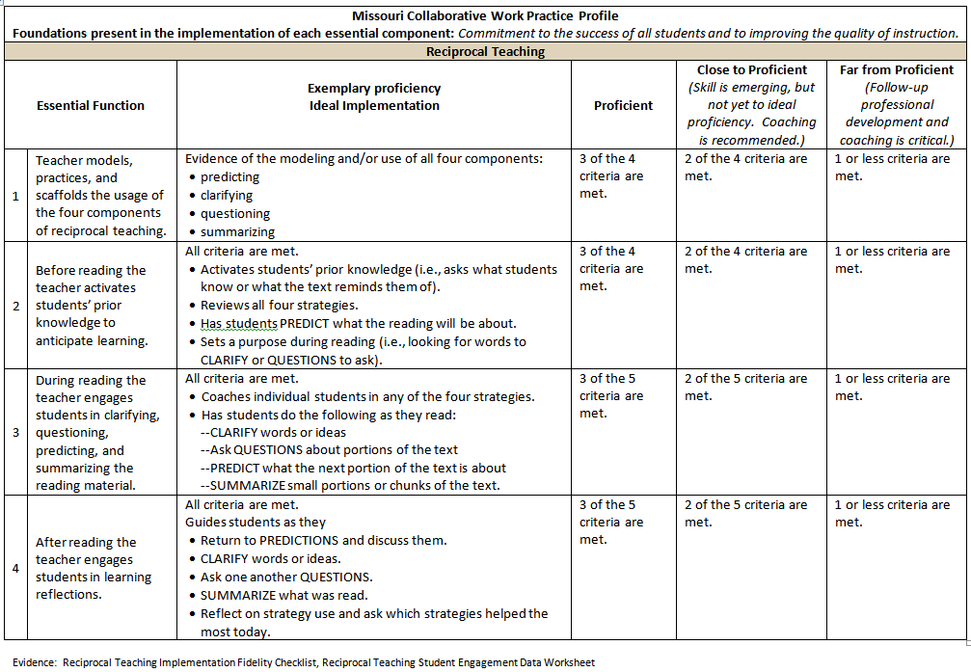
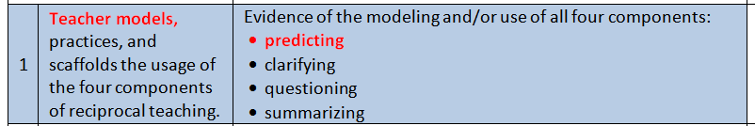
Practice Profile Essential Function 1
Notes:
Animation: After entering the slide one click will bring forth the blue box which is Essential Function 1 of the Practice Profile. The video segment on the next slide is only about the teacher modeling prediction for her students.
The next slide in the PowerPoint shows a portion of a video from Laura Grayson on Blue Springs School District. In this segment Ms. Grayson models what predicting is about, using first a set of visuals to help students think about how to tap into their schema/background knowledge. She then takes the students to the cover and selected illustrations from the book BATS, modeling for students how to use the illustrations to make predictions.

Slide 37
Pre-Reading: Predicting
https://youtu.be/wJGUkJNNvJ4
Notes:
Handout: Distribute handout for individuals to use as note taking and after viewing the video conversation starters. After reviewing the video, participants may complete the first portion of the note organizer and share insights with a shoulder partner or clock partner depending on the method used by the presenters to engage participants in conversation.
Video information: This excerpt is taken from a video received from Ronda Jensen.
The teacher Laura Grayson models how to make a prediction with her students. She begins with a concrete item tapping into background information/schema that most if not all students will be able to access; using a grocery bag and egg carton. She then moves to a text Zipping, Zapping, Zooming Bats and models for students how to use first the cover and then illustrations to make predictions. In this manner she is helping all students see how to use a text to connect to or develop schema from the text rather than previous personal experiences allowing all students despite their level of background knowledge on bats to make connections and therefore predictions.
Book: Zipping, Zapping, Zooming Bats by Ann Earle; HarperCollins Children’s Books.

Slide 38
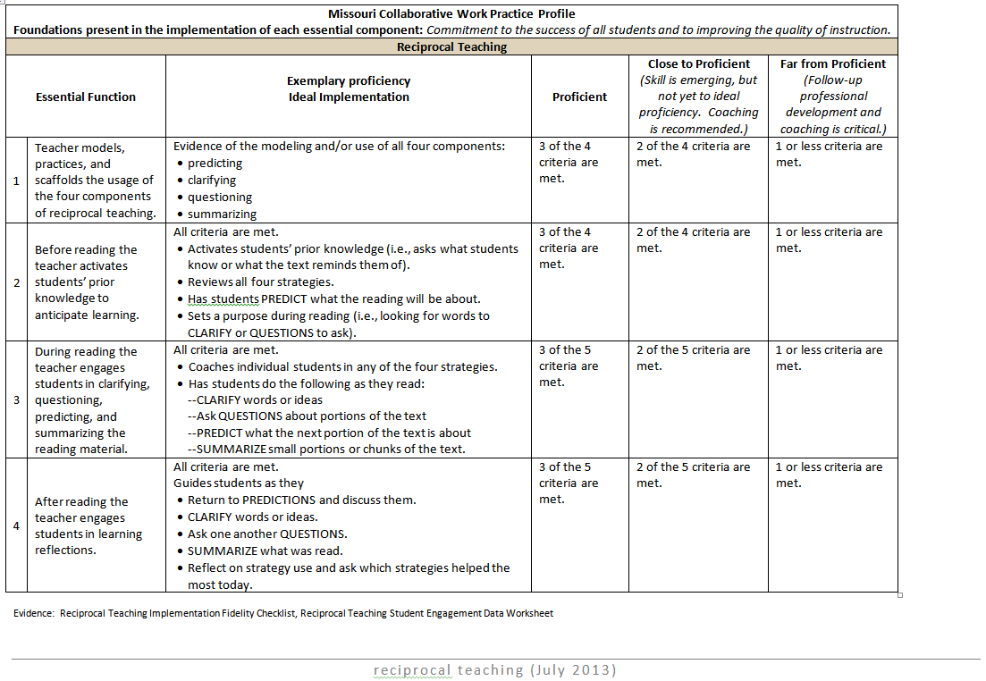
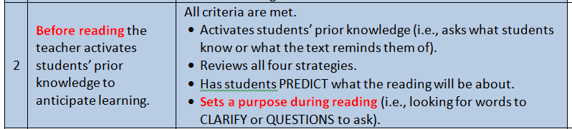
Practice Profile Essential Function 2
Notes:
Animation: After entering the slide one click will bring forth the blue box which is Essential Function 2 of the Practice Profile.
The activity and information on the next four slides focus only on the teacher understanding and modeling for students why there is the need to set a purpose for reading. After reviewing slides and participating in the reading activity, participants may complete the second portion of the note organizer and share insights with a shoulder partner or clock partner depending on the method used by the presenters to engage participants in conversation.
Note to Presenter: Practice Profile Essential Function 3 was not included because the majority of the second half of the presentation focuses on it. It was felt it would be redundant , but it’s absence should be explained so that participants understand why it doesn’t appear here.

Slide 39
Purpose is Everything
“A reader’s purpose affects everything about reading. It determines what’s important in the text, what is remembered, and what comprehension strategy a reader uses to enhance meaning.”
Cris Tovani (2000), I Read It, But I Don’t Get It

Slide 40
Set a Purpose for Reading
The House by Pichert and Anderson
Read the passage-with your pen/pencil circle whatever you think is important.
Read the piece again, with a pink highlighter mark places in the text with information a robber would find important.
Read the piece a third time, mark with a yellow highlighter any places in the passage a prospective home buyer might find important.
What did you notice as we went through this activity? How might you apply this practice with your students?
Notes:
I Read It But I Don’t Get It-Cris Tovani p 24-26
Handout: Participants will need a copy of The House. There is also a copy of the Tovani text pages 24-26 which includes additional information on setting purpose which may be used by the presenter for additional information or as a reading for the participants. In addition text pages 24-26 include the directions detailed above on the slide.
Animation: Click 1-enters the slide; Click 2-pen/pencil directions-Pause allowing the participants to complete the reading, subsequent pauses may be shorter as they have read the passage already once; Click 3-asks participants to use a pink highlighter; Click 4 asks participants to use the yellow highlighter; Click 5 moves the participants to using their record sheets to add notes and then may be used to converse with others.

Slide 41
Prime the Students’ Brains
Children are often criticized for not paying attention. There is no such thing. The brain is always paying attention to something. What we really mean is that the child is not paying attention to what we think is relevant or important. –Pat Wolfe
Most students don’t know how to set their own purpose.
The teacher’s purpose is often too vague to help.
Notes:
Patricia Wolfe-Brain Matters Translating Research into Classroom Practice 2nd edition 2010

Slide 42
Prime the Students’ Brain
Priming to set the purpose for reading helps readers:
Determine what is important in text
Determine what is remembered
Determine what comprehension strategy might be a good fit
Increase the likelihood that information will be held in long term memory

Slide 43
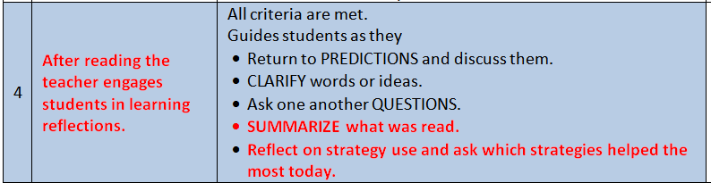
Practice Profile Essential Function 4
Notes:
Animation: After entering the slide one click will bring forth the blue box which is Essential Function 2 of the Practice Profile.
The next slide in the PowerPoint shows a portion of a video from a grade 6 teacher with a team of students following their conversation over an informational piece of text. The video segment has been selected to focus on Summarizing and Reflection.

Slide 44
Post Reading: Engage Students in Reflection
https://youtu.be/e8gSIcSyypk?t=3m11s
Notes:
The segment focuses only the teacher and her work with the students in discussing effective choice of information in their individual summaries, she leads them to understanding that the use of specific words provides a clear, specific summary. She then asks the students to reflect on the process of Reciprocal Teaching to strengthen their comprehension of text. She then provides her own personal reflection on the benefits of Reciprocal Teaching for her as the teacher. After reviewing the video, participants may complete the first portion of the note organizer and share insights with a shoulder partner or clock partner depending on the method used by the presenters to engage participants in conversation.
Entire Video https://www.youtube.com/watch?v=e8gSIcSyypk

Slide 45
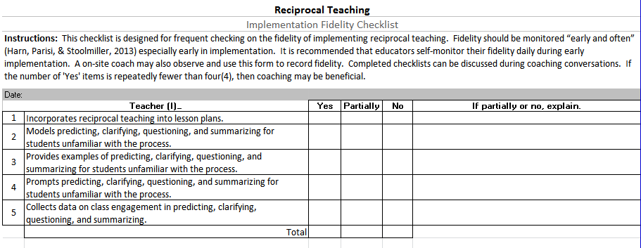
Fidelity Checklist
Notes:
Handouts: Participants will need a copy of the fidelity checklist. Presenter may go through the checklist indicating that the form may first be used by individuals or teams of teachers to self reflect and monitor their implementation of Reciprocal Teaching. Additionally the form may be used by either internal or external coaches to provide feedback to teachers. School leadership teams or building/district administrators may use to determine coaching opportunities or professional development needs in supporting the implementation of Reciprocal Teaching.

Slide 46
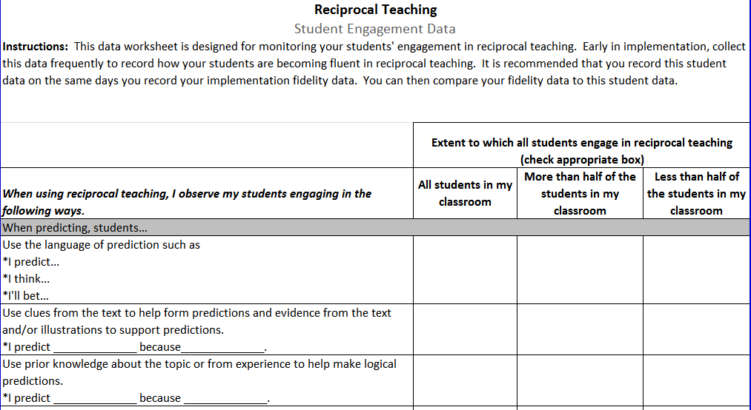
Evidence
Notes:
Handouts: Participants will need a copy of the entire Student Engagement Data checklist.
Presenters may distribute the form and ask participants to review to continue to develop their individual/team/school implementation plan. They also may discuss and list evidence that may be collected beyond the checklist to support the levels at which they have ranked student engagement. This tool also may be used by teachers as the work in Collaborative Data Teams to assist in unpacking the process of reciprocal teaching and determining their own needs in professional development or instructional strategies to then use the checklist as a results indicator to determine student growth in utilizing the comprehension strategies employed in reciprocal teaching.

Slide 47
Exploration
PURPOSE: Explore the core components and implementation steps.
CONTENT:
  Detailed description of the core components
  Rationale for components
  Detailed implementation steps

Slide 48
Four Steps of Reciprocal Teaching
Predict
Clarify
Question
Summarize
Notes:
See Handouts Package – Meeting the Needs of Students through Learning Strategies in the Handouts Package folder to help meet the needs of English Language Learners. Additionally see the Sentence Frames Handout to assist all students. The Sentence Frames Handout is particularly helpful for students with disabilities.

Slide 49
Predict
To make predictions, readers use information in a text to anticipate what they are about to read.
Pre-Reading stragegy-based upon a review of text features (titles, heading, pictures and captions, etc.). Students will make predictions about the content of the passage.
During Reading-readers cue in to the use of questions used by the author within a text or when a character is about to do something.
Post-Reading-readers check their predictions.
Notes:
Information adapted from:
http://www.miamisci.org/tec/introduction.html

Slide 50
Predictor
Tell your teammates what you think the author will tell you about in the next section.
Show your teammates the clues you noticed in the passage.
Role Prompts-Use language such as:
  I predict
  I think
  I’ll bet

Slide 51
Making Predictions
It is important to teach students that their predictions should be based on evidence from the text or other background knowledge.
Notes:
Source: http://www.teacher2teacherhelp.com/reading-strategies/prediction-mini-lessons-and-practice

Slide 52
Prediction – Sentence Strips
I think…
I wonder…
I bet…
I imagine…
I suppose…
I predict…
Notes:
To help students begin to internalize the language of strategy use, it is often helpful to give them sentence stems to stimulate their thinking. Sentence stems can be used to spark students’ ideas during reciprocal teaching dialogue and written responses to literature.
From:
http://www.teacher2teacherhelp.com/reading-strategies/prediction-mini-lessons-and-practice

Slide 53
Predictor Activity- Stroll Line
Assign participants to preview a selected text.
They will write down 3-4 predictions with supporting clues from the text.
Divide class into two lines so that each participant is facing a partner.
Partners share their predictions and clues with each other.
Signal participants to stroll to the next partner. They will complete this process with 3-4 partners.
Notes:
Select a reading text from www.timeforkids.com to use for this activity, or you can select your own.
For this activity, you can assign participants to work individually, or with a partner to complete the first two bullets. After they have written their predications, then divide participants into two straight lines, so that each participant is facing a partner. Instruct partners to share their predictions with each other. Then, signal one line of students to stroll down to share predictions with the next partner.
Only one line will move during this activity. Repeat several times. Demonstrate this activity with students to ensure that understand how the activity is be completed.
After you have repeated this process 3-4 times, participants can remain standing or be seated while you debrief the activity. Discuss and list several of the predictions on chart paper. Return to the chart paper to confirm or adjust predictions after reading.
From:
http://www.teacher2teacherhelp.com/reading-strategies/prediction-mini-lessons-and-practice

Slide 54
Predictor Activity – Story Impressions
From a selected narrative text, select 7-10 words.
List words on chart paper in a column in the order they appear in the story.
Assign participants to work in small groups to construct a story using all of the listed words.
Have each group share their story with the whole group.
Then have students read the original story and then compare and contrast their stories with the original story.
Notes:
Select a short narrative text for this activity. You can select your own narrative text, or choose from www.timeforkids.com
From the narrative text, choose 7-10 words that relate to the characters, setting, problem, events, and solution of the story.
List the words in a column format in the order they appear in the story. Have students read the original story and then compare and contrast their stories with the original.
Source: Guided Comprehension: A Teaching Model for Grades 3-8 by Maureen McLaughlin and Mary Beth Allen, IRA, 2002.

Slide 55
Clarify
When readers are confused about what the author is trying to get across they must stop reading to get a picture in their mind about the ideas of the author.
Strategies to find out the meaning of words
  Look for little words inside big words
  Look for word parts
  Use commas or the word or to determine meaning of unknown words
  Pause and then read on the remainder of the paragraph may help the reader get an understanding of the unknown word
Notes:
Information adapted from:
http://www.miamisci.org/tec/introduction.html
There are four strategies you can use to help you figure out the meanings of words that you don't understand. They are:
Look for little words in big words.
Look for word parts such as bases (roots), prefixes, and suffixes.
Look for commas that follow unfamiliar words. Sometimes when an author uses a word that maybe unfamiliar to the reader, he/she will follow it with a comma, give the definition, use another comma and then continue on with the sentence. The definition of the word will be between the commas. Sometimes the author may use the word "or".
Keep reading. The word that you are stuck on may not be important to the meaning of the sentence, or as you read you will get a general ida of the meaning even though you can't give a dictionary definition

Slide 56
Clarifier
Ask if anyone got stuck on a word or an idea.
Help your teammates by using resources. Try rereading first.
If the person is stuck on a word, try the glossary or dictionary.
If these don't work, ask for help from the teacher.
Role Prompts-Use language such as: I didn’t get it…

Slide 57
Clarifying Activity –
What do you do when struggling readers continue to plow through a text even when they don’t understand what they are reading?
We want students to slow down their reading process and focus on the meaning of the text.
Notes:
Assign participants to work in small groups to discuss: What do you do when struggling readers continue to plow through a text even when they don’t understand what they are reading?
Have participants to report their key ideas on chart paper and share with the whole group.
From:
http://www.teacher2teacherhelp.com/reading-strategies/clarifying-mini-lessons-and-practice

Slide 58
Clarifying Strategies
Read-Cover-Remember-Retell
To help students understand a text even when they don’t understand what they are reading. Teach students to:
  Read only as much as their hand can cover.
  Cover up the part of the story they just read.
  Remember to think about what they just read.
  Retell what they just read to a partner.
Notes:
Model this activity with participants. Assign students to work with partners for this activity.
This partner activity forces students to slow down their reading process and focus on the meaning of the text.
From:
http://www.teacher2teacherhelp.com/reading-strategies/clarifying-mini-lessons-and-practice

Slide 59
Clarifying Activity –
What do you do when struggling readers continue to plow through a text even when they don’t understand what they are reading?
We want students to slow down their reading process and focus on the meaning of the text.
Notes:
Assign participants to work in small groups to discuss: What do you do when struggling readers continue to plow through a text even when they don’t understand what they are reading?
Have participants to report their key ideas on chart paper and share with the whole group.
From:
http://www.teacher2teacherhelp.com/reading-strategies/clarifying-mini-lessons-and-practice

Slide 60
Clarifying – Fix Up Strategy 1
Adjust Reading Rate: Many struggling readers think that good readers read everything quickly. However, proficient readers constantly adjust their reading rate – they speed up and even skim easy, boring or unimportant parts and slow down to concentrate on difficult or confusing parts. They select the reading rate that meets the needs of the task at hand.
Notes:
From:
http://www.teacher2teacherhelp.com/reading-strategies/clarifying-mini-lessons-and-practice

Slide 61
Clarifying – Fix Up Strategy 2
Substitute Another Word: context clues help bring meaning to many unfamiliar words, but at times this strategy fails. Substituting another word that makes sense in the sentence can often help a reader sustain meaning even if he/she cannot figure out the exact pronunciation or meaning of a particular word.
Notes:
From:
http://www.teacher2teacherhelp.com/reading-strategies/clarifying-mini-lessons-and-practice

Slide 62
Question
Readers who ask questions during reading are actively engaged and monitor their comprehension.
Good questions focus on the information in the text.
Readers should ask good questions to test their predictions and clarification of unknown words.
Readers should ask good questions to identify what is important to remember about the text.
Good questions ask who, what, when, where, why and how.
Good questions ask you to compare.
Notes:
Information adapted from:
http://www.miamisci.org/tec/introduction.html
Good questions ask who, what, when, where, why, and how. They also ask you to compare two or more things, tell why something is important, or give the order in which things happen. Good teacher-like questions are based on the information given in the text.
Information adapted from:
http://www.thedailycafe.com/RRF%20Comprehension_Ask%20Questions%20Throughout%20the%20Reading%20Proce.pdf

Slide 63
Role Prompts-Questioner
Ask a question that can be answered in the text (a Right There or Think and Search question).
Ask an opinion question (Do you agree? What do you think?).
Show your teammates where you found the answers.

Slide 64
Questioning Strategy- Question Starters
Most students are familiar with the questions who, what, when, where, why and how. Once these are mastered, try extending these to question phrases to help students begin to formulate higher level questions. Examples include:
  What caused?
  What are the characteristics of?
  What if?
  Would you agree that?
Notes:
From:
http://www.teacher2teacherhelp.com/reading-strategies/questioning-mini-lessons-and-practice

Slide 65
Main Idea Questions
While struggling readers find processing and synthesizing difficult, spending time explicitly teaching it can greatly increase reading comprehension. The best way to teach students to generate main idea questions is through guided lessons.
Notes:
Struggling readers may require a great deal of practice before reaching independence with this skill. Be sure to provide coaching and corrective feedback.
From:
http://www.teacher2teacherhelp.com/reading-strategies/questioning-mini-lessons-and-practice

Slide 66
Questioning Strategy – Main Idea Questions
Generate main idea questions is through guided lessons.
Begin with teacher modeling.
Gradually ask students to practice formulating their own main idea questions.
Provide coaching and corrective feedback.
Notes:
Struggling readers may require a great deal of practice with this task.
From: http://www.teacher2teacherhelp.com/reading-strategies/questioning-mini-lessons-and-practice

Slide 67
Formulate Higher Level Questions
Examples include:
What caused…?
What are the characteristics of…?
What if…?
What does the author mean when…?
Would you agree that…?
Would it be better if…?
Notes:
Question phrases to help students begin to formulate higher level questions.
Question Starters
Introduce students to the language of questioning. Most students are familiar with the question words who, what, where, when, why, and how. Once these are mastered, try extending these to question phrases to help students begin to formulate higher level questions. Examples include: What caused…?
What are the characteristics of…?
What if…?
What does the author mean when…?
Would you agree that…?
Would it be better if…?

Slide 68
Wonder Questions - Activity
Have students skim through a literature and/or informational text.
Assign them to write an “I wonder” question for each page of a picture book or each section of a textbook or article.
After writing questions, students go back and read the text to find answers.
Notes:
This activity works well with nonfiction text. Have students skim through nonfiction text and write an “I wonder” question for each page of a picture book or each section of a textbook or article. After writing questions, students go back and read the text to find answers. This is a great activity to use with “the rest of the class” when you are working with a small guided reading group.
Prepare examples of “I wonder” questions to share as examples before beginning the activity.
Source: Reciprocal Teaching at Work: Strategies for Improving Reading Comprehension by Lori Oczkus, IRA, 2003.

Slide 69
Summarize
A summary is constructed:
  for yourself largely for the purpose of remembering what you have heard or read
  for an audience, where you may need to explain the background knowledge within the discipline you are writing
  is a learned process of deleting, substituting, and keeping information-Marzano
We must teach students how to:
  identify important information no matter the content or how it is presented
  dig for main ideas and supportive details, principal claims and evidence
  structure the information for meaning and successful application

Slide 70
Role Prompts-Summarizer
Tell your teammates the main idea of the passage and the important supporting details.
Make sure your summary isn't longer than the reading!

Slide 71
Summarize
When summarizing narrative text, students should use story structure (characters, setting, problem, events, resolution) to help recount the story in order.
When summarizing expository text, students need to determine the most important ideas and arrange them in a logical order.
Notes:
From:
http://www.teacher2teacherhelp.com/reading-strategies/summarizing-mini-lessons-and-practice

Slide 72
Summarizing Strategy
Sentence Stems
Prompt students using the language of summarizing. Sentence stems include the following:
  First…
  Next…
  Then…
  After that…
  Finally…
  This part was about…
Notes:
From:
http://www.teacher2teacherhelp.com/reading-strategies/summarizing-mini-lessons-and-practice
Additional sentence stems for practice.

Slide 73
Summarizing Strategy-
Sentence Stems
The story takes place…
The main characters are…
A problem occurs when…
I learned that…
The most important ideas in this text are…
This part was about…
Notes:
Additional sentence stems for practice.
From:
http://www.teacher2teacherhelp.com/reading-strategies/summarizing-mini-lessons-and-practice

Slide 74
Summarizing Strategy – 25 Word Summary
Give pairs of students a half sheet of transparency paper.
Have the pair work together to construct a summary of a selection in 25 words or less and write it on the transparency.
Give students the opportunity to share summaries on the overhead. Compare and contrast summaries.
This activity can be used as a alternative to book reports. It allows students to “advertise” a favorite book for their classmates.
Notes:
From:
http://www.teacher2teacherhelp.com/reading-strategies/summarizing-mini-lessons-and-practice

Slide 75
Reciprocal Teaching Benefits
“Reciprocal teaching (RT) is an instructional procedure developed by Palincsar and Brown (1984) to improve students’ text comprehension skills through scaffolded instruction of four comprehension-fostering and comprehension-monitoring strategies (Palincsar & Brown, 1984; Palincsar, David, & Brown, 1989; Rosenshine & Meister, 1994), that is, (a) generating one’s own questions, (b) summarizing parts of the text, (c) clarifying word meanings and confusing text passages, and (d) predicting what might come next in the text. These four strategies are involved in RT in ongoing dialogues between a dialogue leader and the remaining students of the learning group.”
Spörer, N., Brunstein, J. C., & Kieschke, U. (2009)
Notes:
Remember the benefits of using this instructional practice is to improve students’ comprehension skills.
We also need to use data to inform our practice, (NEXT SLIDE)

Slide 76
Reciprocal Teaching
2 meta-analyses, 38 studies, Rank 9th
(Self-Reported Grades)
(.74 effect size)
Notes:
Hattie looked at 2 meta-analyses, consisting of 38 studies to determine that reciprocal teaching ranked number 9 in the most effective teaching/learning practices.
*The effect size from both meta-analyses is very high (.74) . The effects were highest when there was explicit teaching of cognitive strategies before beginning reciprocal teaching dialogue, showing the importance of modeling and practice as well as giving instruction in the use of the strategies close to the time students used them.
*Rosenshine and Meister (1994) reported no differences in results by grade level, number of sessions, size of instructional group, number of cognitive strategies taught, or whether the investigator or the teacher did the training.
*The effects were greater when the comprehension assessments were experimenter-developed than when using standardized tests, although both short answer tests and tests asking students to summarize passages gave similar results.
*The explicit teaching of cognitive strategies and deliberative practice with content when using these strategies made a major difference.
Hattie, John 2009. Visible Learning, p. 204
(Notes are taken from Visible Learning: A Synthesis of Over 800 Meta-Analyses Relating to Achievement by John Hattie)

Slide 77
Practice
PURPOSE: Provide opportunity for learners to discuss what application in the classroom looks like.
CONTENT:
  Detailed description of what implementation looks like
  Group discussion on what implementation looks like in a variety of contexts
  Measuring fidelity
  Using data to inform practice
Notes:
Choose a familiar text and model how to make predictions, clarify confusing text, generate questions, and summarize important points.
As the presenter actually use the protocol from The Reading Teacher article, Hands-On Reciprocal Teaching: A Comprehension Technique by Kelley Stricklin in the section, “Introducing the Fab Four”. You can use any short book of your choice
NEXT - Demonstrate reciprocal teaching with a four-person group of students in a “fishbowl” format. Designate one students to act as the “teacher” and facilitate discussion among his/her group members. Guide the group through the reciprocal teaching process as the rest of the class observes. For example, prompt the student teacher by asking, “What question do you think a teacher would ask at this point?” Alternatively, have the student teacher begin the discussion with summary of the passage if he or she is having trouble thinking of appropriate questions. This will help the student summarize thoughts that he or she can turn into questions. Soliciting advice from the rest of the class can also shift the focus away from you and keep students in control of the discussion.
AS students become more proficient with reciprocal teaching, have them work with longer passages and alternate roles among group members.

Slide 78

Time to Model and Practice
Notes:
For primary grades: Use the protocol from The Reading Teacher article, Hands-On Reciprocal Teaching: A Comprehension Technique by Kelley Stricklin in the section, “Introducing the Fab Four” to introduce the 4 roles participants will undertake. You can use any short book/article of your choice from which to model.
For upper elementary and HS: Select from the following articles and model how to make predictions, clarify confusing text or vocabulary, generate questions, and summarize important points.
HANDOUT (An Unsolved Ocean Mystery)- MODEL USING THIS ARTICLE
Suggestions for articles: http://www.timeforkids.com/news/unsolved-ocean-mystery/42576 (grades 4-6)
http://www.timeforkids.com/news/victory-blind/13646 (grades 4-6)
http://www.timeforkids.com/news/debate/80636 (grades 4-6
“Stopping Distance” Missouri Department of Revenue (Reprinted with permission by Texts and Lessons for Content-Area Reading by Harvey “Smokey” Daniels and Nancy Steineke, 2011 (Portsmouth, NH: Heinemann)
“Study: Distractions Cause Most Car Crashes” San Francisco Chronicle (Reprinted with permission by Texts and Lessons for Content-Area Reading by Harvey “Smokey” Daniels and Nancy Steineke, 2011 (Portsmouth, NH: Heinemann)
“The Superbug in Your Supermarket: Part 1 and Part 2” Prevention Magazine (Reprinted with permission by Texts and Lessons for Content-Area Reading by Harvey “Smokey” Daniels and Nancy Steineke, 2011 (Portsmouth, NH: Heinemann)
NEXT STEP - Demonstrate reciprocal teaching with a four-person group of students in a “fishbowl” format. Designate one students to act as the “teacher” and facilitate discussion among his/her group members. Guide the group through the reciprocal teaching process as the rest of the class observes. For example, prompt the student teacher by asking, “What question do you think a teacher would ask at this point?” Alternatively, have the student teacher begin the discussion with summary of the passage if he or she is having trouble thinking of appropriate questions. This will help the student summarize thoughts that he or she can turn into questions. Soliciting advice from the rest of the class can also shift the focus away from you and keep students in control of the discussion.
As students become more proficient with reciprocal teaching, have them work with longer passages and alternate roles among group members.
Answer questions participants have about roles or teacher modeling of this practice.

Slide 79
Application
PURPOSE: Explore ways for the learners to incorporate the new knowledge and skills into their teaching.
CONTENT:
  Reflection on what implementation would look like in their classrooms
  Discuss and problem-solve potential challenges to implementation and fidelity drift

Slide 80
Application
Partner/Small Group Discussion
  How might reciprocal teaching look and feel when I use this practice in my classroom?
  After watching the video segments and practicing the reciprocal teaching, what potential challenges might you face when implementing it in your classroom? What possible solutions do you see for these challenges?
Notes:
Partner or Small Group Share:
In small groups, reflect and discuss based on the questions on this slide.
Write ideas on back of slide 39 handout

Slide 81
Why use reciprocal teaching? | What are you currently doing with reciprocal teaching in your classroom?
Questions about the reading | Steps for Implementation
Notes:
Return to this handout page: After our practice session, write down your steps for implementation
Presenters may want to put this on large chart paper. You could use this as a parking lot, gallery walk, etc.

Slide 82
Brainstorm and Collaborate
What types of data might you use in your classroom to determine if reciprocal teaching is effective?
Notes:
Have small groups brainstorm types of data they might use around reciprocal teaching to analyze its effectiveness with improving comprehension.

Slide 83
7) Topics in Action
Consultant will share a variety of sample activities and ways to implement Reciprocal Teaching.
Have each participant choose a concept/topic related to curriculum and determine how they will implement Reciprocal Teaching into classroom.
  What will it look like?
  Give time to create and develop.
  Share with group.
Notes:
Insert sample pieces here, may be handouts.

Slide 84
Various Tools and Resources
Notes:
Various supports can be found on the web for reciprocal teaching. Here are just a few examples that we found and thought would be useful.
Reciprocal Teaching Strategies at Work is video series. We do not have it, but the Video Viewing Guide and Lesson Materials are available online and contain a lot of valuable information and resources. We will use some of them today.
The Reciprocal Teaching Recording Sheet was created by a teacher.

Slide 85
Notes:
Sharing a variety of resources to demonstrate how reciprocal teaching might look in their classrooms.
Having these cards available would be helpful for many students, especially when they change roles.
HANDOUT – HOW TO USE: Make a copy of the page for each group. Cut the cards apart. Pass one out to each member of the group. That becomes their role during this session.

Slide 86
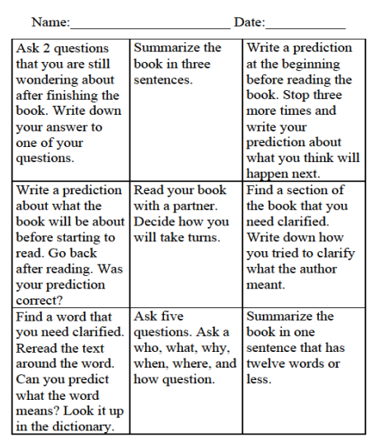
Tic-Tac-Toe
Notes:
You can use this form to play Reciprocal Teaching Tic-Tac-Toe

Slide 87
TAKE ACTION!
Decide how you will model the four strategies from reciprocal teaching to your students.
Gather props and materials for the modeling session and student practice session.
Explain to students why you are modeling these strategies, and activate prior knowledge about the topic to be studied.
Notes:
Go back to the handout with “Steps for Implementation” and record your thoughts centered around #1 on “Take Action!”
HANDOUT - Reciprocal Teaching Protocol for Demonstration Lessons and Coaching in Reciprocal Teaching Strategies at Work. This document will help support the steps listed on this slide and the next.
****Here is where you will find the foundations of reciprocal teaching that is referred to on the assessment.

Slide 88
After modeling, break students into groups of four and assign each a strategy role.
Monitor and guide students as they try out the strategies, changing jobs after each page.
After the reading is completed, bring the class together to discuss which of the strategies helped them the most.
Reflect on the experience and consider what instructional improvements you can make. Decide how you will implement your next hands-on reciprocal teaching session.

Slide 89
Assessment & Reflection
PURPOSE: Provide opportunity for the learners to reflect on their learning and potential implementation challenges.
CONTENT:
  Post-assessment learner knowledge
  Reflect on personal teaching context and implementation.

Slide 90
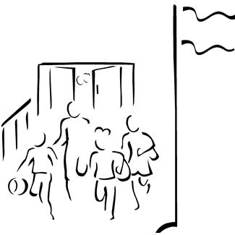
Assessment Options for Reciprocal Teaching

Slide 91
The Four-Door Chart Assessment Tool
Directions for Making a Four-Door Chart
1. Place an 8.5-inch × 11-inch sheet of white paper
horizontally on a flat surface.
2. Fold both sides of the paper toward the middle
to form two doors.
3. Using scissors, cut the doors in half horizontally,
making four doors.
fold
fold
cut
cut
Reciprocal Teaching Strategies at Work: Improving Reading Comprehension, Grades 2-6: Video Viewing Guide and Lesson Materials by Lori D. Oczkus, 2006 International Reading Association, p. 16.
Notes:
In the Reciprocal Teaching Strategies at Work: Improving Reading Comprehension Grade 2-6 Video Viewing Guide and Lesson materials booklet they demonstrate how to use the “four-door chart” as a discussion guide and assessment tool.
(The folds in step 2 needed vertical dotted lines, but I didn’t know how to do those)
HAVE EACH PARTICIPANT MAKE A SAMPLE ONE OF THESE DURING THIS TRAINING
MATERIAL NEEDED: White Paper

Slide 92
Have students write the words
predict, question, clarify, and
summarize on the outside of
the doors.
Have students write their name
on the back of their Four-Door Charts.
Students use the chart to record their
written responses under each door.
Reciprocal Teaching Strategies at Work: Improving Reading Comprehension, Grades 2-6: Video Viewing Guide and Lesson Materials by Lori D. Oczkus, 2006 International Reading Association, p. 17.
predict
question
clarify
summarize
Notes:
To assess, have the students write a one- or two-sentence response inside each door. Their written responses provide you with a quick assessment tool during the reciprocal teaching lessons. If you want to evaluate the quality and depth of students’ questioning, for example, collect the completed charts and look for each student’s ability to ask higher level questions.

Slide 93
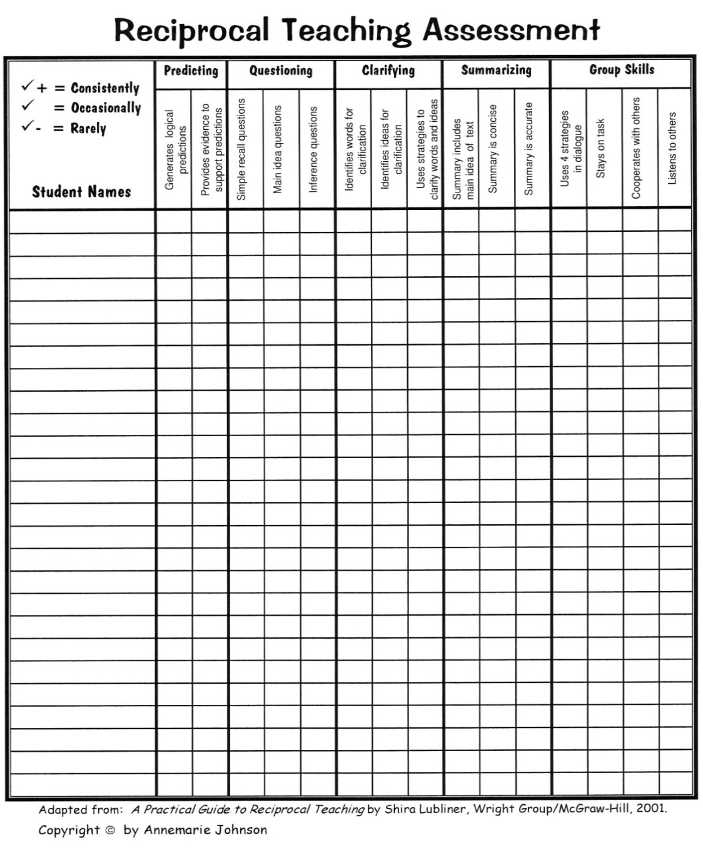
Notes:
HANDOUT: This form could be used as you observe students using the reciprocal teaching strategies during their learning.
Talk about how to use it.

Slide 94
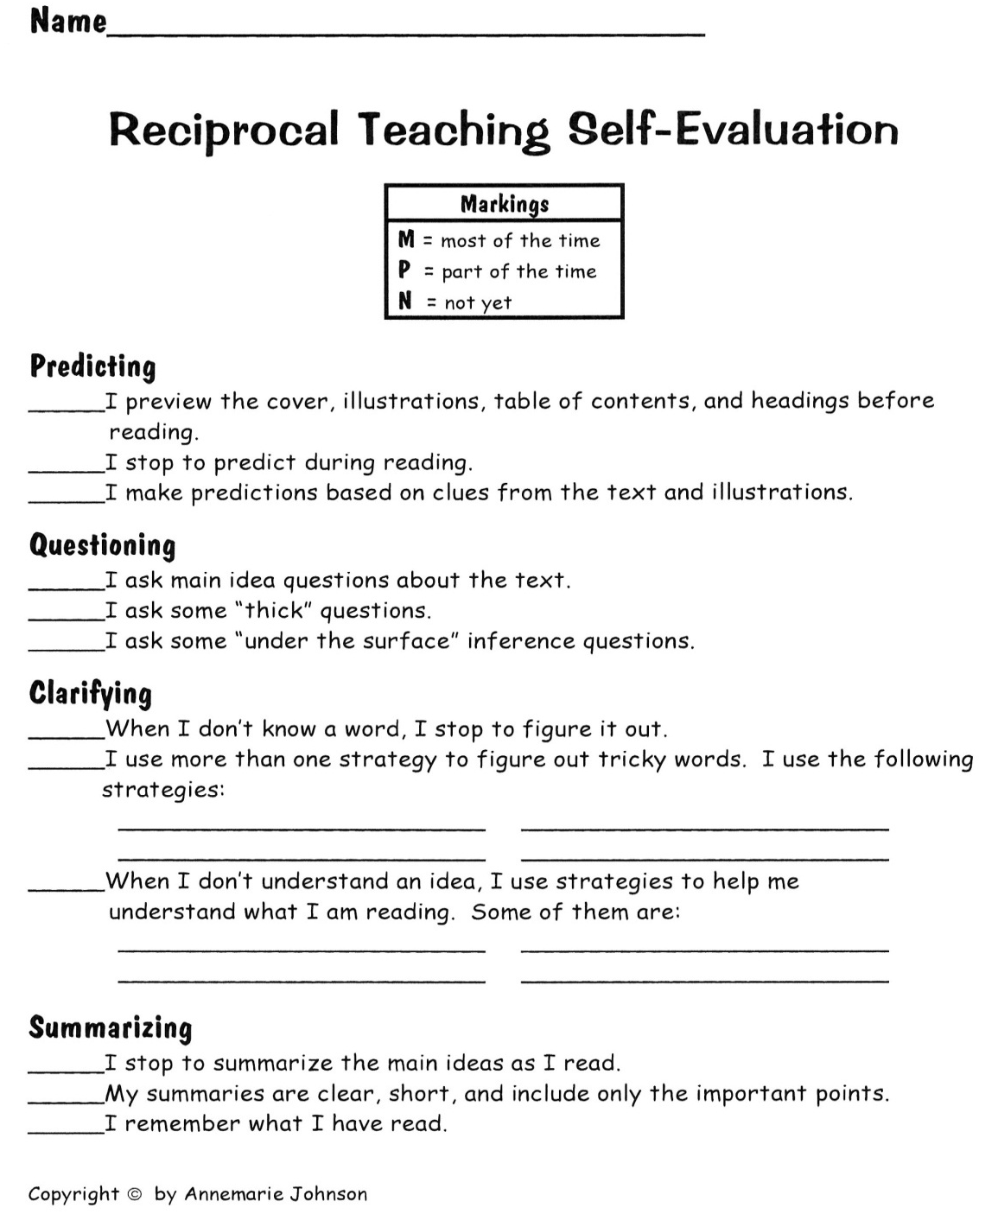
Notes:
A form for students to self-evaluate themselves or their team.

Slide 95
Closing & Follow-Up
PURPOSE: Provide opportunity for learner to outline their implementation steps and plans for follow-up coaching.
CONTENT:
  Template for outlining implementation steps in personal teaching contexts and follow-up coaching
  Additional resources for further learning

Slide 96
Next Steps: Action=Results
What steps will you take to start implementing?
Notes:
Complete the Next Steps template. Example is included in the learning package materials.

Slide 97
Review: Learning Objectives
In this training, the participants will:
Use reciprocal teaching terminology and strategies (predicting, clarifying, question generating, summarizing) to discuss text.
Explore how the implementation of reciprocal teaching improves learning for all students.

Slide 98
Reflection
What have I learned?
What do I need to do now?
What does my district (we) need to do now?

Slide 99
Further Coaching and Support
What further support do you need from the RPDC consultant(s) to go deeper with implementation?

Slide 101
Resources
Articles:
  Stricklin, Kelly (2011) Hands-on Reciprocal Teaching: A Comprehension Technique. The Reading Teacher, 64(8), 620-625.
  Pilonieta, Paola and Medina, Adriana (2009) Reciprocal Teaching for the Primary Grades: “We Can Do It, Too!” The Reading Teacher, 63(2). 120-129.
  Websites:
  www.readingquest.org/strat/rt.html (Strategies-Reciprocal Teaching)
  www.timeforkids.com (Articles for students to read)
  www.YouTube.com (Summarization 6 Reciprocal Teaching Part 1
  http://www.reading.org/Libraries/book-supplements/500-videoguide.pdf
  (Lori Oczkus’s Materials)

Slide 102
Questions You Have

