Slide 1
MO SPDG Data Report
School Implementation Scale
Team Functioning Survey
OSEP Annual Performance Report
Collaboration Survey
Quarterly Reports
Evidence-Based PD Components Rubric

Slide 2
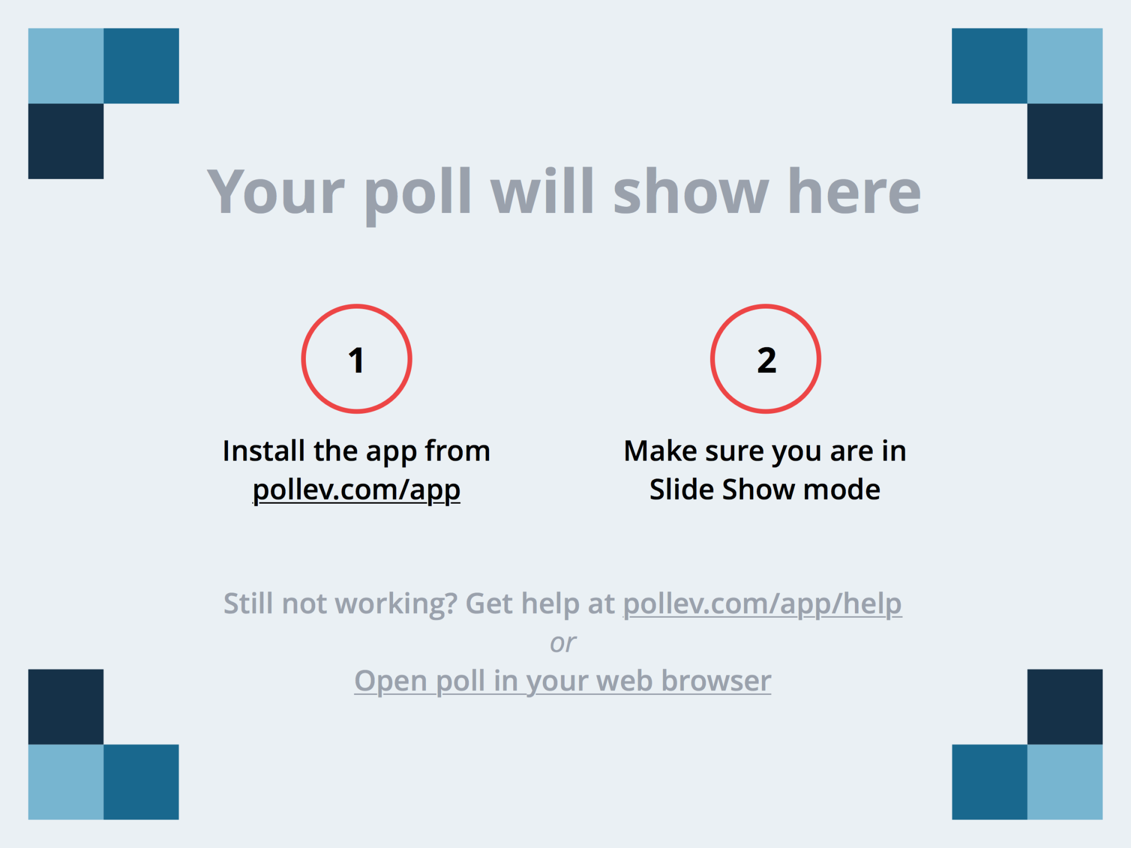
Notes:
What is the primary reason to collect data for the MO SPDG? https://www.polleverywhere.com/multiple_choice_polls/zMHroj8YOHKoRGJ

Slide 3
Evaluation Overview
Evaluation data collected for many purposes:
Reporting to OSEP
Continuous improvement for schools
Continuous improvement for RPDC providers
Reporting to DESE
Monitoring implementation compliance

Slide 4
School Implementation Scale
42-item online survey
Assesses implementation in five domains:
Leadership & Empowering Culture
Evidence-Based Instruction, Assessment, & Curriculum
Ongoing Professional Development
Collaborative Data Teaming Processes

Slide 5
School Implementation Scale
31 items on a Likert Scale:
Six Yes/No Items relating to Collaborative Data Teams
1 | 2 | 3 | 4 | 5
Not at all true of me now |  | Somewhat true of me now |  | Very true of me now

Slide 6
School Implementation Scale
3,126 respondents in 206 schools
Comparisons with 2013 data based on 2,487 responses from that year

Slide 7
School Implementation Scale
Average percent of respondents who answered “Agree” or “Strongly Agree” on items in each domain.

Slide 8
School Implementation Scale

Slide 9
School Implementation Scale
STRONG: Administrator commitment (Item 1)
WEAK: Time needed to analyze data and problem-solve(Item 17)
ACTION ITEM: Work with administrators to increase meeting time allocated to data teams.
STRONG: Administrator commitment (Item 1)
WEAK: Technology and resources needed for effective instruction (Item 28)
ACTION ITEM: Work with administrators to obtain new technology and make resources available to instructional staff.
ACTION ITEM: Provide training to help instructional staff identify and effectively utilize existing technology/resources.

Slide 10
School Implementation Scale

Slide 11
School Implementation Scale
STRONG: Adapting environment, curriculum, and instruction based on student data (Item 6)
WEAK: Evaluate the effectiveness of instruction based on common formative assessment data (Item 20)
ACTION ITEM: Ensure that common formative assessment data is being collected at least three times per year.
ACTION ITEM: Work with administration to ensure that each teacher is administering common formative assessments.
ACTION ITEM: Teach instructional staff how to use common formative assessment data to adapt instruction more effectively.

Slide 12
School Implementation Scale

Slide 13
School Implementation Scale
STRONG: Participation in professional development to improve instructional practices(Item 3)
WEAK: Receive coaching/mentoring to improve instructional practices(Item 4)
ACTION ITEM: Use post-test results to identify areas for follow-up support.
ACTION ITEM: Provide in-district coaching to instructional staff to improve instructional practices.

Slide 14
School Implementation Scale

Slide 15
School Implementation Scale
STRONG: Collaborative Data Teams are established and meet at least once per month (Item 32)
WEAK: CDTs include representatives from all teaching roles (Item 33)
ACTION ITEM: Invite additional staff to participate on the Collaborative Data Team, making sure to include general education teachers, special education teachers, and teachers of special classes.
STRONG: Three effective practices are identified (Item 36)
WEAK: All teachers have been trained to implement the identified effective practices (Item 37)
ACTION ITEM: Identify which staff members have not been trained, then provide additional training to these individuals.

Slide 16
School Implementation Scale
Quickly glance through the data. What are your first impressions?
Does the number/role of survey participants adequately represent our schools?
Celebrate successes: Which items or essential elements show high levels of implementation? What processes, professional development, etc. are in place that support these high levels of implementation?
How do the results from the School Implementation Scale align with other school-level data? Is additional data needed?
Prioritize needs: Which essential elements show low levels of implementation? Which survey items highlight areas that could be improved over the next year?
Next steps: How do the results influence our action planning for next year?
Blog post: List three action items you might suggest to schools in your region.

Slide 17
Team Functioning Survey
17-item online survey
Assesses team functioning in three domains:
Structure
Communication
Focus

Slide 18
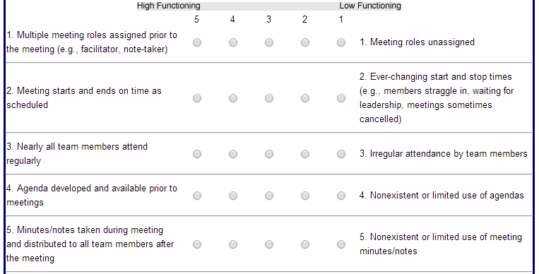
Team Functioning Survey
17 items on a Likert Scale:

Slide 19
Team Functioning Survey
2,927 respondents in 203 schools
Comparisons with 2013 data based on 2,472 responses from that year

Slide 20
Team Functioning Survey
Average percent of respondents who answered “Agree” or “Strongly Agree” on items in each domain.

Slide 21
Team Functioning Survey

Slide 22
Team Functioning Survey
STRONG: Nearly all members attend regularly
WEAK: Multiple roles assigned prior to meeting
ACTION ITEM: Use the CDTs learning package to provide training on how to assign meeting roles.
ACTION ITEM: Work with school teams to create a system of rotating meeting roles (e.g. facilitator, note-taker).
STRONG: Agenda created and available
WEAK: Minutes/notes taken and distributed
ACTION ITEM: Use the CDTs learning package to provide training on how to take and distribute notes.
ACTION ITEM: Follow up with school teams to be sure notes are being distributed after meetings.

Slide 23
Team Functioning Survey

Slide 24
Team Functioning Survey
STRONG: Team members communicate effectively
WEAK: Discussions stay on track; no sidebar conversations
ACTION ITEM: Use the CDTs learning package to provide training on the roles of Facilitator and Norms Minder.
ACTION ITEM: Keep track of how time is spent during a team meeting, including time on task and time spent in sidebar conversations. Review the results with team members and brainstorm strategies to cut down on sidebar conversations.

Slide 25
Team Functioning Survey

Slide 26
Team Functioning Survey
STRONG: Data drives decision-making
WEAK: Status of action items from last meeting are reviewed
ACTION ITEM: Use the CDTs learning package to provide training on creating agendas.
ACTION ITEM: Be sure each agenda includes time to review the action items from the previous meeting.
ACTION ITEM: Use data on the progress made on action items from the previous meeting to determine whether further action is required.

Slide 27
Team Functioning Survey
What is your team most proud of regarding team functioning?
Name one area in which your team needs to improve.
Why is it important to improve this aspect of team functioning?
What will your team do to improve this aspect of team functioning?
Finish this phrase: It is beneficial to look at team functioning because…
Blog post: List three steps you can take to help building-level teams improve their team functioning.

Slide 28
ACTIVITY

Slide 29
SPDG Annual Performance Report
Submitted annually to OSEP
Three main program measures:
Program measure 1: Projects use evidence-based professional development practices to support the attainment of identified competencies.
Program measure 2: Participants in SPDG professional development demonstrate improvement in implementation of SPDG-supported practices over time.
Program measure 3: Projects use SPDG professional development funds to provide follow-up activities designed to sustain the use of SPDG-supported practices.

Slide 30
SPDG Annual Performance Report
Program measure 1: Projects use evidence-based professional development practices to support the attainment of identified competencies.
High-Quality Professional Development Checklist
Subject | Avg % Indicators met | Percent of trainings missing one or fewer indicator for each domain: |  |  |  |  |  | % found to be HQ | Number of submitted checklists
 |  | Prepar-ation | Intro-duction | Demon-stration | Engage-ment | Evalu-ation | Mastery
Assessment Capable Learners | 95.8% | 100.0% | 100.0% | 100.0% | 100.0% | 91.7% | 91.7% | 91.7% | 12
Collaborative Work Overview | 100.0% | 100.0% | 100.0% | 100.0% | 100.0% | 100.0% | 100.0% | 100.0% | 1
Common Formative Assessment | 96.4% | 100.0% | 100.0% | 100.0% | 100.0% | 100.0% | 100.0% | 100.0% | 15
Data-Based Decision Making | 96.6% | 100.0% | 100.0% | 100.0% | 100.0% | 100.0% | 100.0% | 100.0% | 4
Feedback | 94.7% | 100.0% | 100.0% | 100.0% | 100.0% | 83.3% | 91.7% | 83.3% | 12
Reciprocal Teaching | 97.5% | 100.0% | 100.0% | 100.0% | 100.0% | 100.0% | 100.0% | 100.0% | 9
Spaced v. Massed | 98.5% | 100.0% | 100.0% | 100.0% | 100.0% | 100.0% | 100.0% | 100.0% | 3
Overall | 97.1% | 100.0% | 100.0% | 100.0% | 100.0% | 96.4% | 97.6% | 96.4% | 56

Slide 31
SPDG Annual Performance Report
Program measure 1: Projects use evidence-based professional development practices to support the attainment of identified competencies.
Pre/post-tests

Slide 32
SPDG Annual Performance Report
Program measure 1: Projects use evidence-based professional development practices to support the attainment of identified competencies.
Pre/post-tests

Slide 33
SPDG Annual Performance Report
Program measure 1: Projects use evidence-based professional development practices to support the attainment of identified competencies.
Satisfaction surveys

Slide 34
SPDG Annual Performance Report
Program measure 1: Projects use evidence-based professional development practices to support the attainment of identified competencies.
Collaboration Survey

Slide 35
SPDG Annual Performance Report
Program measure 1: Projects use evidence-based professional development practices to support the attainment of identified competencies.
Collaboration Survey

Slide 36
SPDG Annual Performance Report
Program measure 1: Projects use evidence-based professional development practices to support the attainment of identified competencies.
Collaboration Survey

Slide 37
SPDG Annual Performance Report
Program measure 2: Participants in SPDG professional development demonstrate improvement in implementation of SPDG-supported practices over time.
School Implementation Scale
Team Functioning Survey
Student data
Attendance
State assessment proficiency rates
Inclusion data
Discipline data
Response rate data

Slide 38
SPDG Annual Performance Report
Program measure 2: Participants in SPDG professional development demonstrate improvement in implementation of SPDG-supported practices over time.
Student data
2.g. Performance Measure | Measure Type | Quantitative Data
The attendance rate for students with IEPs in buildings participating in SPDG professional development will increase. | PROJ | Target |  |  | Actual Performance Data
 |  | Raw Number | Ratio | % | Raw Number | Ratio | %
 |  |  | 89/100 |  | 93.93% | 93.93/100 | 93.93%
2.i. Performance Measure | Measure Type | Quantitative Data
The percentage of students with IEPs in Collaborative Work buildings who meet or exceed proficiency on state assessments in Communication Arts will increase. | PROJ | Target |  |  | Actual Performance Data
 |  | Raw Number | Ratio | % | Raw Number | Ratio | %
 |  |  | 58/100 |  | 24.76% | 24.76/100 | 24.76%
2.m. Performance Measure | Measure Type | Quantitative Data
The percentage of students with IEPs within Collaborative Work buildings who were in the regular education classroom greater than 79% of the school day will increase. | PROJ | Target |  |  | Actual Performance Data
 |  | Raw Number | Ratio | % | Raw Number | Ratio | %
 |  |  | 60/100 |  | 64.7% | 64.7/100 | 64.7%

Slide 39
SPDG Annual Performance Report
Program measure 2: Participants in SPDG professional development demonstrate improvement in implementation of SPDG-supported practices over time.
Response rate data
2.n. Performance Measure | Measure Type | Quantitative Data
All (100%) Collaborative Work buildings are represented by respondents on the School Implementation Scale. | PROJ | Target |  |  | Actual Performance Data
 |  | Raw Number | Ratio | % | Raw Number | Ratio | %
 |  |  | 100/100 |  | 61.4% | 221/360 | 61.4%
2.r. Performance Measure | Measure Type | Quantitative Data
All (100%) Collaborative Work buildings are represented by respondents on the Team Functioning Survey. | PROJ | Target |  |  | Actual Performance Data
 |  | Raw Number | Ratio | % | Raw Number | Ratio | %
 |  |  | 100/100 |  | 60.0% | 216/360 | 60.0%

Slide 40
SPDG Evidence-Based Professional Development Components Rubric
Management team rates the project’s performance annually
Results are reported to OSEP in the APR
Domains:
Selection
Training
Coaching
Performance Assessment
Facilitative Administrative Support/Systems Intervention

Slide 41
SPDG Evidence-Based Professional Development
Components Rubric
Prof Dev Domain | Specification | Exemplar Description (=4) | Good Description (=3) | Barely Adequate Description (=2) | Inadequate Description (=1)
B(3) Training Designed with relevance and application practice incorporated | Describes how training is skill-based Participant behavior rehearsals to criterion with an expert observing | 90% of training meets the criteria for behavior rehearsals and reflection as observed by an outside evaluator or as reported by participants in training evaluation. 90% of the training provides opportunities to plan for initial and continued implementation as observed by an outside evaluator or as reported by participants in training evaluation. 80% of participants track and report the use of new skills as monitored through fidelity measures built into the training packages. Of the 80% of participants tracking and reporting the use of new skills, 90% receive coaching and feedback. 100% of participating buildings submit a Common formative assessment developed by the collaborative data teams monthly to the SPDG data portal. 100% of the submitted Common Formative Assessments are vetted by the RPDC consultants and posted to the public access area of the SPDG data portal. | 80% of the training meets the criteria for behavior rehearsals and reflection as observed by an outside evaluator or as reported by participants in training evaluation. 80% of the training provides opportunities to plan for initial and continued implementation as observed by an outside evaluator or as reported by participants in training evaluation. 70% of participants track and report the use of new skills as monitored through fidelity measures built into the training packages. Of the 70% of participants tracking and reporting the use of new skills, 80% receive coaching and feedback. 90% of participating buildings submit a Common formative assessment developed by the collaborative data teams monthly to the SPDG data portal. 90% of the submitted Common Formative Assessments are vetted by the RPDC consultants and posted to the public access area of the SPDG data portal. | 60% training meets the criteria for behavior rehearsals and reflection as observed by an outside evaluator or as reported by participants in training evaluation. 60% of the training provides opportunities to plan for initial and continued implementation as observed by an outside evaluator or as reported by participants in training evaluation. 50% of participants track and report the use of new skills as monitored through fidelity measures built into the training packages. Of the 50% of participants tracking and reporting the use of new skills, 70% receive coaching and feedback. 80% of participating buildings submit a Common formative assessment developed by the collaborative data teams monthly to the SPDG data portal. 80% of the submitted Common Formative Assessments are vetted by the RPDC consultants and posted to the public access area of the SPDG data portal. | Less than 60% of training meets the criteria for behavior rehearsals and reflection as observed by an outside evaluator or as reported by participants in training evaluation. Less than 60% of the training provides opportunities to plan for initial and continued implementation as observed by an outside evaluator or as reported by participants in training evaluation. Less than 50% of participants track and report the use of new skills as monitored through fidelity measures built into the training packages. Of the participants tracking and reporting the use of new skills, less than 70% receive coaching and feedback. Less than 80% of participating buildings submit a Common formative assessment developed by the collaborative data teams monthly to the SPDG data portal. Less than 80% of the submitted Common Formative Assessments are vetted by the RPDC consultants and posted to the public access area of the SPDG data portal.

Slide 42
ACTIVITY

Slide 43
Review Collaboration Survey results
What results did you expect to see? Does the data match your expectations? How does it differ?
Which entities does your RPDC do a good job of collaborating with?
Which entities could your RPDC do a better job of collaborating with?
What are some of the barriers you encounter when collaborating with these entities? How could those barriers be overcome?
Blog post: List two entities you would like to improve collaboration with and explain how you plan to accomplish this.

Slide 44
Review Quarterly Reports (pre/post-test results & satisfaction survey results)
What results did you expect to see? Does the data match your expectations? How does it differ?
What do the pre/post-test results tell you about what content areas need to be re-taught?
What do the pre/post-test results tell you about how consistently the pre- and post-tests are administered? How could you improve distribution of these tests?
What do the satisfaction survey results tell you about the efficacy of content delivery? How could content delivery be improved?
Blog post: Describe your plan for improving administration of pre/post-tests.

Slide 45
Research Collaboration
Pattie Noonan
pnoonan@ku.edu
Jennifer Brussow
jbrussow@ku.edu
(785) 864-0517

Slide 46
Blog about your data findings
Blog post: Based on your results from the School Implementation Scale, list three action items you might suggest to schools in your region.
Blog post: Based on your results from the Team Functioning Survey, list three steps you can take to help building-level teams improve their team functioning.
Blog post: Based on your results from the Collaboration Survey, list two entities you would like to improve collaboration with and explain how you plan to accomplish this.
Blog post: Based on your results from the quarterly reports, describe your plan for improving administration of pre/post-tests.

