Slide 1
For Presenter only
**See Presenter Notes on Slides 65-71 for handouts, pacing, etc.
Preparation Activity for Participants
Pre-training Exercises:
Participants should be instructed to review the following online article and video at the National Center on Universal Design for Learning:
Articles for Pre-Reading: (1) The Concept of UDL & (2) UDL Intersections: Universal Design for Learning and Universal Design
(1) Retrieved from http://www.udlcenter.org/aboutudl/whatisudl/conceptofudl
(2) Retrieved from http://www.udlcenter.org/sites/udlcenter.org/files/UDL_UD_BRIEF.pdf
Video for Previewing: UDL at a Glance from the National Center on Universal Design for Learning. Retrieved from http://www.udlcenter.org/aboutudl/whatisudl/conceptofudl
Reflection Assignment: Instruct participants that they should bring one question or idea about UDL to the training session.
Text from: CAST. (2012). The concept of UDL. Wakefield, MA: Author.
Video from: CAST. (2012). UDL at a glance [online video] Wakefield, MA: Author.
Notes:
HIDE SLIDE DURING PRESENTATION
To DO:
Review the presentation and slides 65-71 for presenter’s notes and materials to prepare for the day of the presentation. Read the UDL Guidelines Version 2.0 that can be downloaded from http://www.udlcenter.org/aboutudl/udlguidelines/downloads
Two to three weeks prior to the workshop, send an email to the participants containing this information (there is a presenter initial letter template that you can use if you prefer):
Welcome from the presenter,
Title of the workshop,
Learning objectives from slide 7,
Pre-workshop activities found on this slide
Hide this slide the day of presentation

Slide 2
Universal Design for Learning for ALL Students
This work is licensed under a Creative Commons Attribution-NonCommercial-NoDerivatives 4.0 International License.
Notes:
Title slide

Slide 3
Session-at-a-Glance
Opening Activities: 20 minutes
Origins of UDL: 75 minutes
UDL Principles: 50 minutes
UDL Implementation: 70 minutes
Connection to other Frameworks: 15 minutes
Implementation Planning: 40 minutes
Closing: 15 minutes
Notes:
TO DO: Go over the information on the slide

Slide 4
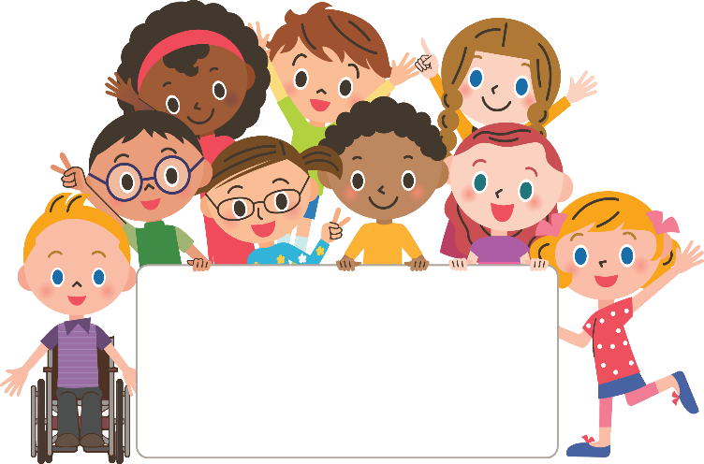
Acknowledgments
Special thanks to all contributors to the development of this module.
Winona Anderson, Ph.D., South-Central RPDC
Susan Borgmeyer, UMKC RPDC
Dawn Cook, formerly of Heart of Missouri RPDC
Mary McConnell, Ph.D., UMKC RPDC
Pam Williams, DESE
Thank you!

Slide 5
Welcome and Introductions
Welcome
Introductions
Housekeeping
Notes:
(5 minutes)
To DO:
Welcome participants.
Conduct Introductions:
Introductions can be presenter choice. Use your preference. Each person could introduce themselves or they can interview and introduce another person. Time should be considered in this choice.
Review Housekeeping Items: Share information such as location of restrooms, approximate break times, lunch arrangements if applicable, etc.

Slide 6
Norms
Be present
Turn cell phones to silent
Minimize sidebar conversations
Use technology for workshop learning purposes
Ask questions
Take care of your personal needs with minimal distraction
Have open hearts & open minds
Have fun!
Notes:
To DO: Go over the suggested norms. The content of this slide is flexible . If you would prefer a different set of norms, you may use them.

Slide 7
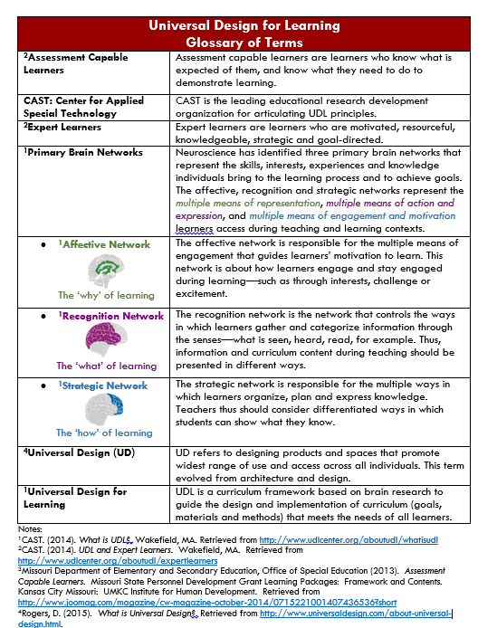
Learning Objectives
As a result of today’s learning you will be able to……
Identify the origin and principles of the UDL framework
Apply UDL to your instructional practices
Make connections between UDL and…
✓Universal Design ✓Differentiated Instruction ✓MO Learning Standards & ✓MO Teacher Standards
Notes:
TO DO: Give the Glossary of Terms for UDL handout to the participants.
TO SAY: The purpose of this workshop is to help you develop background knowledge of the UDL framework develop an understanding of how to implement UDL principles in to your classroom. The following UDL Glossary of Terms will be a helpful reference throughout the session for defining key terms associated with UDL.

Slide 8
Essential Questions
What is Universal Design for Learning (UDL)?
What advantages do students and teachers gain with UDL?
What practical strategies can we use to implement UDL?
How does UDL connect with other frameworks or initiatives?
Notes:
To SAY: This slide lists the Essential Questions we will be addressing in today’s workshop. (Then read the questions/ or pause for participants to read them)

Slide 9
Pre-Assessment
Notes:
To DO: Give the pre-assessment at this point. A copy of the pre-test/post-test and answer key are in the presenter resources and on slide 67. (4 minutes)
This can be given as a paper-pencil test or have participants use Socrative (www.socrative.com) to complete the pre-assessment. Socrative is a free website, or a free app for tablets. Participants will click “Sign in as student” and enter the room number provided by the presenter. Before training, the presenter must set up his or her own Socrative account, which is free, and enter the assessment in the “create assessment” section. This will give the presenter a “room number” to give to participants. Simply select “Start quiz” and “student paced” for participants to quickly complete the pre-assessment.

Slide 10
Pre-Reading Reflection Questions
Write your questions on a sticky note.
Read it to the group.
Place your sticky note on the Pre-Reading Reflection Questions chart.
Notes:
To DO: Have a piece of chart paper labeled “Pre-Reading Reflection Questions”. Need Post-It Notes.
To SAY: As a part of the pre-training exercises you were asked to bring one question or idea about UDL to the training session. Please write your question on a Post-it Note. Read your question as you place it on the “Pre-Reading Reflection Questions” chart.
(5 minutes)

Slide 11
UDL ORIGINS
Notes:
TO KNOW: This section should take approximately 35 minutes.

Slide 12
We say we’re educating everyone, but are we?
Image by UAA: http://www.uaa.alaska.edu/accessibility/topic/architecture.cfm
Notes:
TO SAY: As we begin thinking about Universal Design for Learning today, we want to start by thinking critically about teaching and recognize that the work we do is intended to meet the needs of all learners, but ask does it?
Take 2 minutes to talk with your table about this idea: How is education, as we practice it today, accommodating or not accommodating to every student?
After 2 minutes say: As we learn about the origins of UDL, a key factor to keep in mind is that Universal Design for Learning removes barriers to learning for everyone.
(3 minutes total)

Slide 13
The Concept of UDL
“Universal Design for Learning (UDL) provides the opportunity for all students to access, participate in, and progress in the general-education curriculum by reducing barriers to instruction.”
~Ralabate (2011)
Ralabate, P. K. (2011). Universal Design for Learning: Meeting the Needs of All Students. The ASHA Leader. Retrieved from
http://www.readingrockets.org/article/universal-design-learning-meeting-needs-all-students
Notes:
TO SAY: Here is a quote from 2011. (Pause for participants to read) Note that again it says, “All”.

Slide 14
Introduction to UDL
Watch ‘Videos About UDL: Introduction to UDL’
David Rose, Center for Applied Special Technology Director, explains the development of UDL
Video from: CAST. (2015). Introduction to UDL [online video] Wakefield, MA: Author. Retrieved from http://www.udlcenter.org/resource_library/videos/udlcenter/udl#video2
Notes:
TO SAY:
David Rose, Director at the National Center for Applied Special Technology (CAST) which houses the Universal Design for Learning Center, is the leading researcher in developing this framework. We are going to view a short two minute video about how UDL began. As you watch, jot down notes about what you hear. After the video concludes, you will have the opportunity to share with your observations with your table partners.
TO DO:
Click on the text “Watch Videos About UDL: Introduction to UDL” This is a hyperlink. If the link does not work, the web address is located in the citation at the right of the slide.
Show this 2-minute video.
After the video: Allow 3 minutes for the discussion. Take two or three share-outs from the group.
(8 min. total for video and discussion)

Slide 15
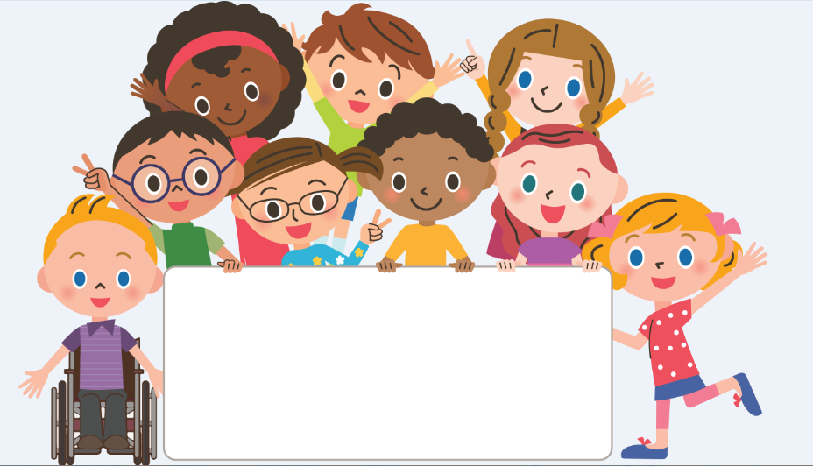
What is Universal Design for Learning?
Not one size fits all – but alternatives for everyone.
Not added on later – but designed from the beginning.
Not access for some – but access for everyone.
Universal Design for Learning
ACCESS Project (2011). UDL: A concise introduction. Retrieved from: http://accessproject.colostate.edu/udl/modules/udl_introduction/udl_concise_intro.pdf
Notes:
TO SAY: UDL came from the architectural concept of Universal Design. The Universal Design tenants were expanded to apply to education. Share information on slide.
TO KNOW:
For more background information refer to “Universal Design for Learning, a Concise Introduction” reprinted from ACCESS Project, Colorado State University (2011). http://accessproject.colostate.edu/udl/modules/udl_introduction/udl_concise_intro.pdf

Slide 16
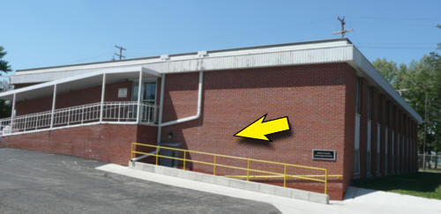
Universal Design
It is always better to build in flexibility from the beginning, rather than try to add it on later.
Photo: www.rootsweb.ancestry.com
Photo: VisualLightBox.com
Notes:
To SAY:
Architecture learned that it is easier and less costly to start with universal design, rather than retrofitting buildings.

Slide 17
Higher Education Opportunity Act of 2008
Universal Design for Learning refers to a scientifically valid framework for guiding educational practice that:
(A) Provides flexibility in the ways
information is presented
students respond or demonstrate knowledge and skills, and
students are engaged
(B) Reduces barriers in instruction
(C) Provides appropriate accommodations, supports, and challenges
(D) Maintains high achievement expectations for all students, including students
with disabilities and students who are limited English proficient
Notes:
TO SAY: This quote is from the Higher Education Opportunity Act of 2008. Let me call your attention to the first part that says that UDL is a scientifically valid framework . That means that it has been proven to work and the word framework means everything you do is built on this model. Not only do we want to recognize that UDL reduces barriers and provides appropriate accommodations, but also stress that as seen in part (D) UDL maintains high achievement expectations for ALL students.

Slide 18
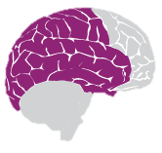
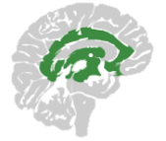
Three Brain Networks
Brain Network |  | Examples | Implications for Teaching
Recognition Network | How information we see, hear, and read is gathered and categorized | Recognition Tasks: Identifying letters, words or an author’s style | Present information and content in multiple ways
Strategic Network | How our ideas are organized and expressed | Strategic Tasks: Writing an essay, solving a math problem, acting out a story sequence | Differentiate the ways that students can express what they know
Affective Network | How learners are engaged and stay actively involved, challenged, interested or excited in learning tasks | Affective Tasks: Using a rubric, planning learning goals, using a graphic organizer for note-taking | Stimulate interest and motivation for learning through multiple ways
CAST (2014). Universal design for learning. Wakefield, MA: Author
Retrieved from: http://www.udlcenter.org/aboutudl/whatisudl
Notes:
To Do: (3-4 minutes)
as an alternative to showing the slide, you can click on the link on the slide to open the webpage prior to the presentation http://www.udlcenter.org/aboutudl/whatisudl
To SAY:
Universal Design for Learning created its framework based on knowledge from neuroscience, which is that the three primary brain networks direct an individual’s learning:
The first, the recognition network, is responsible for the “what” of learning. This network gathers facts and categorizes what we see, hear and read. When you identify letters and words, you are using your recognition network.
The second, the strategic network, is responsible for the “how” of learning. This network organizes and expresses ideas. When you write an essay or solve math problems, you are using the strategic network
The third, the affective network, is responsible for the “why” of learning. This network controls engagement and motivation.
All networks are active in the learning process

Slide 19
Students use all three brain networks to learn.
Identifies objects and discerns the overall context
Determines how you analyze and express information
Influences how long you engage with the information
Recognition Network Strategic Network Affective Network
Notes:
To Say:
When you take in information or view an object for example your recognition network rapidly identifies objects and discerns the overall context. Your strategic network determines how you examine the image and what information you will gain from it. Your affective network determines how long and how carefully you look.

Slide 20
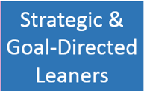
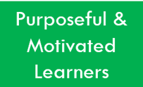
What is the goal of UDL?
The goal of UDL is to develop expert learners who are:
Source: CAST. (2015). Background information about UDL. Retrieved from: http://www.udlcenter.org/aboutudl/take_a_tour_udl
Notes:
To SAY:
The purpose of UDL curricula is not simply to help students master a specific body of knowledge or a specific set of skills, but to help them master learning itself—in short, to become expert learners. Expert learners have developed three broad characteristics. They are: a) strategic, skillful and goal directed; b) knowledgeable, and c) purposeful and motivated to learn more. Designing curricula using UDL allows teachers to remove potential barriers that could prevent learners from meeting this important goal.
“The purpose of UDL implementation is to create expert learners — learners who can assess their own learning needs, monitor their own progress, and regulate and sustain their interest, effort, and persistence during a learning task. Many students learn within traditional classrooms with a traditional curriculum. However, most need supports and/or scaffolds to become expert learners.”
In UDL terms they refer to this kind of learner as an expert learner.
You might know of researcher, John Hattie who refers to this kind of learner as an “Assessment Capable Learner” which he defines as learners knowing what is expected of them and knowing what they need to do to demonstrate that learning. Hattie found that developing Assessment Capable Learners had the highest effect size on student learning. Expert learners or Assessment Capable Learners both talk about teaching students to learn. UDL reduces barriers that might impede learning.

Slide 21
UDL Framework: Putting it All Together
Brain Networks | UDL Goals | Guiding Principles | Outcomes for Learners
Recognition Network The what of learning What am I learning? | Resourceful and Knowledgeable Learners | Multiple Means of Representation | Comprehension
Strategic Network The how of learning How will I learn it? | Strategic and Goal Directed Learners | Multiple Means of Action and Expression | Executive Function
Affective Network The why of learning Why am I learning this? | Purposeful and Motivated Learners | Multiple Means of Engagement | Self-Regulation
Notes:
To Say:
For our understanding of the development of the UDL concept we want to be sure to see the transformation from brain research to conceptual framework, to the goals of UDL and then ultimately what UDL means for learners.
The Brain Networks –Recognition, Strategic and Affective represent students’ pathways to learning. Essentially students are asking “What am I learning?”, “How will I learn it?” and Why am I learning this?” . These networks informed the development of the guiding principles: Multiple means of representation, Multiple means of action and expression and Multiple Means of Engagements. These Guiding Principles direct teachers planning for methods, materials, goals and assessment of teaching and learning processes. Teachers using UDL ask themselves as they are planning for instruction and assessment—in what ways does this information need to be presented to the learners in my classroom; in what ways do I need to support the action and expression of students as they learn, and in what ways do I need to provide clear, concrete connections for learning this material so students will be engaged and capable learners?

Slide 22
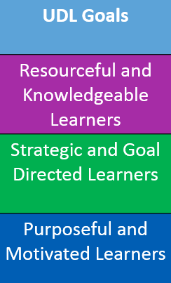
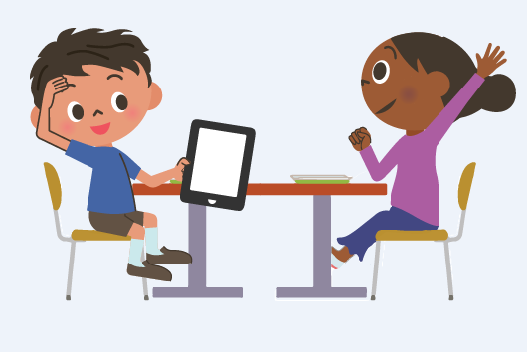
UDL Goal Activity
Notes:
TO DO: ACTIVITY: (8 minutes for this slide activity)
This activity will use the presenter handout, “The Goal of Universal Design for Learning Activity” . Each table will need a complete set of characteristics and the framework template. For each table set, cut apart the characteristics into sentences strips and place them in an envelope. Each group will read the characteristics of the goal components (sentence strips) and place the characteristics on the framework template under the goal component they describe. When participants are done sorting, display the next three slides (you will have to hide them if you copy for participants).
TO KNOW: Here are the correct answers found on the next three slides:
Expert learners are:
Resourceful & Knowledgeable which means:
Bring considerable prior knowledge to new learning
Activate that prior knowledge to identify, organize, prioritize, and assimilate new information
Recognize the tools and resources that would help them find, structure, and remember new information
Know how to transform new information into meaningful and useable knowledge
Strategic & Goal-Directed which means
Formulate plans for learning
Devise effective strategies and tactics to optimize learning
Organize resources and tools to facilitate learning
Monitor their progress
Recognize their own strengths and weaknesses as learners
Abandon plans and strategies that are ineffective
Purposeful & Motivated which means:
Are eager for new learning and are motivated by the mastery of learning itself
Are goal-directed in their learning
Know how to set challenging learning goals for themselves
Know how to sustain the effort and resilience that reaching those goals will require
Monitor and regulate emotional reactions that would be impediments or distractions to their successful learning
BACKGROUND KNOWLEDGE:
“ The UDL framework values diversity through proactive design of an inclusive curriculum, thereby eliminating or reducing barriers to academic success. Initially proposed as a means for including students with disabilities in the general-education classroom, it is now better understood as a general-education initiative that improves outcomes for all learners.”
http://www.readingrockets.org/article/universal-design-learning-meeting-needs-all-students

Slide 23
Resourceful and Knowledgeable
Bring considerable prior knowledge to new learning
Activate that prior knowledge to identify, organize, prioritize, and assimilate new information
Recognize the tools and resources that would help them find, structure, and remember new information
Know how to transform new information into meaningful and useable knowledge
http://www.udlcenter.org/aboutudl/expertlearners
Notes:
Show slide after activity for table group self-check (1 minute)

Slide 24
Strategic and Goal-Directed
Formulate plans for learning
Devise effective strategies and tactics to optimize learning
Organize resources and tools to facilitate learning
Monitor their progress
Recognize their own strengths and weaknesses as learners
Abandon plans and strategies that are ineffective.
http://www.udlcenter.org/aboutudl/expertlearners
Notes:
TO DO: Show slide after activity for table group self-check (1 minute)
TO SAY: Take two minutes to debrief with your group about any questions or comments on your task. (any conflicts? Matched up well?)

Slide 25
Purposeful and Motivated Learners
Are eager for new learning and are motivated by the mastery of learning itself
Are goal-directed in their learning
Know how to set challenging learning goals for themselves
Know how to sustain the effort and resilience that reaching those goals will require
Monitor and regulate emotional reactions that would be impediments or distractions to their successful learning.
http://www.udlcenter.org/aboutudl/expertlearners
Notes:
TO DO: Show slide after activity for table group self-check (1 minute)
TO SAY: Now that we have viewed each UDL goal component do a self-check of the match up between goal component and goal characteristic.

Slide 26
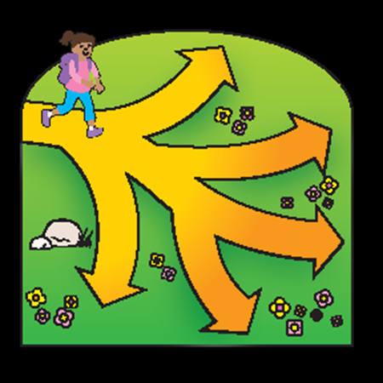
Why is UDL important?
“UDL provides a blueprint for creating instructional goals, methods, materials, and assessments that work for everyone not a single, one-size-fits-all solution, but rather flexible approaches that can be customized and adjusted for individual needs.” ~CAST (2015)
No single pathway works for every student
Notes:
(2 minutes)
TO SAY:
With UDL, we increase learning by reflecting the three primary brain networks in the teaching and learning processes—such as in planning goals, methods, materials and assessments within curriculum design.
Because individuals bring a wide variety of skills, needs, and interests to learning, UDL provides important opportunities for teachers and students to have choices.
UDL
Reduces barriers
Provides a flexible blueprint and approach to meet the needs of all learners
Involves Multi-sensory processes within instructional planning, materials, methods and assessments

Slide 27
Self-Reflection
Notes:
To SAY: Throughout today’s module we will have Reflection Checkpoints in order to give you time to self-reflect and self-assess your progress with the UDL topic. A handout called the Universal Design for Learning Reflection Placemat is provided for you to record key points, reflections or questions you have. The placemat is organized so that as you begin your journey with UDL you can record along the path of UDL origins, UDL Principles and UDL Implementation. At the end you will be able to note your action steps for after the training. Take a few minutes now to think about the UDL Origins and make your reflections.
4 min

Slide 28
UDL PRINCIPLES
National Center on Universal Design for Learning. (2010). UDL Principles and Practice. Retrieved from https://www.youtube.com/watch?v=pGLTJw0GSxk
Notes:
TO KNOW: This section should take approximately 50 minutes.
TO DO: At this slide, you will show a 6 minute video from National Center on UDL as Director David Rose explains how UDL helps meet the challenging issues that teachers have today—which is meeting the variable needs of the children in their classrooms. He discusses how UDL provides solutions for teachers to create success for all children.
A hyperlink is embedded in the citation for the video
https://www.youtube.com/watch?v=pGLTJw0GSxk

Slide 29
Using the UDL Guidelines
The Guidelines should be:
Applied to all aspects of the curriculum
Used with ALL students—not just a few
Used to evaluate and plan goals, methods, materials, and assessments
Used to create a fully accessible learning environment for all
Notes:
TO SAY:
The UDL Guidelines should be carefully selected and applied to the curriculum as appropriate. The UDL Guidelines are not meant to be a “prescription”, but rather as a set of strategies that can be employed to overcome the barriers inherent in most existing curricula. They may serve as the basis for building in the options and the flexibility that are necessary to maximize learning opportunities. In many cases, educators may find that they are already incorporating many of these guidelines into their practice.

Slide 30
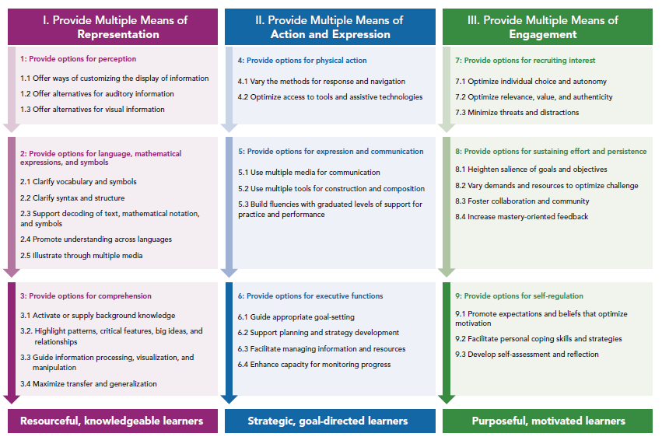
How are the Universal Design for Learning Guidelines organized?
Source: CAST. (2013). How are the guidelines organized? [video]. Retrieved from (http://www.udlcenter.org/aboutudl/udlguidelines/aboutrepresentation
Notes:
T0 SAY: The Universal Design for learning Guidelines are organized under three guiding principles that emerged from the three primary brain networks.
Principle I. Provide Multiple Means of Representation
Principle II. Provide Multiple Means of Action and Expression
Principle III. Provide Multiple Means of Engagement
We will look at a four minute video where David Rose introduces the organization of the guidelines and emphasizes how the guidelines enable teachers to provide children with opportunities for deepened levels of independence in learning.
TO DO: Click on the title “how are the Universal Design for learning Guidelines organized?” which is a hyperlink to the webpage where the video is located. (same link as listed on the source) Show video
(This slide 5 min)
This Graphic Organizer with the UDL Guidelines can be downloaded from http://www.udlcenter.org/aboutudl/udlguidelines/downloads

Slide 31
How do we do it?
CAST (Retrieved from:
http://www.udlcenter.org/aboutudl/udlguidelines
Notes:
TO DO: Go to : http://www.udlcenter.org/aboutudl/udlguidelines which is hyperlinked on the slide. You will lead the participants through the Guidelines as described on the next slides.
TO SAY: As we saw on the video, the UDL Guidelines are organized according to three principles, and deepen vertically. We are going to look at the 3 Guiding Principles.

Slide 32
CAST. (2014). Three primary principles guide UDL—and provide structure for the Guidelines. Wakefield, MA: Author. Retrieved from: http://www.udlcenter.org/aboutudl/udlguidelines
Notes:
To DO: If technology allows, use the link in the resource to access the webpage where the Guideline is located. Practice in advance clicking on a principle, then a guideline, then a checkpoint. Look at the examples and resources provided. This will help you to be prepared to make this a live demonstration.
Demonstrate how the principles, guidelines, and checkpoints are set-up and how to access the resources associated with each. If technology is not available, provide one copy of the printable handout of the principles, guidelines and checkpoints http://www.udlcenter.org/sites/udlcenter.org/files/updateguidelines2_0.pdf and one copy of the educator’s worksheet http://www.udlcenter.org/aboutudl/udlguidelines/downloads (and click on “Get an Educator’s Worksheet for the UDL Guidelines)
Allow 10 minutes for the entire examination of the UDL principles, guidelines, and checkpoints and resources from this slide to slide 33. At this time you are showing the participants how the system works. They will get an opportunity to explore the resources on their own in the next section.
TO SAY: Each principle has three guidelines. Each guideline has several checkpoints. There are examples of resources given for each checkpoint. Together, let’s step through Principle I. Now take time to look with your table or a partner at Principle II and III.

Slide 33
UDL Guidelines: Principle I
CAST. (2011). Universal design for learning guidelines-version 2.0. Wakefield, MA: Author. Retrieved from: http://www.udlcenter.org/aboutudl/udlguidelines
Notes:
IMPORTANT—THIS SLIDE MAY BE HIDDEN IF YOU ARE DEMONSTRATING THIS NAVIGATION FROM SLIDE 29
TO DO: This slide and the following slide could be viewed as a continuation of your demonstration if you are not able to have participants independently navigate.
Be sure to know how to show participants how they can find many more resources for each checkpoint.
Click on the first arrow to get the information on the next slide.
http://www.udlcenter.org/aboutudl/udlguidelines/principle1
TO SAY: Here is the first Principle : Provide multiple means of representation. Under Principle I we have three guidelines, the first of which is perception. Under perception there are three checkpoints. Checkpoint 1.1 is, “Offer ways of customizing the display of information. Let’s click on that link.

Slide 34
CAST. (2011). Universal design for learning guidelines-version 2.0. Wakefield, MA: Author.
Retrieved from: http://www.udlcenter.org/aboutudl/udlguidelines/principle1
Notes:
IMPORTANT—THIS SLIDE MAY BE HIDDEN IF YOU ARE DEMONSTRATING THIS NAVIGATION FROM SLIDE 29
To KNOW and DO: If you do the live demonstration described on last slide, you would skip this slide.
Otherwise, This is the expanded view of Checkpoint 1.1. More specific examples are within the checkpoint 1.1 View examples and resources link. This is the same format for all-different information, same format.
TO SAY: Here are suggestions for ways to “offer ways of customizing the display of information.” We can find examples and resources which we will give you time to explore in the next section.

Slide 35
UDL Guidelines: Principle II
CAST. (2011). Universal Design for Learning Guidelines version 2.0. Wakefield, MA: Author. Retrieved from: http://www.udlcenter.org/aboutudl/udlguidelines/principle2
Notes:
IMPORTANT—THIS SLIDE MAY BE HIDDEN IF YOU ARE DEMONSTRATING THIS NAVIGATION FROM SLIDE 29
Principle II: Provide Multiple Means of Action and Expression
To DO: Continue with a live demonstration by clicking on the links as you point them out like you did for Principle I.

Slide 36
UDL Guidelines: Principle III
CAST. (2011). Universal Design for Learning Guidelines version 2.0. Wakefield, MA: Author. Retrieved from: http://www.udlcenter.org/aboutudl/udlguidelines/principle3
Notes:
IMPORTANT—THIS SLIDE MAY BE HIDDEN IF YOU ARE DEMONSTRATING THIS NAVIGATION FROM SLIDE 29
To DO: Repeat your live demonstration by clicking on the links as you point them out for Principle III

Slide 37
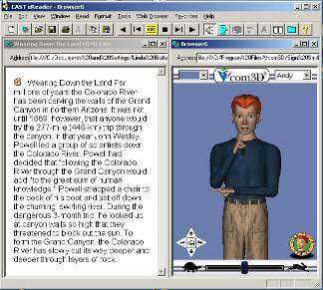
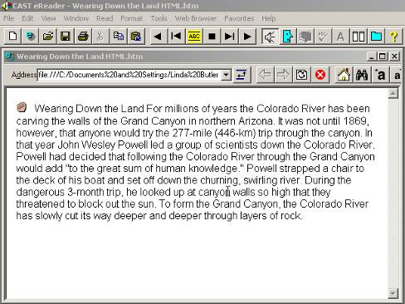
Multiple Means of Representation
Tale of Two Cities
…It was the best of times, it was the worst of times, it was the age of wisdom, it was the age of foolishness,
IT WAS the best of times, it was the worst of times, it was the age of wisdom, it was the age of foolishness, it was the epoch of belief, it was the epoch of incredulity, it was the season of Light, it was the season of Darkness, it was the spring of hope, it was the winter of despair,
IT WAS the best of times, it was the worst of times, it was the age of wisdom, it was the age of foolishness, it was the epoch of belief, it was the epoch of incredulity, it was the season of Light, it was the season of Darkness, it was the spring of hope, it was the winter of despair, we had everything before us, we had nothing before us, we were all going direct to Heaven, we were all going direct the other way- in short, the period was so far like the present period, that some of its noisiest authorities insisted on its being received, for good or for evil, in the superlative degree of comparison only.
There were a king with a large jaw and a queen with a plain face, on the throne of England; there were a king with a large jaw and a queen with a fair face, on the throne of France. In both countries it was clearer than crystal to the lords of the State preserves of loaves and fishes, that things in general were settled for ever.
Notes:
To SAY: This is an example of various forms of representation-Braille, text highlighted as it is read by the computer, simplified text. Each of these provides access to the same text in a form appropriate for the needs of certain, individual students.
1 minute

Slide 38
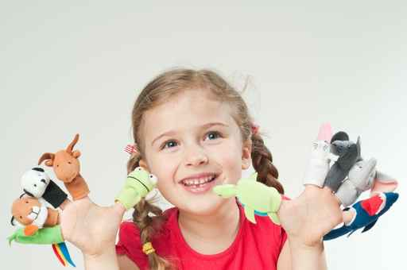
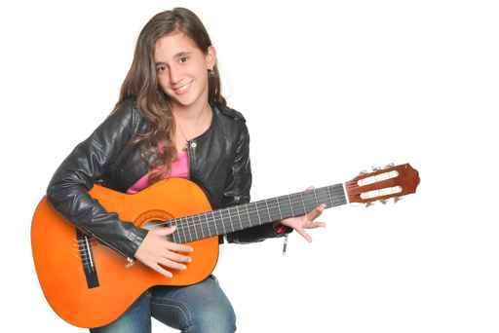
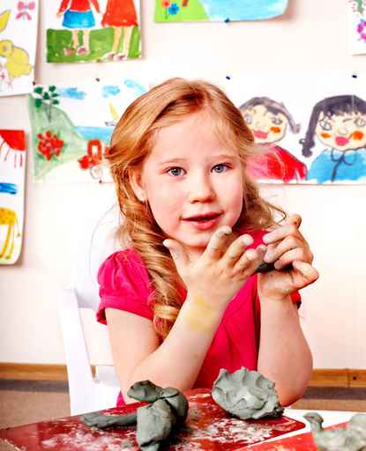
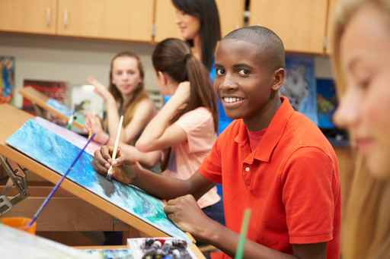
Multiple Means of Expression
Notes:
To SAY: Expression could include: drawing, sculpting, using technology, writing, painting, dramatization, talking, rapping, or writing/playing music
1 minute

Slide 39
Multiple Means of Engagement
Influences choices
Filters out the unimportant
Focuses towards challenging and enjoyable activities
Example of Multiple Means of Expression, Representation and Engagement
Notes:
TO SAY: When students are engaged, that will influence their choices, help them filter out the unimportant and focus toward challenging, enjoyable activities.
Let’s view an example of each principle in action as Geometry students at Mountlake Terrace High School engage in a powerful learning project, that involves real-life problems, application of multiple ways to express and represent ideas, and the involvement of real-life experts—all a recipe for challenge and exciting motivation.
TO DO: click on hyperlink in the slide or http://www.edutopia.org/mountlake-terrace-geometry-real-world-video
Play video to 3:16
BACKGROUND: To find out more about the Mountlake Terrace High School project go to: http://www.edutopia.org/mountlake-terrace-geometry-real-world-video
4 minutes total

Slide 40
Applying the Guiding Principles
Perception and access to the instructional material
What are different ways information and content can be presented?
Expression and action in learning.
What are some ways to vary how students express what they know?
Engagement in the learning tasks.
What are some ways to stimulate interest and motivation for learning?
http://www.udlcenter.org/aboutudl/whatisudl
Notes:
To SAY: Now, let’s take a moment to reflect on the guiding principles and their foundation in how the brain works.
To reduce barriers of learning, it is important to ensure that key information is equally perceptible to all learners, that students have opportunities to express and demonstrate their learning, and that students are provided with multiple options to be engaged and motivated to stay engaged in learning activities.
Take a few minutes to consider possibilities for each question that represents UDL principles in action. Then, you will have time to discuss at your table.
TO DO: Allow time for a group or table discussion to respond to the question. May take one to two shout-outs for each question after table discussion.
10 minutes total

Slide 41
Self-Reflection
Notes:
To SAY: Record on your reflection sheet key points and questions regarding UDL Principles. When you and your shoulder partner are ready, share your reflections

Slide 42
UDL IMPLEMENTATION
Notes:
TO KNOW: This section should take approximately 65 minutes.

Slide 43
Universal Design for Learning Guiding Principles
Principle I:
To support recognition learning, provide multiple flexible methods of presentation/representation
Principle II:
To support strategic learning, provide multiple flexible methods of action and expression
Principle III:
To support affective learning, provide multiple, flexible options for engagement
Notes:
To SAY: We have spent the last portion of our session developing an understanding about the three guiding principles of the UDL framework.
The three principles emphasize the idea of flexibility in the multiple methods for representing, expressing and engaging students and their ideas in the classroom. Now you are going to be able to explore these guidelines further and consider more ways that you can apply the principles to your classroom
1 min.

Slide 44
Application Activity
Go to: http://www.udlcenter.org/aboutudl/udlguidelines
2. Look at specific examples for each checkpoint.
3. Choose 2 or 3 that you would like to explore.
4. Click on the “view examples and resources” link.
Choose 2 of the resources that you can implement in an upcoming lesson that you will be teaching.
Use “UDL Principles, Guidelines, Checkpoints in the Classroom” to record your findings.
7. Be ready to share.
Notes:
To DO:
Use: http://www.udlcenter.org/aboutudl/udlguidelines and handout “UDL Principles, Guidelines, Checkpoints in the Classroom” to model how to find the guidelines, checkpoints and resources. Follow the steps on the slide to complete one example together.
When technology does not allow have copies of full text version of the guidelines: http://www.udlcenter.org/aboutudl/udlguidelines/downloads
Divide group into thirds. One third will do Principle 1, one third will do Principle 2, and the final third will do Principle 3. Participants will use “UDL Principles, Guidelines, Checkpoints in the Classroom” worksheet for note taking. Allow 20 minutes for participants to explore the links. Provide additional time to share their ideas with the whole group (your choice). Participants should add information that is shared to their worksheet. Add 10 minutes for sharing.
TO SAY: We are going to divide the group into three parts. One third will do Principle 1, one third will do Principle 2, and the final third will do Principle 3. You will use “UDL Principles, Guidelines, Checkpoints in the Classroom” worksheet for note taking. You will have time to explore the links. Be prepared to share what you’ve found with the group.
As we share, feel free to add information that is shared by others to your worksheet
30 minutes total

Slide 45
Classroom Implementation Examples
Gr 1 math
https://www.youtube.com/watch?v=KuTJJQWnMaQ&index=15&list=UUk-BxeAygzqGabYBs1TPIHQ
Gr 5 ELA
http://www.udlcenter.org/resource_library/videos/udlcenter/guidelines#video3
Gr 6 Science
http://www.udlcenter.org/resource_library/videos/udlcenter/guidelines#video4
Notes:
To KNOW:
Each video is approximately 10 minutes long. Look at them ahead of time so you have a short introduction for each. You will select one that best fits your group.
TO DO:
Choose to show the one(s) that is/are most appropriate for your audience and download it. Check your link. Duplicate the template for each participant : “Educator’s Worksheet for UDL Guidelines” from http://www.udlcenter.org/aboutudl/udlguidelines/downloads.
TO SAY:
What does Universal Design for Learning look like in the classroom? Let’s look at an example of UDL in a classroom. Because of time constraints, we are only going to watch one but you have the links to look at later. You should take notes about what you see on the Educator’s Worksheet for UDL Guidelines.”

Slide 46
Benefits and Challenges: Carousel Activity
Count off into 4 groups
Each group take a marker and go to one of the charts posted on the wall.
Read the prompt on the paper and write your responses.
When the signal is given, rotate to the next paper. Read what the last group wrote and add your ideas.
Repeat until you have recorded at each prompt (chart).
Notes:
Carousal activity (15 minutes)
Post 4 pieces of chart paper
Benefits to teachers who apply UDL principles.
Benefits to ALL students when UDL principles are applied.
Benefits to Students with Disabilities when UDL principles are applied.
Challenges or Roadblocks to Applying UDL principles
Divide participants in four groups
Each group goes to one paper and writes their responses on that piece
After 2 minutes, the groups rotate to the next piece of paper, read what is on the paper and add any additional thoughts
Continue in this fashion until everyone has an opportunity to write on every paper.
One person in each group reports out on the paper where they ended or take one last walk around. (4 minutes)

Slide 47
Implications of UDL
UDL environments support the needs of ALL students
English Language Learners, Students with Special Needs, Gifted and Talented learners, and the “average” student
Supports are readily available in the methods, materials, goals and assessments
Teachers consider ways to support purposeful, resourceful and motivated learners
Barriers to learning are removed
Notes:
TO DO: Connect these implications to those participants suggested or just mention the ones not suggested by the participants.
TO SAY: Did we hear all of these things from the group when they shared out? Did we hear some other ideas that are not listed?

Slide 48
Self-Reflection
What do you want to remember about implementation of UDL in your classroom?
Notes:
To SAY: Record on your reflection sheet key points and questions regarding UDL Principles. When you and your shoulder partner are ready, share your thoughts on the relationship between the three brain networks and good lesson design. We will take four minutes for this checkpoint. Go now.

Slide 49
CONNECTION TO OTHER FRAMEWORKS
Notes:
TO KNOW: This section should take approximately 10 minutes

Slide 50
UDL & Differentiated Instruction
Both support learners by…
Presenting information and content in different ways…the "what" of learning
Differentiating the ways that students can express what they know…the "how" of learning
Stimulating interest and motivation for learning…the "why" of learning
Source: CAST. (2007). Universal design for learning: Questions and answers. Wakefield, MA: Author.
Notes:
TO SAY:
UDL supports teachers in meeting the challenge of teaching a diverse group of learners by providing flexible instructional materials, techniques, and strategies that help teachers differentiate instruction to meet these varied needs by:
UDL shares commonalities with Differentiated Instruction. One way they are alike is that they both offer choice to students. One way they are different is that UDL is on-going, it is the way the classroom operates. Differentiated instruction might be on a lesson by lesson basis. Goals of each are similar in that each recognizes there are multiple ways to learn, and multiple ways to express learning.
One unique feature of UDL is that A universally designed curriculum is designed from the outset to meet the needs of the greatest number of users, making costly, time-consuming, and after-the-fact changes to curriculum unnecessary.

Slide 51
UDL & Missouri Learning Standards
Not to “fix” the child who has a problem
INSTEAD
“Fix” the curriculum so that it can meet the needs of diverse learners and support achievement of the Missouri Learning Standards
Notes:
TO SAY: By implementing UDL the curriculum supports ALL learners, and supports goals and objectives of meeting the MO Learning standards at the same time

Slide 52
UDL & Missouri Teacher Standards
Through focus on:
student engagement, problem solving and critical thinking (1.2; 4.1)
differentiated lesson design & instructional strategies (2.4; 3.3)
diverse learner needs & sensitivity to cultural, gender,
intellectual differences (3.2; 6.2)
appropriate use of instructional materials (4.2)
supporting learners’ expression (6.3)
Notes:
T0 SAY:
UDL helps all learners to meet the Missouri Learning Standards and compliments our professional growth towards applying the Missouri Teacher Standards. Several standards . (Individual standard is listed after the bullet points)
TO DO:
Read the underlined words and make connections to previous learning.

Slide 53
UDL and Curriculum Development
The UDL framework views curriculum as goals, methods, materials and assessments. In UDL, curriculum is intentionally and systematically designed from the start to address individual differences.
It uses best practices for ALL in the initial design rather than offering them after learners have failed (retrofitting).
National Center on Universal Design for Learning. (2011).
How Does UDL Address Curricular Disabilities? Wakefield, MA: CAST. Retrieved from http://www.udlcenter.org/aboutudl/udlcurriculum/addressdisabledcurricula
Notes:
TO SAY: One size fits all curriculum doesn’t work in today’s classroom. Curriculum should be designed from the start to address individual differences.
TO KNOW: The usual process for making existing curricula more accessible is adaptation of curricula so that they are more accessible to all learners. Often, teachers themselves are forced to make difficult attempts at adapting inflexible “one-size-fits-all” curricular elements that were not designed to meet the variability of individual learners. The term Universal Design for Learning is often mistakenly applied to such after-the-fact adaptations.
However, Universal Design for Learning refers to a process by which a curriculum (i.e., goals, methods, materials, and assessments) is intentionally and systematically designed from the beginning to address individual differences. With curricula that are designed with the principles of UDL, the difficulties and expenses of subsequent “retrofitting” and adaptation of “disabled” curricula can be reduced or eliminated–and a better learning environment can be implemented.
The challenge is not to modify or adapt curricula for a special few, but to do so effectively and from the start. Considerable research already exists that identifies the effective evidence-based practices for learners presently “in the margins”. Unfortunately, these best practices have not been available to all learners, and typically are offered only after learners have already failed in mainstream curricula. They are often then provided in separate remedial or special placements where ties to the general curriculum and its high standards have been severed entirely. A UDL curriculum provides the means to repair those severed ties, and promote the inclusion of all learners.

Slide 54
What role does technology play in UDL?
You can implement UDL without technology.
You can have technology and not be implementing UDL.
Technology applied using UDL principles makes it easier and more effective to customize the curriculum for all learners.
For more on technology visit: http://www.udlcenter.org/aboutudl/udltechnology
Notes:
TO SAY: Technology makes it easier to implement UDL. We are not always talking about high-tech technology. Technology can be as low-tech as a pencil. Lack of technology doesn’t mean you can’t use UDL. Effective teachers can be resourceful in designing flexible learning environments to meet the needs of ALL learners.
TO KNOW: Dedicated educators always find ways to design curricula that meets the needs of all learners, whether they are using technology or not. However, powerful digital technologies applied using UDL principles enable easier and more effective customization of curricula for learners. Advances in technology and the learning sciences have made “on-the-fly” individualization of curricula possible in practical, cost-effective ways, and many of these technologies have built in supports, scaffolds, and challenges to help learners understand, navigate, and engage with the learning environment.
Learning and demonstrating effective uses of technology is itself an important instructional outcome. Technology has permeated all aspects of our economy and culture. Every learner now in school needs a range of literacies that are much broader and more inclusive of our changing culture. Further an understanding of these technologies leads to a greater understanding of the possible non-tech options that can be utilized.
However, it is important to note that these technologies should not be considered to be the only way to implement UDL. Effective teachers should be creative and resourceful in designing flexible learning environments that address the variability of learners using a range of high-tech and low-tech solutions. The goal of UDL is to create environments in which everyone will have the opportunity to become expert learners, and the means to get there, be it tech or non-tech, should be flexible.
It is also important to point out that simply using technology in the classroom should not be considered implementation of UDL. Using technology does not necessarily enhance learning, and many technologies have the same accessibility problems that non-tech options might have. Technology needs to be carefully planned into the curriculum as a way to achieve the goals.

Slide 55
IMPLEMENTATION PLANNING
Notes:
TO KNOW: This section should take approximately 33 minutes

Slide 56
UDL Implementation: A Process of Change
http://udlseries.udlcenter.org/presentations/udl_implementation.html
This is a link to a video presentation of the steps schools have gone through in order to fully implement UDL.
Notes:
This link contains a video with corresponding slides that walks through the steps for implementation. Included are examples of school leaders discussing their personal experience and endorsement for each step. Call attention to the UDL features of this link (audio, visual graphics and visual print).
TO SAY: In a few minutes you will be making a plan for implementing UDL in your school. To give you some examples, we will watch a video describing how different school leaders implemented UDL at their school. As you watch think about what you can learn from their experiences.
(ALLOW 18 minutes)

Slide 57
Implementing UDL
If attending as a school team complete the template: “Implementing UDL at my school”
If attending as an individual teacher, complete the template: “Implementing UDL in my classroom”
Share out
Notes:
TO DO: School teams should complete the template, “Implementing UDL at my school” (ALLOW 10 minutes)
TO SAY: Now that you have information about UDL and how a school can implement it, we are going to give you a chance to begin to make plans for your school. Use the template, “Implementing UDL at my school? You won’t have time to write a complete plan today but you will have time to make a start.
Share out: have groups share out as conclusion: Be sure that there is adequate time for sharing out after these are completed. (ALLOW 5 minutes for sharing) If individual teachers have them share with partners and then each table share out one or two ideas at the end of sharing

Slide 58
Self-Reflection
What do I want to remember about implementing UDL principles?
Notes:
To SAY: Record on your reflection sheet key points and questions regarding UDL Principles. When you and your shoulder partner are ready, share your reflections.

Slide 59
CLOSING
Notes:
TO KNOW: This section should take approximately 15 minutes.

Slide 60
Self-Reflection
Was your question from the Pre-Reading question answered?
3-2-1 Reflection:
3 new things you learned about UDL today
2 things about UDL you want to remember
1 UDL idea you want to try right away
Turn to a table partner and share
Notes:
To DO: Refer to the chart, “Pre-Reading Reflection Questions” created at the beginning of the day (see slide 10) to answer any questions that were not addressed in the training.
To SAY: Turn to someone at your table and discuss the 3-2-1 points
(ALLOW 4 minutes)

Slide 61
Post-Assessment
Take a moment to take a post-assessment
Notes:
TO DO: Do in the same manner as the pre-test. Go over the correct answers shown on the next slide. You will have to unhide the slide to present. (ALLOW 5 minutes)

Slide 62
Post-Test Answers
1. b) A scientific framework that guides teaching practices so that ALL students can learn
2. a) Multiple means of representation, action and expression, and engagement
3. b) Three brain networks from neuroscience research
4. d) UDL minimizes barriers and maximizes learning for all students, so that students are resourceful and knowledgeable, goal-oriented, and purposeful, motivated learners.
5. c) Providing students with a choice on demonstrating the current English Language Arts learning target
Notes:
Change this slide

Slide 63
Further Coaching Contact
For further coaching contact:
Notes:
TO DO: Presenter should add their own contact information

Slide 64
Recommended Resources
Center for Applied Special Technology (CAST)
www.cast.org
http://lessonbuilder.cast.org
National Center on Universal Design for Learning
Fidelity Checklist for UDL Implementation:
http://www.udlcenter.org/sites/udlcenter.org/files/updateguidelines2_0.pdf
www.udltechtoolkit.wikispaces.com
www.udlcenter.org
http://udlselfcheck.cast.org
Notes:
These resources will be on a handout that should be distributed to all participants
It would be very beneficial to open the resource page up and open the hyperlink of two or three different resources. There are some very good resources that participants may not take the time to investigate otherwise.

Slide 65
Recommended Resources
Other Resources:
http://trackstar.4teachers.org/
http://42explore.com/
http://www.4teachers.org/
www.internet4classrooms.com/
http://www.marcopolosearch.org/teacher/teacher_index.html

Slide 66
Recommended Resources
Other Resources:
The Iris Center www.iris.peabody.vanderbilt.edu/module/udl/
Project Access www.accessproject.colostate.edu/udl/
Universal Design for Learning: Meeting the Needs of All Students. August 30, 2011. www.asha.org
UDL in Early Childhood. www.ectacenter.org/topics/atech/udl.asp

Slide 67
For Presenter only
Handouts put into a handout packet or handed out as needed
Slide 6: Glossary of Terms
Slide 8: Pre-test
Slide 41: Template , “UDL Principles, Guidelines, Checkpoints in the Classroom”
Slide 29 & 42: Retrieve directly from the site for use in the training. “Educator’s Worksheet for UDL Guidelines.” from the National Center for Applied Science Technology/CAST website http://www.udlcenter.org/aboutudl/udlguidelines/downloads
Slide 30: Retrieve “Graphic Organizer of the UDL Guidelines” directly from the website for use in the training: http://www.udlcenter.org/aboutudl/udlguidelines/downloads
Slides 24, 38, 45, 55: UDL Reflection Sheet
Slide 54: Template , “Implementing UDL at my School” or “Implementing UDL in my classroom”
Slide 58: Post-test
Slide 61-63: UDL Resources Handout
(continued)
Notes:
Hide slide during presentation

Slide 68
For Presenter only (continued)
For Presenter’s background
Slide 14 : Retrieve directly from the Access Project cite: ”Universal Design for Learning, a Concise Introduction” http://accessproject.colostate.edu/udl/modules/udl_introduction/udl_concise_intro.pdf
PREPARE activity :
Slide 17-20: Matching Activity “The Goal of UDL” one per table. Some materials need to be cut apart.
Label Chart paper :
Slide 9: “Pre-Reading Reflection Questions” and need Post-it notes
Slide 43: 4 charts with the following titles
1. Benefits to teachers who apply UDL principles
2. Benefits to ALL students when UDL principles are applied.
3. Benefits to students with Disabilities when UDL principles are applied
4. Challenges or Roadblocks to Applying UDL principles
Notes:
Hide slide during presentation

Slide 69
Section | Time | Slides | For Presenter Use: Materials Needed
OPENING ACTIVITIES Welcome, Intro, ... Norms, At-a-Glance, Obj., ... Pre-Assessment Pre-Reading Reflection | 20 min 5 min 4 min 5 min 5 min | 2-10 5 6-8 9 10 | HO: Glossary of Terms HO: Pre-Test Chart paper entitled, “Pre-reading Reflection Questions” Post-it notes
ORIGINS OF UDL Video & discussion Sorting Activity Self-Reflection | 35 min 8 min 15 min 4 | 11-24 14 18-21 25 | Check hyperlink to video on slide Activity: The Goal of UDL: NEEDS PREPARATION HO: UDL Reflection Sheet
UDL PRINCIPLES Video (6 min) Video (2 min) Electronic tour of guidelines Table discussions Self-Reflection | 30 min 5 min 2 min 10 min 10 min 4 min | 26-39 26 28 29-34 38 39 | Check hyperlink to video given on slide (in title) Check hyperlink to video given on slide (on left side title) HO: UDL Reflection Sheet
UDL IMPLEMENTATION Application Activity Video Carousel Activity Self-Reflection | 65 min 30 min 10 min 15 min | 40-46 42 43 44 46 | HO: Template: UDL Principles, Guidelines, checkpoints in the Classroom HO: Educator’s worksheet for UDL Guidelines Retrieve from UDL Center 4 pieces of chart paper with the following titles: 1. Benefits to teachers who apply UDL principles 2. Benefits to ALL students when UDL principles are applied 3. Benefits to Students with Disabilities when UDL principles are applied 4. Challenges or Roadblocks to Applying UDL principles
Notes:
Hide slide during presentation
TO KNOW: Slide 74 and 75 is what it would take to cover all the information in one day.
With modified openings and closings, the presentation could be divided into two half-day presentations:
Day 1: Origins of UDL and UDL Principles
Day 2: UDL Implementation, Connections to Other Frameworks, and Implementation Planning.

Slide 70
Continued
Section | Time | Slides | For Presenter Use: Materials Needed
CONNECTION TO OTHER FRAMEWORKS | 8 min | 47-52
IMPLEMENTATION PLANNING Video Make a plan Checkpoint | 40 min 18 min 15 min 4 min | 53-56 54 55 56 | HO: Template: Implementing UDL at my School/Implementing UDL in my classroom HO: UDL Reflection Sheet
CLOSING Reflection Post Assessment Recommended Resources | 15 min 4 min 3 min 2 min | 57-64 58 59 62-64 | HO: Post-Assessment HO: Recommended Resources
Notes:
Hide slide during presentation

Slide 71
For Presenter only
Suggestions for Presentation
Entire Package is currently 3 hours and 40 minutes
For a 1 hour 45 minute
UDL Origins
UDL Principles
UDL Implementation
Evaluation
OPENING ACTIVITIES Welcome, Intro, ... Norms, At-a-Glance, Obj., ... Pre-Assessment Pre-Reading Reflection | 18 min 5 min 4 min 4 min 5 min | 2-9 4 5-7 8 9 | HO: Glossary of Terms HO: Pre-Test Chart paper entitled, “Pre-reading Reflection Questions” Post-it notes
ORIGINS OF UDL Video & discussion Goals of UDL Checkpoint | 16 min 8 min 5 min 3 | 11-24 13 17-20 24 | Check hyperlink to video on slide HO: UDL Reflection Sheet
UDL PRINCIPLES Video (6 min) Video (2 min) Electronic tour of guidelines Table discussions Checkpoint | 31 min 6 min 2 min 10 min 10 min 3 min | 25 27 29-33 37 38 | Check hyperlink to video given on slide (in title) Check hyperlink to video given on slide (on left side title) HO: UDL Reflection Sheet
UDL IMPLEMENTATION Application Activity Video ADJUSTED Carousel Activity Closing and Evaluation | 40 min 15 min 10 min 10 min 5 | 41 42 43 | HO: Template: UDL Principles, Guidelines, checkpoints in the Classroom HO: Educator’s worksheet for UDL Guidelines Retrieve from UDL Center Adjust this activity to be a table discussion
Notes:
Hide slide during presentation

Slide 72
For Presenter only
Suggestions for Presentation Continued…
For a follow up 1 hour
Notes:
Hide slide during presenation

