Slide 1
Missouri Model Districts
Making Connections
for
The Big Picture
Notes:
To Know/To Say:
Today we will explore through various MMD materials, tools, and processes the interrelationships of the foundations (CT, DBDM, CFA) and ETLP (ACL/Feedback, Metacognition), and supports (SBIC and Leadership) to make connections for the big picture of these concepts for MMD.

Slide 2
Presenters:
Dr. Suzy Cutbirth, MMD Facilitator, Cadre 2
suzyc417@gmail.com
Dr. Sarah Spence, MMD Facilitator, Cadre 3 spences@umkc.edu
Notes:
To Know/To Say/To Do: Introduce the presenters and thank all the facilitators.

Slide 3
Outcomes:
Coaching Support Team members will understand and describe relationships among the Key Components of Missouri Model Districts.
Coaching Support Team members will locate and explore MMD materials and tools, including the DESE Virtual Platform, to connect the Key Components of Missouri Model Districts.
Coaching Support Team members will reflect and identify applications of Key Components of Missouri Model Districts for work with districts.
Notes:
To Know/To Say/To Do: Briefly review the learning outcomes of this PD session.

Slide 4
How do you see the big picture of MMD?
Notes:
To Know/To Say/To Do: Present the optical illusion slide to stimulate interest for the relationships among the Key Components of MMD. Ask participants to reflect briefly if this is how they see MMD? Or how the participating districts may see MMD? It’s all relationships: Teams, schools, districts, educational practices. . . not separate practices that circle but never intersect!

Slide 5
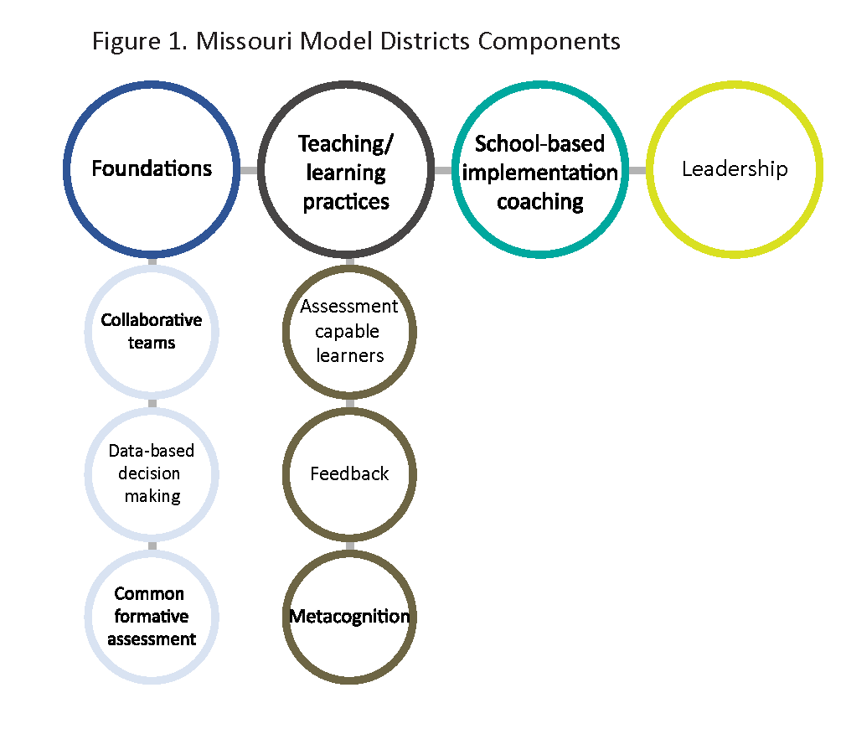
Key Components of Missouri Model Districts
Notes:
To Know/To Say: When we explored the MMD Blueprint at the MMD Summit in June, we examined a framework for effective educational systems (pp. 7, 8). This framework is based on the work of Dr. John Hattie, Visible Learning, and the Moving Your Numbers research. Key Components of the MMD framework are foundational practices (CT, DBDM, CFA), 3 selected ETLP based on effect size high impact on student learning (ACL/Feedback, Metacognition), and two support areas of SBIC and Leadership. Figure one represents each of these key components as a conceptual piece. In the process of systems change, each piece interacts dynamically, and differently, for the setting and situation. So, what are some of our materials and tools for MMD that help us understand, explain, organize, and focus these components? Yesterday, we discussed revisions to the SBIC learning package including the practice profile as a support. We also navigated the DESE Virtual Platform and used self-assessment practice profiles for coaching scenarios in ACL, CT, and CFA.

Slide 6
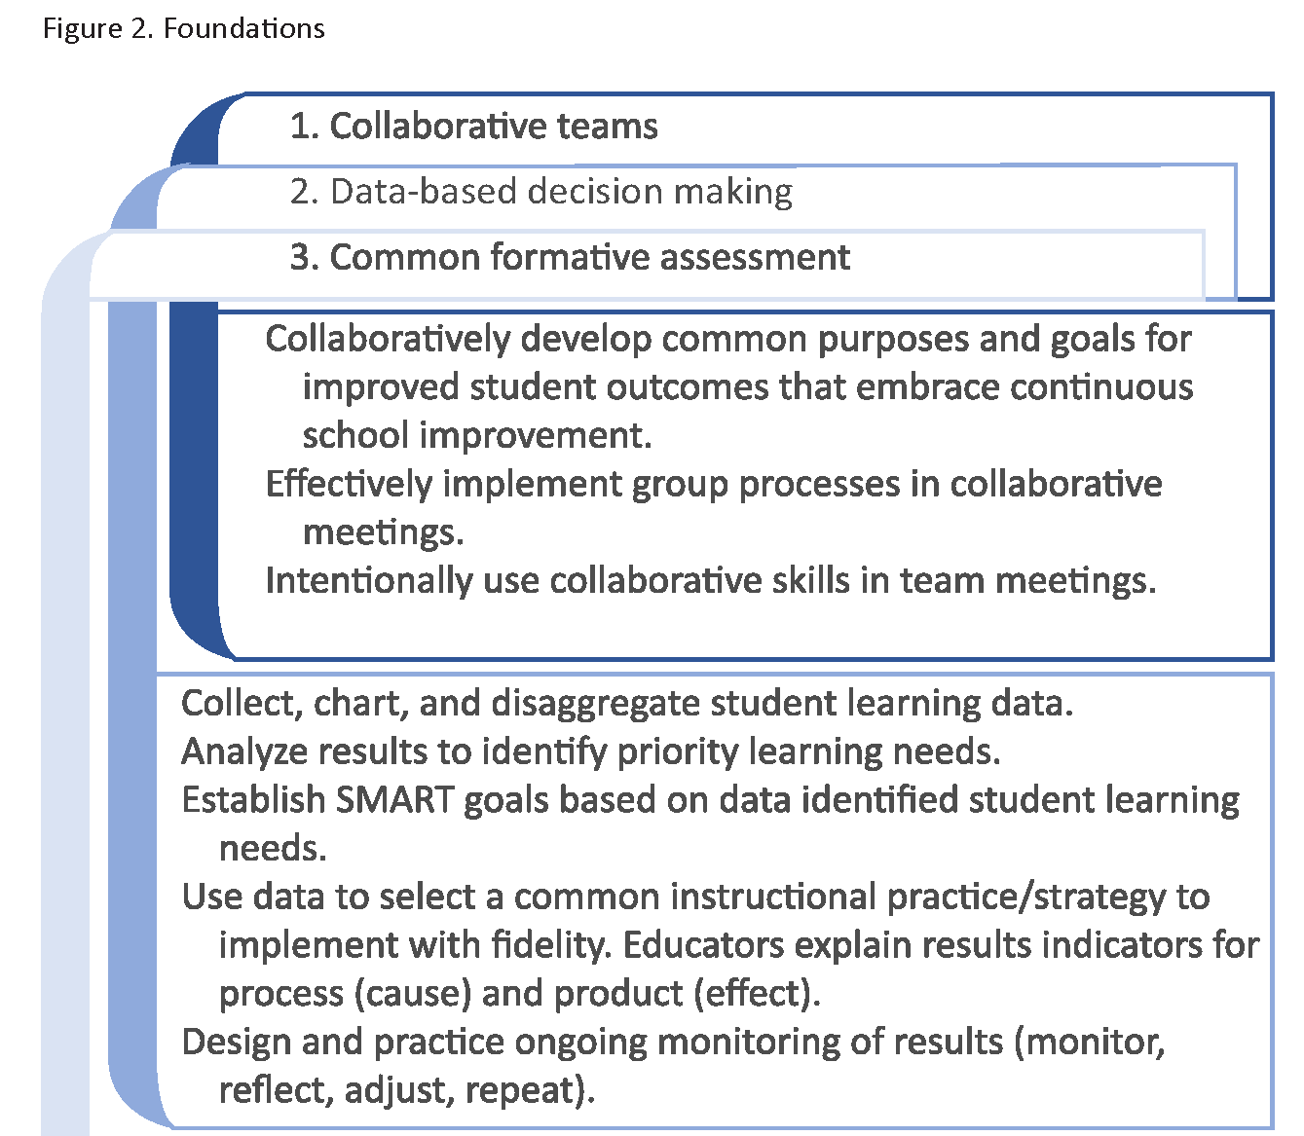
Putting the Foundations into Place
Notes:
To Know/To Say/To Do: Figure 2. Foundations is shown in its entirety on page 12 of the MMD Blueprint. This overlapping cascade describes and represents the relationships among the foundations. In your Blueprint, read the paragraph on page 11 under the heading, Putting the Foundations into place, and the note at the bottom of page 11. Underline references to CT, circle references to DBDM, and highlight references to CFA. When you have finished, write a statement that describes your marking of the paragraph. Share your marked paragraph and your statement with a partner. Presenter will ask for a couple volunteers to share with the entire group.

Slide 7
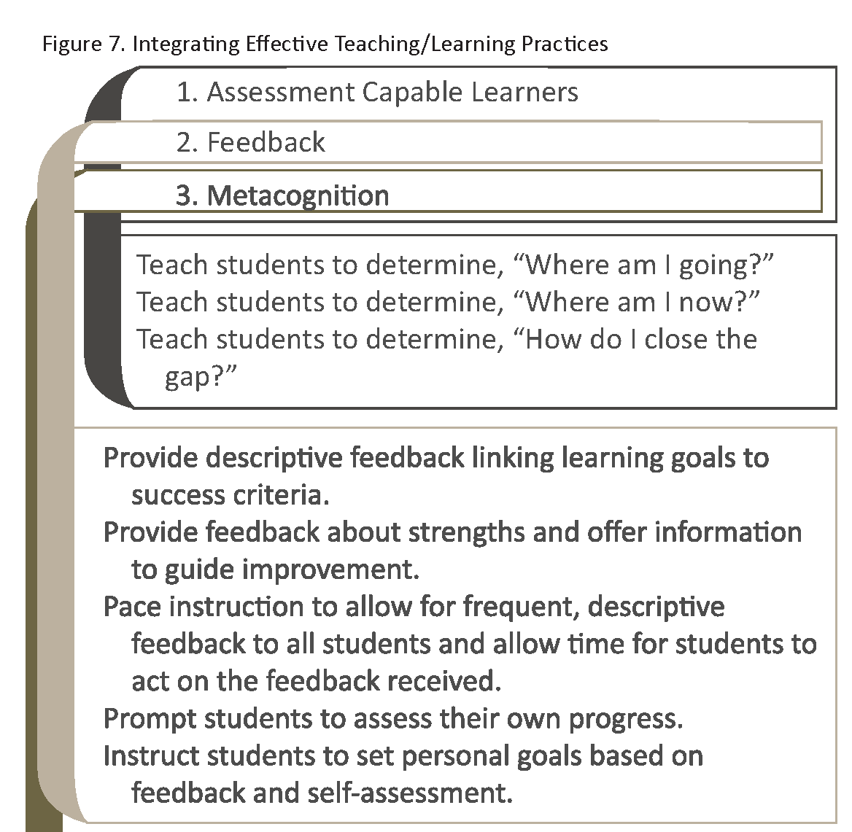
Integrating Effective Teaching/Learning Practices
Notes:
To Know/To Say: Figure 7. Integrating Effective Teaching/Learning Practices is shown in its entirety on page 19 of the MMD Blueprint. These three effective teaching and learning practices were selected as the focus for MMD, based on their effect size for student learning as high impact practices. In fact, the learning package for ACL includes Feedback, because of the close interrelationship of the practices. Metacognition also fits into the structure of ACL. None of these practices occur in isolation.

Slide 8
Connecting with Vocabulary
Notes:
To Know/To Say/To Do: One of the important ways we make connections and help those in our MMD districts make connections is through our choice of words. Take a minute and write terms you have heard, read, or use yourself when referring to CT, DBDM, or CFA.
Are these all synonyms? For example, if a district asks to conduct self-assessment on their DATA TEAMS, what are your thoughts and questions? Take a minute to share with a partner.
MMD is not all new practices, but a shared vocabulary is very important. Terms are used throughout the MMD Blueprint, on moedu-sail, and on the DESE Virtual Platform that have specific meanings. The Glossary of Terms, pages 64-70 in the Blueprint, is a vital reference to build shared understanding and provide clear communications for CST’s and districts. Find and read the definitions for CT, DBDM, and CFA in the glossary and see how they compare with the terms you wrote for these foundational practices.

Slide 9
DESE Virtual Platform: https://apps.dese.mo.gov/VLP/app/mycourses/course_content.aspx?cpt=8&l=28&t=66
The What:
What we do in Collaborative Teams is around being intentional in our purpose, focused on high impact instruction, and using data effectively. The “what” ties the foundational pieces together—-Collaborative Teams, Formative Assessment, Data Based Decision Making and then a focus on effective teaching and learning practices.
Collaboration is intentional with a clear purpose and utilizes effective processes. (Collaborative Teams)
Collaboration is focused around the discussion of high impact practices. (Effective teaching and learning practices.)
Collaboration uses data effectively to improve student outcomes. (Data Based Decision Making and Common Formative Assessment.)
Notes:
To Know/To Say/To Do: Demonstrate the navigation on the DESE Virtual Platform to the Collaborative Teams course and page through to the page showing the chart with The Why, The What, and The How. Read and verbally highlight the connections shown of the foundations and ETLP.

Slide 10
Supports: School Based Implementation Coaching and Leadership
Notes:
To Say: Suzy will briefly discuss the relationships of SBIC and Leadership and MO teacher evaluation system components with the foundations and ETLP of MMD. She will introduce the Tetris activity for participants to work in groups (cadres), demonstrating how pieces may fit together differently. Group will spend 15 to 20 minutes on this activity, depending on available time.

Slide 11
TETRIS Bingo
DBDM
?
?
Are
You
Game
CT
To
Make
EFFECTIVE
LEADERSHIP
the
CFA
PRACTICE
Pieces
MMD/
Fit?
SBIC
CST

Slide 12
REFLECTION and QUESTIONS
How will you use one material, tool, or concept from today in your role as an MMD CST member?
Write one lingering question on a post it note and place it on the
doorframe of the room when we take our break.
Notes:
To Know/To Say/To Do: Ask participants to write for themselves one material, tool, or concept they will use and to write and leave a post it note for any questions. We will take a 10 minute break and return to cadre work time.

Slide 13
NEXT STEPS
Cadre work time
Thank you!
Notes:
To Know/To Say/To Do: We’ll apply ways the MMD practices are integrated as we work together during cadre time. Thank you!

