Slide 1
Hidden Slide #1
Presenter notes information
Tools and documents
Helpful suggestions
Notes:
To Know: The Developing Assessment Capable Learners (ACL) learning package is organized in four parts. The first PowerPoint contains the ACL Overview. ACL, Part 1 contains the first question, “Where am I going?” and strategies 1, 2. Strategy 1 focuses on providing clear and understandable vision of the learning target. Strategy 2 uses examples and models of strong and weak work. The remaining two PowerPoints address the second question, “Where am I now?” and strategies 3, 4 and the third question, “How can I close the gap?” and strategies 5, 6, 7.
The CW Content Fidelity Checklist aligned to each PowerPoint includes all critical items for a training session. The CW HQPD Training Checklist and Coaching Checklist contain process elements to be used as guidance when designing, revising, or coaching high quality professional development.
Important notes:
A script of presenter notes is included in the PowerPoint. Background information for the presenter is shown as “To Know.” Statements to be shared with participants are shown as “To Say.” In some instances, the “To Know/To Say” are the same material. For fidelity of content and consistency among presenters, the “To Say” information should be presented with minimal paraphrasing. The presenter notes also include “To Do” prompts and cues for “Handouts”.
A presenter may add slides to supplement the content. For example, a slide of essential questions may be added since only objectives have been included.
A presenter may choose to differentiate a presentation to meet the needs of the participants. For example, another form may be substituted for the Next Steps template if the district or building already uses a similar form or protocol.
Additional activities, examples, videos, etc. are being developed. A presenter may interchange the additional material for the corresponding PowerPoint content.
An Implementation Fidelity Checklist is available for frequent monitoring by a teacher or observer.
A print Practice Profile and an electronic Self-Assessment Practice Profile (SAPP) tool are available for use by individuals, teams, or schools for periodic self-assessment and monitoring of implementation of practice or to identify training or coaching needs.
The presenter should download onto a hard drive or a flash drive any video intended for use in a training. The links shown on slides may not be able to be accessed online at the school sites.
Breaks should be inserted at the discretion of the presenter based on the needs of participants.

Slide 2
Hidden Slide #2
Supplies needed:
Placemat size paper
Post-it-notes
Variety of pencils, pens, markers, colored pens
Notes:
To Know: These supplies are needed for Developing Assessment Capable Learners, Part 1.

Slide 3
Hidden Slide #3
Handouts needed:
  Pre-reading, Chappuis (2005) Helping Students Understand Assessment
  Where am I Going?
  Learning Targets
  Rubric Template
  Using Strong and Weak Work
  What Do You Already Do? Strategies 1 and 2
Handouts used in all ACL presentations:
  ACL infographic
  Teacher Strategies for Developing Assessment Capable Learners
  Developing Assessment Capable Learners Practice Profile
  Next Steps: Action = Results
Notes:
Handouts: Handouts are available on MOEDUSAIL.
Reference: Chappuis, J. (2005). Helping students understand assessment. Educational Leadership, 63(3).

Slide 4
Pre-Reading
Helping Students Understand Assessment
by Jan Chappuis (2005)
Guiding Questions:
1. Describe the findings in those schools that used formative assessment and reported significant student gains.
2. What are the three overarching questions that students must be able to answer?
3. Explain the seven strategies that teachers must implement to enable students to answer the three questions.
(Chappuis, 2005)
Notes:
To Do: Send the pre-reading out ahead of the workshop.
Ask participants to highlight five key ideas, revelations or questions from the article.
The three guiding questions can be discussed at the beginning of the training.
Handout: Helping Students Understand Assessment
Reference: Chappuis, J. (2005). Helping students understand assessment. Educational Leadership, 63(3).

Slide 5

Developing Assessment Capable Learners
Part 1:
Where Am I Going?
Notes:
To Know/To Say: Good morning/afternoon! We will begin in _____ minutes.
To Do: Greet participants.

Slide 6
Acknowledgements
Special thanks to all contributors to the development and revision of this module.
The original collection of learning packages was rolled-out for use by Regional Professional Development Center (RPDC) Consultants in July 2013 after being developed by a team of content experts. The collection of learning packages was developed through efforts funded by the Missouri State Personnel Development Grant (SPDG). The following individual/groups are thanked immensely for their hard work in developing this package.
Content Development and Revision Support
UMKC Institute for Human Development
Ronda Jenson, Director Stefanie Lindsay
Arden Day Carla Williams
Jodi Arnold
SPDG Management Team
Notes:
To Know/To Say: Special thanks to all contributors to the development and revision of this module.

Slide 7
Initial Content Development Team, 2013
Mary Richter, Team Leader, MO SW-PBS Ginger Henry, DESE
Winona Anderson, South Central RPDC Amy King, Kansas City RPDC
Julie Blaine, Central RPDC Debbie Litner, Southeast RPDC
Deb Childs, MO SW-PBS Jana Loge, Southwest RPDC
Janet Crafton, South Central RDPC Kris Luginbill, Southwest RPDC
Susan Feeback, Central RPDC Robert Rethemeyer, Central RPDC
Diane Feeley, MO SW-PBS Patty Wilmes, Northwest RPDC
Doug Hatridge, Central RPDC Liz Condray, South Central RPDC (Enhancent, ‘14)
2016 Revision Team
Nancy Steele, Facilitator, NE SIS Alan Bancroft, C RPDC
Beverly Colombo, StL RPDC Ginger Henry, DESE
Bev Kohzadi, C RPDC Stephanie Kuper, SE RPDC
Lori Ladwig, NE RPDC Sarah Spence, C SIS
Terri Steffes, Hook Center
Notes:
To Know/To Say: Thank the contributors.

Slide 8

Opening & Introductions
Notes:
Purpose: Provide an overview of the day, including reviewing learner objectives, outcomes, and essential questions
Content:
Universal slides explaining; Organization of learning packages, Infographic, Hattie’s barometer
Missouri Teacher Standards
Session at-a-Glance
Learning Targets
Essential questions
Norms
To Know/To Say: Welcome to Developing Assessment Capable Learners, Part 1: Where Am I Going?
The introductions may be formal or informal depending on how well you know the group. Trainers should use whatever process is comfortable for introductions. I am/we are _______________ (provide some background about trainers.) Please introduce yourself to the group (name, district, position.)
To Do: (optional) Consultant develop an ice-breaker or introductory activity.

Slide 9
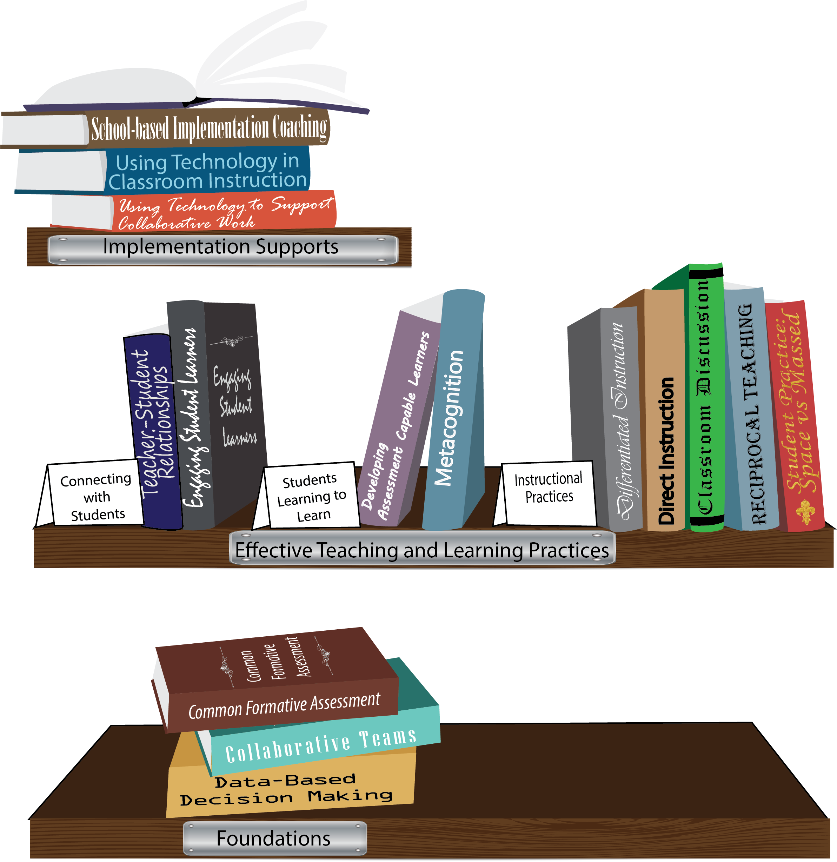
Notes:
To Know/To Say: Missouri’s professional development learning packages are organized in three categories: Foundations, Effective Teaching & Learning Practices, and Implementation Supports. All schools begin their professional development journey with the Foundations, as these learning packages provide foundation knowledge in three key areas: Collaborative Teams, Data-based Decision-making, and Common Formative Assessment. Effective Teaching & Learning Practices encompass research-based instructional practices for deepened learning. These learning packages address ways of connecting with students, ways of helping students learn how to learn, and feature specific instruction practices. Implementation Supports are learning packages designed to help school staff support and enhance the Implementation of Effective Teaching & Learning Practices through using technology and peer coaching supports.
To Do: Explain how the graphic depicts professional development in Missouri.
To Know/To Say: Developing Assessment Capable Learners, an Effective Teaching & Learning Practice, is divided into an overview and three parts.

Slide 10

Developing
Assessment Capable Learners
1. Where Am I Going?
2. Where Am I Now?
3. How Can I Close the Gap?
Assessment Capable Learners
can identify:
Notes:
To Know/To Say: Developing Assessment Capable Learners (ACL) focuses on the three questions that students can identify: Where am I going? Where am I now? How can I close the gap? Today we will look at ACL Part 1 which addresses the first question.

Slide 11
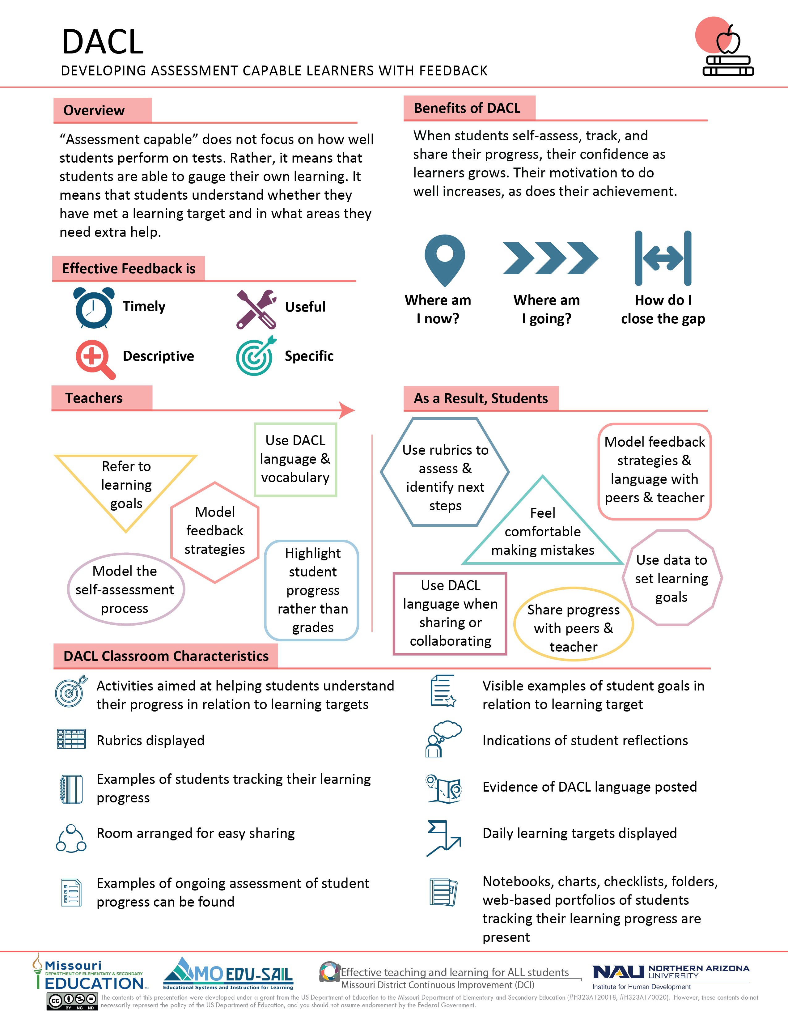
Notes:
To Know/To Say: The ACL infographic summarizes key content from the learning package.
Handout: Developing Assessment Capable Learners
References: Chappuis, J. 2015. Seven strategies of assessment for learning, 2e. Upper Saddle River, NJ: Pearson Education.
Hattie, J. (2015). Hattie Ranking: 195 Influences And Effect Sizes Related to Student Achievement. Visible Learning. Retrieved from https://visible-learning.org/hattie-ranking-influences-effect-sizes-learning-achievement/.

Slide 12
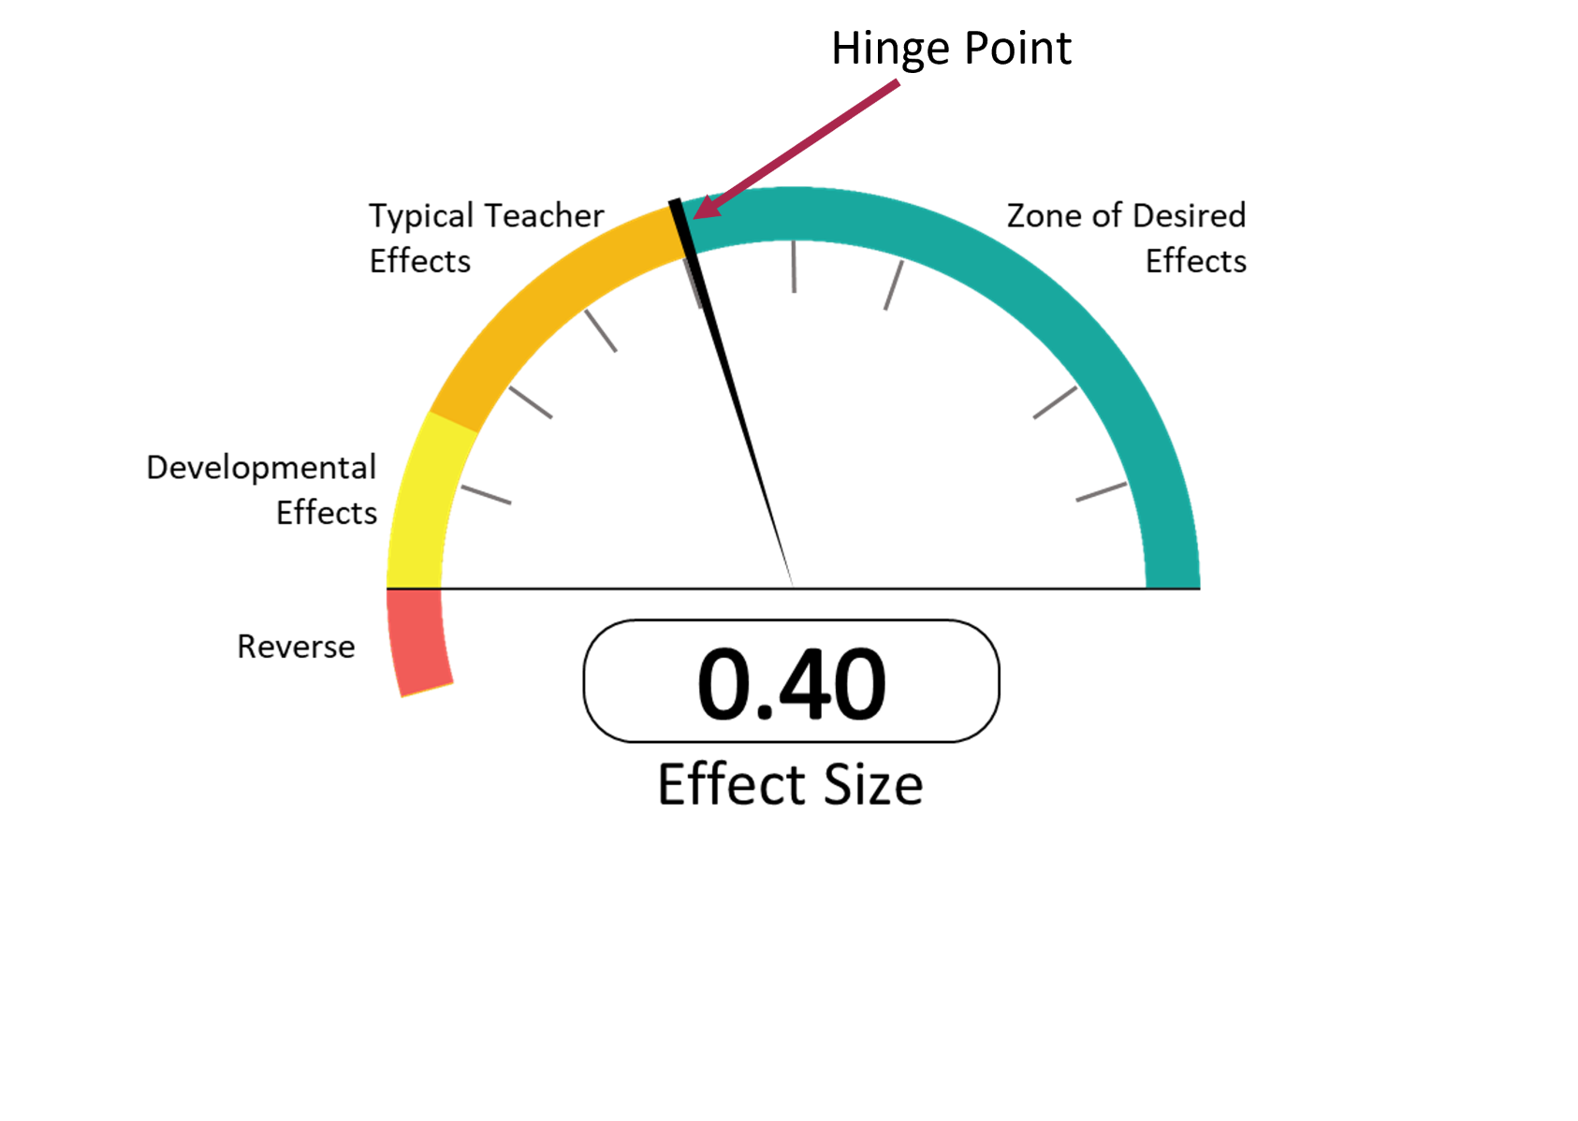
Hattie’s “Barometer of Influence”
Hattie (2015)
Notes:
To Know: EFFECT SIZE
“An effect size is a useful method for comparing results on different measures (such as standardized, teacher-made tests, student work), or over time, or between groups, on a scale that allows multiple comparisons independent of the original test scoring (for example, marked out of 10, or 100), across content , and over time. This independent scale is one of the major attractions for using effect sizes, because it allows relative comparisons about various influences on student achievement.” (Hattie, 2012)
To Know/To Say: John Hattie’s 2009 book, Visible Learning, was based on more than 800 meta-analyses of 50,000 research articles, about 150,000 effect sizes, and about 240 million students. Hattie’s new research (2015) has updated effect sizes for the effective teaching and learning practices.
Effect size is a standard measure that can be calculated from any number of statistical outputs. (Biddix, 2009)
Perhaps the most significant discovery from evidence was almost any intervention can stake a claim to making a difference to student learning.
Any effect above zero means that achievement has been raised by the intervention. The average effect size is 0.40; there are just as many influences on achievement above the average as there are below the average.
For any particular intervention to be considered worthwhile, it needs to show an improvement in student learning of at least an average gain – that is, an effect size of at least 0.40, referred to as the hinge-point for identifying what is and what is not effective.
Half of the influences on achievement are above this hinge-point. This is a real-world, actual finding and not an aspiration claim. That means that about half of that we do to all students has an effect of greater than 0.4 or greater, while half are in classes that get less than the 0.4 effect. (Hattie, 2012)
Hattie’s Barometer of Influence represents a summary of the effect size from the studies that were reviewed. The average effect size, 0.40, may be viewed as a typical one year of growth in student learning. Missouri’s Collaborative Work has identified from Hattie’s research Effective Teaching and Learning Practices which are in the high rank of desired effects for student learning outcomes.
To Do: Explain Hattie’s Barometer of Influence.
References:
Biddix, P. (2009, July). Effect Size. Retrieved from https://researchrundowns.wordpress.com/quantitative-methods/effect-size/. Hattie, J. (2009). Visible learning: A synthesis of over 800 meta-analyses relating to achievement. New York, NY: Routledge.
Hattie, J. (2009). Visible learning: A synthesis of over 800 meta-analyses relating to achievement. New York, NY: Routledge.
Hattie, J., Masters, D., & Birch, K. (2015). Visible learning into action: International case studies of impact. Routledge.

Slide 13
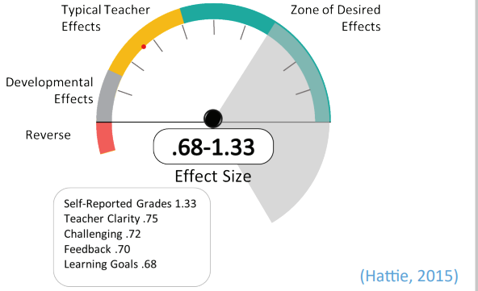
Assessment Capable Learners
Notes:
To Know/To Say: ACL are at the top of the ‘teaching’ domain! ACL has a 1.33 Effect Size.
So, how do you develop Assessment Capable Learners?
Today is an overview to enhance your understanding and explore how to help students become ACL.
To become assessment capable, students need to use high yield practices, or those that have an effect size greater than .40. The higher the effect size, the more impact on student achievement. The following high yield practices that contribute to the development of assessment capable learners are
Self-Reported Grades- effect size 1.33
Teacher Clarity- effect size .75
Challenging Tasks- effect size .72
Feedback- effect size .70
Learning Goals- effect size .68
Reference: Hattie, J. (2015). Hattie Ranking: 195 Influences And Effect Sizes Related to Student Achievement. Visible Learning. Retrieved from https://visible-learning.org/hattie-ranking-influences-effect-sizes-learning-achievement

Slide 14
Missouri Teacher Standards
Standard 1: Content knowledge aligned with appropriate instruction.
Standard 2: Student Learning, Growth and Development
Standard 6: Effective Communication
Standard 7: Student Assessment and Data Analysis
(Missouri Department of Elementary and Secondary Education, 2013)
Notes:
To Know/To Say: ACL aligns with Missouri Teacher Standards.
Standard #1: Content Knowledge and Perspectives Aligned with Appropriate Instruction: The teacher understands the central concepts, structures and tools of inquiry of the discipline(s) and creates learning experiences that make these aspects of subject matter meaningful and engaging for all students.
Standard #2: Understanding and Encouraging Student Learning, Growth and Development: The teacher understands how students learn, develop and differ in their approaches to learning. The teacher provides learning opportunities that are adapted to diverse learners and support the intellectual, social and personal development of all students.
Standard #6: Offering effective communication, especially in the form of feedback to students: The teacher models effective verbal, nonverbal, and media communication techniques with students, colleagues and families to foster active inquiry, collaboration, and supportive interaction in the classroom.
Standard #7: Use of Student Assessment Data to Analyze and Modify Instruction: The teacher understands and uses formative and summative assessment strategies to assess the learner’s progress, uses assessment data to plan ongoing instruction, monitors the performance of each student, and devises instruction to enable students to grow and develop.
Reference: Missouri Department of Elementary and Secondary Education (MO DESE), (2013). Teacher Standards: Missouri's educator evaluation system. Retrieved from: http://dese.mo.gov/sites/default/files/TeacherStandards.pdf.

Slide 15
Session-at-a-Glance
Discover strategies for teachers and students
  Where Am I Going?
    Provide a clear vision of the learning target
    Use rubrics
    Analyze examples of strong and weak work
Notes:
To Know/To Say: In this session, we will focus on the first question Assessment Capable Learners should be able to answer: “Where am I going?” in reference to strategies 1 and 2.
At the end of the training, action planning is provided for teams to determine their next steps. Included are examples for embedding ACL in Professional Practice.

Slide 16
Learning Targets
I can implement strategies that maximize the impact of providing clear and understandable learning targets.
I can identify components of a successful rubric to help students identify success criteria.
I can implement strategies that maximize the impact of providing examples of strong and weak work to students.
I can use student goal setting as a way to move forward in learning.
Notes:
To Know/To Do: Go over the learning targets listed.
To Say: As a learner, today you will develop an understanding of clear learning targets, the importance of rubrics, how to utilize strong and weak work, and goal setting. You will learn to teach students to assess with a focus on learning targets.
When teachers return to school, following training, the expectation is to utilize the components of ACL in their classrooms.

Slide 17

Essential Questions
Why is it essential to provide a clear picture of “where am I going” to students?
How can I clearly convey the learning targets and assessment criteria?
How can we use a combination of strategies to promote assessment capable learners?
Notes:
To Know/To Say: Let’s begin the work of learning a strategic and consistent understanding of what ACL is with these essential questions in mind.

Slide 18
Norms
Begin and end on time.
Be an engaged participant.
Be an active listener—open to new ideas.
Use notes for side bar conversations.
Use electronics respectfully.
Notes:
To Know/To Do: Consider including a check mid-way through trainings to assess a norm or norms. The presenter may want to use norms printed on agenda handouts, in addition to or in place of presentation slides, so the norms are always available in print for participants. Norms may be added to address specific school needs. Some schools already have established norms for all PD. In that case, adapt to their norms.

Slide 19
Developing Assessment Capable Learners
Part 1:
Where Am I Going?
Notes:
To Know/To Say: Today’s workshop focuses on the first question that assessment capable learners should be able to answer: “Where Am I Going?”
The next several slides are an overview of how the seven strategies align within the three questions.

Slide 20

Pre-Reading Discussion
Helping Students Understand Assessment
Guiding Questions:
1. Describe the findings in those schools that used formative assessment and reported significant student gains.
2. What are the three overarching questions that students must be able to answer?
3. Explain the seven strategies that teachers must implement to enable students to answer the three questions.
(Chappuis, 2005)
Notes:
To Do: Send the pre-reading out ahead of the workshop.
Ask participants to highlight five key ideas, revelations or questions from the article.
The three guiding questions can be discussed at the beginning of the training.
To Say: Ask participants to discuss the three guiding questions and five key ideas from the article with a partner or with others at their tables. Then share out.
Handout: Helping Students Understand Assessment
Reference: Chappuis, J. (2005). Helping students understand assessment. Educational Leadership, 63(3).

Slide 21
Teacher Strategies for Developing Assessment Capable Learners
To help students know where they are going, I need to:
  Provide clear and understandable vision of the learning target.
  Use examples and models of strong and weak work.
To help students know where they are now, I need to:
  Offer regular descriptive feedback.
  Teach students to self-assess and set goals.
To help students know how to close the gap, I need to:
  Use evidence of student learning needs to determine next steps in teaching.
  Design focused instruction, followed by practice with feedback.
  Provide students opportunities to track, reflect on, and share their learning progress.
(Chappuis, 2015)
Notes:
To Know: A handout of this slide was distributed in the ACL Overview.
To Say: Jan Chappuis has organized seven teacher strategies within the three ACL questions.
Handout: Teacher Strategies for Developing Assessment Capable Learners (This is a participant copy of these 7 strategies aligned with the three questions.)
Reference: Chappuis, J. (2015). Seven strategies of assessment for learning, 2e. Upper Saddle River, NJ: Pearson Education.

Slide 22
Questions Students Need to Answer
Where Am I Going?
  Provide clear and understandable vision of the learning target.
  Use examples and models of strong and weak work.
Where Am I Now?
  Offer regular descriptive feedback.
  Teach students to self-assess and goal set each day.
How Can I Close the Gap/
  Use evidence of student learning needs to determine next steps in teaching.
  Design focused instruction, followed by practice.
  Provide students opportunities to track, reflect on, and share their learning progress.
(Chappuis, 2009)
Notes:
To Know/To Say: These questions and strategies are written in student friendly language.
Reference: Adapted from: Chappuis, J. (2009). Seven strategies of assessment for learning. Allyn & Bacon.

Slide 23
Use of These Strategies Is Not Linear
Strategies 1 through 3, provide a clear picture of where we are going.
Strategy 4 and Strategy 7, explain where we want our students to arrive.
Strategies 5 and 6, can happen at any time and often use Strategies 1-4 as part of the lessons.
(Chappuis, 2015)
Notes:
To Know/To Say: The Seven Strategies of Assessment for Learning comes from the work of Jan Chappuis. While the seven strategies seem like a continuum of when to use each strategy, the strategies can actually be used at various points of instruction.
Reference: Chappuis, J. 2015. Seven strategies of assessment for learning, 2e. Upper Saddle River, NJ: Pearson Education.

Slide 24
“Indispensable Conditions” for Improvement in Learning
The student:
  comes to hold a concept of quality roughly similar to that of the teacher. (Where am I going?)
  is able to monitor continuously the quality of work produced during the act of production. (Where am I now?)
  has a repertoire of alternative learning strategies to employ when faced with incomplete mastery. (How can I close the gap?)
(Sadler, 1989)
Notes:
To Know/To Say: Sadler’s “indispensable conditions” for improving learning aligned to the three questions.
Reference: Sadler, D. R. (1989). Formative assessment and the design of instructional systems. Instructional science, 18(2), 119-144.

Slide 25
Today’s Focus:
Where Am I Going?
Strategy 1: How do you (or could you) provide students with a clear and understandable vision of the learning targets?
Strategy 2: What kind of examples and models of strong and weak work do you (or could you) use with students?
Notes:
To Do/To Know: Give participants time to write a brief reflection. This reflection by participants helps them identify “where am I now?” on this topic and can be used to see growth at the end of the training.

Slide 26
Where Am I Going?
To help students know where they are going, I need to:
Provide clear and understandable vision of the learning target.
Use examples and models of strong and weak work.
Pair up with another person.
One person read about strategy 1.
One person read about strategy 2.
Both readers highlight important points from the reading.
Come together and share information about your strategy.
(Chappuis, 2015)
Notes:
To Do: Distribute the Where am I Going? handout and follow the directions on the slide.
Handout: “Where Am I Going?”
Reference: “Seven Strategies of Assessment for Learning” is excerpted from Chappuis, J. (2015). Seven strategies of assessment for learning, 2e. Upper Saddle River, NJ: Pearson Education, pp. 11‐14.

Slide 27
Unpacking the Topic
Where Am I Going?
Strategy 1: Provide clear and understandable vision of the learning target.
Notes:
To Know/To Say: We will begin with Strategy 1: Provide clear and understandable vision of the learning target.

Slide 28
Learning Targets
Number off by three.
Independently read assigned section of text and highlight key points.
Form like-numbered groups to discuss key points of assigned section and make notes in your handout.
Rejoin your team and discuss your new learning.
(Moss, 2012)
Notes:
To Do/To Say: Ask participants to number everyone off by threes.
After distributing the handout, participants follow the directions listed on the screen.
1’s get together and read “Learning Targets” page 1 – “Learning Targets, Student Look-Fors, Performance of Understanding, Formative Learning Cycle”
2’s get together and read “Learning Targets” page 2 – “The Role of Learning Targets and Success Criteria “Student Look-Fors”
3’s get together and read “Learning Targets” page 3 – “Building a Learning Target”
Each numbered group will determine the most important points to share with their original teams. After the information has been shared and discussed, everyone will read the elementary, middle school, and high school examples on the handout (pages 4, 5, 6).
Handout: Learning Targets
Reference: Moss, Connie M. (2012, July 17). Learning Targets: Helping Students Aim for Understanding In Today’s Lesson [webinar]. In ASCD webinar series. Retrieved from http://dmfa3ba8wpnh6.cloudfront.net/00/000147887cd534a7df9b7cbd120009/file/122463-LearningTargetsResource.pdf

Slide 29
Strategy 1: Provide Clear Target
Provide a clear and understandable vision of the learning target:
Write targets that are conversational in tone.
Extract the essence of the learning.
Use “I can ____,” or “I know ____” statements.
Consider the guiding questions you want students to be able to answer.
Invite students into the learning process.
(Chappuis, 2009)
Notes:
To Say: Providing a clear target is the first strategy.
Reference: Adapted from: Chappuis, J. (2009). Seven strategies of assessment for learning. Allyn & Bacon.

Slide 30
Language Arts Example
4.R.2.A
Read, infer, analyze, and draw conclusions to:
  summarize and sequence the events/plot, and explain how past events impact future events, and identify the theme
  describe the personality traits of characters from thoughts/words/actions
  I can describe events in a story and put them in order. Then I can explain how events early in the story effect later events. I can identify the theme of the story in relation to these events.
  I can use descriptive details from a character’s thoughts, words, and actions to describe a characters in a story.
(Missouri Department of Elementary and Secondary Education, 2016)
Notes:
To Know/To Say/To Do: This example is from the Missouri Learning Standards, adopted in April 2016. This is a 4th grade ELA, reading standard. The first two (a & b) have been turned into “I can” statements. The next slide has the standard’s C, D, and E.
Reference: Missouri Department of Elementary and Secondary Education (2016, Spring). K-5 ELA Missouri Learning Standards: Grade Level Expansions. Retrieved from https://dese.mo.gov/sites/default/files/curr-mls-standards-ela-k-5-sboe-2016.pdf.

Slide 31
Language Arts Example
4.R.2.A
Read, infer, analyze, and draw conclusions to:
  describe the interaction of characters, including relationships and how they change
  compare and contrast the adventures or exploits of characters and their roles
  compare and contrast the point of view from which stories are narrated, explain whether the narrator or speaker of a story is first or third person
(Missouri Department of Elementary and Secondary Education, 2016)
Notes:
To Know/To Say/To Do: This example is from the Missouri Learning Standards, adopted in April 2016. This is a 4th grade ELA, reading standard. Give participants time to create “I Can” statements for C, D, and E.
Reference: Missouri Department of Elementary and Secondary Education (2016, Spring). K-5 ELA Missouri Learning Standards: Grade Level Expansions. Retrieved from https://dese.mo.gov/sites/default/files/curr-mls-standards-ela-k-5-sboe-2016.pdf.

Slide 32
Mathematics Example
3rd Grade – 3.NF.A.6
Compare two fractions with the same numerator or denominator using the symbols >, =, or <,
and justify the solution.
The student will compare two fractions with the same denominator using >, = or <.
The student will compare two fractions with the same numerator using >, = or <.
I can compare two fractions with the same denominator using >, =, < symbols, and can explain my thinking.
I can compare two fractions with the same numerator using the symbols >, =, or < and can justify my thinking.
(Missouri Department of Elementary and Secondary Education, 2016)
Notes:
To Know/To Say/To Do: This example is from the Missouri Learning Standards, adopted in April 2016. This is a 3rd grade Mathematics, Number and Operations, Fractions standard. This was unwrapped by participants working on the MO Item Specifications. “I can” statements have been provided for the first two parts of the standard. On the next slide, participants will have an opportunity to practice writing “I can” statements for the remaining parts of this standard.
Reference: Missouri Department of Elementary and Secondary Education (2016, Spring). 6-12 Mathematics Grade Level Expectations. Retrieved from https://dese.mo.gov/sites/default/files/curr-mls-standards-math-6-12-sboe-2016.pdf.

Slide 33
Mathematics Example
3rd Grade – 3.NF.A.6
Compare two fractions with the same numerator or denominator using the symbols >, =, or <,
and justify the solution.
The student will use number lines or visual models to illustrate why two fractions with the same numerator are >, = or < each other.
The student will use number lines or visual models to illustrate why two fractions with the same denominator are >, = or < each other.
(Missouri Department of Elementary and Secondary Education, 2016)
Notes:
To Know/To Say/To Do: This example is from the Missouri Learning Standards, adopted in April 2016. This is the second half of this 3rd grade Mathematics, Relationships and Algebraic Thinking standard. This was unwrapped by participants working on the MO Item Specifications. Give participants time to write “I can” statements for the two parts shown on the slide.
Reference: Missouri Department of Elementary and Secondary Education (2016, Spring). 6-12 Mathematics Grade Level Expectations. Retrieved from https://dese.mo.gov/sites/default/files/curr-mls-standards-math-6-12-sboe-2016.pdf.

Slide 34
Informing the students of the learning target by telling them what it is or by writing it on the board is not sufficient.
Most "lesson objectives" are written in language for teachers.
Discussion about what a lesson objective means can help students express the objective in their own words and clarify the concept in their own minds.
(Brookhart & Moss, 2009)
Notes:
To Know/To Say: This slide helps teachers take the discussion from surface level understanding to a deeper discussion. Ask participants to discuss at their table strategies for getting students to interact with learning targets.
Some ideas to share:
Ask students to write down the daily learning objective in a student planner, then rank themselves daily 1-5 stars on how confident they are in that skill or knowledge.
Lead a discussion about the daily learning target, asking students to make connections to previously learned skills or knowledge.
(add your own suggestions)
Reference: Brookhart, C. M., & Moss, S. M. (2009). Advancing Formative Assessment in Every Classroom. ASCD. Retrieved from http://www.ascd.org/publications/books/109031/chapters/Leveling-the-Playing-Field@-Sharing-Learning-Targets-and-Criteria-for-Success.aspx

Slide 35
Unpacking the Topic
Where Am I Going?
Extending Strategy 1: Using Rubrics to Determine Success Criteria.
Notes:
To Know/To Say: Strategy 1 can be extended by using rubrics to determine success criteria.

Slide 36
Draw A Park
Notes:
To Know: Each participant needs one sheet of blank paper.
To Say/To Do:
You are a student in a classroom and have been given a blank piece of paper. The tools needed to complete this task are on your table. You may use a pencil, pen, markers, or colored pencils. Your task is to “Draw A Park”. You may begin.
The teacher does not give a time limit, description of the type of park, or any information about expectations to complete this task successfully.
After a random time (3 minutes) tell the students to put down their pencils.
To Know: Continue to the next slide for further instructions.

Slide 37
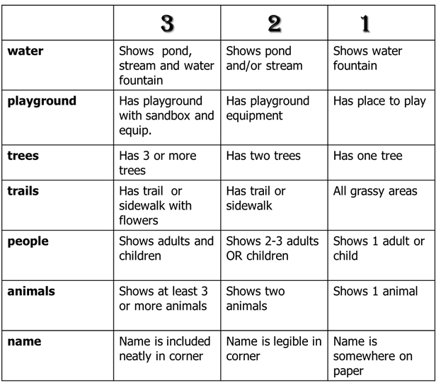
Notes:
To Say/To Do (continued from previous slide):
4. Using the rubric, determine how successful you are at “Drawing A Park”.
5. Discuss what should have been done to help the students complete this task at a proficient level.
To Know: The teacher should have given specific information about the expectations to complete this task successfully. Expectations might include a description of the type of park to draw or a time limit for completing the drawing.

Slide 38
What is a Rubric?
A criterion-based tool used to communicate expectations of proficiency and to assess a student’s demonstrated level of performance, understanding, or knowledge around the defined criteria.
(Allen, 2014)
Notes:
To Do: Share the definition of a rubric.
Reference: Adapted from Allen, M. J. (2014, March 7). Using rubrics to grade, assess and Improve student learning. Presented at Strengthening our roots: Quality, opportunity, & success professional development day, Miami-Dade College. Retrieved from http://www.mdc.edu/sailearn/documents/4.1%20Rubric%20Workshop%20Handout-Mary%20Allen.pdf.

Slide 39
Rubric development is a process.
There is always room for improvement.
Notes:
To Know: This slide transitions to developing or creating rubrics.

Slide 40
Components of a Rubric
Criteria, categories of quality as defined by the learning standard(s) and the task instructions
Performance level headings (may be assigned a numerical value)
Descriptors provide attributes of the product or performance for each criterion at each level
(Arter & McTighe, 2000)
(Mueller, 2016)
Notes:
To Do: Discuss the components of a rubric.
References: Arter, J., & McTighe, J. (2000). Scoring rubrics in the classroom: Using performance criteria for assessing and improving student performance. Corwin Press.
Mueller, J. (2016). Authentic assessment toolbox: What is a portfolio? Retrieved from http://jfmueller.faculty.noctrl.edu/toolbox/portfolios.htm.

Slide 41
Suggested Guidelines for
Creating Rubrics
List performance levels from the highest to the lowest.
Write descriptors in student-friendly language.
Use specific learning standards.
Rubric descriptors should provide specific descriptive feedback to student.
(Brookhart, 2013)
Notes:
To Know: This is an animated slide.
To Know/To Say: Reminders about guidelines for rubrics from previous sessions. Ask participants to reflect about their rubrics. Do their rubrics reflect the guidelines?
Reference: Brookhart, S. M. (2013). How to create and use rubrics for formative assessment and grading. Ascd.

Slide 42

Award Winning
Chocolate Chip Cookie
Brainstorm possible qualities of a chocolate chip cookie. (one quality per post-it-note)
Sort the qualities into categories.
As a team, use the categories to determine criteria for an Award Winning Cookie.
Fill in the criteria on the rubric template.
Decide on performance level headings.
Write descriptors for each performance level/criterion beginning with Proficient.
Notes:
To Know: Optional Activity. The presenter may choose to use the ELA example of a good research paper which is on the following slide and hidden.
To Know/To Do/To Say:
Give participants post-it-notes. First have them individually brainstorm and write down all the qualities for a “Blue Ribbon” Chocolate Chip Cookie; one quality per post-it-note.
Individually sort qualities into categories.
As a team, compare each other’s categories and determine the final criteria for judgment of a “Blue Ribbon” Chocolate Chip Cookie.
Determine the performance levels headings.
Write descriptors for each level. Begin with Proficient
Examples of criteria that participants may determine: number/size of chips, texture, color, taste
What is a proficient number of chocolate chips in a cookie?
What is a proficient texture?
What is the proficient color?
What is the proficient taste?
What is the richness/flavor that is proficient?
To Know: In this activity, teachers will begin writing the proficient column first. In a content or core subject, the Standard clarifies what is proficient.
Handout: Rubric Template

Slide 43
Creating a Rubric
Brainstorm possible qualities of a good research paper. (List one quality per sticky note)
Sort the qualities into categories.
As a team, use the categories to determine criteria for your assignment.
Fill in the criteria on the rubric template.
Decide on performance level headings.
Write descriptors for each performance level/criterion beginning with Proficient.
Notes:
To Know: Optional Activity. This is a hidden slide and may be substituted for the Award Winning Chocolate Cookie rubric which is on the preceding slide.
This activity is geared towards middle/secondary ELA, though it could easily be altered to fit any content/grade level.
To Know/To Do/To Say:
Give participants post-it-notes. First have them individually brainstorm
Individually sort qualities into categories.
As a team, compare each other’s categories and determine the final criteria.
Determine the performance levels headings.
Write descriptors for each level. Begin with Proficient
Participants can also view writing samples on achievethecore.org.
To Know: In this activity, teachers will begin writing the proficient column first. In a content or core subject, the Standard clarifies what is proficient.
Handout: Rubric Template

Slide 44
Rubric Reflection
Based on this experience, what are some potential challenges of developing rubrics for your classroom?
From your experience and what you have learned so far, discuss the benefits of using quality rubrics.
Notes:
To Do: Allow participants two minutes to discuss each item. Allow time for sharing to reveal commonality in the room.

Slide 45
“Helpful rubrics offer rich descriptors that clarify for learners the quality sought; poor rubrics amount to no more than saying that ‘Excellent is better than Good’ etc.”
How can quality rubrics help develop
Assessment Capable Learners?
(Wiggins, 2013)
Notes:
To Do: Allow participants time to reflect on this quote and Essential Question: How would a quality rubric develop an assessment capable learners?
Reference: Wiggins, G. (2013, August 9) How To Use A Rubric Without Stifling Creativity [Blogpost]. Carnegie Mellon University, Eberly Center. Retrieved from http://www.teachthought.com/pedagogy/how-to-use-a-rubric-without-stifling-creativity/.

Slide 46

Involving Students in the
Creation of Rubrics
Notes:
To Know/To Say: We are now going to take the idea of using rubrics to foster Assessment Capable Learners a step further, involving students in the process.

Slide 47
Involving Students in the Process
Develop Assessment Criteria with Students
Provide examples of student work.
Engage students in identifying proficiency criteria, using student-friendly language.
Facilitate the development of scoring guides based on the criteria.
Clarify the meaning of the language in the scoring guide.
(Chappuis, 2009)
Notes:
To Know/To Say: Including students in the process may not be where you start, but should be an end goal in developing and using rubrics. This works best after students have had experience in using rubrics..
We must be careful about not pulling rigor out of the standard. Here is an opportunity to pull in academic vocabulary.
When rubrics are used for assessing performance tasks, the rubrics should be used throughout the production of the product/performance. A rubric shouldn’t only be used at the introduction of the assignment.
It’s important to provide samples of student work at different levels, even if that mean you might have to create some yourself.
Reference: Adapted from: Chappuis, J. (2009). Seven strategies of assessment for learning. Allyn & Bacon.

Slide 48
Austin’s Butterfly: Video
http://www.youtube.com/watch?v=hqh1MRWZjms
How could concepts from this video inform the process of rubric development?
What lessons did you learn from this video about the Assessment Capable Learner?
(EL Education, 2016)
Notes:
To Know/To Say: Teachers need to understand that writing rubrics is a process. All of the components of ACL work have a dependent relationship upon each other.
This video is really focused on the purpose and the end results of using quality rubrics in the whole scheme of developing Assessment Capable Learners. The video is meant to “tie everything together.”
Reference: EL Education [username] (2016, October 4). Austin's Butterfly: Models, Critique, and Descriptive Feedback [videofile]. Retrieved from http://www.youtube.com/watch?v=hqh1MRWZjms.

Slide 49
Final Thoughts
Rubrics are a good starting point because they organize the criteria for students into levels of description about various aspects of the work.
You can find out how students comprehend what the descriptive levels of a rubric mean by asking them to state them in their own words.
Students can learn to more precisely identify levels of quality when they see them by looking at examples of work.
Students who can identify quality levels in sample papers are better at self-assessment and at producing desired levels of work themselves.
(Moss & Brookhart, 2009)
Notes:
To Do: Review the final thoughts concerning rubrics.
Reference: Moss, C. M., & Brookhart, S. M. (2009). Chapter 2: Leveling the playing field: sharing learning targets and criteria for success in advancing formative assessment in every classroom: A guide for instructional leaders. ASCD. Retrieved from http://www.ascd.org/publications/books/109031/chapters/Leveling-the-Playing-Field@-Sharing-Learning-Targets-and-Criteria-for-Success.aspx

Slide 50



Resources for Using Technology to Create Rubrics
Notes:
To Know/To Say: There are two web-based tools commonly used to create rubrics. Themespark allows participants to create rubrics based on standards, which Rubistar allows full control of rubric creation.
To Do: (Optional) If time permits, allow participants to explore these two tools and share out benefits/drawbacks of using each. (Internet access is needed).
References: https://themespark.net/
http://rubistar.4teachers.org/index.php

Slide 51
Resources for Further Learning: Rubrics
Websites:
Tools for Writing Rubrics. Activities for Student Generated, Revising Rubrics, and new Rubrics
Create Rubric: 5 Part Series
Book:
How to Create and Use Rubrics for Formative Assessment and Grading, by Susan Brookhart
Articles:
Developing and Using Instructional Rubrics, by Jennifer Turner
Helping Students Understand Assessment, by Jan Chappuis
How to Use a Rubric Without Stifling Creativity, by Grant Wiggins
Notes:
To Know/To Do: This slide is hidden. The additional resources may be shared with the participants for further learning or for coaching.

Slide 52
Unpacking the Topic
Where Am I Going?
Strategy 2: Use examples and models of strong and weak work.
Notes:
To Know/To Say: Strategy 2: Use examples and models of strong and weak work.

Slide 53
Strategy 2: Use Sample Work
Analyze Student Work Together
Provide examples of both strong and weak work to students.
Engage students in analyzing the samples using the scoring guide to determine appropriate and inappropriate responses.
Ask students to justify their analysis.
(Chappuis, 2009)
Notes:
To Do: Introduce strategy 2, Use Sample Work, using the three items.
Reference: Adapted from: Chappuis, J. (2009). Seven strategies of assessment for learning. Allyn & Bacon.

Slide 54
“Informing the students of the learning target by telling them what it is or by writing it on the board is not sufficient.”
Students will understand best what a goal really means when they can see examples of good work.
(Moss & Brookhart, 2009)
Notes:
To Know/To Say: Share strategies for how teachers can analyze student work.
Optional : Can choose to share one of these two videos (included in next four slides)
Option 1: Precision Teaching: Success Criteria and Exemplars (3:04) https://www.youtube.com/watch?v=IiTsPPSqZfQ&t=51s
Video Summary: Students are learning how to write about the inferences they draw in relation to the characters in the texts they are reading. They have collaboratively created learning goals, success criteria and exemplars to guide their writing. These learning tools are posted in the classroom for students to refer to during their writing. Before they work on their individual writing, they will have many opportunities to write with support from their peers and teacher.
Reflective Questions:
1. Exemplars are helpful in clarifying for students exactly what is expected of them in their work. How would you encourage students to use the exemplars during their writing as part of their self-assessment?
2. How might you use exemplars in science or social studies?
3. What caution might you need to consider when using exemplars
Option 2: Unpacking a Learning Target & Discussing Academic Vocabulary (5:18) https://www.youtube.com/watch?v=M6NcjsrPqC8
Video Summary: Sixth-grade students in Jon Exall's class at the Odyssey School in Denver, CO, actively engage in “unpacking” learning targets—including embedded academic vocabulary—in preparation for developing research question for an immigration case study. Learning targets articulate a clear vision of the intended learning as a first step toward achieving success.
Reflective Questions:
1. In what ways does Mr. Exall engage students in unpacking the learning target?
2. How will this process help students be more successful as they move forward in this project?
Reference: Moss, C. M., & Brookhart, S. M. (2009). Chapter 2: Leveling the playing field: sharing learning targets and criteria for success in advancing formative assessment in every classroom: A guide for instructional leaders. ASCD. Retrieved from http://www.ascd.org/publications/books/109031/chapters/Leveling-the-Playing-Field@-Sharing-Learning-Targets-and-Criteria-for-Success.aspx

Slide 55
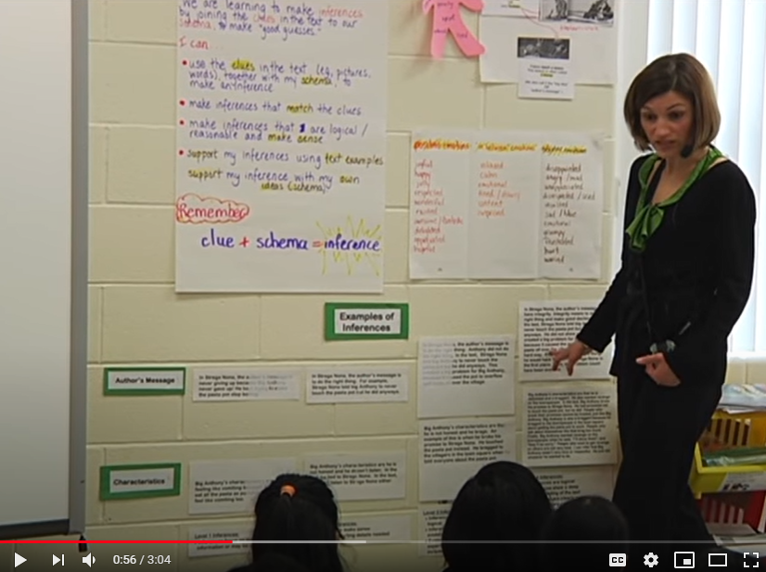
Precision Teaching: Success Criteria and Exemplars
https://www.youtube.com/watch?v=IiTsPPSqZfQ&t=51s
Notes:
Option 1: Precision Teaching: Success Criteria and Exemplars (3:04) https://www.youtube.com/watch?v=IiTsPPSqZfQ&t=51s
Video Summary: Students are learning how to write about the inferences they draw in relation to the characters in the texts they are reading. They have collaboratively created learning goals, success criteria and exemplars to guide their writing. These learning tools are posted in the classroom for students to refer to during their writing. Before they work on their individual writing, they will have many opportunities to write with support from their peers and teacher.
Reflective Questions for discussion on next slide:
1. Exemplars are helpful in clarifying for students exactly what is expected of them in their work. How would you encourage students to use the exemplars during their writing as part of their self-assessment?
2. How might you use exemplars in science or social studies?
3. What caution might you need to consider when using exemplars

Slide 56
Reflective Questions for Discussion
Exemplars are helpful in clarifying for students exactly what is expected of them in their work. How would you encourage students to use the exemplars during their writing as part of their self-assessment?
How might you use exemplars in science or social studies?
What caution might you need to consider when using exemplars?
Notes:
Give participants a short time to process these questions individually, then open up for a table discussion or whole group discussion (if group is small).

Slide 57
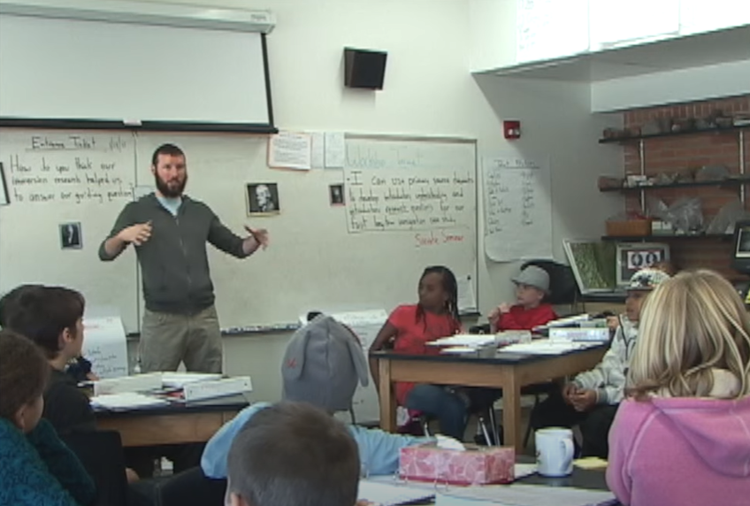
Unpacking a Learning Target and Discussing Academic Vocabulary
https://www.youtube.com/watch?v=M6NcjsrPqC8
Notes:
Option 2: Unpacking a Learning Target & Discussing Academic Vocabulary (5:18) https://www.youtube.com/watch?v=M6NcjsrPqC8
Video Summary: Sixth-grade students in Jon Exall's class at the Odyssey School in Denver, CO, actively engage in “unpacking” learning targets—including embedded academic vocabulary—in preparation for developing research question for an immigration case study. Learning targets articulate a clear vision of the intended learning as a first step toward achieving success.
Reflective Questions for discussion on next slide:
1. In what ways does Mr. Exall engage students in unpacking the learning target?
2. How will this process help students be more successful as they move forward in this project?

Slide 58
Reflective Questions for Discussion
In what ways does Mr. Exall engage students in unpacking the learning target?
How will this process help students be more successful as they move forward in this project?
Notes:
Give participants a short time to process these questions individually, then open up for a table discussion or whole group discussion (if group is small).

Slide 59
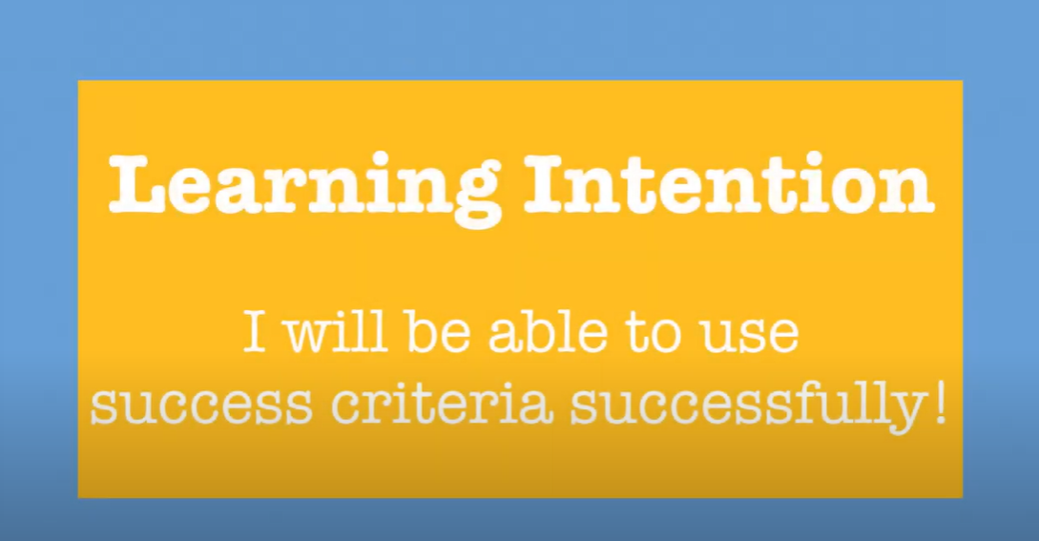
https://www.youtube.com/watch?v=0hgPnj4Y9Fk
Notes:
Option 1:
Success Criteria PD (4:34) https://www.youtube.com/watch?v=0hgPnj4Y9Fk
[Note: elementary math lesson]
Video Summary:
An example of incorporating learning intentions and success criteria into an elementary school classroom. Crescent Elementary School, 2018
Reflective Questions for discussion on next slide

Slide 60
Reflective Questions for Discussion
How do the criteria for success help students assess their own learning?
How does Ms. Hadock use the success criteria throughout the lesson?
In what ways do students use the success criteria to measure their own learning?
How do students measure their progress to the learning target?
Notes:
Give participants a short time to process these questions individually, then open up for a table discussion or whole group discussion (if group is small).

Slide 61
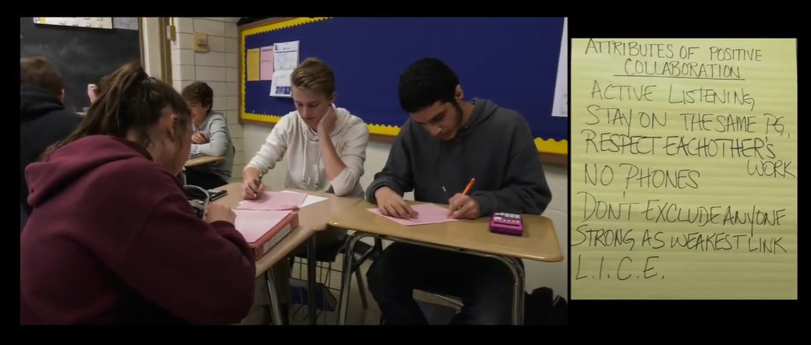
Co-Creating Success Criteria in Algebra II
https://www.youtube.com/watch?v=oC4G5BXpNvI&t=265s
Notes:
Option 2:
Co-Creating Success Criteria in Algebra II (8:47)
https://www.youtube.com/watch?v=oC4G5BXpNvI&t=265s
(HS example)
Video Summary:
This video showcases Alyssa Brands (Lyons Township High School) and her Algebra II class co-creating success criteria for group work in math class.
Reflective Questions for discussion on next slide

Slide 62
Reflective Questions for Discussion
In what ways did the success criteria (attributes of a positive collaboration) help students as they worked on their task?
How would you use the idea of students discussing and offering suggestions for success criteria in your classes?
Notes:
Give participants a short time to process these questions individually, then open up for a table discussion or whole group discussion (if group is small).

Slide 63

https://www.youtube.com/watch?v=b4Id1CTQpks
Notes:
Raising the Bar for Student Work (4:23) https://www.youtube.com/watch?v=b4Id1CTQpks
(Note: HS students)
Video summary:
Sharing high-quality examples from past students makes expectations for classwork tangible in a high-school math and history class.
Reflective Questions for discussion on next slide

Slide 64
Reflective Questions for Discussion
Where would you get the best examples of work to use as models for your students?
How does using a rubric and strong models of work engage students in unpacking success criteria?
How does examination of strong work samples bring clarity to students around success criteria?
Notes:
Give participants a short time to process these questions individually, then open up for a table discussion or whole group discussion (if group is small).

Slide 65
Strategy 2: Reflections
Which of your learning targets might benefit most from a strategy 2 activity?
Where might you find examples of strong and weak work?
How will you engage students in analyzing samples?
How much time might you devote to these activities?
(Chappuis, 2015)
Notes:
To Say/To Do:
Ask participants to take a few moments and reflect on these four questions.
Hand tables or groups of four a consensus placemat with the words “Strong and Weak Work” written in the circle in the middle.
Then each of the four participants sit at four different corners of the poster and write their individual responses to the four questions.
After all four are finished, they can share their ideas with the group.
Then lead into a whole group discussion.
Reference: Chappuis, J. 2015. Seven strategies of assessment for learning, 2e. Upper Saddle River, NJ: Pearson Education.

Slide 66
Activity: Stars and Steps
Find the handout on the “Using Strong and Weak Work”.
Read the points independently.
Star the ideas that would work best in your classroom.
Add a stair step next to ideas that might need adapting to fit your classroom.
Find a partner and discuss your take-away ideas.
Notes:
To Know/To Do: Optional activity.
Handout: Using Strong and Weak Work

Slide 67
Unpacking the topic
Where Am I Going?
Moving forward → Setting Goals
Notes:
To Know/To Say: Setting goals helps students know where they are going.

Slide 68
Importance of Student
Goal Setting
Classrooms full of actively engaged students are created when teachers intentionally work to develop self-regulated learners who set their own goals, select effective strategies to reach those goals, and monitor and adjust what they do depending on the demands of the task and their own strengths and needs.
(Brookhart & Moss, 2009)
Notes:
To Know/To Do: Give participants a post-it-note and ask them to condense this paragraph into nine words or less.
Reference: Brookhart, S., & Moss, C. (2009) Chapter 4: Achieving More with Focus: Fostering Student Goal Setting in Advancing formative assessment in every classroom: A guide for instructional leaders. ASCD. (2009). ASCD. Retrieved from http://www.ascd.org/publications/books/109031/chapters/Achieving-More-with-Focus@-Fostering-Student-Goal-Setting.aspx.

Slide 69

Student Goal Setting
(483) Teach: Student Goal-Setting and Reflection - YouTube
Notes:
To Know/To Do: If you are unsure you will have internet access, download the video.
To Do: After watching the video, participants briefly discuss how the Goal setting can help students as they transition from knowing “Where am I going” to actually doing work.
Reference: VBSchools (2017). Teach: Student Goal-Setting and Reflection. [Video File] Retrieved from https://www.youtube.com/watch?v=yiFWPd1PJZc

Slide 70
“Clear learning targets direct both teachers and students toward specific goals.”
"Students can meet goals only if they are actually working toward them, and they can't work toward them until they understand what they are.”
(Moss & Brookhart, 2009)
Notes:
To Know/To Say/To Do: Ask participants “How often do you have students set goals?” or “How often should students set goals?” The answer is daily!
Ask participants to think about when would be an appropriate time to ask students to set goals.
Ideas you could use:
If students write down learning targets, they could also write 1-5 stars to identify how confident they are about the skill or knowledge and write a short goal for how they would like to improve by tomorrow.
After discussing the learning target and clarifying language/expectations, ask students to write goals on post-it-notes for how they would like to improve by the end of the lesson.
Ask students to fill out a KWL (what I know, what I would like to know, and after learning, what I learned) chart. Use this for students to set goals about how they plan to learn what they write in the “W” section.
After discussing and interacting with the rubric, ask students to identify one criteria they would like to see growth on for this assignment and set a goal for how stay focused on it.
Reference: Moss, C. M., & Brookhart, S. M. (2009). Chapter 2: Leveling the playing field: sharing learning targets and criteria for success in advancing formative assessment in every classroom: A guide for instructional leaders. ASCD. Retrieved from http://www.ascd.org/publications/books/109031/chapters/Leveling-the-Playing-Field@-Sharing-Learning-Targets-and-Criteria-for-Success.aspx

Slide 71
Assessment & Reflection
Developing Assessment Capable Learners
Where Am I Going?
Notes:
Purpose: Provide opportunity for the learners to reflect on their learning and potential implementation challenges.
Content: Post-assessment learner knowledge; Reflect on personal teaching context and implementation

Slide 72
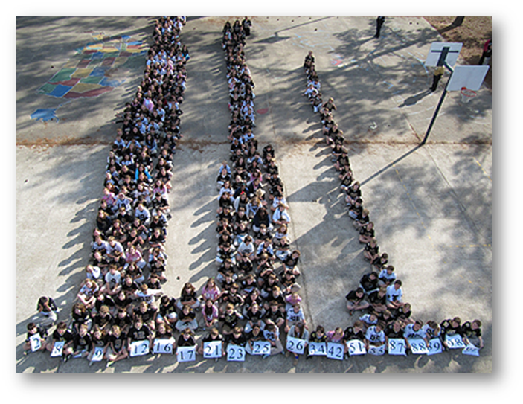
Where Am I Now?
Notes:
To Know: This is a transition slide.

Slide 73
What Do You Already Do?
Strategies 1 and 2
Make a list of practices you plan to implement for each strategy based on your learning from today.
Strategy | My Practice/Activity
1a. Provide students with a clear and understandable vision of the learning target.
1b. Use Rubrics to help define learning targets
2. Use examples and models of strong and weak work.
→ Set Goals
(Chappuis, 2015)
Notes:
To Know/To Do: Provide the chart on the slide as a handout to participants to write on. Allow participants time to think about practices/activities they plan to implement and place these practices/activities on the chart for future reference.
Handout: What Do You Plan To Do? Part 1
Reference: Chappuis, J. (2015). Seven strategies of assessment for learning, 2e. Upper Saddle River, NJ: Pearson Education.

Slide 74
When we have made the learning clear to students, focused instruction on the intended learning, offered practice opportunities targeted to learning needs, offered feedback on students’ learning strengths and needs, and taught them how to self-assess and set goals, we are inches away from students taking initiative to determine what they need practice with and to create their own personalized learning path.
(McTighe & O’Connor, 2016)
Notes:
To Know: This slide is also used in the ACL Overview, Part 1, and Part 2.
To Know/To Say: Allow participants to read this slide silently for a minute. It really brings all of the first four strategies together. Since ACL Part 1 only focuses on the first two strategies, remind participants about ACL Part 2, strategies 3, 4 and ACL Part 3, strategies 5, 6, 7.
Reference: Adapted From: McTighe, J. & O’Connor, K. (2016) Seven Practices for Effective Learning. Educational Leadership, 63(3).
Retrieved from http://www.ascd.org/publications/educational-leadership/nov05/vol63/num03/Seven-Practices-for-Effective-Learning.aspx

Slide 75
Closing & Follow-up
Developing Assessment Capable Learners

Slide 76
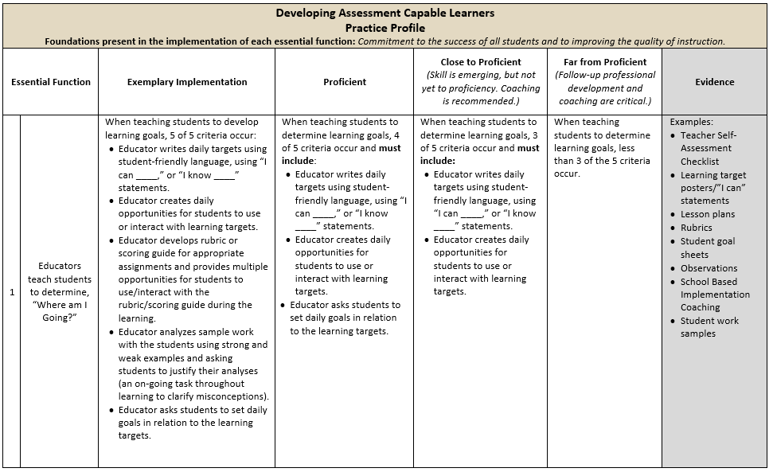
Practice Profile
Notes:
To Do: Review the practice profile with the participants. Suggest all stake-holders complete a self-analysis three or four times a year and engage in collaborative conversation.
To Know/To Say: The Practice Profile template includes four pieces and is anchored by the essential functions. First, as a header is the foundation of implementation that philosophically grounds implementation. Then moving from left to right across the template are the essential functions of the practice, implementation performance levels, and lastly, evidence which provides data or documentation for determining implementation levels.
The essential functions align with the teaching/learning objectives for each learning package. Four levels of implementation are described for each teaching/learning objective: exemplary, proficient, close to proficient, and far from proficient. The professional development provider should walk through the practice profile with the educator-learners, referring to the data and artifacts listed as suggested evidence. It is an important tool for self-monitoring their own implementation because it serves as a reminder as to the implementation criteria and is also aligned with the fidelity checklists and the electronic practice profile self-assessment tool. These sources provide data regarding further training or coaching.
Review the practice profile with the participants. Suggestion is to do self-analysis three or four times a year as well as ask a coach or administrator to also complete this form. Discussion would occur in comparing the self-analysis to the “outside analysis.”
Handout: Developing Assessment Capable Learner Practice Profile

Slide 77
Implementation Fidelity
Notes:
To Know: This is a hidden slide. The implementation fidelity checklist was developed for the Assessment Capable Learners learning package originally rolled out in 2013 as a tool for checking on the fidelity of implementing assessment capable learners instruction. It was not revised to reflect the changes to the Developing Assessment Capable Learners materials completed in 2017; however it may still be a useful guide to begin self-monitoring fidelity during early implementation. The checklist will be reviewed/revised at a later time.

Slide 78
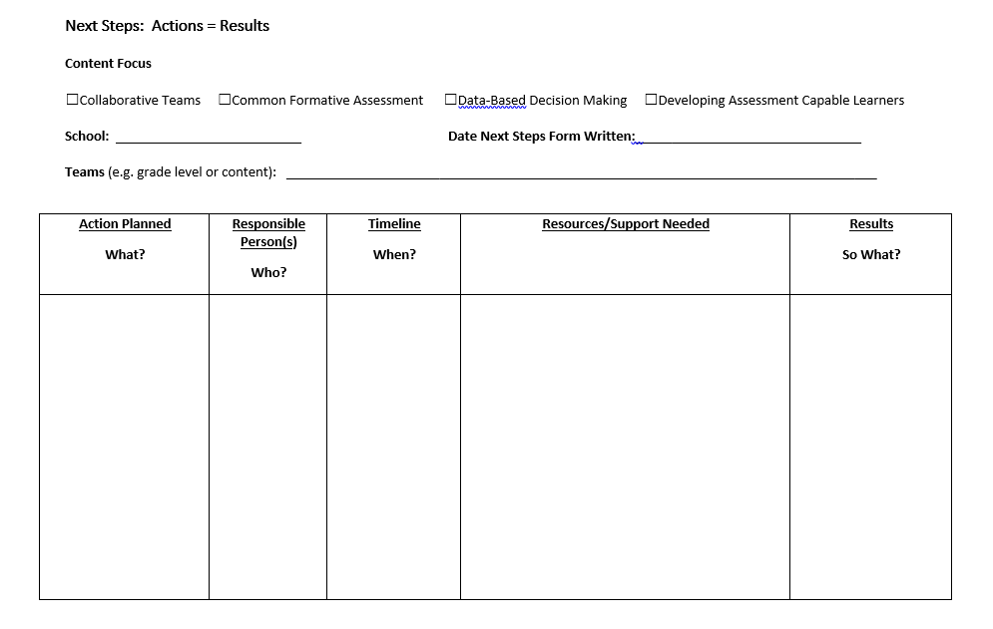
Next Steps: Action = Results
What steps will you take to start implementing?
Notes:
To Know/To Say: The Next Steps template is used for planning either today or back in your building. What resources do you need to begin implementing Assessment Capable Learners.
To Do: Complete the Next Steps template. Example is included in the learning package materials.
Handout: Next Steps: Action = Results

Slide 79


Resources for Further Learning/Coaching
Video:
Breaking Down “I Can” Statements with Students
Document:
Assessment for Learning Strategies
Books:
Seven Strategies of Assessment for Learning, (2nd Edition) by Jan Chappius
Classroom Assessment for Student Learning: Doing it Right--Using it Well, (2nd Edition) by J. Chappuis, R. Stiggins, S. Chappuis, and J. Arter
Notes:
To Know/To Do: This slide is hidden. The additional resources may be shared with the participants for further learning or for coaching. Make sure participants know these books areavailable from several sources.

Slide 80





Resources for Using Technology with Assessment Capable Learners
Visit MOEDU-SAIL for resources to implement technology in Strategies 1 & 2
Notes:
To Know/To Do: This slide is hidden. The additional resources may be shared with the participants for further learning or for coaching.

Slide 81
Contact Information
Please contact me to schedule follow-up coaching and/or additional professional development.
Notes:
To Know/To Say/To Do: Include presenter’s contact information.
Please contact me to schedule follow-up coaching and/or additional professional development. Thank you.

