Slide 1
Hidden Slide #1
The CTE Module was designed to be used in the following manner.
The audience for this Module is Leadership Teams, including district and building leaders. This Module is not meant for whole staff presentations.
Participants complete the Base Module, Collective Teacher Efficacy: An Introduction to Developing CTE in Schools.
Following this training, participants should complete the Flow Chart or the CTE Planning Reflection Questions document to determine next steps.
There are four Focus Modules. Teams are not required to complete all four Focus Modules. Instead, participants will complete only those Focus Modules that fit the needs of their school. Both the Flow Chart and CTE Planning Reflection Questions document were designed to direct a group to a starting Focus Module.
Notes:
The Base Module is designed to be completed in 2 to 2.5 hours and each Focus Module in 1 to 1.5 hours.

Slide 2
Hidden Slide #2
CTE in-person training suggestions
Presenter notes information
Notes:
CTE in-person training suggestions
The Collective Teacher Efficacy (CTE) Base Module in-person training should take about 2 to 2.5 hours to complete.
This presentation provides the basics of CTE. You may want to add or enhance portions with visuals and examples that will resonate with your audience. As a reminder, always be sure to include appropriate citations when adding resources. Also, you might look to the coaching companion for additions that may be helpful.
In summary
This module outlines the basics of CTE
It can be adapted to individual contexts
The training should last about 2 to 2.5 hours
Presenter notes information
Presenter notes are included in the PowerPoint. Background information for the presenter is shown as “To Know.” Statements to be shared with participants are shown as “To Say.” In some instances, the “To Know/To Say” are combined. The presenter notes also include “To Do” prompts and cues for “Handouts” (illustrated by icons – see slide 13 for icon glossary).
Additional activities, examples, videos, etc. are being developed as a CTE Coaching Companion. A presenter may add material from the Coaching Companion to corresponding PowerPoint content.
A printed Practice Profile and an electronic Self-Assessment Practice Profile (SAPP) tool are available for use by individuals, teams, or schools for periodic self-assessment and monitoring of implementation of practice or to identify training or coaching needs.
The presenter should download onto a hard drive or a flash drive any video intended for use in a training. You might not have internet access at the school sites.
Breaks should be inserted at the discretion of the presenter based on the needs of participants.

Slide 3
Hidden Slide #3
Supplies needed
WIFI access for presenter and participants
Access to videos (through WIFI if available, but download to flash drive as a back-up)
Chart paper
Markers
Post-it-Notes
Notes:
To Know
These supplies are needed for the CTE Professional Learning Modules.

Slide 4

Hidden Slide #4
Handouts
Pre or Post Reading Brinson, D., & Steiner, L. (2007). Building collective efficacy: How leaders inspire teachers to achieve (Issue Brief). Retrieved from https://files.eric.ed.gov/fulltext/ED499254.pdf
CTE Infographic
CTE Graphic Organizer
Middle School High Five: Strategies Can Triumph. Retrieved from https://www.ncte.org/library/NCTEFiles/Resources/Journals/VM/0132-dec05/VM0132Middle.pdf
CTE Flow Chart
CTE Planning Reflection Questions
CTE Practice Profile
CTE Action Plan
Notes:
To Know
The CTE Participant and Presenter Materials are located on the Moedu-SAIL website in the CTE Handout Packet. Due to copyright, some materials are linked to their original source and must be downloaded from the link.
Go to: http://www.moedu-sail.org/mmd-professional-development/mmd-content/
References
Brinson, D., & Steiner, L. (2007). Building collective efficacy: How leaders inspire teachers to achieve (Issue Brief). Washington, DC: Center for Comprehensive School Reform and Improvement. Retrieved from https://files.eric.ed.gov/fulltext/ED499254.pdf
Goodman, A. (2005). Middle school high five: Strategies can triumph. Voices from the Middle, 13(2), 12-19. Retrieved from https://www.ncte.org/library/NCTEFiles/Resources/Journals/VM/0132-dec05/VM0132Middle.pdf

Slide 5
Hidden Slide # 5
CTE Key Terms
Collective Teacher Efficacy (CTE) is a perception of teachers in a school that the efforts of the faculty as a whole will have a positive effect on students.
Efficacy is a capacity for producing a desired result or effect.
Self-Efficacy is an individual's belief in his or her capacity to execute behaviors necessary to produce specific performance and goal attainment.
Teacher Efficacy is one’s confidence in his/her ability to promote students’ learning.
Collective Efficacy is a group’s shared belief in its combined capabilities to attain their goals and accomplish desired tasks.
Mastery Experience is when you experience success firsthand. It requires experience in overcoming obstacles through perseverant effort.
Vicarious Experience is seeing people similar to oneself succeed.
Notes:
To Know
These are the key terms used throughout the module.

Slide 6
Hidden Slide # 6
CTE Key Terms
Social Persuasion is when a trusted source gives feedback and encouragement.
Affective State is when people rely partly on their emotional state to judge their capabilities.
A Social Network is a network of individuals (e.g. friends, acquaintances, coworkers) connected by interpersonal relationships.
Collaboration means to work jointly with others.
Teacher Leadership refers to other roles teachers, who work directly with students, participate in that have an influence extending beyond their own classroom/caseloads.
Decision Making means the act or process of deciding something important, especially in a group of people or an organization.
Notes:
To Know
These are the key terms used throughout the module.

Slide 7
Hidden Slide # 7
CTE Key Terms
Teacher Voice refers to the values, opinions, beliefs, perspectives, expertise, and cultural backgrounds of the teachers working in a school/district.
Teacher Inquiry is a process used by educators to explore teaching practices that enables the identification of successful approaches to improving learning and outcomes for students.
Professional Learning refers to activities educators engage in to stimulate their thinking and professional knowledge to ensure that their practice is informed and current.
Notes:
To Know
These are the key terms used throughout the module.

Slide 8

Pre/Post-Reading Opportunity
Notes:
To Know
This article may be used as a pre or post reading.
References
Donohoo, J., Hattie, J., & Eells, R. (2018). The power of collective efficacy. [Online Article]. Retrieved from http://www.ascd.org/publications/educational-leadership/mar18/vol75/num06/The-Power-of-Collective-Efficacy.aspx
Will need to be downloaded from link due to Copyright.

Slide 9
Collective Teacher Efficacy
An Introduction to Developing CTE in Schools
Notes:
Welcome and introductions

Slide 10
Acknowledgements
Special thanks to all contributors to the development and revision of this Professional Learning Module.
The original collection of Professional Learning Modules was rolled-out for use by Regional Professional Development Center (RPDC) Consultants in July 2013 after being developed by a team of content experts through efforts funded by the Missouri State Personnel Development Grant (SPDG).
Content Development and Revision Support Team, 2019
  Carla Williams, UCM Marcia Clark, SE RPDC
  Liz Condray, SCRPDC Jan Davis, MoEdu-SAIL
  Janie Pyle, Raytown School District Cheryl Wrinkle, SW RPDC
  Marilyn Cannon, Raytown School District
Institute for Human Development
Ronda Jenson Jodi Arnold
Sarah Marten Arden Day
Chelie Nelson Cynthia Beckmann
Notes:
To Know/To Say
Special thanks to all contributors to the development and revision of this Professional Learning Module.

Slide 11
Welcome and Introductions
Our trainers for the day

Slide 12
Norms
Begin and end on time
Be an engaged participant
Be an active listener - open to new ideas
Use notes for side bar conversations
Use electronics respectfully
Notes:
To Know
It is important to establish norms for training. Trainers are free to adjust this list of norms.
To Do
Consider including a check mid-way through trainings to assess a norm or norms. The presenter may want to use norms printed on agenda handouts in addition to or in place of presentation slides, so the norms are always available in print for participants. Norms may be added to address specific school needs. Some schools already have established norms for all PD. In that case, adapt to their norms.
To Say
Please review the norms for this training. Are there any additions that need to be made to the norms at this time?

Slide 13





Icon Glossary
Collective Teacher Efficacy
Step-by-Step Guide
Reflection/Activities
Handout Packet
Essential Questions
Blueprint
Notes:
To Know/To Say
You will see these icons on slides and handouts throughout the presentation.

Slide 14
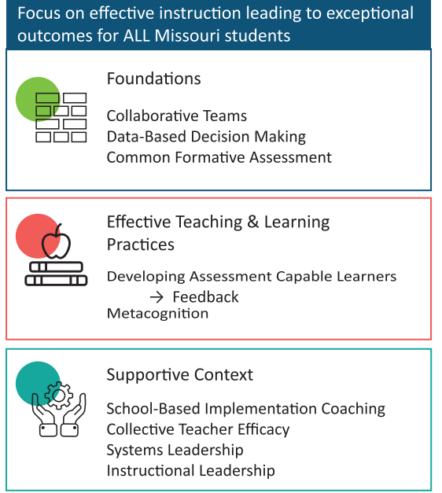
District Continuous Improvement Framework (MMD/DCI)
Notes:
To Know
Missouri’s Professional Learning Modules are organized in the same three categories as defined in the District Continuous Improvement Framework (MMD/DCI). All schools begin their professional development journey with the Foundations, as these professional learning modules provide foundational knowledge in three key areas: Collaborative Teams, Data-Based Decision Making, and Common Formative Assessment. Effective Teaching & Learning Practices encompass research-based instructional practices for deepened learning. These professional learning modules address ways of connecting with students, ways of helping students learn how to learn, and feature specific instructional practices. Supportive Context contains Professional Learning Modules designed to help school staff support and enhance the implementation of Effective Teaching & Learning Practices through technology, leadership, and coaching supports.
To Do/To Say
Before we delve into CTE, let’s take a few minutes to review the MMD/DCI Framework graphic, looking specifically at where CTE falls into the larger content.
As you see, the focus of MMD/DCI is on effective instruction leading to exceptional outcomes for all Missouri students.
The Content Framework has three main components:
Foundations (consisting of Collaborative Teams, Data-Based Decision Making, and Common Formative Assessment)
Effective Teaching and Learning Practices (Developing Assessment Capable Learners with Feedback and Metacognition)
Supportive Context (School Based Implementation Coaching, Collective Teacher Efficacy, and Leadership)
References
District Continuous Improvement (MMD/DCI) Blueprint, Third Edition, (2019). Missouri Department of Elementary and Secondary Education: Northern Arizona University, Institute for Human Development.

Slide 15
CTE Alignment with
MO Leader Standards
Standard #2 Teaching and Learning
Educational leaders have the knowledge and ability to ensure the success of all students by promoting a positive school culture, providing effective instructional program that applies best practice to student learning, and designing comprehensive professional growth plans for staff.
Notes:
To Know/To Say
The CTE module aligns with the Missouri Learning Standards because it addresses
teacher collaboration,
reflection,
data analysis,
action planning, and
feedback.

Slide 16
CTE Alignment with
MO Teacher Standards
This CTE module supports the following MO Teacher Standards.
#2 Student Learning, Growth, and Development: Teachers can adapt instruction in order to effectively teach all learners
#7 Student Assessment and Data Analysis: Teachers uses formative and summative assessment strategies to assess learner progress
#8 Professionalism: Teachers are reflective practitioners and use data to inform reflection
#9 Collaboration: Teachers collaborate with a shared goal of effective instruction and student learning
Notes:
To Know
Detailed information about the MO Teacher Standards is provided below for your review only.
Standard #2 Student Learning, Growth and Development: The teacher understands how students learn, develop, and differ in their approaches to learning. The teacher provides learning opportunities that are adapted to diverse learners and support the intellectual, social, and personal development of all students. [SB 291 Section 160.045.2 (1) Students actively participate and are successful in the learning process; (5) The teacher keeps current on instructional knowledge and seeks and explores changes in teaching behaviors that will improve student performance.]
Standard #7 Student Assessment and Data Analysis: The teacher understands and uses formative and summative assessment strategies to assess the learner’s progress and uses both classroom and standardized assessment data to plan ongoing instruction. The teacher monitors the performance of each student, and devises instruction to enable students to grow and develop, making adequate academic progress. [SB 291 Section 160.045.2 (2) Various forms of assessment are used to monitor and manage student learning; (5) The teacher keeps current on instructional knowledge and seeks and explores changes in teaching behaviors that will improve student performance.]
Standard #8 Professionalism: The teacher is a reflective practitioner who continually assesses the effects of choices and actions on others. The teacher actively seeks out opportunities to grow professionally in order to improve learning for all students. [SB 291 Section 160.045.2 (2) Various forms of assessment are used to monitor and manage student learning; (5) The teacher keeps current on instructional knowledge and seeks and explores changes in teaching behaviors that will improve student performance; (6) The teacher acts as a responsible professional in the overall mission of the school.]
Standard #9 Professional Collaboration: The teacher has effective working relationships with students, parents, school colleagues, and community members. [SB 291 Section 160.045.2 (4) The teacher uses professional communication and interaction with the school community; (6) The teacher acts as a responsible professional in the overall mission of the school.] Quality Indicator 1: Induction and collegial activities. Quality Indicator 2: Collaborating to meet student needs. Quality Indicator 3: Cooperative partnerships in support of student learning.

Slide 17
Session-at-a-Glance
Impact of High and Low Teacher Efficacy
Developing Common Understanding for Collective Teacher Efficacy
Four Sources of Efficacy
Developing Capacity
Where Do We Go From Here: Reflection and Action Planning
Notes:
To Know
There is an agenda
To Do
Show slide
To Say
Please take a look at the agenda for this training. We will talk about the impact of high and low teacher efficacy and how to develop a common understanding. Today we will be exploring what it means to have “Collective Teacher Efficacy.” At the end of the day we will develop a plan for additional information you will want to explore around CTE. Today we simply want to begin the conversation. There are four Focus Modules that can be used following this initial introduction. We will discuss the four sources of efficacy and then help you decide where to go from here.

Slide 18
Learning Targets
By the end of the session, the learner will know how to
design intentional support for establishing CTE by providing opportunities for the teachers to experience self-efficacy,
create opportunities for teachers to network and professionally collaborate,
provide feedback to determine and evaluate impact, and
involve teachers in shared decision making to build confidence and leadership skills.
Notes:
To Know/To Do
Go over the learning targets listed
To Say
As a learner, today you will develop an understanding of what CTE is and how it can impact student outcomes.
Following the training, you will have time to plan how to incorporate supports for CTE in your school/district.

Slide 19
Essential Questions
What is CTE and how does it impact student learning?
What is happening in my school now that facilitates CTE?
Where do I go from here?
Notes:
To Know/To Say
Let’s begin the work of CTE with these essential questions in mind.

Slide 20

Notes:
To Know/To Say
The CTE infographic summarizes key content from the learning package.
Handout
CTE InfoGraphic

Slide 21
Collective Teacher Efficacy
Collective Teacher Efficacy (CTE) is a perception of teachers in a school that the efforts of the faculty as a whole will have a positive effect on students.
(Goddard, Hoy, & Hoy, 2000)
Notes:
To Know
This is a quick definition of CTE to set the stage for the discussion of impact. CTE will be defined and put into context later in the presentation, so there is no need to go too far in-depth here. Just introduce the term.
To Do/To Say
CTE is a perception of teachers in a school that the efforts of the faculty, as a whole will have an effect on student learning.
References
Goddard, R. D., Hoy, W. K., & Hoy, A. W. (2000). Collective teacher efficacy: Its meaning, measure, and impact on student achievement. American Educational Research Journal, 37(2), 479-507.

Slide 22

Collective Efficacy Training Video
Write
which elements from the definition of CTE you hear?
Notes:
Note
This video is embedded and should play in slideshow mode. However, some older versions of PPT may not recognize the video format. If the video in this slide will not play, use this https://youtu.be/YVWRJ-nBwcU to play the video from the original source or use the hidden slide that follows.
To Know
This activity gives school leaders an opportunity to consider what they already know about CTE. They should be able to identify elements of collective efficacy.
To Do/To Say
Show this video.
Note:
As you watch this short video clip, please write some elements of Collective Teacher Efficacy you hear. What are some specific examples she cites? At the end of the clip, please share out your responses. Overall
answer: Teachers are the leaders of professional learning. Then say “Hold on to your paper and we will come back to it at the end.”
References
Raytown Schools. (2018, May 1). Collective efficacy training interview clip 4 [Video file]. Retrieved from https://youtu.be/YVWRJ-nBwcU

Slide 23
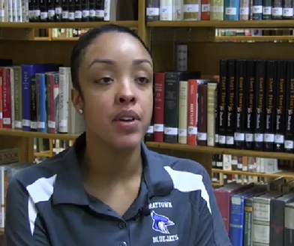

Collective Efficacy Training Video
Write
which elements from the definition of CTE you hear?
Notes:
Note
This slide is hidden and a duplicate of 22 because some older versions of PPT may not recognize the video format in the previous slide. If the video in this slide will not play, use this https://youtu.be/YVWRJ-nBwcU to play the video from the original source.
To Know
This activity gives school leaders an opportunity to consider what they already know about CTE. They should be able to identify elements of collective efficacy.
To Do/To Say
Show this video.
Note:
As you watch this short video clip, please write some elements of Collective Teacher Efficacy you hear. What are some specific examples she cites? At the end of the clip, please share out your responses. Overall
answer: Teachers are the leaders of professional learning. Then say “Hold on to your paper and we will come back to it at the end.”
References
Raytown Schools. (2018, May 1). Collective efficacy training interview clip 4 [YouTube video]. Retrieved from https://youtu.be/YVWRJ-nBwcU

Slide 24
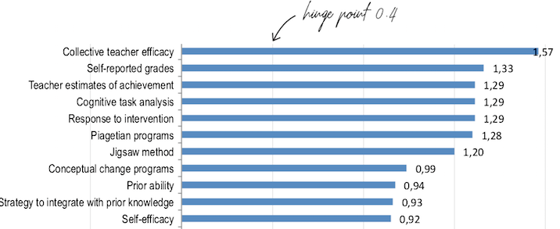
John Hattie 2018 Effect Size of Factors Influencing Student Achievement
(https://visible-learning.org/hattie-ranking-influences-effect-sizes-learning-achievement)
Notes:
To Know
John Hattie shows the effect sizes of the factors that most impact student achievement.
To Do/To Say
Show the slide
This chart reflects the continual shifts in effect size as John Hattie adds studies to his meta-analyses. Collective Teacher Efficacy is currently ranked first; it was second a year ago. It is advisable to check the rankings on a yearly basis.
References
Visible-Learning. (n.d.). Hattie’s ranking: 252 influences and effect sizes related to student achievement. Retrieved from https://visible-learning.org/hattie-ranking-influences-effect-sizes-learning-achievement

Slide 25
Impact of High and Low Collective Teacher Efficacy
Notes:
To Know
It is important that school leaders know the impact of high and low Collective Teacher Efficacy.
To Do/To Say
Show Slide
We will now look at the impact of high and low Collective Teacher Efficacy in a school.

Slide 26
When CTE is high in schools, teachers…
Find new ways to tackle difficult challenges
Set more difficult group goals and are more committed to those goals
Put more effort into planning
Are more open to new ideas
Are more willing to experiment
Are more resilient
Work collaboratively
Welcome parent participation
Are more committed
(Brinson & Steiner, 2007; Donohoo, 2018 )
Notes:
To Know
High CTE within schools has a positive impact on how teachers work.
To Do/To Say
Show slide
When schools have a high degree of CTE, teachers give greater effort and show passion about teaching. They are persistent in the face of challenges and are more resilient when faced with failures.
Within your table groups discuss how these teacher characteristics could impact both student and teacher outcomes? Please share out after a few minutes.
After listening to the share out, make sure they noted the following.
Increased student achievement
Other affected outcomes linked are dropout/attendance rates
College attendance
Student course selection
Teacher satisfaction
Teacher learning & innovation
.
References
Brinson, D., & Steiner, L. (2007). Building collective efficacy: How leaders inspire teachers to achieve (Issue Brief). Washington, DC: Center for Comprehensive School Reform and Improvement. Retrieved from https://files.eric.ed.gov/fulltext/ED499254.pdf
Donohoo, J. (2018). Collective teacher efficacy research: Productive patterns of behaviour and other positive consequences. Journal of Educational Change, 19(3), 323–345.

Slide 27
When CTE is low in schools, teachers…
Extend less effort
Give up more easily
Perform at lower levels
Experience burnout
Feel isolated
Have greater apathy
Experience more uncertainty
(Donohoo, 2017)
Notes:
To Know
There are also consequences of having low CTE for teachers.
To Do/To Say
Show Slide
These are things that lead to teachers not wanting to be involved in the decision making/problem solving process in schools. Can you think of others? This will lead to the opposite of having high CTE.
References
Donohoo, J. (2017). Collective efficacy: How educators’ beliefs impact student learning. Thousand Oaks, CA: Corwin.

Slide 28
Consequences of high CTE in schools
Improves student performance
Improves the negative effects of low SES
Enhances parent-teacher relationships
Creates a work environment that builds teacher commitment to the school
(Brinson & Steiner, 2007; Donohoo, 2018)
Notes:
To Know
High CTE within schools has a positive impact.
To Do
Show slide
Principals and district leaders should turn their attention to improving CTE because it has an impressive list of positive consequences, including…
References
Brinson, D., & Steiner, L. (2007). Building collective efficacy: How leaders inspire teachers to achieve (Issue Brief). Washington, DC: Center for Comprehensive School Reform and Improvement. Retrieved from https://files.eric.ed.gov/fulltext/ED499254.pdf
Donohoo, J. (2018). Collective teacher efficacy research: Productive patterns of behaviour and other positive consequences. Journal of Educational Change, 19(3), 323–345.

Slide 29

CTE Leads to Increased Student Achievement
In 100% of the studies reviewed by Fernandez, Ramos, Silva, Nina, & Pontes, a positive correlation between CTE and student performance was found.
(Fernandez, Ramos, Silva, Nina, & Pontes, 2016)
Notes:
To Know
CTE leads to outcome of increased student achievement.
To Do/To Say
Show slide
And most importantly, CTE leads to outcomes of increased student success. CTE is a predictor of student achievement – one unit increase in CTE is connected to more than 40% of a standard deviation in student achievement.
Next we will look at some ways school leaders (administrators and teacher leaders) can work to support CTE in schools.
References
Fernandez, A., Ramos, M., Silva, S., Nina, K., & Pontes, F. (2016). Overview of research on teacher self-efficacy in social cognitive perspective. Anales de Psicología, 32.

Slide 30
Beliefs About Teaching and Learning
I believe…
Teachers in our school believe…
Building leaders believe…
District leaders believe…
As a learning community we believe…
Notes:
To Know
There are common beliefs about teaching and learning.
To Do/To Say
Show slide
There are common beliefs about teaching and learning that guide our actions. Look at these statements. Share in your table groups how you would expect a school with High CTE to complete each of these stems. How might a school with low CTE complete these stems?

Slide 31
Developing a Common Understanding of Collective Teacher Efficacy
Notes:
To Know
It is important to know the definition of efficacy and have a common understanding.
To Do/To Say
Show this slide
In this part of the session, we will discuss the definitions of efficacy, self efficacy, teacher efficacy, and collective teacher efficacy.

Slide 32
Efficacy

Slide 33
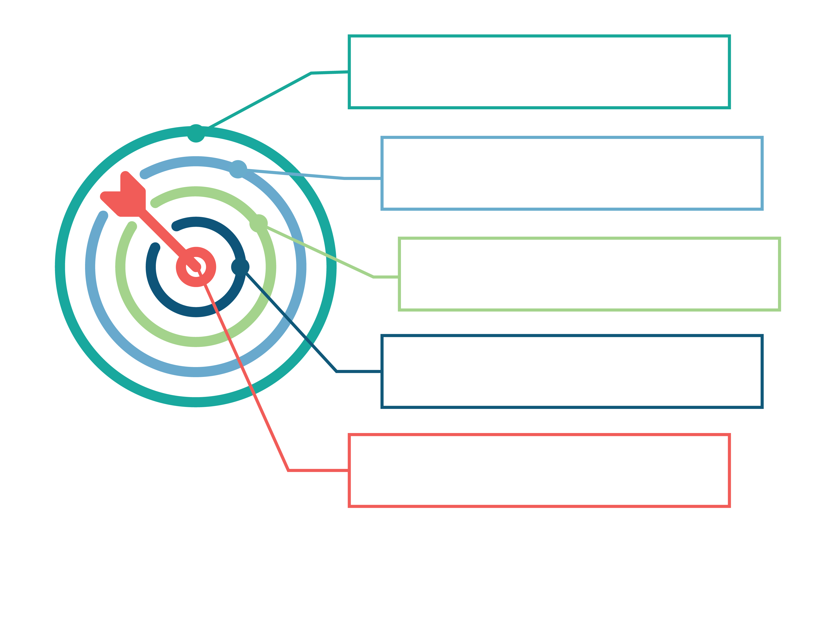
CTE Graphic Organizer
Mastery
Affective
Efficacy
Self-Efficacy
Teacher Efficacy
Collective Efficacy
Collective Teacher Efficacy
Social Persuasion
Vicarious
Notes:
To Know
Use the handout “CTE Graphic Organizer” during the next slides in the presentation to help organize definitions. The graphic on the slide is in PDF format - there is also a word version that can be used electronically.
To Do/To Say
Have participants locate handout for use.
Please use the handout as your personal graphic organizer to take notes during the next few slides that work with definitions. Having consistent vocabulary is an essential component for all involved in Collective Teacher Efficacy.

Slide 34
Defining Efficacy
Efficacy is…
a Latin word that refers to a capacity for producing a desired result or effect;
a predictor of individual behavior; and
suggestive of strength and fortitude, resulting in effectiveness.
(Merriam-Webster, 2019)
Notes:
To Know
Make sure you know the general definition of efficacy given on the slide.
To Do/To Say
Show slide
Read slide to participants. Efficacy comes from the same roots as effectiveness and is the broadest term. The terms moving toward the center become narrower.
Possible Object Lesson: Fable –The Bundle of Sticks
A certain father had a family of sons, who were forever quarreling among themselves. No words he could say did the least good, so he cast about in his mind for some very striking example that should make them see that discord would lead them to misfortune.
One day when the quarreling had been much more violent than usual, and each of the sons was moping in a surly manner, he asked one of them to bring him a bundle of sticks. Then handing the bundle to each of his sons in turn he told them to try to break it. But although each one tried his best, none was able to do so.
The father then untied the bundle and gave the sticks to his sons to break one by one. This they did very easily.
"My sons," said the father, "do you not see how certain it is that if you agree with each other and help each other, it will be impossible for your enemies to injure you? But if you are divided among yourselves, you will be no stronger than a single stick in that bundle."
In unity is strength.

Slide 35
CTE Graphic Organizer
Mastery
Affective
Efficacy
Self-Efficacy
Teacher Efficacy
Collective Efficacy
Collective Teacher Efficacy
Social Persuasion
Vicarious
Notes:
To Do/To Say
Make sure participants have their graphic organizer
Take a moment to record what the definition of efficacy means to you and a personal experience (either professional or personal) that you can think of to help personalize the definition. Please use the space in the outer circle as definitions will become more narrowed to reflect the goal of Collective Teacher Efficacy.

Slide 36
Self-Efficacy
An individual's belief in his or her capacity to execute behaviors necessary to produce specific performance and goal attainment.
Reflects confidence in the ability to exert control over one's own motivation, behavior, and social environment.
(Bandura, 1986)
Notes:
To Know
An individual’s belief in their own capacity is important to execute behaviors necessary to reach goals.
To Do/To Say
Show slide
Summarize and read slide
References
Bandura, A. (1986). The explanatory and predictive scope of self-efficacy theory. Journal of Social and Clinical Psychology, Special Issue: Self-Efficacy Theory in Contemporary Psychology, 4, 359-373.

Slide 37
CTE Graphic Organizer
Mastery
Affective
Efficacy
Self-Efficacy
Teacher Efficacy
Collective Efficacy
Collective Teacher Efficacy
Social Persuasion
Vicarious
Notes:
To Do/To Say
Make sure participants have their graphic organizers
Take a moment to record what the definition of self-efficacy means to you and a personal experience (either professional or personal) that you can think of to help personalize the definition. Please use the space in the next circle as definitions will become more narrowed to reflect the goal of Collective Teacher Efficacy.

Slide 38
Teacher Efficacy
A teacher’s confidence in his/her ability to promote students’ learning.
(Hoy, 2004; Donohoo, 2018)
Notes:
To Know
Make sure you know the definition of Teacher Efficacy.
To Do/To Say
Show Slide and video
Read slide and definition. Show the video https://www.youtube.com/watch?v=SFnMTHhKdkw. How does what this teacher says demonstrate Teacher Efficacy?
References
Hoy, A. W. (2004). Self-efficacy in college teaching. Essays on Teaching Excellence; Toward the Best in the Academy, 15(7). Retrieved from https://cft.vanderbilt.edu/wp-content/uploads/sites/59/vol15no7_self_efficacy.htm
Donohoo, J. (2018). Collective teacher efficacy research: Productive patterns of behaviour and other positive consequences. Journal of Educational Change, 19(3), 323–345.
Pierson, R. (2013, May 3). Every kid needs a champion [Video file]. Retrieved from https://www.youtube.com/watch?v=SFnMTHhKdkw

Slide 39
CTE Graphic Organizer
Mastery
Affective
Efficacy
Self-Efficacy
Teacher Efficacy
Collective Efficacy
Collective Teacher Efficacy
Social Persuasion
Vicarious
Notes:
To Know
Make sure participants have their graphic organizer.
To Do/To Say
Give participants time to record personal responses into their graphic organizer.
Take a moment to record what the definition of teacher-efficacy means to you and also record a professional experience to help personalize the definition. Please continue to use the spaces working inward on your graphic organizer, as definitions will become more narrowed to reflect the goal of collective teacher efficacy.

Slide 40
Collective Efficacy
A group or team’s shared belief in its combined capabilities to attain their goals and accomplish desired tasks; involves the belief or perception that an effective collective action is possible to address a problem.
(Bandura, 1986)
Notes:
To Know
The definition of collective efficacy
To Do/To Say
Read the slide and the definition of collective efficacy.
Share an example using a personal story (non-academic) or talk about the research on neighbors and collective efficacy. Collective efficacy in a neighborhood describes what residents are willing to do to improve their neighborhoods. Although social cohesion is the foundation of collective efficacy, at the core of collective efficacy is the willingness to intervene and the capacity for informal social control. In neighborhoods with collective efficacy, neighbors agree on what is acceptable behavior and reinforce it in each other.
Together, social cohesion and collective efficacy are the qualities that distinguish well-functioning, harmonious neighborhoods from poorly functioning, disordered ones.
References
Bandura, A. (1986). The explanatory and predictive scope of self-efficacy theory. Journal of Social and Clinical Psychology, Special Issue: Self-Efficacy Theory in Contemporary Psychology, 4, 359-373.

Slide 41
CTE Graphic Organizer
Mastery
Affective
Efficacy
Self-Efficacy
Teacher Efficacy
Collective Efficacy
Collective Teacher Efficacy
Social Persuasion
Vicarious
Notes:
To Know
Make sure that participants have their graphic organizers.
To Do/To Say
Give participants time to record personal responses into their graphic organizer.
Take a moment to record what the definition of collective efficacy means to you and record an experience (either professional or personal) that you can think of to help personalize the definition. Please continue the pattern of working to the bullseye.

Slide 42
Collective Teacher Efficacy
Collective teacher efficacy (CTE) is a perception of teachers in a school that the efforts of the faculty as a whole will have a positive effect on students.
CTE has the potential to explain the differential effect schools have on student achievement.
(Goddard, Hoy, & Woolfolk Hoy, 2000; Donohoo, 2018)
Notes:
To Know
The definition of CTE
To Do/To Say
Show slide
Read slide and definition of CTE
Teacher belief
Perception of teachers in a school that the efforts of the faculty will have an effect on student learning (Brinson & Steiner)
Has the potential to explain the differential effect schools have on student achievement. Goddard, Hoy, and Woolfolk Hoy found that a one-point increase on a schools’ CE score is associated with an 8.5 point increase on student achievement scores (moderate effect).
Talk about how CTE can be achieved through
building instructional knowledge and skills;
creating opportunities for teachers to collaboratively share skills and experience;
interpreting results and providing actionable feedback on teacher performance; and
involving teachers in school decision making.
References
Goddard, R. D., Hoy, W. K., & Hoy, A. W. (2000). Collective teacher efficacy: Its meaning, measure, and impact on student achievement. American Educational Research Journal, 37(2), 479-507.
Donohoo, J. (2018). Collective teacher efficacy research: Productive patterns of behaviour and other positive consequences. Journal of Educational Change, 19(3), 323–345.

Slide 43
CTE Graphic Organizer
Mastery
Affective
Efficacy
Self-Efficacy
Teacher Efficacy
Collective Efficacy
Collective Teacher Efficacy
Social Persuasion
Vicarious
Notes:
To Know
Make sure participants have their graphic organizers.
To Do/To Say
Give participants time to record personal responses into their graphic organizer.
Take a moment to record what the definition of collective teacher efficacy means to you and record an experience (either professional or personal) that you can think of to help personalize the definition. If you have not experienced CTE, record what it would look like, feel like, and sound like in your current position. This is the bullseye and the goal! Use the back of your graphic organizer or create an additional page if using electronically.

Slide 44
Collective Efficacy in Action
The Middle School High Five:
Strategies Can Triumph
Notes:
To Know
The Middle School High Five is an article which is an example of teachers seeing a deficit, being willing to collectively implement change, and observe positive results. This is a down-to-earth, practical example—not a deep dive into research. There are flaws in that there is not documentable proof, but it speaks to collective efficacy. Teachers will jigsaw the reading and surmise the cause/effect, connecting it to collective efficacy. Make copies of the article (address below) for participants to annotate.
To Do/To Say
Look for the cause (problem) and the effect, noting these on the document. Why is this an example of CTE--moving beyond problem solving? When tables complete the work, have table members share their understandings among themselves first, then share findings whole-room. Encourage teachers to provide other examples they have experienced that may be similar.
References
Goodman, A. (2005). Middle school high five: Strategies can triumph. Voices from the Middle, 13(2), 12-19. Retrieved from https://www.ncte.org/library/NCTEFiles/Resources/Journals/VM/0132-dec05/VM0132Middle.pdf

Slide 45


TEACHER EFFICACY
I CAN, I DO
COLLECTIVE TEACHER EFFICACY
WE ALL CAN, WE ALL DO
Notes:
To Know
This is a visual display of the difference between teacher efficacy and collective teacher efficacy.
To Do/To Say
Look at the visual that illustrates the strength and capacity of a collective strength and approach.

Slide 46
The Four Sources of CTE

Slide 47
CTE Graphic Organizer
Mastery
Affective
Efficacy
Self-Efficacy
Teacher Efficacy
Collective Efficacy
Collective Teacher Efficacy
Social Persuasion
Vicarious
Notes:
To Know
Use the same handout for the next slides.
To Do/Say
We will now being moving into the four sources of Collective Teacher Efficacy. We will again be using the graphic organizer to process personal experiences from which we can draw to understand. Have participants locate their personal graphic organizer and start to think about how we proactively set up experiences in our school to experience and build upon. The outside four boxes will now be used.

Slide 48




Four Main Sources of Efficacy
Mastery Experience
Experience success firsthand
Vicarious Experience
Success is modeled
Social Persuasion
Trusted source gives feedback & encouragement
Affective State
Physiological effect
(Bandura, 1994)
Notes:
To Know
These are the four main sources of efficacy.
Mastery experience is when you experience success firsthand. This is the most effective way of creating a strong sense of self-efficacy. Successes build a robust belief in one’s personal efficacy. A resilient sense of efficacy requires experience in overcoming obstacles through perseverant effort.
Vicarious experience occurs when success is modeled. Seeing people similar to oneself succeed by sustained effort raises observers' beliefs that they too possess the capabilities to master comparable activities required to succeed.
Social persuasion is when a trusted source gives feedback and encouragement. People who are persuaded verbally that they possess the capabilities to master given activities are more likely to mobilize greater effort and sustain it than if they harbor self-doubts and dwell on personal deficiencies when problems arise. To the extent that persuasive boosts perceived self-efficacy leads people to try hard enough to succeed, promote development of skills, and a sense of personal efficacy.
Affective state is the actual physiological effect. People also rely partly on their emotional state to judge their capabilities. Positive mood enhances perceived self-efficacy, despondent mood diminishes it. The fourth way of modifying self-beliefs of efficacy is to reduce people's stress reactions and alter their negative emotional proclivities and interpretations of their physical states. People who have a high sense of efficacy are likely to view their state of affective arousal as an energizing facilitator of performance, whereas those who are beset by self-doubt regard their arousal as a debilitating.
To Do/Say
Show slide
You may remember this information from the Base Module. These are the four main ways that people build efficacy.
Mastery experience is when you experience success firsthand.
Vicarious experience occurs when you see others succeed and it raises your belief that you too could do something.
Social persuasion is when someone motivates you to believe you can achieve a goal.
Affective state is how your emotional state affects your belief in your ability.
References
Bandura, A. (1994). Self-efficacy. In V. S. Ramachaudran (Ed.), Encyclopedia of human behavior (Vol. 4, pp. 71-81). New York: Academic Press. (Reprinted in H. Friedman [Ed.], Encyclopedia of mental health. San Diego: Academic Press, 1998).

Slide 49

Mastery Experience
Directly experiencing success is the strongest of the sources and these experiences build self-efficacy.
(When a teacher experiences failure it undermines efficacy.)
Notes:
To Know
Mastery experiences are the strongest sources for CTE. People's beliefs about their efficacy can be developed by four main sources of influence. The most effective way of creating a strong sense of efficacy is through mastery experiences. Successes build a robust belief in one's personal efficacy. Failures undermine it, especially if failures occur before a sense of efficacy is firmly established.
If people experience only easy successes they come to expect quick results and are easily discouraged by failure. A resilient sense of efficacy requires experience in overcoming obstacles through perseverant effort. Some setbacks and difficulties in human pursuits serve a useful purpose in teaching that success usually requires sustained effort. After people become convinced they have what it takes to succeed, they persevere in the face of adversity and quickly rebound from setbacks. By sticking it out through tough times, they emerge stronger from adversity.
To Do/Say
Show slide
The most powerful source of CTE is mastery experiences. When a person or team experiences success (mastery) and attributes that success to causes within their control, collective efficacy increases and the team comes to expect that effective performances can be repeated.
Goddard, Hoy, & Hoy (2004) explained that past school successes build teachers’ beliefs in the capability of the faculty, whereas failures tend to undermine a sense of collective efficacy. Past levels of school success help influence a staff’s belief in their capability to make a difference for students.
References
Bandura, A. (1994). Self-efficacy. In V. S. Ramachaudran (Ed.), Encyclopedia of human behavior (Vol. 4, pp. 71-81). New York: Academic Press. (Reprinted in H. Friedman [Ed.], Encyclopedia of mental health. San Diego: Academic Press, 1998).
Donohoo, J. (2017). Collective efficacy: How educators’ beliefs impact student learning. Thousand Oaks, CA: Corwin.
Goddard, R.D., Hoy, W. K., Hoy, A. W. (2004). Collective efficacy beliefs: Theoretical developments, empirical evidence, and future directions. Educational Researcher, 33(3), 3-13.

Slide 50
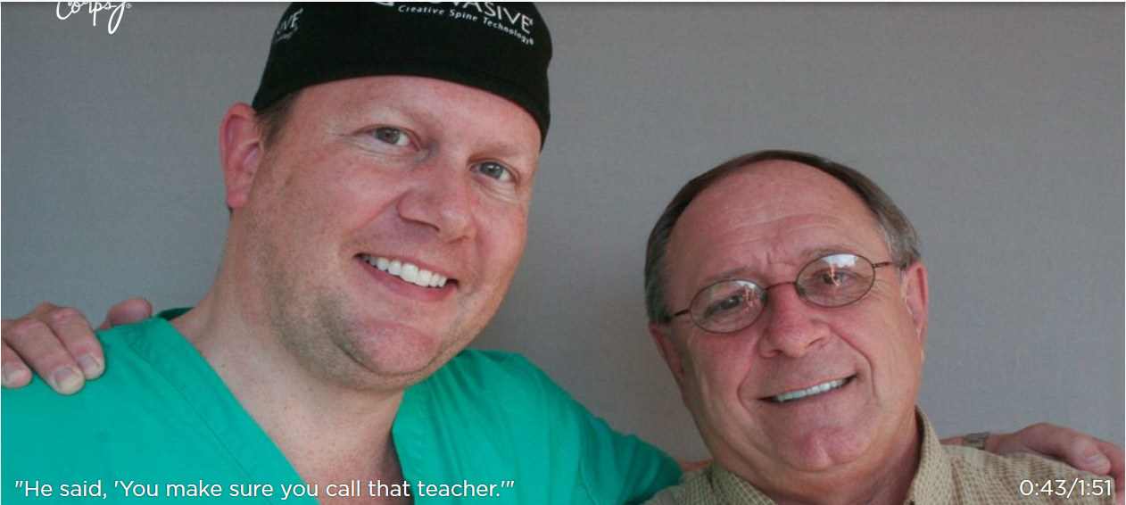

From StoryCorps® on NPR
https://storycorps.org/listen/al-siedlecki-and-lee-buono/
Notes:
Note
To play the audio file, click the speaker in the left lower corner.
To Know
This audio story shows the impact of a mastery experience.
To Do/Say
Show video
We are going to listen to a conversation between a surgeon and a teacher. After you have viewed it, we will share out how it depicted a mastery experience that led to efficacy.
References
StoryCorps, Inc. (2011). He said, you make sure you call that teacher [Video file]. Retrieved from https://storycorps.org/stories/al-siedlecki-and-lee-buono/

Slide 51
CTE Graphic Organizer
Mastery
Affective
Efficacy
Self-Efficacy
Teacher Efficacy
Collective Efficacy
Collective Teacher Efficacy
Social Persuasion
Vicarious
Notes:
To Know
Use the same handout for the next slides.
To Do/Say
Using the same process of recording that we used in the concentric circles, please record a short definition and personal example of a mastery experience in the box labeled mastery. This will help build connections.

Slide 52

Vicarious Experience
Having a vicarious experience is the second most powerful means of collective efficacy.
Teachers observe other teachers succeed and transfer a sense that they, too, can succeed. This could be from
    direct observation during a site visit;
    watching videos;
    networking and collaboration; and/or
    reading about a strategy, skill, or practice.
Notes:
To Know
Vicarious experiences are the second most powerful source of collective efficacy. Seeing people similar to oneself succeed by sustained effort raises an observer’s beliefs that they too possess the capabilities to master comparable activities and goals. Similarly, seeing others fail despite high effort lowers observers judgments of their own efficacy and undermines their efforts. The impact of modeling on perceived self-efficacy is strongly influenced by perceived similarity to the model. The greater the assumed similarity the more persuasive are the model’s successes and failures. Modeling influences do more than provide a social standard against which to judge one’s own capabilities. People see proficient models who posses the competencies to which they aspire. Through their behavior and expressed ways of thinking, competent models transmit knowledge and teach observers effective skills and strategies for managing environmental demands.
To Do/Say
Using the same process of recording that we used in the concentric circles, please record a short definition and personal example of a mastery experience in the box labeled mastery. This will help build connections.
Show Slide
The second most powerful source of collective efficacy is vicarious experience. When school staffs see others who are faced with similar opportunities and challenges perform well, they see things differently, learn new skills, and are more likely to believe they can overcome similar challenges. CTE is enhanced when teams of educators observe success in school environments similar to their own. These experiences can occur through site visit, watching video, networking, or reading about it.
References
Bandura, A. (1994). Self-efficacy. In V. S. Ramachaudran (Ed.), Encyclopedia of human behavior (Vol. 4, pp. 71-81). New York: Academic Press. (Reprinted in H. Friedman [Ed.], Encyclopedia of mental health. San Diego: Academic Press, 1998).
Donohoo, J. (2017). Collective efficacy: How educators’ beliefs impact student learning. Thousand Oaks, CA: Corwin.

Slide 53
CTE Graphic Organizer
Mastery
Affective
Efficacy
Self-Efficacy
Teacher Efficacy
Collective Efficacy
Collective Teacher Efficacy
Social Persuasion
Vicarious
Notes:
To Know
Use the same handout for the next slides.
To Do/Say
Please continue the same process to think about your own vicarious experience.

Slide 54

Social Persuasion
Social persuasion occurs when a trustworthy source expresses confidence, gives specific feedback, encouragement, and/or offers support.
Notes:
To Know
Social Persuasion is the third source of collective efficacy. Social persuasion is a third way of strengthening people's beliefs that they have what it takes to succeed. People who are persuaded verbally that they possess the capabilities to master given activities are likely to mobilize greater effort and sustain it than if they harbor self-doubts and dwell on personal deficiencies when problems arise. To the extent that persuasive boosts in perceived self-efficacy lead people to try hard enough to succeed, they promote development of skills and a sense of personal efficacy.
It is more difficult to instill high beliefs of personal efficacy by social persuasion alone than to undermine it. Unrealistic boosts in efficacy are quickly disconfirmed by disappointing results of one's efforts. But people who have been persuaded that they lack capabilities tend to avoid challenging activities that cultivate potentialities and give up quickly in the face of difficulties. By constricting activities and undermining motivation, disbelief in one's capabilities creates its own behavioral validation.
Successful efficacy builders do more than convey positive appraisals. In addition to raising people's beliefs in their capabilities, they structure situations for them in ways that bring success and avoid placing people in situations prematurely where they are likely to fail often. They measure success in terms of self-improvement rather than by triumphs over others.
To Do/Say
Show slide
Social persuasion has the potential to influence collective efficacy when groups are encouraged by credible and trustworthy persuaders to innovate and overcome challenges. The more believable the source of the information, the more likely are efficacy expectations to change. (Social persuasion “depends on establishing norms of openness, collaboration, and cooperation.” (Adams and Forsyth, 2006) The more cohesive the faculty, the more likely they are to be persuaded by sound arguments.
References
Adams, C. M., Patrick B. Forsyth, P. B. (2006). Proximate sources of collective teacher efficacy, Journal of Educational Administration, 44(6), 625-642.
Bandura, A. (1994). Self-efficacy. In V. S. Ramachaudran (Ed.), Encyclopedia of human behavior (Vol. 4, pp. 71-81). New York: Academic Press. (Reprinted in H. Friedman [Ed.], Encyclopedia of mental health. San Diego: Academic Press, 1998).
Donohoo, J. (2017). Collective efficacy: How educators’ beliefs impact student learning. Thousand Oaks, CA: Corwin.

Slide 55
CTE Graphic Organizer
Mastery
Affective
Efficacy
Self-Efficacy
Teacher Efficacy
Collective Efficacy
Collective Teacher Efficacy
Social Persuasion
Vicarious
Notes:
To Know
Use the same handout.
To Do/Say
Use the same process for social persuasion. When have you been encouraged by a colleague or trusted friend in the field of education?

Slide 56
Affective States
Moods, feelings, and attitudes
Feelings of anxiety can be associated with a perception of incompetence, while feelings of eagerness with capability
The emotional tone of an organization can also impact one’s perception of capability
Notes:
To Know
People also rely on their emotions in judging their capabilities. Mood also affects people's judgments of their personal efficacy. Positive mood enhances perceived self-efficacy, despondent mood diminishes it. The fourth way of modifying self-beliefs of efficacy is to reduce people's stress reactions and alter their negative emotional proclivities and interpretations of their physical states.
It is not the sheer intensity of emotional and physical reactions that is important but rather how they are perceived and interpreted. People who have a high sense of efficacy are likely to view their state of affective arousal as an energizing facilitator of performance, whereas those who are beset by self-doubts regard their arousal as debilitating. Physiological indicators of efficacy play an especially influential role in health functioning and in athletic and other physical activities.
To Do/Say
Show Slide
The fourth and least influential source, affective states, includes feelings of excitement or anxiety associated with an individual’s perceptions of his or her capability or incompetence. Goddard et al. (2004) noted that there is little research on the impact of affective states on organizations and that “affective states may influence how organizations interpret and react to the myriad of challenges they face.”
References
Donohoo, J. (2017). Collective efficacy: How educators’ beliefs impact student learning. Thousand Oaks, CA: Corwin.
Goddard, R.D., Hoy, W. K., Hoy, A. W. (2004). Collective efficacy beliefs: Theoretical developments, empirical evidence, and future directions. Educational Researcher, 33(3), 3-13.

Slide 57

Social Persuasion and Affective States Working Together to Build Efficacy
Notes:
Note
If the video in this slide will not play, use this https://youtu.be/bqytnV3xHvE to play the video from the original source.
To Know
Two sources of efficacy are social persuasion and affective states. Become familiar with the water bottle flip.
To Do/Say
Show Water Bottle Flip
After you have watched this video, how does it illustrate the two sources of efficacy of social persuasion and affective states? You can actually see all four sources of this video clip.
References
Rogers, M. (2017, January 18). Baby bottle flip part 2 [YouTube video]. Retrieved from https://youtu.be/bqytnV3xHvE

Slide 58
CTE Graphic Organizer
Mastery
Affective
Efficacy
Self-Efficacy
Teacher Efficacy
Collective Efficacy
Collective Teacher Efficacy
Social Persuasion
Vicarious
Notes:
To Know
Use the same handout
To Do/Say
Use the same process for affective.

Slide 59
Self-Reflection
When you consider these four sources of efficacy, what experiences can you share that connect with each of the descriptions?
Mastery experience
Vicarious experience
Social persuasion
Affective states
Notes:
To Know
The four sources of efficacy
To Do/Say
Prepare the group for sharing activity and read slide
Share first at table with a partner; then share at tables or in quads, depending on the size of the group. If time, share out an example or two of each. Consider stand up, hand up, or pair up to have a group or quad share out the most powerful.

Slide 60
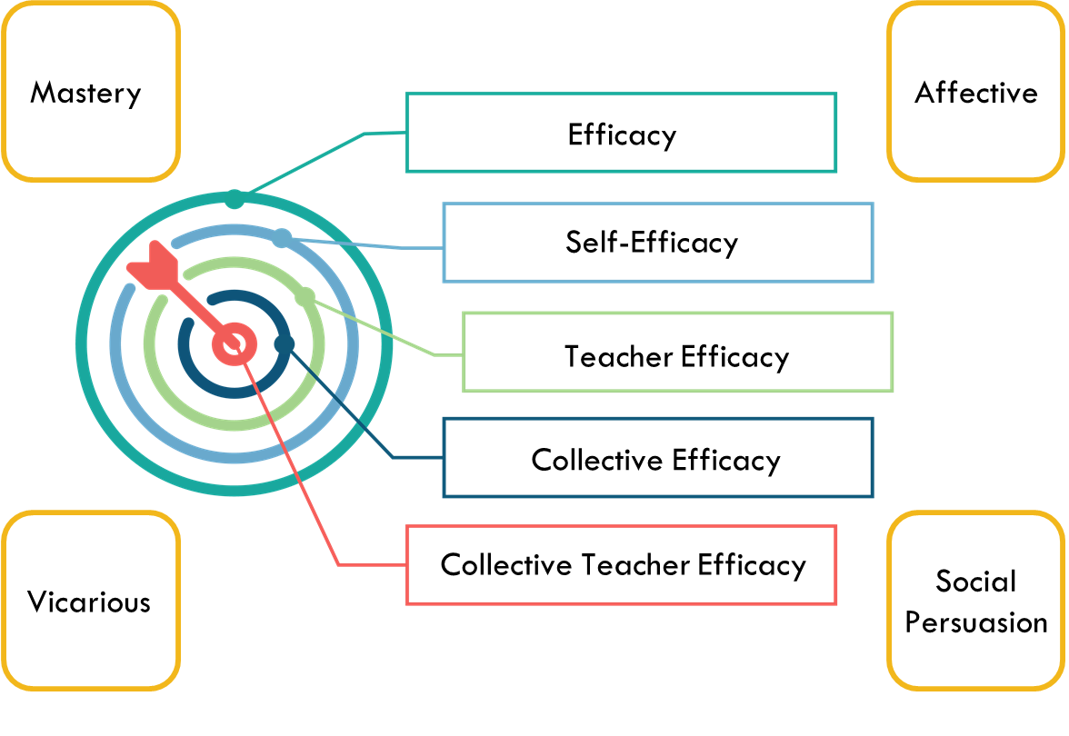
Understanding CTE
Look at the template and the notes you have made. With a highlighter, mark 3 important pieces of information you have recorded.
Be ready to share with a colleague.
Notes:
To Know
This is a brief opportunity to review the concepts of CTE.
To Do/Say
You can do a whip-around of learning by asking participants to share aloud or record their ideas on chart paper as a summative activity.
Stand up, hands up, or pair up.
Take your template with you; find someone with whom you haven’t talked today, and share your significant learning. Allow 2-3 minutes of conversation.
.

Slide 61


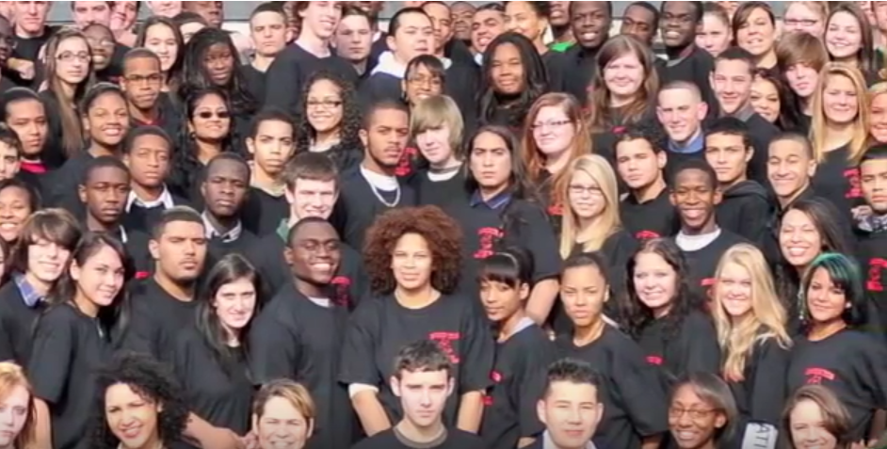
Brockton High School Example
Notes:
To Know
This activity uses a blog post about a school turn around at Brockton High School. Make copies or provide electronic access to the article (address below) for participants. The story is old, but the experience highlights elements of CTE. The story of Brockton illustrates a school that went from failing to being recognized as the most improved in the state. The blog post is long and could be provided as a pre-read if you are short on time.
To Do/Say
Give each participant a copy of the article, “How a decade-long literacy obsession transformed Brockton High” by Andrea Gabor (address below).
Take a few minutes to skim through the article, while this is an older story, it highlights many aspects of CTE in action. The article describes a school that went from failing, to one recognized as the most improved in the state. As you read through the article, highlight places where CTE is found.
The CST may wish to use a sheet of chart paper to record participants’ reflections or key findings.
Possible CTE connections include:
a school that was in trouble academically because the focus was mainly on sports--teaches would “pass the buck” if students weren’t theirs or the content was someone else’s--not their responsibility. (Poor example of CTE)
a group of teachers decided somebody had to do something, so they did. It started with a small group and, bit by bit, came to encompass almost all the faculty. The article makes no bones about the fact that some didn’t and wouldn’t get on board, but when the dust settled, they made improvements happen.
It was either work together or go down together. In the end, it was about students and being able to demonstrate that it was teachers working together that created success.
Leadership’s role in creating conditions for CTE
Role of PD to supporting CTE
Getting everyone to “row in the same direction”
Use of data to guide decisions (not teaching to the test)
Continuous Improvement
References
Gabor, A. (2011, September 30). How a decade-long literacy obsession transformed Brockton High [Web log post]. Retrieved from https://andreagabor.com/2011/09/30/a-school%E2%80%99s-decade-long-literacy-obsession-and-how-it-transformed-brockton-high/

Slide 62
Your beliefs become your thoughts. Your thoughts become your words. Your words become your actions. Your actions become your habits. Your habits become your values. Your values become your destiny.
-Ghandi

Slide 63
Which elements of CTE do you hear?
Notes:
Note
This video is embedded and should play in slideshow mode. However, some older versions of PPT may not recognize the video format. If the video in this slide will not play, use this https://youtu.be/YVWRJ-nBwcU to play the video from the original source or use the hidden slide that follows.
To Know
Overall answer: Teachers are the leaders of professional learning.
To Do/Say
Revisit Collective Efficacy Training Video from slide 22. Watch video again and add to previous notes.
Let’s watch this video from the beginning of our training again. Now that you have a deeper understanding of efficacy, what might you add to your thoughts about the elements of CTE you hear?
References
Raytown Schools. (2018, May 1). Collective efficacy training interview clip 4 [YouTube video]. Retrieved from https://youtu.be/YVWRJ-nBwcU

Slide 64
Which elements of CTE do you hear?
Notes:
Note
This slide is hidden and a duplicate of 63 because some older versions of PPT may not recognize the video format in the previous slide. If the video in this slide will not play, use this https://youtu.be/YVWRJ-nBwcU to play the video from the original source.
To Know
Overall answer: Teachers are the leaders of professional learning.
Note: Some older versions of PPT may not recognize the video format. If the video in this slide will not play, use this url to play the video from the original source.
To Do/Say
Revisit Collective Efficacy Training Video from slide 22. Watch video again and add to previous notes.
Let’s watch this video from the beginning of our training again. Now that you have a deeper understanding of efficacy, what might you add to your thoughts about the elements of CTE you hear?
References
Raytown Schools. (2018, May 1). Collective efficacy training interview clip 4 [Video file]. Retrieved from https://youtu.be/YVWRJ-nBwcU

Slide 65
Next Steps
Developing Capacity
Notes:
Slides 65 – 76 are provided to help districts determine next steps in their focus on CTE.
The trainings will then continue in the appropriate focus modules.

Slide 66
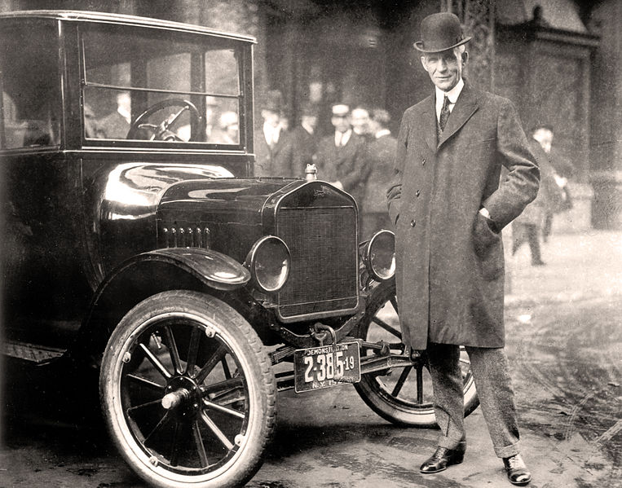
If you think you can do a thing or think you can't do a thing, you're right.
--Henry Ford
Notes:
To Know
The means to build capacity are conveyed in separate, focused modules that can be selected and done one at a time, depending on time allotments in districts or buildings.
To Do/Say
Relate the quote to CTE

Slide 67
How Do We Develop CTE Capacity?
Collaboration and Social Networks
Teacher Leadership
Teacher Voice in Decision Making and Problem-Solving
Collaborative Teacher Inquiry
Notes:
To Know
Each of these topics is a stand-alone focus module.
To Do/Say
Decide on Next Steps for learning
As you look at this list, know that each of these areas is a short focus module that explains how each of these work (together) to create and deepen collective teacher efficacy. These focus module do not have to be done in this order, but knowing this material will help teachers and teacher teams understand their strengths and areas for growth. If you have time and have a group ready to move on, you might even introduce another focus module and get participants thinking about what’s ahead. Additionally, the SBIC module is also a significant piece.

Slide 68
Where Do We go From Here?
Notes:
To Know
This slide is provided as a handout. It is too small to read and participants will need a copy to use in their planning.
From here, schools may use the flowchart to see which focus module is the best fit for their building. As an alternative to the flowchart, there are Planning Reflection Questions on the next slide or the SAPP could be used to prioritize training.
Either the flowchart of reflection questions can be used, but there is no need to use both.
To Do/Say
Use the flowchart to make some decisions about next steps.

Slide 69
Where Do We go From Here?
Notes:
To Know
This slide is provided as a handout. It is too small to read and participants will need a copy to use in their planning. From here, schools may use the flowchart or the reflection questions to see which, if any focus module might be a next consideration. Teams would use the decision tree or the reflection questions to consider the other focus modules they might want to consider and develop next steps.
As an alternative to the reflection questions, there is a flow chart on the previous slide, or the SAPP could be used to prioritize which focus module might be next. Participants will do either the flowchart or the Planning Reflection Questions but do not need to do both. If there are checkboxes left unchecked, participants should consider going through the focus module for that area.
To Do/Say
Use the reflection questions to make some decisions about next steps. Is there another focus module that you need to explore? What would be the best timeline for the next module? Remember, it will be more beneficial to fully implement the plan you have just developed before moving to the another module.

Slide 70
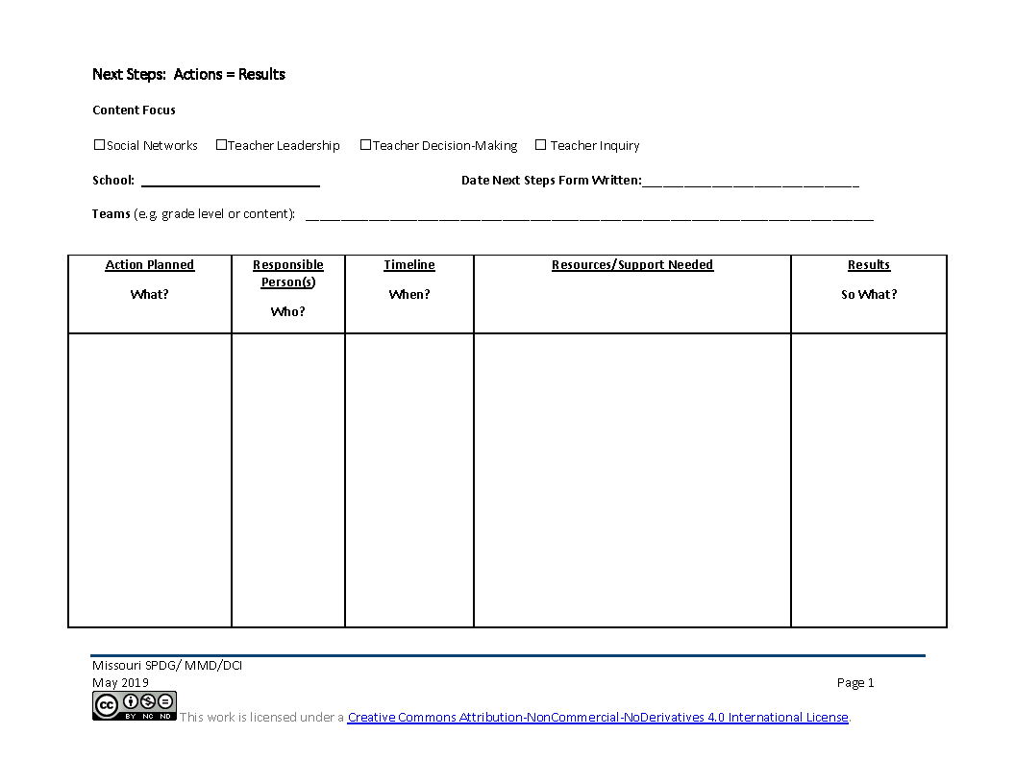
Next Steps: CTE Action = Results
What is teacher inquiry like in my school?
What are actionable steps I can take to build teacher inquiry?
Notes:
To Know
Action Planning is a critical component for change. The action plan document is a living document that will be updated as needed after each focus module.
To Do/Say
Provide a copy of the action plan handout to participants. You may choose to provide one per team or one per participants.
Provide participants an overview of the action plan process by stating that the action plan process is a critical element to deeper implementation of practice as what gets planned is what gets done. It is also a communication piece to make sure that everyone is on the same page.
Dependent on the time structure for completion of the form, the following guiding questions can be posed per section.
Statement of vision Take a minute to self-reflect. What key words related to CTE Decision-Making resonate with you as work to deepen any areas of weakness? What will it look like in 3 years?
Where are we going? From your vision statement, what is your short term goal for the end of this school year? (If mid school year, may want to frame at the end of the school year, if beginning of the year, may want to frame it as first semester, or frame it when we meet again, etc., but important to frame it in a time line.)
How will I close the gap? Beginning with the short term target, what are the actions/next steps that we need to take. (Dependent on the group, may want to randomly list all actions on chart paper and then prioritize.) Everyone take a minute to review our steps, have we covered key points, do we have the right supports, structure, and people? Do our proposed actions align with our gaps and address our vision? (Utilize a fist to five or other methods to obtain consensus from those present.) Do we need to get consensus or buy in from others to move forward? What else?
Now that we have our first actions, let’s go back to the big picture. Looking again at our vision statement, where do we want to be in a year? What should our long range target be for CTE implementation?
Remind participants that CST support is available throughout implementation.

Slide 71
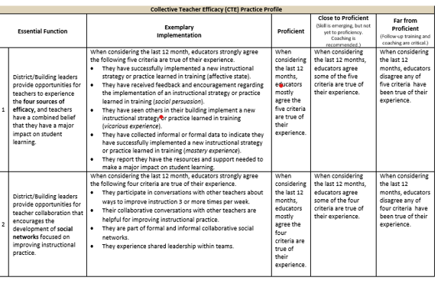
Practice Profile
Notes:
To Know/ To Do/ To Say:
This is a screen shot of the Practice Profile which you have as a handout. It is a rubric that will help you determine where you are in regards to implementing CTE in your building. Please take a moment to see what is looks like to be proficient.

Slide 72
References
Adams, C. M., Forsyth, P. B. (2006). Proximate sources of collective teacher efficacy. Journal of Educational Administration, 44(6), 625-642.
Bandura, A. (1986). The explanatory and predictive scope of self-efficacy theory. Journal of Social and Clinical Psychology, Special Issue: Self-Efficacy Theory in Contemporary Psychology, 4, 359-373.
Bandura, A. (1994). Self-efficacy. In V. S. Ramachaudran (Ed.), Encyclopedia of human behavior (Vol. 4, pp. 71-81). New York: Academic Press. (Reprinted in H. Friedman [Ed.], Encyclopedia of mental health. San Diego: Academic Press, 1998).
Berebitsky, D. & Salloum, S. J. (2017). The relationship between collective efficacy and teachers’ social networks in urban middle schools. American Educational Research Association, 3(4), 1-11. Retrieved from https://journals.sagepub.com/doi/pdf/10.1177/2332858417743927
Brinson, D., & Steiner, L. (2007). Building collective efficacy: How leaders inspire teachers to achieve (Issue Brief). Washington, DC: Center for Comprehensive School Reform and Improvement. Retrieved from https://files.eric.ed.gov/fulltext/ED499254.pdf
Cobb, P., & Jackson, K. (2011). Towards an empirically grounded theory of action for improving the quality of mathematics teaching at scale. Mathematics Teacher Education and Development, 13(1), 6-33. Retrieved from https://files.eric.ed.gov/fulltext/EJ960944.pdf

Slide 73
References
DeWitt, P. (2017, March 12). Why can’t teachers make decision on their own. [Education Week’s Web log post, Finding Common Ground]. Retrieved from http://blogs.edweek.org/edweek/finding_common_ground/2017/03/why_cant_teachers_make_decisions_on_their_own.html
Donohoo, J. (2017). Collective efficacy: How educators’ beliefs impact student learning. Thousand Oaks, CA: Corwin.
Donohoo, J. (2018). Collective teacher efficacy research: Productive patterns of behaviour and other positive consequences. Journal of Educational Change, 19(3), 323–345.
Ermeling, B. A. (2010). Tracing the effects of teacher inquiry on classroom practices. Teaching and Teacher Education, 26(3), 377-388.
Fernandez, A., Ramos, M., Silva, S., Nina, K., & Pontes, F. (2016). Overview of research on teacher self-efficacy in social cognitive perspective. Anales de Psicología, 32.
Gabor, A. (2011, September 30). How a decade-long literacy obsession transformed Brockton High [Web log post]. Retrieved from https://andreagabor.com/2011/09/30/a-school%E2%80%99s-decade-long-literacy-obsession-and-how-it-transformed-brockton-high/
Goddard, R. D., Hoy, W. K., & Hoy, A. W. (2000). Collective teacher efficacy: Its meaning, measure, and impact on student achievement. American Educational Research Journal, 37(2), 479-507.

Slide 74
References
Goddard, R.D., Hoy, W. K., Hoy, A. W. (2004). Collective efficacy beliefs: Theoretical developments, empirical evidence, and future directions. Educational Researcher, 33(3), 3-13.
Goodman, A. (2005). Middle school high five: Strategies can triumph. Voices from the Middle, 13(2), 12-19. Retrieved from https://www.ncte.org/library/NCTEFiles/Resources/Journals/VM/0132-dec05/VM0132Middle.pdf
Hoy, A. W. (2004). Self-efficacy in college teaching. Essays on Teaching Excellence; Toward the Best in the Academy, 15(7). Retrieved from https://cft.vanderbilt.edu/wp-content/uploads/sites/59/vol15no7_self_efficacy.htm
Massachusetts Department of Elementary and Secondary Education. (2015). Building a school culture that supports teacher leadership [Online report]. Retrieved from www.doe.mass.edu/edeval/leadership/BuildingSchoolCulture.pdf
MoEdu-Sail. (2019). District Continuous Improvement Framework (MMD/DCI): Blueprint for district and building leadership, Third Edition. Missouri Department of Elementary and Secondary Education: Northern Arizona University, Institute for Human Development.
Moolenaar, N. M., Sleegers, P. J. C., & Daly, A. J. (2012). Teaming up: Linking collaboration networks, collective efficacy, and student achievement. Teaching and Teacher Education, 28(2), 251-262.
Pierson, R. (2013, May 3). Every kid needs a champion [Video file]. Retrieved from https://www.youtube.com/watch?v=SFnMTHhKdkw

Slide 75
References
Raytown Schools. (2018, May 1). Collective efficacy training interview clip 4 [Video file]. Retrieved from https://youtu.be/YVWRJ-nBwcU
Reeves, D. B. (2006). The learning leader. Alexandria, VA: ASCD. Retrieved from http://www.ascd.org/publications/books/105151/chapters/The-Dimensions-of-Leadership.aspx
Rogers, M. (2017, January 18). Baby bottle flip part 2 [Video file]. Retrieved from https://youtu.be/bqytnV3xHvE
StoryCorps, Inc. (2011). He said, you make sure you call that teacher [Video file]. Retrieved from https://storycorps.org/stories/al-siedlecki-and-lee-buono/
Visible-Learning. (n.d.). Hattie’s ranking: 252 influences and effect sizes related to student achievement. Retrieved from https://visible-learning.org/hattie-ranking-influences-effect-sizes-learning-achievement
York-Barr, J., & Duke, K. (2004). What do we know about teacher leadership? Findings from two decades of scholarship. Review of Educational Research, 74(3), 255-316.

