Slide 1
Hidden Slide #1
Presenter notes information
Tools and documents
Helpful suggestions
Notes:
To Know: The Developing Assessment Capable Learners (ACL) learning package is organized in four parts. The first learning package contains the ACL Overview. Part 1 addresses the first question, “Where am I going?” or strategies 1 and 2. Part 2 addresses the second question, “Where am I now?” or strategies 3 and 4. Strategy 3 focuses on effective feedback which was originally a separate learning package. Strategy 4 focuses on students self-assessment and goal setting. The third question, “How can I close the gap?” or strategies 5, 6, 7 is Part 3 of the ACL learning package.
The CW Content Fidelity Checklist aligned to each learning package includes all critical items for a training session. The CW HQPD Training Checklist and Coaching Checklist contain process elements to be used as guidance when designing, revising, or coaching high quality professional development.
Important notes:
A script of presenter notes is included in the PowerPoint. Background information for the presenter is shown as “To Know.” Statements to be shared with participants are shown as “To Say.” In some instances, the “To Know/To Say” are the same material. For fidelity of content and consistency among presenters, the “To Say” information should be presented with minimal paraphrasing. The presenter notes also include “To Do” prompts and cues for “Handouts”.
A presenter may add slides to supplement the content. For example, a slide of essential questions may be added since only objectives have been included.
A presenter may choose to differentiate a presentation to meet the needs of the participants. For example, another form may be substituted for the Next Steps template if the district or building already uses a similar form or protocol.
Additional activities, examples, videos, etc. are being developed. A presenter may interchange the additional material for the corresponding PowerPoint content.
An Implementation Fidelity Checklist is available for frequent monitoring by a teacher or observer.
A print Practice Profile and an electronic Self-Assessment Practice Profile (SAPP) tool are available for use by individuals, teams, or schools for periodic self-assessment and monitoring of implementation of practice or to identify training or coaching needs.
The presenter should download onto a hard drive or a flash drive any video intended for use in a training. The links shown on slides may not be able to be accessed online at the school sites.
Breaks should be inserted at the discretion of the presenter based on the needs of participants.

Slide 2
Hidden Slide #2
Handouts needed:
Where am I Now?
Seven Keys to Effective Feedback
Feedback, Descriptive or Evaluative?
Descriptive Feedback Exemplars
Formative Assessment and Feedback to Learners
My Feedback Practices
Self-Assessment – Engage in Assessment
Self Assessment Tools
Student-Self Assessment
Student Goal Setting Tools
What Do You Already Do? Strategies 3 and 4
Handouts used in all ACL presentations:
ACL infographic
Teacher Strategies for Developing Assessment Capable Learners
Developing Assessment Capable Learners Practice Profile
Next Steps: Action = Results
Notes:
Handouts: Handouts are available on MOEDUSAIL.

Slide 3

Preparation
Developing Assessment Capable Learners
Part 2:
Where Am I Now?
Notes:
Purpose: Provide opportunity for learners to engage in the content prior to the formal training
Content:
Learning objectives
Expectations for the training
Preparatory reading Reflection exercise

Slide 4
Pre-Reading
Teacher Strategies for Developing Assessment Capable Learners
Notes:
To Know: Jan Chappuis has organized seven teacher strategies within the three ACL questions. Review of strategies 1 and 2 under the first question and introduction of strategies 3 and 4 under the second question can serve as a pre-reading activity. These strategies and questions will be discussed at the beginning of the training session.
Handout: Teacher Strategies for Developing Assessment Capable Learners (This is a participant copy of these 7 strategies aligned with the three questions.)
Reference: Chappuis, J. (2015). Seven strategies of assessment for learning, 2e. Upper Saddle River, NJ: Pearson Education.

Slide 5
Developing Assessment Capable Learners
Part 2:
Where Am I Now?
Notes:
To Know/To Say: Good morning/afternoon! We will begin in _____ minutes.
To Do: Greet participants.

Slide 6
Acknowledgements
Special thanks to all contributors to the development and revision of this module.
The original collection of learning packages was rolled-out for use by Regional Professional Development Center (RPDC) Consultants in July 2013 after being developed by a team of content experts. The collection of learning packages was developed through efforts funded by the Missouri State Personnel Development Grant (SPDG). The following individual/groups are thanked immensely for their hard work in developing this package.
Content Development and Revision Support
UMKC Institute for Human Development
Ronda Jenson, Director Stefanie Lindsay
Arden Day Carla Williams
Jodi Arnold
SPDG Management Team
Notes:
To Know/To Say: Special thanks to all contributors to the development and revision of this module.

Slide 7
Initial Content Development Team, 2013
Mary Richter, Team Leader, MO SW-PBS Ginger Henry, DESE
Winona Anderson, South Central RPDC Amy King, Kansas City RPDC
Julie Blaine, Central RPDC Debbie Litner, Southeast RPDC
Deb Childs, MO SW-PBS Jana Loge, Southwest RPDC
Janet Crafton, South Central RDPC Kris Luginbill, Southwest RPDC
Susan Feeback, Central RPDC Robert Rethemeyer, Central RPDC
Diane Feeley, MO SW-PBS Patty Wilmes, Northwest RPDC
Doug Hatridge, Central RPDC Liz Condray, South Central RPDC (Enhancent, ‘14)
2016 Revision Team
Nancy Steele, Facilitator, NE SIS Alan Bancroft, C RPDC
Beverly Colombo, StL RPDC Ginger Henry, DESE
Bev Kohzadi, C RPDC Stephanie Kuper, SE RPDC
Lori Ladwig, NE RPDC Sarah Spence, C SIS
Terri Steffes, Hook Center
Notes:
To Know/To Say: Thank the contributors.

Slide 8

Opening & Introductions
Notes:
Purpose: Provide an overview of the day, including reviewing learner objectives, outcomes, and essential questions
Content:
Universal slides explaining; Organization of learning packages, Infographic, Hattie’s barometer
Session at-a-glance
Learning targets
Essential questions
Norms
Missouri Teacher Standards
To Know/To Say: Welcome to Developing Assessment Capable Learners Part 2: Where Am I Now?
The introductions may be formal or informal depending on how well you know the group. Trainers should use whatever process is comfortable for introductions. I am/we are _______________ (provide some background about trainers.) Please introduce yourself to the group (name, district, position.)
To Do: (optional) Consultant develop an ice-breaker or introductory activity.

Slide 9
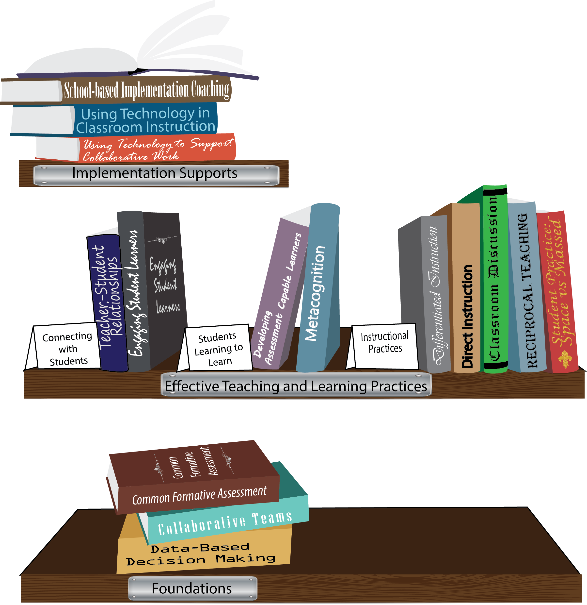
Notes:
To Know/To Say: Missouri’s professional development learning packages are organized in three categories: Foundations, Effective Teaching & Learning Practices, and Implementation Supports. All schools begin their professional development journey with the Foundations, as these learning packages provide foundation knowledge in three key areas: Collaborative Teams, Data-based Decision-making, and Common Formative Assessment. Effective Teaching & Learning Practices encompass research-based instructional practices for deepened learning. These learning packages address ways of connecting with students, ways of helping students learn how to learn, and feature specific instruction practices. Implementation Supports are learning packages designed to help school staff support and enhance the Implementation of Effective Teaching & Learning Practices through using technology and peer coaching supports.
To Do: Explain how the graphic depicts professional development in Missouri.
To Know/To Say: Developing Assessment Capable Learners, an Effective Teaching & Learning Practice, is divided into an overview and three parts.

Slide 10

Developing
Assessment Capable Learners
1. Where Am I Going?
2. Where Am I Now?
3. How Can I Close the Gap?
Assessment Capable Learners
can identify:
Notes:
To Know/To Say: Assessment Capable Learners (ACL) focuses on the three questions that students can identify: Where am I going? Where am I now? How Can I close the gap? Today we will look at ACL Part 2 which addresses the second question.

Slide 11
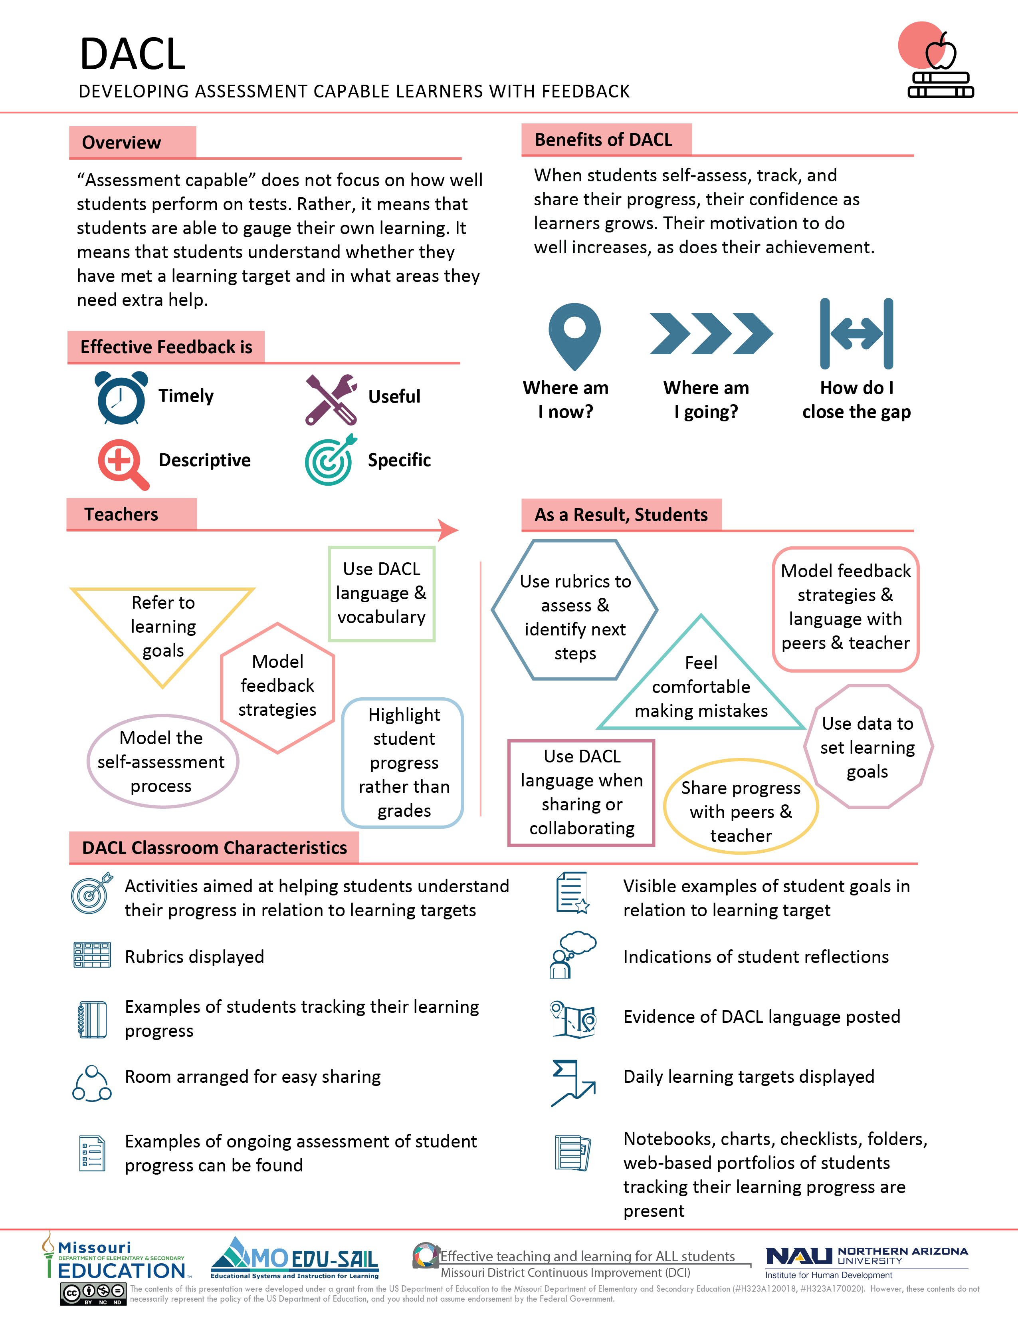
Notes:
To Know/To Say: The ACL infographic summarizes key content from the learning package.
Handout: Developing Assessment Capable Learners
References: Chappuis, J. 2015. Seven strategies of assessment for learning, 2e. Upper Saddle River, NJ: Pearson Education.
Hattie, J. (2015). Hattie Ranking: 195 Influences And Effect Sizes Related to Student Achievement. Visible Learning. Retrieved from https://visible-learning.org/hattie-ranking-influences-effect-sizes-learning-achievement/.

Slide 12
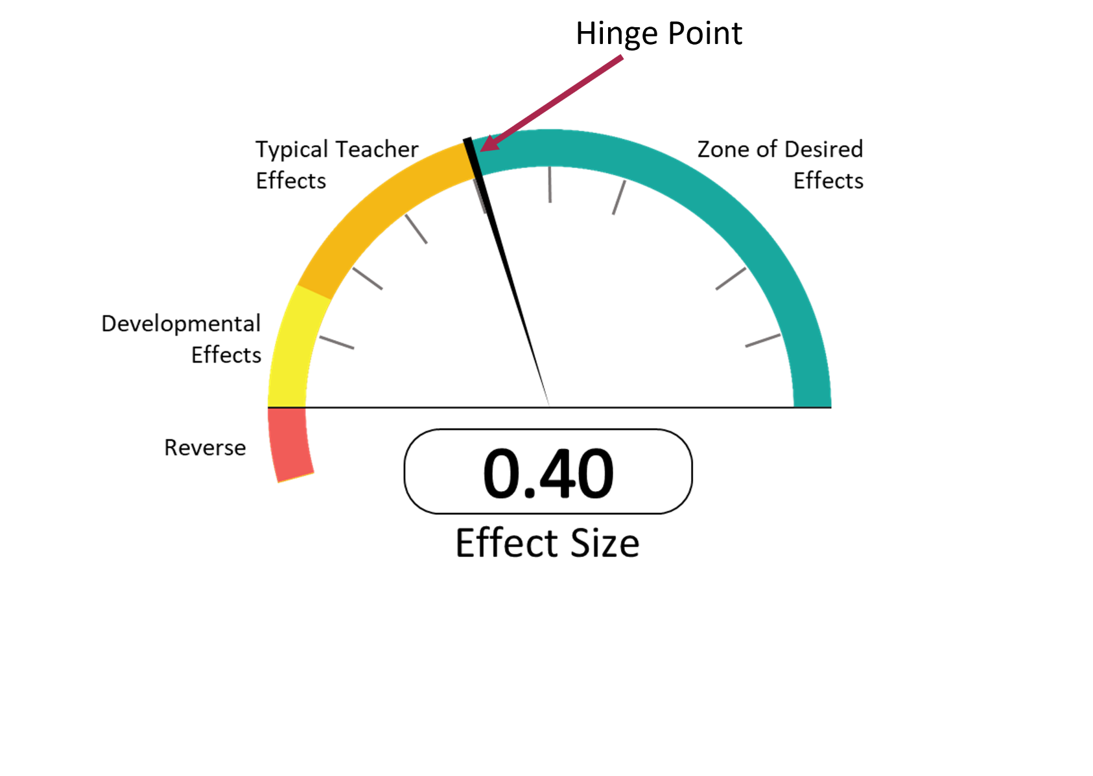
Hattie’s “Barometer of Influence”
Hattie (2015)
Notes:
To Know: EFFECT SIZE
“An effect size is a useful method for comparing results on different measures (such as standardized, teacher-made tests, student work), or over time, or between groups, on a scale that allows multiple comparisons independent of the original test scoring (for example, marked out of 10, or 100), across content , and over time. This independent scale is one of the major attractions for using effect sizes, because it allows relative comparisons about various influences on student achievement.” (Hattie, 2012)
To Know/To Say: John Hattie’s 2009 book, Visible Learning, was based on more than 800 meta-analyses of 50,000 research articles, about 150,000 effect sizes, and about 240 million students. Hattie’s new research (2015) has updated effect sizes for the effective teaching and learning practices.
Effect size is a standard measure that can be calculated from any number of statistical outputs. (Biddix, 2009)
Perhaps the most significant discovery from evidence was almost any intervention can stake a claim to making a difference to student learning.
Any effect above zero means that achievement has been raised by the intervention. The average effect size is 0.40; there are just as many influences on achievement above the average as there are below the average.
For any particular intervention to be considered worthwhile, it needs to show an improvement in student learning of at least an average gain – that is, an effect size of at least 0.40, referred to as the hinge-point for identifying what is and what is not effective.
Half of the influences on achievement are above this hinge-point. This is a real-world, actual finding and not an aspiration claim. That means that about half of that we do to all students has an effect of greater than 0.4 or greater, while half are in classes that get less than the 0.4 effect. (Hattie, 2012)
Hattie’s Barometer of Influence represents a summary of the effect size from the studies that were reviewed. The average effect size, 0.40, may be viewed as a typical one year of growth in student learning. Missouri’s Collaborative Work has identified from Hattie’s research Effective Teaching and Learning Practices which are in the high rank of desired effects for student learning outcomes.
To Do: Explain Hattie’s Barometer of Influence.
References:
Biddix, P. (2009, July). Effect Size. Retrieved from https://researchrundowns.wordpress.com/quantitative-methods/effect-size/. Hattie, J. (2009). Visible learning: A synthesis of over 800 meta-analyses relating to achievement. New York, NY: Routledge.
Hattie, J. (2009). Visible learning: A synthesis of over 800 meta-analyses relating to achievement. New York, NY: Routledge.
Hattie, J., Masters, D., & Birch, K. (2015). Visible learning into action: International case studies of impact. Routledge.

Slide 13
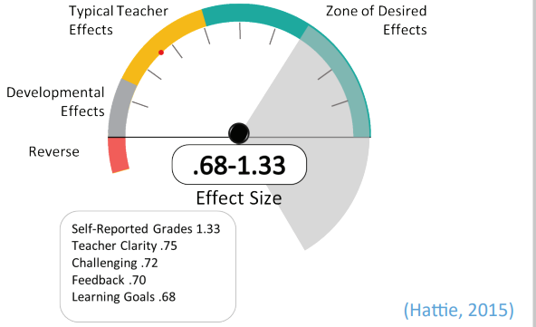
Assessment Capable Learners
Notes:
To Know/To Say: ACL are at the top of the ‘teaching’ domain! ACL has a 1.33 Effect Size.
So, how do you develop Assessment Capable Learners?
Today is an overview to enhance your understanding and explore how to help students become ACL.
To become assessment capable, students need to use high yield practices, or those that have an effect size greater than .40. The higher the effect size, the more impact on student achievement. The following high yield practices that contribute to the development of assessment capable learners are
Self-Reported Grades- effect size 1.33
Teacher Clarity- effect size .75
Challenging Tasks- effect size .72
Feedback- effect size .70
Learning Goals- effect size .68
Reference: Hattie, J. (2015). Hattie Ranking: 195 Influences And Effect Sizes Related to Student Achievement. Visible Learning. Retrieved from https://visible-learning.org/hattie-ranking-influences-effect-sizes-learning-achievement

Slide 14
Missouri Teacher Standards
Standard 1: Content knowledge aligned with appropriate instruction.
Standard 2: Student Learning, Growth and Development
Standard 6: Effective Communication
Standard 7: Student Assessment and Data Analysis
(Missouri Department of Elementary and Secondary Education, 2013)
Notes:
To Know/To Say: ACL aligns with Missouri Teacher Standards.
Standard #1: Content Knowledge and Perspectives Aligned with Appropriate Instruction: The teacher understands the central concepts, structures and tools of inquiry of the discipline(s) and creates learning experiences that make these aspects of subject matter meaningful and engaging for all students.
Standard #2: Understanding and Encouraging Student Learning, Growth and Development: The teacher understands how students learn, develop and differ in their approaches to learning. The teacher provides learning opportunities that are adapted to diverse learners and support the intellectual, social and personal development of all students.
Standard #6: Offering effective communication, especially in the form of feedback to students: The teacher models effective verbal, nonverbal, and media communication techniques with students, colleagues and families to foster active inquiry, collaboration, and supportive interaction in the classroom.
Standard #7: Use of Student Assessment Data to Analyze and Modify Instruction: The teacher understands and uses formative and summative assessment strategies to assess the learner’s progress, uses assessment data to plan ongoing instruction, monitors the performance of each student, and devises instruction to enable students to grow and develop.
Reference: Missouri Department of Elementary and Secondary Education (MO DESE), (2013). Teacher Standards: Missouri's educator evaluation system. Retrieved from: http://dese.mo.gov/sites/default/files/TeacherStandards.pdf.

Slide 15
Session-at-a-Glance
Review and reflect Part 1
Discover strategies for teachers and students
  Where Am I Now?
    A look at effective feedback
    A look at self-assessment
Use evidence of student learning to determine next steps in teaching
Notes:
To Know/To Say: In the previous session we focused on the first question that Assessment Capable Learners should be able to answer: “Where am I going?” in reference to strategies 1 and 2.
This training focuses on answering the question, “Where am I now?” in reference to strategies 3 and 4.
At the end of the training, action planning is provided for teams to determine their next steps. Included are examples for embedding ACL in professional practice.

Slide 16
Learning Targets
I can reflect on/discuss how I helped students know “Where I am going?”.
I can identify and implement characteristics of effective feedback.
I can teach students to self‐assess accurately with a focus on learning targets.
I can implement strategies that maximize the impact of student self‐assessment and goal setting.
Notes:
To Know/To Do: Go over the learning targets listed.
To Say: As a learner, today you will develop an understanding of effective feedback, self-assessment, and goal setting. You will learn to teach students to assess with a focus on learning targets.
When teachers return to school, following training, the expectation is to utilize the components of ACL in their classrooms.

Slide 17

Essential Questions
Why is it important to have students identify “Where am I going?” and “Where am I now?”?
How can I utilize effective feedback to help students identify “Where am I now?”
How can I help students assess and identify “Where am I now?”
How can we use a combination of strategies to promote assessment capable learners?
Notes:
To Know/To Say: Let’s begin the work of learning a strategic and consistent understanding of what ACL is with these essential questions in mind.

Slide 18
Norms
Begin and end on time.
Be an engaged participant.
Be an active listener—open to new ideas.
Use notes for side bar conversations.
Use electronics respectfully.
Notes:
To Know/To Do: Consider including a check mid-way through trainings to assess a norm or norms. The presenter may want to use norms printed on agenda handouts, in addition to or in place of presentation slides, so the norms are always available in print for participants. Norms may be added to address specific school needs. Some schools already have established norms for all PD. In that case, adapt to their norms.

Slide 19
Developing Assessment Capable Learners
Part 2:
Where Am I Now?
Notes:
To Know/To Say: We are moving into the Overview section of the topic of Assessment Capable Learners Part 2. We will look at current assessment practices, define what an assessment capable learner is, assess our current reality, identify the strategies for developing assessment capable learners, and discuss how the practice of assessment capable learners directly correlates to student motivation.

Slide 20
Teacher Strategies for Developing Assessment Capable Learners
To help students know where they are going, I need to:
  Provide clear and understandable vision of the learning target.
  Use examples and models of strong and weak work.
To help students know where they are now, I need to:
  Offer regular descriptive feedback.
  Teach students to self-assess and set goals.
To help students know how to close the gap, I need to:
  Use evidence of student learning needs to determine next steps in teaching.
  Design focused instruction, followed by practice with feedback.
  Provide students opportunities to track, reflect on, and share their learning progress.
(Chappuis, 2015)
Notes:
To Know: A handout of this slide was distributed in the ACL Overview.
To Say: Jan Chappuis has organized seven teacher strategies within the three ACL questions.
Handout: Teacher Strategies for Developing Assessment Capable Learners (This is a participant copy of these 7 strategies aligned with the three questions.)
Reference: Chappuis, J. (2015). Seven strategies of assessment for learning, 2e. Upper Saddle River, NJ: Pearson Education.

Slide 21
Questions Students Need to Answer
Where am I going?
  1. I know what I am supposed to be learning and it makes sense to me.
  2. I know what quality work looks like.
Where am I now?
  3. It is clear to me what I am doing well and what I need to do next.
  4. I self-assess and set my own learning goals.
How can I close the gap?
  5. I know what the next step is for my learning.
  6. I rework, refine, and revise my work to reach my learning target.
  7. I reflect on my work and keep track of my progress in order to share my learning with others.
(Chappuis, 2009)
Notes:
To Know/To Say: These questions and strategies are written in student friendly language.
Reference: Adapted from: Chappuis, J. (2009). Seven strategies of assessment for learning. Allyn & Bacon.

Slide 22
Use of These Strategies Is Not Linear
Strategies 1 through 3, provide a clear picture of where we are going.
Strategy 4 and Strategy 7, explain where we want our students to arrive.
Strategies 5 and 6, can happen at any time and often use Strategies 1-4 as part of the lessons.
(Chappuis, 2015)
Notes:
To Know/To Say: The Seven Strategies of Assessment for Learning comes from the work of Jan Chappuis. While the seven strategies seem like a continuum of when to use each strategy, the strategies can actually be used at various points of instruction.
Research: Chappuis, J. 2015. Seven strategies of assessment for learning, 2e. Upper Saddle River, NJ: Pearson Education.

Slide 23
“Indispensable Conditions” for Improvement in Learning
The student:
  comes to hold a concept of quality roughly similar to that of the teacher. (Where am I going?)
  is able to monitor continuously the quality of work produced during the act of production. (Where am I now?)
  has a repertoire of alternative learning strategies to employ when faced with incomplete mastery. (How can I close the gap?)
(Sadler, 1989)
Notes:
To Know/To Say: Sadler’s “indispensable conditions” for improving learning aligned to the three questions.
Reference: Sadler, D. R. (1989). Formative assessment and the design of instructional systems. Instructional science, 18(2), 119-144.

Slide 24

Today’s Focus:
Where Am I Now?
Strategy 3: How do you (or could you) offer feedback to students?
Strategy 4: How do you (or could you) teach students to self-assess and set goals?
Notes:
To Do/Know: Give participants time to write a brief reflection. This reflection by participants helps them identify “Where am I now?” on this topic and can be used to see growth at the end of the training.

Slide 25
Where Am I Now?
To help students know where they are now, I need to:
  Offer regular descriptive feedback.
  Teach students to self-assess and set goals each day.
Pair up with another person.
One person read about strategy 3.
One person read about strategy 4.
Both readers highlight important points from the reading.
Come together and share information about your strategy.
(Chappuis, 2015)
Notes:
To Do: Distribute the handout titled, Where am I Going? and follow the directions on the slide.
Handout: Where am I Now?
Reference: “Seven Strategies of Assessment for Learning” is excerpted from Chappuis, J. (2015). Seven strategies of assessment for learning, 2e. Upper Saddle River, NJ: Pearson Education, pp. 11‐14.

Slide 26
Unpacking the Topic
Where Am I Now?
Strategy 3: Offer Regular Descriptive Feedback
Notes:
To Know: Various adjectives (effective, descriptive, actionable) can be used with the term feedback depending on the author. Sometimes these adjectives are interchangeable; however, effective feedback is generally an overall term and descriptive feedback or actionable feedback provides further details about effective feedback. Since authors may use any of these adjectives with the term feedback, you will notice these various terms within this training.
Purpose: Explore the core components and implementation steps for effective feedback.
Content:
Learning Outcomes and Barometer
Definition, Benefits and Purpose of Feedback
Classroom Climate
Effective Feedback
Descriptive or Evaluative Feedback
Three Levels of Feedback

Slide 27
Learning Outcomes
Feedback
Understand the power of effective feedback as it relates to student learning and instructional practices.
Recognize and apply meaningful, descriptive/ actionable feedback.
Develop an awareness of Hattie’s and Timperley’s three important levels of feedback: task, process, and self-regulation.
Notes:
To Know/To Say: Strategy 3, descriptive feedback, has three learning outcomes. Learning intentions clarify explicitly what participants will learn through the training experience.
Hattie uses the term Learning Intentions as opposed to the term Learning Objectives in Visible Learning for Teachers. This is up to the presenter’s discretion.
To Know: Hattie and Timperley talk about four levels of feedback, but the intent is to make the participant aware of the three important levels of feedback.
Learning Intentions (LI) are aligned to version 1.0 with greater application. LI apply to teachers of all grade levels, Special Education, and ELL.

Slide 28
Assessment Capable Learners
Notes:
To Know/To Say: Please remember this slide from earlier. Of the 195 influences studied by Hattie, Feedback ranked 15th in its impact on student achievement with an effect size of 0.70.
Reference: Hattie, J. (2015). The applicability of Visible Learning to higher education. Scholarship of Teaching and Learning in Psychology, 1(1), 79.
Reference: Hattie, J. (2015). Hattie Ranking: 195 Influences And Effect Sizes Related to Student Achievement. Visible Learning. Retrieved from https://visible-learning.org/hattie-ranking-influences-effect-sizes-learning-achievement

Slide 29
Definition of Feedback
Feedback is defined as:
“information provided by an agent (e.g. teacher, peer, book, parent, self, experience) regarding aspects of one’s performance or understanding.”
(Hattie & Timperley, 2007, p. 81)
Notes:
To Know/To Say: Hattie’s (1999) overall studies on learning it became clear that giving feedback is one of the highest influences on achievement, along with direct instruction, reciprocal teaching and students’ prior cognitive ability. The meta-analysis on the effects of feedback does ‘show considerable variability, indicating that some type of feedback are more powerful than others. Those studies showing the highest effect sizes involved students receiving information feedback about a task and how to do it more effectively’. ‘The most effective forms of feedback provide cues or reinforcement to learners; are in the form of video-, audio-, or computer-assisted instructional feedback; and/or relate to goals. Programed instruction, praise, punishment, and extrinsic rewards were the least effective for enhancing achievement’.
Reference: Hattie, J., & Timperley, H. (2007). The power of feedback. Review of educational research, 77(1), 81-112.

Slide 30
Benefits of Feedback
According to James Pennebaker,
“Students must be given access to information about their performance. At the broadest level, students need to know if they actually have mastered the material or not. Giving them feedback about the ways they are studying, reading, searching for information, or answering questions can be invaluable.”
(Stenger, 2014)
Notes:
To Know/To Say: When students have access to this information, they develop an awareness of their learning, and are more easily able to recognize mistakes and eventually develop strategies for tackling weak points themselves. Thus, becoming self monitors of their own learning.
Reference: Stenger, M. (2014, August 6). 5 Research-based tips for providing students with meaningful feedback. Web blog post. Edutopia. George Lucas Educational Foundation, August 5, 2014. Retrieved from https://www.edutopia.org/blog/tips-providing-students-meaningful-feedback-marianne-stenger.

Slide 31
Purpose of Feedback
The main purpose of feedback is to reduce discrepancies between current understanding or performance and some desired level of performance or goal.
Current Understanding
GAP
Desired Level of Performance
(Hattie & Timperley, 2007)
Notes:
To Know/To Say: The purpose of this slide is to provide a visual that restates and expands on the important role of feedback in the learning process. The graphic builds to show flow of beginning with Current Understanding, providing feedback to close the gap to attain the Desired Level of Performance.
Reference: Hattie, J., & Timperley, H. (2007). The power of feedback. Review of Educational Research, 77(1), 81-112.

Slide 32
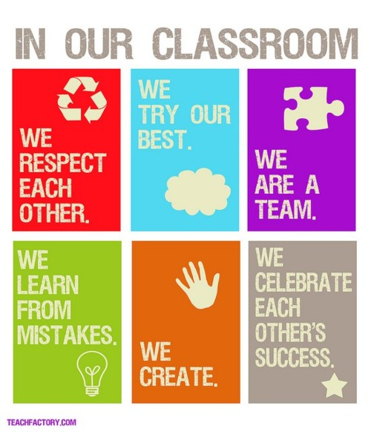
Setting the Stage for
Descriptive Feedback
Developing a safe, collaborative and constructive classroom for receiving/giving descriptive feedback.
Notes:
To Know: This slide serves as a transition slide into the classroom climate component.

Slide 33
Classroom Climate is Critical
Students are active participants as individuals and as members of collaborative groups.
A safe, healthy and supportive environment can develop compassion and mutual respect.
Efficient classroom management promotes comfort, order and appropriate student behavior.
Learning is a process where risks are encouraged and mistakes are a natural part of learning.
(Hattie & Timperley, 2007)
Notes:
To Know/To Say: Giving students feedback in the classroom during the learning process has been proven to increase learning and improve student outcomes. When feedback is given correctly, along with a positive classroom climate setup, it sends a message to the student that the instructor cares about the learning taking place. It also allows the student to become more engaged and involved in the classroom.
To Do: Have participants individually write down one of these components they believe they need to work/or enhance on in their classroom. (Pair share at presenter”s discretion.)
Reference: Hattie, J., & Timperley, H. (2007). The power of feedback. Review of educational research, 77(1), 81-112.

Slide 34
“The goal of effective classroom management is not creating “perfect” children, but providing the perfect environment for enhancing their growth, using research-based strategies that guide students toward increasingly responsible and motivated behavior.”
(Sprick, Knight, Reinke & McKale, 2006, p. 185)
Notes:
To Know: The quote provides a transition into why it is important to establish an effective/positive classroom environment. This information is communicated in a podcast to follow, it might be useful for participants to hear it more than once. This is a presenter’s discretion.
To Say: When the amount of time spent in various classroom activities was researched, only 17% was spent in instruction and 33% in seatwork.
Transitions take 20% of the school day. The typical elementary classroom loses 7-10 minutes each transition from one subject to another; with a typical day including at least 10 transitions, 70 minutes are lost each day; almost one day per week lost to transitions alone.
Unfortunately discipline and other non-instructional activities such as taking attendance, announcements, etc., accounted for 30% of the school day.
Reference: Sprick, R., Knight, J., Reinke, W., & McKale, T. (2006). Coaching classroom management: A toolkit for coaches and administrators. Eugene, OR: Pacific Northwest Publishing.

Slide 35
Video
An Introduction to Effective Classroom Practices
Michael Kennedy (n.d.)
Notes:
To Know/To Say: To have an effective classroom climate we must address ways to develop the perfect environment for all students to be successful. That is our goal, isn’t it? We want to set our class up so they can be successful behaviorally so we can teach them the important academic content we want to teach. We can’t control who walks in our classroom door and what their learning history is but we DO have influence over setting up our classroom environment.
To Say/To Do: We are going to view a five minute podcast discuss necessary components for the classroom: instructional time = time to teach and engaged time = students are actively engaged in the learning. Under each of these components are four effective classroom practices to take note.
After viewing podcast;
To Say/To Do: Think about your typical day and the time you spend in various activities. How does it compare to these statistics?
Why is this information relevant to us? (Discipline takes away from time to teach academic curriculum.)
To Know/To Say: Teachers are pivotal in building a community of learners in their classrooms. Teachers bear the responsibility of modeling how to provide effective feedback which enables students to take action on the feedback communicated.
To Do: Take a few minutes and engage in table talk. Reflect on the effective classroom practices for instructional time and engaged time. What might be some next steps for you to take in your classroom?
To Know/To Say: Conclusion: We want to implement effective classroom practices to prevent and decrease interruptions caused by discipline problems and increase the amount of time we have to teach and provide feedback.
Reference: Kennedy, M. (n. d.). Introduction to Effective Classroom Practices from [video file]. Retrieved from Missouri Schoolwide Postitive Behavior Support, Retrieved from: https://vimeo.com/79681916/.

Slide 36
Unpacking the Topic
Effective Feedback
Notes:
To Know: For the purpose of this training session, there is not a distinction between effective feedback and descriptive feedback.

Slide 37
Characteristics of Effective Feedback
“Less teaching + more feedback = better learning”
(Wiggins, 2016, p. 24)
Notes:
To Know/To Say: This slide transitions to the characteristics of effective feedback.
Reference: Wiggins, G. (2016). Seven keys to effective feedback. On Formative Assessment: Readings from Educational Leadership (EL Essentials), 24.

Slide 38
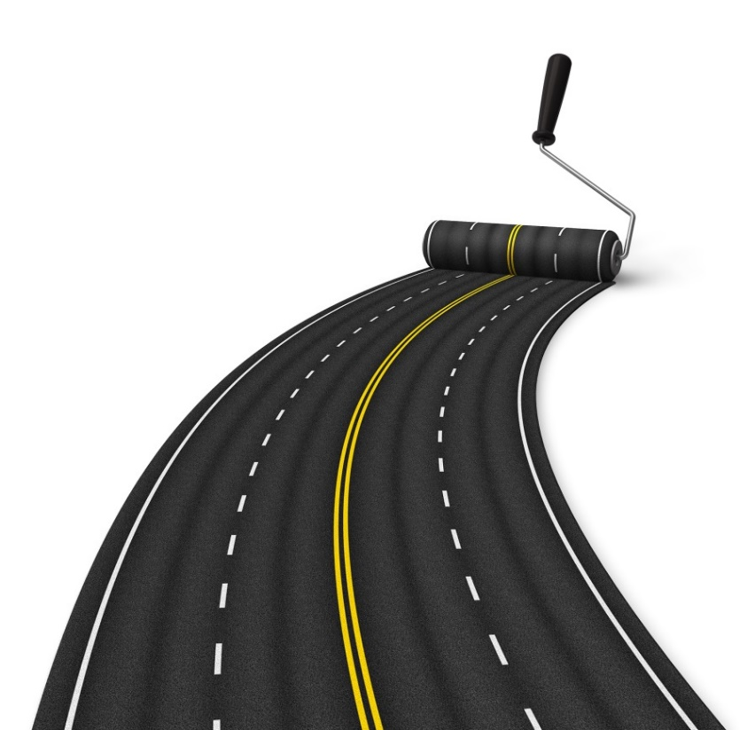
Seven Keys to Effective Feedback
Goal–referenced
Tangible and transparent
Actionable
User friendly
Timely
Ongoing
Consistent
(Wiggins, 2012)
Notes:
To Know/To Say: Seven Keys to Effect Feedback will be read utilizing a jigsaw activity. Instructions are on the next slide.
Handout: Seven Keys to Effective Feedback
Reference: Wiggins, G. (2012). Seven keys to effective feedback. Feedback, 70(1).
To Know:
Goal-referenced: There is only feedback if a person has a goal, takes actions to achieve the goal, and gets goal-related information fed back. To talk of feedback, in other words, is to refer to some notable consequence of one’s actions, in light of an intent.
Transparent and tangible, value-neutral information about what happened: Therefore, any useful feedback system involves not only a clear goal, but transparent and tangible results related to the goal. Feedback to students (and teachers!) needs to be as concrete and obvious as the laughter or its absence is to the comedian and the hit or miss is to the Little League batter.
Information: Thus, feedback is actionable information; data or facts that you can use to improve on your own since you likely missed something in the heat of the moment. No praise, no blame, no value judgment, helpful facts. I hear when they laugh and when they don’t; I adjust my jokes accordingly.
User friendly: Feedback is thus not of much value if the user cannot understand it or is overwhelmed by it, even if it is accurate in the eyes of experts or bystanders.
Timely: The sooner I get feedback, then, the better (in most cases). I don’t want to wait hours or days to find out which jokes they laughed at or didn’t, whether my students were attentive, or which part of my paper works and doesn’t. My caveat, “in most cases”, is meant to cover situations such as playing a piano piece in recital: I don’t want either my teacher or the audience to be barking out feedback as I perform. That’s why it is more precise to say that good feedback is “timely” rather than “immediate.”
Ongoing: It follows that the more I can get such timely feedback, in real time, before it is too late, the better my ultimate performance will be, especially on complex performance that can never be mastered in a short amount of time and on a few attempts. That’s why we talk about powerful feedback “loops” in a sound learning system.
All adjustment in route depends upon feedback and multiple opportunities to use it. This is really what makes any assessment truly “formative” in education. The feedback is “formative” not merely because it precedes “summative” assessments but because the performer has many opportunities, if results are less than optimal, to adjust the performance to better achieve the goal. Many so-called formative assessments do not build in such feedback use.
Consistent: For feedback to be useful it has to be consistent. Clearly, I can only monitor and adjust successfully if the information fed back to me is stable, unvarying in its accuracy, and trustworthy. In education this has a clear consequence: teachers have to be on the same page about what is quality work and what to say when the work is not up to standard. This can only come from teachers constantly looking at student work together, becoming more consistent (i.e. achieving inter-rater reliability) over time, and formalizing their judgments in highly-descriptive rubrics supported by anchor products and performances. If we want student-to-student feedback to be more helpful, students have to be trained the same way we train teachers to be consistent, using the same exemplars and rubrics.

Slide 39
Jigsaw
Number off 1-7
All 1’s, 2’s, 3’s… get together
All 1’s become experts on Goal-referenced, all 2’s become experts on Tangible and transparent, etc.
Come back to your table and share your expert knowledge to your table mates.
Notes:
To Know/To Say: A jigsaw is a cooperative learning strategy that enables each student of a "home" group to specialize in one aspect of a topic (for example, one group read & learn about goal referenced another group read & learn about tangible & transparent. Students meet with members from other groups who are assigned the same aspect, and after mastering the material, return to the "home" group and teach the material to their group members. With this strategy, each student in the "home" group serves as a piece of the topic's puzzle and when they work together as a whole, they create the complete jigsaw puzzle.
To Say: Communicate the directions of the jigsaw activity.
To Do: Jigsaw the Wiggins article, Seven Keys to Effective Feedback.
Handout: Seven Keys to Effective Feedback

Slide 40
Effective Feedback
Helps all students answer these three questions.
Where am I going? (What are my learning intentions?)​
How am I going? (What does the evidence tell me?)​
Where to next? (What learning activities should I do to make better progress?)​
(Chappuis, 2009)
(Hattie & Timperley, 2007)
Notes:
To Know: Hattie/Chappuis presents a useful model for feedback as participants consider three questions.
The three questions are phrased from a student’s point of view. The questions are not new; however, what may be new is their intentional use. Focusing on the student as the most influential decision maker in your classroom. The Question is in bold type and the strategy how to answer the question is in parenthesis. As explained further down below in notes…
Where Am I going? The first question relates to goals. When students understand their goals and what success of those goals look like, then the feedback is more powerful. Without them feedback is often confusing, disorienting, and interpreted as something about the student not their tasks or work. There are two major elements of goals, these are challenge and commitment. Challenging goals relate to feedback in two major ways. First, they inform individuals “as to what type or level of performance is to be attained so that they can direct and evaluate their actions and efforts accordingly. Feedback allows them to set reasonable goals and to track their performance in relation to their goals so that adjustments in effort, direction, and even strategy can be made as needed” (Locke & Latham, 1990, p. 23). These levels of attainment can be termed success criteria. Goal commitment, which refers to one’s attachment or determination to reach a goal, has a direct and often secondary impact on goal performance. There are many mediators that can affect goal commitment and among the more important are peers, who can influence goal commitment through pressure, modeling, and competition, and particularly during adolescence the reputation desired by the student can very much affect the power of this peer influence (Carroll, Houghton, Durkin, & Hattie, 2009).
How am I going? The second question is more related to progress feedback (How Am I Going?). This entails feedback (about past, present or how to progress) relative to the starting or finishing point and is often expressed in relation to some expected standard, to prior performance, and/or to success or failure on a specific part of the task. Feedback information about progress, about personal best performance, and comparative effects to other students can be most salient to this second question.
Where to next? The third question is more consequential, Where to next? Such feedback can assist in choosing the next most appropriate challenges, more self-regulation over the learning process, greater fluency and automaticity, different strategies and processes to work on the tasks, deeper understanding, and more information about what is and what is not understood.
References: Chappuis, J. (2009). Seven strategies of assessment for learning. Allyn & Bacon.
Hattie, J., & Timperley, H. (2007). The power of feedback. Review of educational research, 77(1), 81-112.

Slide 41
Goldilocks Principle
“ Not too much,
not too little,
but just right.”
Notes:
To Know/To Say: For students to be able to act on the feedback, they need to know the next steps to take, but not so much that the work has been done for them. The one doing the work is the one learning.
To Know: The presenter might choose to use one of the articles listed below to further deepen the participants knowledge of feedback.
References: Brookhart, S. M. (2008). How to give effective feedback to your students. ASCD.
Wiliam, D. (2016). The secret of effective feedback. Educational Leadership, 73(7), 10-15.
Schwartz, K. (2017, April 12). Why giving effective feedback is trickier than it seems [Blog Post]. KQED. Retrieved from https://ww2.kqed.org/mindshift/2017/04/12/why-giving-effective-feedback-is-trickier-than-it-seems/.

Slide 42
Descriptive Feedback
Descriptive feedback provides information to students and teachers about learning.
It helps to reduce the gap between the student’s current level of understanding and/or performance and a desired goal.
Depending on the nature and delivery of the feedback, it can have powerful positive effects on student learning and engagement.
(Hattie & Timperley, 2007)
Notes:
To Know: For the purpose of this training session, there is not a distinction between effective feedback, descriptive feedback.
To Say: The importance of descriptive feedback are listed on this slide as stated by Hattie and Timperley.
Reference: Hattie, J., & Timperley, H. (2007). The power of feedback. Review of educational research, 77(1), 81-112. Retrieved from http://education.qld.gov.au/staff/development/performance/resources/readings/power-feedback.pdf

Slide 43
Types of Feedback
Descriptive/Actionable
Provided specific information in the form of written comments or conversations
Helps the learner understand what he or she needs to do to improve
Is a crucial part of formative assessment
Evaluative
Tell learners how they compare to others
Provides a judgment summarizing the quality of the learning
Assigning a grade or a quantitative score to the work
(Wiggins, 2016)
Notes:
To Know/To Say: Descriptive feedback is formative, can be verbal or written. Evaluative feedback is summative, a grade. These two types of feedback are applicable to all students (ELL, SpEd, K-12).
Reference: Wiggins, G. (2016). Seven keys to effective feedback. On Formative Assessment: Readings from Educational Leadership (EL Essentials), 24.

Slide 44
Descriptive or Evaluative?
Notes:
To Know/To Do: This activity may be completed using the handout, technology, or responses cards. If using the handout, participants should mark the column corresponding to the type of feedback for each item. This will be followed by discussing the correct answers. If using the response cards, each participant will receive a response card out of card stock, which is printed on both sides. One side for Descriptive or “D” and the other side for Evaluative or “E”. Participants respond by selecting and showing the appropriate side of the card. A similar approach might also be used if technology is available.
Handout: Feedback, Descriptive or Evaluative?
To Know: The following ten slides are hidden, but are available to use with response cards.
To Know: Answers and brief explanation why.
Evaluative: Try harder next time. Provides a judgment summarizing the quality of the learning. What area of focus does the student need to “try harder” on?
Descriptive: You maintained eye contact throughout your entire speech; now you might work on your enunciation. Provides specific information in the form of written comments or conversations. Helps the learner understand what he or she needs to do to improve.
Descriptive: You solved the equation; however, you need to include a written or visual explanation. Provides specific information in the form of written comments or conversations. Helps the learner understand what he or she needs to do to improve.
Evaluative: Your grades on this midterm assessment were much higher than last year’s class. Tells learners how they compare to others.
Descriptive: You made some simple mistakes on your timeline. Make sure that your time intervals are all the same length. Provides specific information in the form of written comments or conversations. Helps the learner understand what he or she needs to do to improve.
Evaluative: Your writing has definitely improved. Provides a judgment summarizing the quality of the learning. What specific areas have improved? What specific areas still need to be improved upon?
Descriptive: You made some errors on your graph. Go back and check the names of your title, x-axis, and y-axis. Provides specific information in the form of written comments or conversations. Helps the learner understand what he or she needs to do to improve.
Evaluative: 89%! B+ Good work! I am proud of you. You should be thrilled with your progress. Is a direct result of summative assessment.
Evaluative: You are so close to proficiency. With a little more work, you should be at a level 3. Is a direct result of summative assessment. No specific feedback about where the student is at, or what they need to do to improve.
Descriptive: Your topic sentence is clear; your next step might be to add concrete details to support it. Provides specific information in the form of written comments or conversations. Helps the learner understand what he or she needs to do to improve. Extension: Write some examples of feedback that is commonly heard in your classroom. With a partner, discuss what kind of feedback it is and if/ how it can be better.

Slide 45
Descriptive or Evaluative?
Try harder next time.
Notes:
To Know: Evaluative
Provides a judgment summarizing the quality of the learning. What area of focus does the student need to “try harder” on?

Slide 46
Descriptive or Evaluative?
You maintained eye contact
throughout your entire speech;
now you might work on your enunciation.
Notes:
To Know: Descriptive
Provides specific information in the form of written comments or conversations. Helps the learner understand what he or she needs to do to improve.

Slide 47
Descriptive or Evaluative?
You solved the equation;
however, you need to include a
written or visual explanation.
Notes:
To Know: Descriptive
Provides specific information in the form of written comments or conversations. Helps the learner understand what he or she needs to do to improve.

Slide 48
Descriptive or Evaluative?
Your grades on this midterm assessment were much higher than last year’s class.
Notes:
To Know: Evaluative
Tells learners how they compare to others.

Slide 49
Descriptive or Evaluative?
You made some simple mistakes
on your timeline. Make sure that your time intervals are all the same length.
Notes:
To Know: Descriptive
Provides specific information in the form of written comments or conversations. Helps the learner understand what he or she needs to do to improve.

Slide 50
Descriptive or Evaluative?
Your writing has definitely improved.
Notes:
To Know: Evaluative
Provides a judgment summarizing the quality of the learning. What specific areas have improved? What specific areas still need to be improved upon?

Slide 51
Descriptive or Evaluative?
You made some errors on your graph. Go back and check the names of your title, x-axis, and y-axis.
Notes:
To Know: Descriptive
Provides specific information in the form of written comments or conversations. Helps the learner understand what he or she needs to do to improve.

Slide 52
Descriptive or Evaluative?
89%! B+! Good work! I am proud
of you. You should be thrilled
with your progress.
Notes:
To Know: Evaluative
Is a direct result of summative assessment.

Slide 53
Descriptive or Evaluative?
You are so close to proficiency. With a little more work, you should be
at a level 3.
Notes:
To Know: Evaluative
Is a direct result of summative assessment. No specific feedback about where the student is at, or what they need to do to improve.

Slide 54
Descriptive or Evaluative?
Your topic sentence is clear; your next step might be to add concrete details
to support it.
Notes:
To Know: Descriptive
Provides specific information in the form of written comments or conversations. Helps the learner understand what he or she needs to do to improve.
Extension: Write some examples of feedback that is commonly heard in your classroom. With a partner, discuss what kind of feedback it is and if/ how it can be better.

Slide 55
Why Exemplary?
Look at each of the exemplars of descriptive feedback on the handout.
Work with a partner to identify why each is exemplary?
Share with the group.
Notes:
To Say/To Do: With a partner determine why each of these statements of descriptive feedback might be considered an exemplar.
Handout: Descriptive Feedback Exemplars

Slide 56
Descriptive feedback is the most powerful tool for improving student learning.
(Black, Harrison, Marshall, Wiliam & Lee 2003)
Notes:
To Know/To Say/To Do: Have participants think/pair/share (cooperative learning activity) why feedback is a powerful tool.
Reference: Black, P., Harrison, C., Marshall, B., Wiliam, D., & Lee, C. (2003). Assessment for Learning: Putting it into Practice. Buckingham: Open University Press.

Slide 57
Unpacking the Topic
Three Levels of Feedback

Slide 58

What is the most effective kind of feedback to give to students?
Depends on the level of learning
Feedback
Notes:
To Know/To Say: We have explored the qualities of ineffective feedback and effective feedback. It is also important to understand there are different levels of feedback. Research has found that feedback directed at the task, the process, or self-regulation is more effective than feedback focused on the individual. This slide transitions into the three levels of feedback.

Slide 59
3 Levels of Feedback
Task Level: How well tasks are understood and performed
Process Level: The main process needed to understand/perform tasks (the how? rather than the what?)
Self-regulation level: Self-monitoring, directing, and regulating of actions
(Higgins, 2014)
Notes:
To Know: The Higgins article, Formative Assessment and Feedback to Learners, explains the difference between the three levels of feedback.
To Do/To Say: Distribute the Higgins article. Participants will read the article and highlight the MIPs (most important points) and ahas! (new learning). Share MIPs and ahas! with a shoulder partner or at the table.
To Know/To Say:
Task Level: The first level of feedback is more information focused (incorrect or correct), leads to acquiring more or different information, and builds more surface knowledge. This type of feedback is most common and most students see feedback in these terms. Having correct information is a pedestal on which processing and self-regulation can be effectively built.
Process level: The second feedback level is aimed at the processes used to create the product or complete the task. Feedback at this process level appears to be more effective than at the task level for enhancing deeper learning. Process level feedback can have a powerful interactive effect between feedback aimed at improving the strategies and processes and feedback aimed at the more surface task information.
Self regulation Level: The third level, self-regulation, focuses on students monitoring their own learning processes. Feedback at this level can enhance students’ skills in self-evaluation, provide greater confidence to engage further on the task, can assist in the student seeking and accepting feedback, and can enhance the willingness to invest effort into seeking and dealing with feedback information. When students can monitor and self-regulate their learning, they can more effectively use feedback to reduce discrepancies between where they are in their learning and the desired outcomes or successes of their learning.
Handout: Formative Assessment and Feedback to Learners
Reference: Higgins, S. E. (2014). Formative assessment and feedback to learners. Corwin Press.

Slide 60
My Feedback Practices
As a Teacher My… |  | Yes | Partially | No
1 | Feedback includes three components: what was done well, what needs improvement, and specific suggestions for how to improve.
2 | The timing of my feedback (oral or written) provides students opportunities to use the information while they are still learning and practicing the requisite knowledge and skills.
3 | Feedback relates to the learning goals(s) which I shared and clarified with students at the outset of the learning cycle.
(Reach Every Student, Ontario 2010, p. 16)
Notes:
To Know/To Say/To Do: This document can serve as a current reality check and next steps for wrapping up the feedback section of this training. Have participants read the 10 components of My Feedback Practices handout. Answer any questions they might have with regard to this document. Have participants select a couple of components to focus on and reflect on how they might implement the selected components.
This could lead into a follow–up coaching discussion at a later date. This allows participants to start thinking about self assessment and goal setting, which is where the next section focuses.
Handout: My Feedback Practices
Reference: Reach Every Student, Ontario (2010). Assessment for learning video series: Descriptive feedback viewing guide. A resource to support the implementation of GROWING SUCCESS assessment, evaluation and reporting in Ontario schools, First Edition, Covering Grades 1 – 12, 2010. EduGAINS. http://www.edugains.ca/resourcesAER/VideoLibrary/Feedback/ViewingGuideFeedbackAfLVideoSeries.pdf
Assessment, Evaluation and reporting in Ontario School First edition, covering grade 1-12, 2010 pg. 16.
Further Guidance: Use the following reference for deeper understanding or as a pre-reading as time permits with your group. Wiliam, D. (2016). The secret of effective feedback. Educational Leadership, 73(7), 10-15.

Slide 61

Resources for Further Learning/Coaching
Books:
How to Give Effective Feedback to Your Students, by Susan Brookhart
Ahead of the Curve: The Power of Assessment to Transform Teaching and Learning, by Douglas Reeves. Chapter 7: “Challenges and Choices: The Role of Educational Leaders in Effective Assessment.”
Ahead of the Curve: The Power of Assessment to Transform Teaching and Learning, by Rick Stiggins. Chapter 3 “Assessment for Learning: An Essential Foundation of Productive Instruction.”
Notes:
To Know: This slide is hidden. The additional resources may be shared with the participants for further learning or for coaching.

Slide 62

https://www.youtube.com/watch?v=HrVUOiDN6CU
Notes:
Option 1:
Engaging Students in Mathematics Using Feedback (4:19)
https://www.youtube.com/watch?v=HrVUOiDN6CU
(Note: upper elementary)
Video Summary:
Upper elementary students use a Gallery Walk to examine others’ work and offer constructive peer feedback. Next, students are given the opportunity to demonstrate how they use that feedback to make their work stronger.
Reflective Questions for Discussion on next slide

Slide 63
Reflective Questions for Discussion
Why is it important to review with students how to give effective feedback?
What do the students gain as they look at other students’ work?
If you’re not using peer feedback in your classes, what are your biggest roadblocks?
Notes:
Give participants a short time to process these questions individually, then open up for a table discussion or whole group discussion (if group is small).

Slide 64
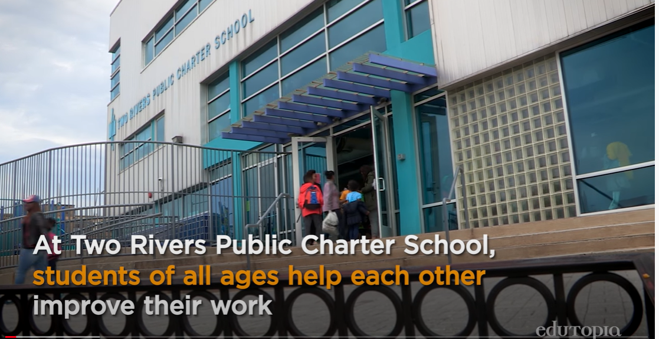
Peer Critique: Creating a
Culture of Revision
https://www.youtube.com/watch?v=M8FKJPpvreY
Notes:
Option 2:
Peer Critique: Creating a Culture of Revision (4:32)
https://www.youtube.com/watch?v=M8FKJPpvreY
(Note: contains both 1st and 7th graders to demonstrate)
Video Summary:
“Starting as early as pre-school the culture of revision and of learning together is what sets up students to be very proficient in their ability to receive critical feedback and to give critical feedback.”
Elaine Hou, Middle School Principal
Two Rivers Public Charter School, Washington, DC
This video demonstrates this culture of revision with students from first grade, as well as 7th grade.

Slide 65
Reflective Questions for Discussion
How does peer feedback empower students to be experts?
In what ways does peer feedback foster growth?
If you’re not seeing peer feedback emerging in your classes, what are the biggest roadblocks?
Notes:
Give participants a short time to process these questions individually, then open up for a table discussion or whole group discussion (if group is small).

Slide 66
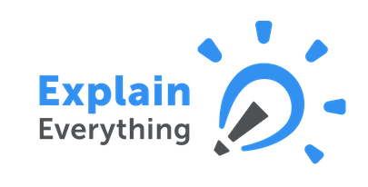


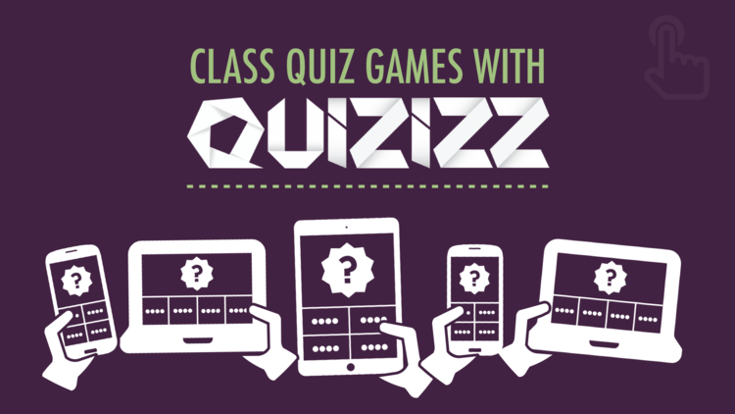


Resources for Using Technology in Feedback
Visit MOEDU-SAIL for resources to implement technology with feedback
Notes:
To Know/Say: These are six websites/apps that can be used for giving student feedback. More information on each of these resources can by found in the “Using Technology to Support CW” learning package.
To Do: (Optional) If time permits, allow participants to explore these tools and share out benefits/drawbacks of using each. (Internet access is needed).

Slide 67
Unpacking the Topic
Where Am I Now?
Strategy 4: Teach Students to Self-Assess and Set Goals.
Notes:
Purpose: Explore the core components and implementation steps for self-assessment.
Content:
Definition and benefits of self-assessment
Implementation of self-assessment

Slide 68
Say Something
Find a partner.
Silently read the first paragraph of Self-Assessment – Engage in Assessment.
Tell each other what you found new, unexpected, or interesting.
Repeat the same process for the remaining paragraphs.
(University of Reading, 2009)
Notes:
To Do/To Say: Distribute the handout, Self-Assessment – Engage in Assessment and ask participants to follow the prompts on the slide.
Handout: Self-Assessment – Engage in Assessment
Reference: Self-assessment - Engage in Assessment - University of Reading. (2017). Reading.ac.uk. Retrieved 3 January 2017, from https://www.reading.ac.uk/engageinassessment/peer-and-self-assessment/self-assessment/eia-self-assessment.aspx.

Slide 69
Strategy 4: Self-Assessment
Self-assessment: Students make judgments about what they know and can do.
Justification: Students show evidence to support the self-assessment.
Goal Setting: Students make a plan for continued learning.
(Chappuis, 2009)
Notes:
To Say: Strategy 4 is self-assessment
Reference: Adapted from Chappuis, J. (2009). Seven strategies of assessment for learning. Allyn & Bacon.

Slide 70
Self-Assessment Readiness
Part 1:
Does the student have a clear vision of quality (what’s expected)?
Can the student describe the intended learning?
Can the student differentiate between strong and weak work?
Part 2:
Has the student had experience giving and offering feedback?
Has the student received descriptive feedback using the language of quality, with opportunity to act on it?
Has the student practiced offering peer feedback using the language of quality?
(Chappuis, 2015, p.167)
Notes:
To Say/To Do: This is a brief checklist to consider if your students are ready to self-assess. If we ask students to self-assess too early, they may feel overwhelmed. It is best to have students self-assess once they have learned, practiced, and received some feedback.
Reference: Chappuis, J. 2015. Seven strategies of assessment for learning, 2e (p. 167). Upper Saddle River, NJ: Pearson Education.

Slide 71
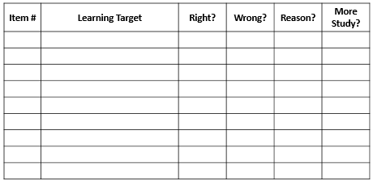
Self Assessment Tools
(Chappuis, 2005)
Notes:
To Know/To Say: This tool is a template that teachers could ask students to complete after returning an assignment or assessment. Students would list the items, the learning target that was being assessed/practiced, if their answer was correct or incorrect, why the student missed the question, and how they plan to study the skill. This type of tool asks students to think about why they made errors and even allows them to see patterns in their errors.
To Do: Ask participants how this tool would work for their students, or if there might be adjustments they would want to consider.
Handout: Self Assessment Tools
Reference: Retrieved from Chappuis, J. (2005). Helping students understand assessment. Educational Leadership, 63(3).

Slide 72
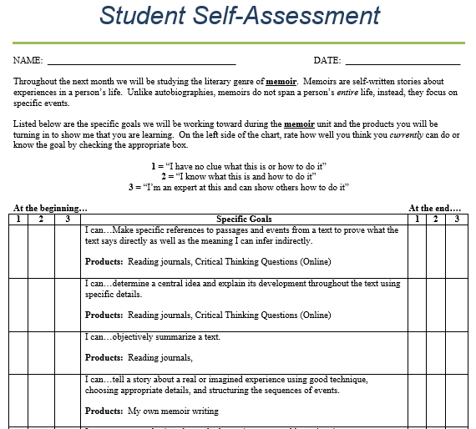
Students can self-assess prior to, during, and after learning
(Collins, 2011)
Notes:
To Know/Say: This is a handout for participants. It shows an example of how students can self assess prior to, during, and after learning.
Handout: Student-Self Assessment
References: Collins, C. (2011, August 30). How I’m using those “I can” statements [Blog Post]. Retrieved from https://turnonyourbrain.wordpress.com/2011/08/30/how-im-using-those-i-can-statements/.
Collins, C. (2011, August 30). Student self-assessment [document linked in Blog Post]. Retrieved from https://turnonyourbrain.files.wordpress.com/2011/08/student-self-assessment.docx.

Slide 73
Self-Assessment includes having students do the following:
Identify their own strengths and areas for improvement.
Write in a response log at the end of class, recording key points they have learned and questions they still have.
Using established criteria, select a work sample for their portfolio that proves a certain level of proficiency, explaining why the piece qualifies.
Offer descriptive feedback to classmates.
Use your feedback, feedback from other students, and their own self-assessment to identify what they need to work on and set goals for future learning.
(Chappuis, J., Stiggins, Chappuis, S., Arter, 2012)
Notes:
To Know/To Say/To Do: This slide brings strategies 3 and 4 together. Please read the list on this slide.
To Say/To Do: Review each of the points with additional details; such as, with the first point, you can ask students to do this before they show their work to you for feedback. This will give them prior thoughts of their own to “hang” it on. Your feedback will be more meaningful and will make more sense.
The last point leads into the next section on setting goals.
Reference: Chappuis, J., Stiggins, R., Chappuis, S., & Arter, J. (2012). Classroom assessment for student learning. Upper Saddle River, NJ: Pearson Education.

Slide 74
Unpacking the Topic
Where Am I Now?
Moving forward → Setting Goals
Notes:
Purpose: Explore the core components and implementation steps for goal setting.
Content:
Benefits of goal setting
Implementation

Slide 75
Why Have Students Set Goals?
Goal setting helps students structure their efforts by helping them focus on the components that are important to the assignment, tracking their progress throughout, and serving as a motivator.
(Schunk, 1990)
In addition to setting goals, students also need concrete strategies they can use to successfully work toward their goals. Students determine which next steps to take through clarifying targets, self-assessing, and pursuing goals.
(Laud, Hirsch, Wagner, and Patel, 2010)
Notes:
To Say: Please read the two statements about students setting goals.
References: Schunk, D. (1990). Goal setting and self-efficacy during self-regulated learning. Educational Psychologist, 25, 71–86. retrieved from https://pdfs.semanticscholar.org/ac47/fb864a0092a931b0b40e1821c9a0c74795ea.pdf
Laud, L., Hirsch, S., Patel, P., & Wagner, M. (2010). Maximize Student Achievement with Formative Assessment. ASCD Espress, 6(1). Retrieved from http://www.ascd.org/ascd-express/vol6/601-laud.aspx.

Slide 76
The teacher models how to self-assess, set goals, and plan improvements by asking:
What aspect of your work was most effective?
What aspect of your work was least effective?
What specific action or actions will improve your performance?
What will you do differently next time?
(McTighe & O’Connor, 2005)
Notes:
To Say/To Do: Review the list.
Research: McTighe, J. & O’Connor, K. (2016) Seven Practices for Effective Learning. Educational Leadership, 63(3). Retrieved from http://www.ascd.org/publications/educational-leadership/nov05/vol63/num03/Seven-Practices-for-Effective-Learning.aspx.

Slide 77
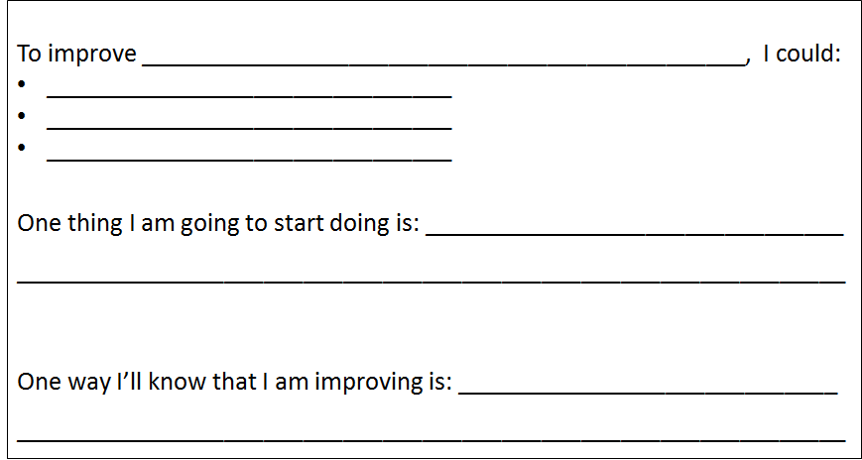
Student Goal Setting Tools
(Chappuis, 2015)
Notes:
To Know/To Say/To Do: This tool is a template that teachers could ask students to complete as a goal setting form and it includes how the student can monitor his or her own progress.
Ask participants how this tool would work for their students, or if there might be adjustments they would want to consider.
Handout: Student Goal Setting Tools
Reference: Chappuis, J. 2015. Seven strategies of assessment for learning, 2e. Upper Saddle River, NJ: Pearson Education.

Slide 78
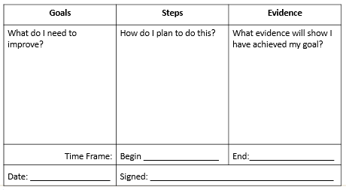
Student Goal Setting Tools
(Chappuis, 2015)
Notes:
To Know/To Say: This tool is a template that teachers could ask students to complete as a goal setting form and it includes how the student can monitor his or her own progress.
To Do: Ask participants how this tool would work for their students, or if there might be adjustments they would want to consider.
Handout: Student Goal Setting Tools
Reference: Chappuis, J. 2015. Seven strategies of assessment for learning, 2e. Upper Saddle River, NJ: Pearson Education.

Slide 79
Assessment & Reflection
Developing Assessment Capable Learners
Where Am I Now?
Notes:
Purpose: Provide opportunity for the learners to reflect on their learning and potential implementation challenges.
Content:
Post-assessment learner knowledge
Reflect on personal teaching context and implementation

Slide 80
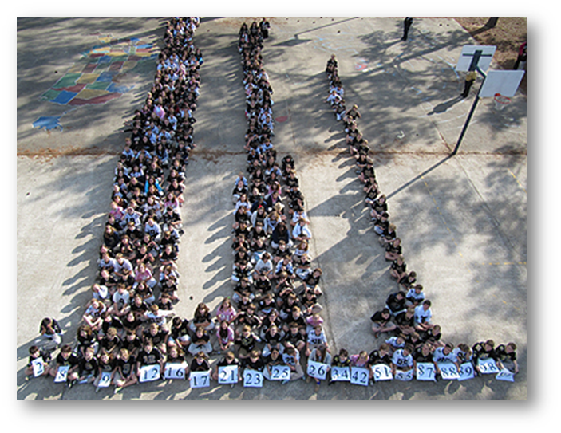
Where Am I Now?
Notes:
To Know: This is a transition slide.

Slide 81
What Do You Already Do?
Strategies 3 and 4
Make a list of practices you plan to implement for each strategy based on your learning from today.
Strategy | My Practice/Activity
3: Offer regular and descriptive feedback.
4: Teach students to self-assess and set goals
→ Set goals
(Chappuis, 2015)
Notes:
To Know/To Do: Provide the chart on the slide as a handout to participants to write on. Allow participants time to think about practices/activities they plan to implement and place these practices/activities on the chart for future reference.
Handout: What Do You Plan To Do? Part 2
Reference: Chappuis, J. (2015). Seven strategies of assessment for learning, 2e. Upper Saddle River, NJ: Pearson Education.

Slide 82
When we have made the learning clear to students, focused instruction on the intended learning, offered practice opportunities targeted to learning needs, offered feedback on students’ learning strengths and needs, and taught them how to self-assess and set goals, we are inches away from students taking initiative to determine what they need practice with and to create their own personalized learning path.
(McTighe & O’Connor, 2016)
Notes:
To Know/To Say: Allow participants to read this slide silently for a minute. It really brings all of the first four strategies together. Since ACL Part 2 only focuses on strategies 3 and 4, remind participants about ACL Part 3, which focus on strategies 5, 6, 7.
Research: Adapted FromMcTighe, J. & O’Connor, K. (2016) Seven Practices for Effective Learning. Educational Leadership, 63(3). Retrieved from http://www.ascd.org/publications/educational-leadership/nov05/vol63/num03/Seven-Practices-for-Effective-Learning.aspx.

Slide 83
Closing & Follow-up
Developing Assessment Capable Learners

Slide 84
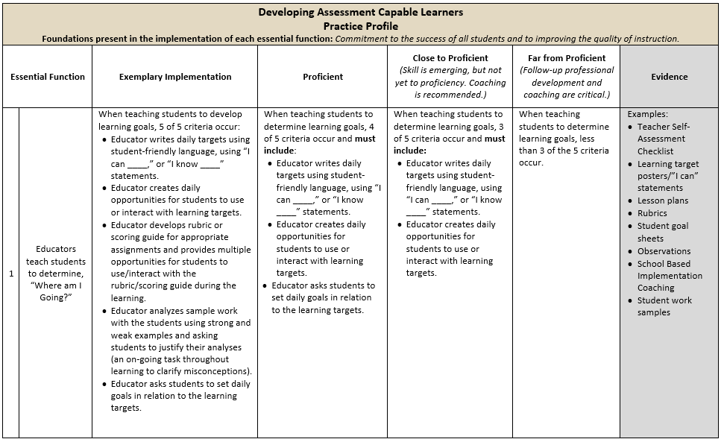
Practice Profile
Notes:
To Do: Review the practice profile with the participants. Suggest all stake-holders complete a self-analysis three or four times a year and engage in collaborative conversation.
To Know/To Say: The Practice Profile template includes four pieces and is anchored by the essential functions. First, as a header is the foundation of implementation that philosophically grounds implementation. Then moving from left to right across the template are the essential functions of the practice, implementation performance levels, and lastly, evidence which provides data or documentation for determining implementation levels.
The essential functions align with the teaching/learning objectives for each learning package. Four levels of implementation are described for each teaching/learning objective: exemplary, proficient, close to proficient, and far from proficient. The professional development provider should walk through the practice profile with the educator-learners, referring to the data and artifacts listed as suggested evidence. It is an important tool for self-monitoring their own implementation because it serves as a reminder as to the implementation criteria and is also aligned with the fidelity checklists and the electronic practice profile self-assessment tool. These sources provide data regarding further training or coaching.
Review the practice profile with the participants. Suggestion is to do self-analysis three or four times a year as well as ask a coach or administrator to also complete this form. Discussion would occur in comparing the self-analysis to the “outside analysis.”
Handout: Developing Assessment Capable Learner Practice Profile

Slide 85
Implementation Fidelity
Date:
Teacher (I)… |  | Yes | Partially | No | If partially or no, explain.
1 | Include lessons teaching students to self-reflect, document, and share learning in lesson plans.
2 | Model "I can__" or "I know___" statements.
3 | Analyze student work with the students using exemplars and non-exemplars.
4 | Prompt students to assess their own progress.
5 | Prompt students to identify learning they need.
 | Total
Notes:
To Know: This is a hidden slide. The implementation fidelity checklist was developed for the Assessment Capable Learners learning package originally rolled out in 2013 as a tool for checking on the fidelity of implementing assessment capable learners instruction. It was not revised to reflect the changes to the Developing Assessment Capable Learners materials completed in 2017; however it may still be a useful guide to begin self-monitoring fidelity during early implementation. The checklist will be reviewed/revised at a later time.

Slide 86
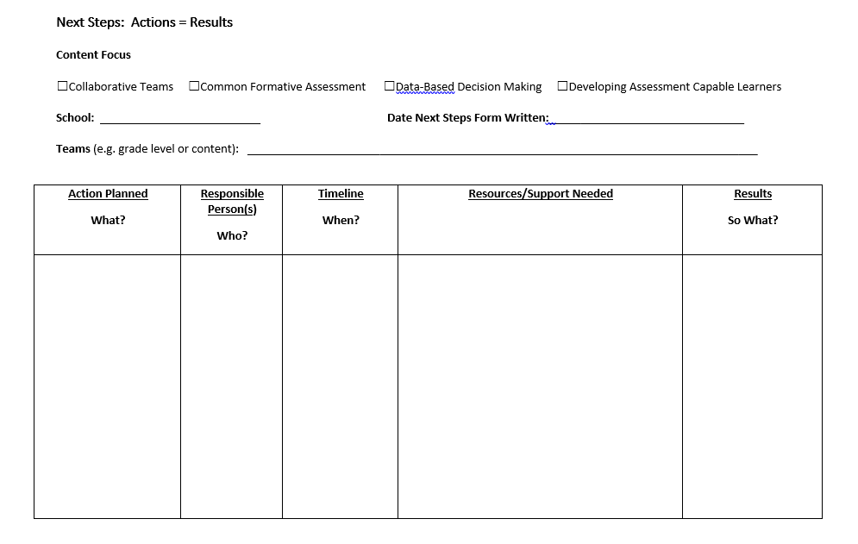
Next Steps: Action = Results
What steps will you take to start implementing?
Notes:
To Know/To Say: The Next Steps template is used for planning either today or back in your building. What resources do you need to begin implementing Assessment Capable Learners.
To Do: Complete the Next Steps template. Example is included in the learning package materials.
Handout: Next Steps: Action = Results

Slide 87


Resources for Further Learning/Coaching
Video:
Breaking Down “I Can” Statements with Students
Document:
Assessment for Learning Strategies
Books:
Seven Strategies of Assessment for Learning, (2nd Edition) by Jan Chappius
Classroom Assessment for Student Learning: Doing it Right--Using it Well, (2nd Edition) by J. Chappuis, R. Stiggins, S. Chappuis, and J. Arter
Excerpt: Student Self-Assessment, by J. McMillan and J. Hearn
Notes:
To Know/To Do: This slide is hidden. The additional resources may be shared with the participants for further learning or for coaching.

Slide 88





Resources for Using Technology with Assessment Capable Learners
Visit MOEDU-SAIL for resources to implement technology in Strategies 3 & 4
Notes:
To Know/Say: This slide is hidden. The additional resources may be shared with the participants for further learning or for coaching.
These are five websites/apps that can be used to help assist in developing assessment capable learners. More information on each of these resources can by found in the “Using technology to Support CW” learning package.
To Do: (Optional) If time permits, allow participants to explore these tools and share out benefits/drawbacks of using each. (Internet access is needed).

Slide 89
Contact Information
Please contact me to schedule follow-up coaching and/or additional professional development.
Notes:
To Know/To Say/To Do: Include presenter’s contact information.
Please contact me to schedule follow-up coaching and/or additional professional development. Thank you.

