Slide 1
Hidden Slide #1
DCI Framework
The DCI Framework is a cohesive, interactive system resulting in exceptional outcomes for all Missouri students. The framework is comprised of Content (DCI Practices and supporting materials), Professional Development (coaching, training and online learning), and Statewide Support (the people).
The nine Professional Learning Modules make up the DCI Practices (the content). These modules and supporting materials were developed from existing research identifying high-leverage practices resulting in student achievement.
Two Leadership Modules
The DCI Practices contain two distinct modules on leadership. The original module on leadership, Becoming the Instructional Leader of Your Building, will be referred to/abbreviated as “Instructional Leadership.” The focus for that module is developing leaders within district buildings and is appropriate for all administrative and instructional staff. This second module on leadership, Leadership for Effective Implementation of District-Wide Evidence-Based Practices, has a systems-based focus and will be referred to/abbreviated as “Systems Leadership.” This module delves into the capacities that an individual or organization can use to plan, enable, and support a process for systems-level change.
Notes:
To Know
You may look to the coaching companion for additional resources that may be helpful. As a reminder, always include appropriate citations when adding resources to the training materials.

Slide 2
Hidden Slide #2
The Becoming the Instructional Leader of Your Building (Instructional Leadership) was designed to be used in the following manner.
The audience for this module is building administrative and instructional staff.
Becoming the Instructional Leader of Your Building is organized around the five essential functions of the Instructional Leadership Practice Profile; collaborative culture and climate, effective teaching and learning practices, assessment, data-based decision making, along with the key actions of an instructional leader.
The module begins with an Overview and Impact section that outlines the purpose and benefits of strong and effective instructional leadership. Capacity building content is then provided for each of the essential functions that address collaborative climate and culture, effective teaching and learning practices, assessment, data-based decision making, and key actions of an instructional leader (collaboration, time, expectations, resources, and monitoring). The module concludes with Next Steps: An action planning section that uses the Essential Planning Inventory (EPI) in conjunction with the Instructional Leadership Action Planning Template to guide next steps to enhance leadership effectiveness.
It is recommended that the content of the entire module (broken into several sessions if necessary) is provided to instructional leaders so they have a clear understanding of each component and how the practices are interrelated. Districts will then action plan and customize future professional learning to meet their district’s needs based on results from the Practice Profile or SAPP for Becoming the Instructional Leader of Your Building.
Notes:
To Know
This is background information presenters

Slide 3
Hidden Slide #3
Please be thorough when reading slide notes as they provide detailed information to assist you in preparation/delivery of the presentation. Estimated timeframes for each section are based on providing participants with ample time to process and reflect on content. Some reflection activities can be expanded by using the activities designated OPTIONAL.
Breaks should be added at the presenter’s discretion.
In-person professional development suggestions
Estimated timeframe for module components
Intro, Overview, and Impact 2 hrs.
Leadership: Management and Instructional Practices 45 min.
Getting Started, Defining Areas of Instructional Focus,
& Employing Key Actions 1 hr.
Next Steps = Action Planning & Closing 45 min.
Total = 4 hrs. 30 min.
Notes:
To Know
Presenter notes information
Presenter notes are included in the PowerPoint. Background information for the presenter is shown as “To Know.” Statements to be shared with participants are shown as “To Say.” In some instances, the “To Know/To Say” are combined. The presenter notes also include “To Do” prompts and cues for “Handouts” (illustrated by icons – see slide #11 for icon glossary) and activities.
Additional activities, examples, videos, etc. are being developed as a Leadership Coaching Companion. A presenter may add material from the Coaching Companion to corresponding PowerPoint content.
A printed Practice Profile and an electronic Self-Assessment Practice Profile (SAPP) tool are available for use by individuals, teams, or schools for periodic self-assessment and monitoring of implementation of practice or to identify training or coaching needs.
The presenter should download any video intended for use in a training, as you may not have internet access in all school sites.
Breaks should be inserted at the discretion of the presenter based on the needs of participants.

Slide 4
Hidden Slide #4
SUPPLIES NEEDED
WiFi access for presenter and participants
Access to videos (through WiFi if available, but download to flash drive as a back-up)
Participants should bring an electronic device (tablet, computer, phone) to access websites
Chart paper
Markers
Post-it-Notes
Master list of handouts, web links, QR codes, and additional resources
Handouts – Many handouts can be accessed through the web link or QR code listed on both the master handout list and slide. Those without web links will be in the handout packet. Advise participants QR codes can be accessed by using the camera on their phone/tablet allowing fast and easy access to many of the documents.
Notes:
To Know
Because QR codes link to external sites, it is important to verify those pages are still active. Consultants should review this slide.

Slide 5
Hidden Slide #5
Handout packet
Key Terms
Instructional Leadership Infographic
Instructional Leadership Practice Profile
Hattie’s Ten Mind Frames for Educators
Managerial vs. Instructional Tasks
Activity: Educational Practice Impact on Student Achievement
Answer Key: Educational Practice Impact on Student Achievement
Ensuring Resources
Instructional Leadership Action Planning Template
Notes:
To Know
The Becoming An Instructional Leader participant and presenter materials are in the VLP and on the MoEdu-SAIL website. Consultants need to make sure these handouts are readily available for each participant.

Slide 6
Hidden Slide #6
Key Terms
Collaboration - Working with another person or group in order to achieve, accomplish, and/or meet goals .
Collective Leader Efficacy - School leaders and leadership teams that have a strong belief in their capabilities and focus on growth by working together collectively to create optimum conditions in the building for the greatest overall impact on learning and achievement.
Data-based Decision Making - DBDM involves small teams meeting regularly and using an explicit, data-driven structure to disaggregate data; analyze student performance; set incremental student learning goals; engage in dialogue around explicit and deliberate classroom instruction; create a plan to monitor instruction and student learning; and identify effective key teaching and learning practices to implement.
Effect size - The amount of impact an influence has on a learner based on John Hattie’s meta-analysis studies.
Effective Teaching and Learning Practices - Evidence-based effective methods, at the classroom level, that are content neutral and when implemented with fidelity and informed through data can produce positive, sustained results for every student.
Essential Planning Inventory (EPI) - An online tool used for reflection and planning to determine next steps needed for school leaders to apply the key actions to instructional focus areas.
Hinge Point - The point representing one year’s growth within a year’s time (0.4) based on John Hattie’s research on influences and their effect on student achievement. Practices above the hinge point are most effective, those below are least effective.
Instructional Leadership - School leadership that focuses on educator and school impact on student learning including instructional choices, conducting classroom observations, ensuring effective professional development, communicating high academic standards, and creating environments conducive to learning.
Mindframes - The internal set of beliefs one has about their role as a school leader.
Transformational Leadership - School leadership that focuses on teachers by setting a vision, common goals, buffering staff from external demands, and ensuring fair and equitable staffing. Educator and teacher impact on student outcomes is not the key focus.
Notes:
Handout #1, Key Terms
To Know
It is advantageous to have knowledge of the key terms for this Professional Learning Module. It is important to establish a shared understanding for each of these terms for learning to be consistent. This is handout #1.

Slide 7
Hidden Slide #7
PRE/POST READING OPPORTUNITY
High Impact Leadership by John Hattie
http://kendrastantoine.weebly.com/uploads/5/4/2/8/54285355/high_impact_leadership_-_hattie_(1).pdf
Notes:
To Know/To Do
This article should be sent to participants to read prior to the session in order to provide a more in-depth understanding of its content. This article is then to be used for the Read & Reflect activity at the beginning of this session.
Reference
Hattie, J. (2015). High impact leadership. Educational Leadership, 72(5), 36-40. http://kendrastantoine.weebly.com/uploads/5/4/2/8/54285355/high_impact_leadership_-_hattie_(1).pdf

Slide 8
Becoming an Instructional Leader of Your Building
This work is licensed under a Creative Commons Attribution-NonCommercial-NoDerivatives 4.0 International License.
Notes:
Title Slide
To Know
Leaders who have a high impact on student outcomes understand the need to focus on learning and the impact of learning and believe their fundamental task is to evaluate the effect of everyone on student learning. Effective instructional leaders accomplish the following.
Develop, support, and maintain a collaborative culture and climate
Promote effective teaching and learning practices that align to leader standards
Provide for the development and use of Common Formative Assessments
Use data to make decisions, determine learning priorities, and expend resources
To Do
Welcome participants to the PowerPoint presentation.
To Say
Welcome to the Becoming the Instructional Leader of Your Building: A Critical Action Guide presentation. Leaders who have a high impact on student outcomes understand the need to focus on learning and the impact of learning and believe their fundamental task is to evaluate the effect of everyone on student learning. We hope you find this information helpful as you take the critical steps toward developing the necessary skills to become a strong instructional leader for your building.

Slide 9
Acknowledgements Special thanks to all contributors to the development of this Professional Learning Module. The original collection of Professional Learning Modules was rolled-out for use by Regional Professional Development Center (RPDC) Consultants in July 2013 after being developed by a team of content experts through efforts funded by the Missouri State Personnel Development Grant (SPDG).
Notes:
To Know/To Say/ To Do
Before we start the content, I would like to thank the group of professionals that helped developed this training module and those who have had a part in making sure it is updated and recent.

Slide 10
Welcome and Introductions
Our trainers for the day…
Notes:
To Do
Begin the session with a warm welcome which includes presenter and participant introductions.

Slide 11
Norms
Begin and end on time
Be an engaged participant
Be an active listener - open to new ideas
Use notes for side bar conversations
Use electronics respectfully
Notes:
To Know
It is important to establish norms for training. Trainers are free to adjust this list of norms. Trainers may also ask participants if there are other norms they would like to add.
To Do/To Say
Review the norms listed on the slide. Ask participants if there should be others added to this list.

Slide 12
Icon Glossary
Step-by-Step Guide
Instructional
Leadership
Reflection/Activities
Handout Packet
Essential Questions
Blueprint
Notes:
To Know/To Say
You will see these icons on slides and handouts throughout the presentation.
Module: Whenever you see a module icon (instructional leadership) it indicates new learning pertinent for this module.
Reflection/Activities: Signifies slides used to facilitate activities or items of reflection.
Essential Questions: This icon calls attention to slides that contain essential questions.
Step-by-Step Guide: Connects items found in the Step-by-Step Guide.
Handout Packet: Indicates when connected items can be located in the handouts.
Blueprint: Connects to items in the Blueprint for District and Building Leadership.

Slide 13
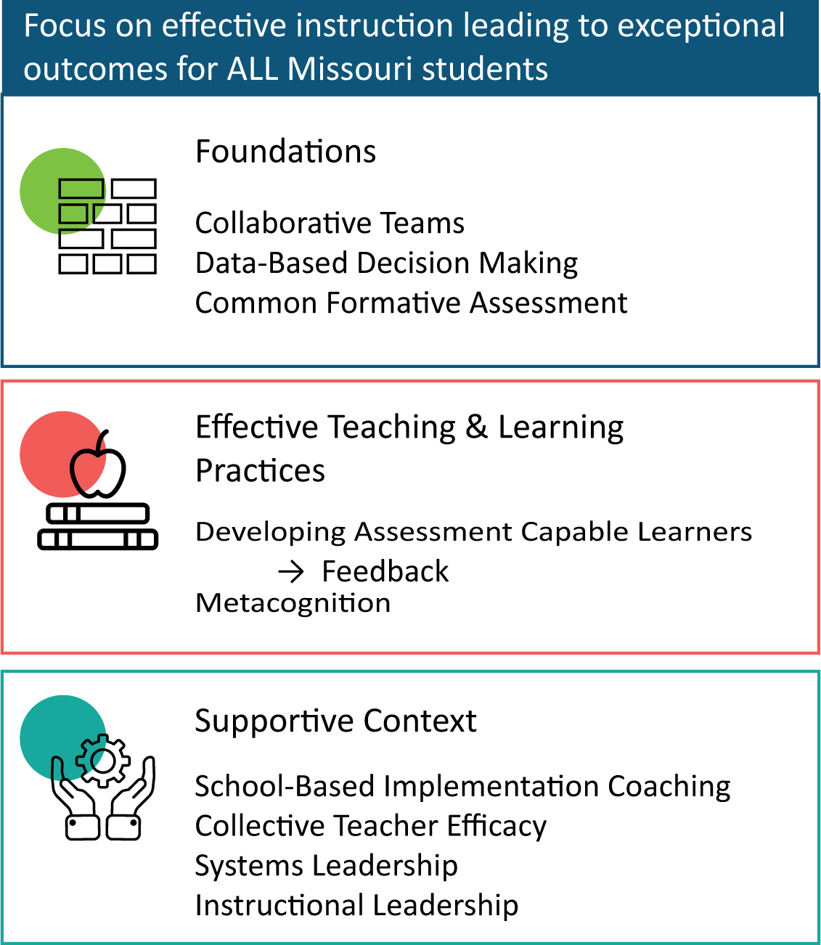
District Continuous Improvement Framework
Notes:
To Know
Nine Professional Learning Modules make up the DCI Content within the DCI Framework as illustrated in the slide.
Three foundational educational practices essential for collaborative, data-informed instruction and decision making
Two effective teaching and learning practices shown to improve student achievement
Four practices that create a supportive context to sustain and advance effective teaching and learning
To Do/To Say
Before we dive into Instructional Leadership, let’s take a few minutes to review the DCI Framework Content, looking specifically at where both Leadership modules fall into the larger content.
As you see, the focus of DCI is on effective instruction leading to exceptional outcomes for all Missouri students.
The Content Framework has three main components
Foundations (consisting of Collaborative Teams, Data-Based Decision Making, and Common Formative Assessment)
Effective Teaching and Learning Practices (Developing Assessment Capable Learners with Feedback and Metacognition)
Supportive Content (School-Based Implementation Coaching, Collective Teacher Efficacy, and two Leadership modules)
References
MoEdu-SAIL. (2022). Blueprint for district and building leadership (6th ed.). Missouri Department of Elementary and Secondary Education: Northern Arizona University, Institute for Human Development.

Slide 14
Instructional Leadership Alignment with MO Leader Standards
Standard #2 Teaching and Learning
Quality Indicators
Promote Positive School Culture
Provide and Effective Instructional Program
Ensure Continuous Professional Learning
Standard # 3 Management of Organizational Systems
Quality Indicators
Manage the Organizational Structure
Lead Personnel
Manage Resources
Standard #6 Professional Development
Quality Indicator
Increase knowledge and skills based on best practices
Notes:
To Know
Be familiar with the Missouri Department of Elementary and Secondary Education Missouri Leader Standards (http://dese.mo.gov/sites/default/files/LeaderStandards.pdf).
To Do
Show alignment between the content of the Becoming the Instructional Leader of Your Building Critical Action Guide materials and the Missouri Department of Elementary and Secondary Education Missouri Leader Standards (https://dese.mo.gov/media/pdf/oeq-ed-leaderstandards)
To Say
The content of the materials contained within the Becoming the Instructional Leader of Your Building Critical Action Guide materials aligns with standards #2, 3, and 6 of the Missouri Department of Elementary and Secondary Education Missouri Leader Standards as shown on this slide.
Reference
Missouri Department of Elementary and Secondary Education. (2013, June). Leader standards. https://dese.mo.gov/media/pdf/oeq-ed-leaderstandards

Slide 15
Session-at-a-Glance
Overview and Impact
Leadership: Management and Instructional Practices
Critical Actions for Instructional Building Leaders: Getting Started
Defining Areas of Instructional Focus
Defining Key Actions of the Building Instructional Leader
Employing Key Actions Across Areas of Instructional Focus
Next Steps = Action Planning
Notes:
To Know
The content of the module can be presented in one session or divided into smaller presentations to fit appropriate timeframes. It is recommended that the content of the entire module is provided to leaders so they have a clear understanding of each component and how the practices are interrelated. Districts will then action plan and customize future professional learning to meet their district’s needs based on results from the Practice Profile or SAPP for Becoming an Instructional Leader of Your Building.
To Do
Review the main topics that will be covered in this presentation with participants.
To Say
The session-at-a glance slide lists the sequence of main topics covered in the presentation. Following the PowerPoint presentation, you will be directed to a tool called the Essential Planning Inventory (EPI) that will walk you through how to get started implementing the practices outlined in this presentation. An action planning template will be used to design a plan for putting these practices into place in your building.

Slide 16
Essential Questions
Why is it important to establish and support a collaborative school culture?
What are the benefits of implementing evidence-based effective teaching and learning practices throughout a school?
How can the strategic use of assessments improve instruction?
Notes:
To Know/To Say
We will now begin our Instructional Leadership work by reflecting on these questions. The remaining questions are continued on the next slide. We will review these at the end of the training.
To Do
Have participants reflect on these essential questions on this slide and the next slide. Have them discuss them with a partner. These essential questions will also be reviewed at the end of this module.

Slide 17
Essential Questions, cont.
How and why should data drive building decision-making?
What are the key actions and steps the building leader should take to improve areas of instructional focus in your school?
Notes:
To Know
The questions on this slide show the remaining Essential Questions. Continue with participants discussing these with a partner.
To Say
The remaining Essential Questions are found on this second slide. Please continue to discuss with your partner.

Slide 18
At the conclusion of this module, building leaders will understand the following:
Course Outcomes
The importance of promoting a collaborative school culture
Evidence-based effective teaching/learning practices
The importance of effective assessment practices used to drive instruction
The benefits of data-based decision making
How to develop, support, and monitor a plan to employ key leadership actions across areas of instructional focus
Notes:
To Know/To Do
Review the course outcomes.
To Say
As a learner, you will develop an understanding of key leadership actions and how to effectively implement them across areas of instructional focus in order to improve student outcomes. Following completion of this module, leaders will have an opportunity to apply their new learning to design an action plan using the EPI (Essential Planning Inventory) in order to achieve your building leadership goals.

Slide 19
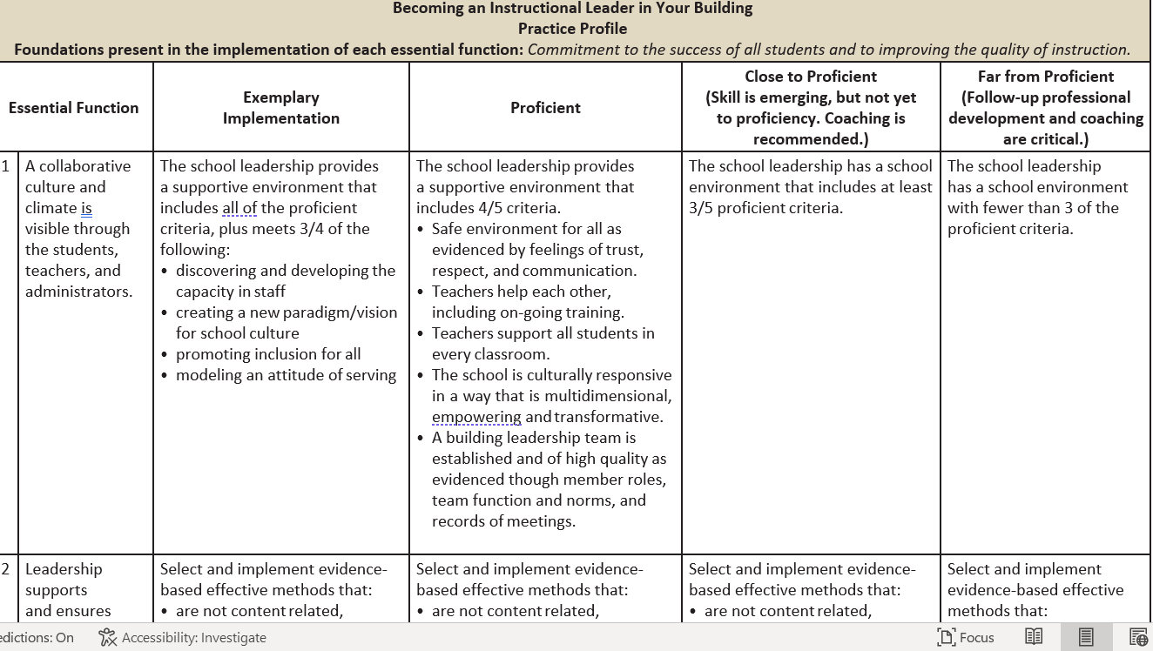
Practice Profile
Notes:
Handout 1, Key Terms
Handout 2, Instructional Leadership Infographic
Handout 3, Becoming an Instructional Leader Practice Profile
To Know
The three handouts listed above help provide an overview and build capacity around the content of the Instructional Leadership module. Distribute and review the handouts with participants prior to beginning the session.
The Key Terms help to clarify words/terms found within the module so new school leaders have a common understanding of these terms.
The Infographic supplies a visual representation of key concepts within the module.
The Practice Profile includes four pieces and is anchored by the essential functions. First, as a header is the foundation of implementation that philosophically grounds implementation. Then moving from left to right across the template are the essential functions of the practice, implementation performance levels, and lastly, evidence which provides data or documentation for determining implementation levels.
To Do
Distribute the following handouts: Key Terms, Infographic, and Practice Profile. The presenter should walk the participants through each of the essential functions on the Practice Profile, then provide time for participants to review/peruse the documents
To Say
These handouts will help to provide an overview and build capacity around the content of the instructional leadership module. The Practice Profile should be used to reflect and assess on the level of implementation quality for each essential function. As you delve deeper into the process of developing practices as instructional building leaders, it is recommended that you use the Practice Profile as an anchor for high quality work. It is also a useful tool for guiding coaching conversations around the pillars of this work.
References
Hall, G. E., & Hord, S. M. (2006). Implementing change: Patterns, principles, and potholes. Pearson/Allyn and Bacon.
MoEdu-SAIL. (n.d.). Becoming an instructional leader of your building infographic. Missouri Department of Elementary and Secondary Education: Northern Arizona University, Institute for Human Development. https://www.moedu-sail.org/leadership-materials/

Slide 20
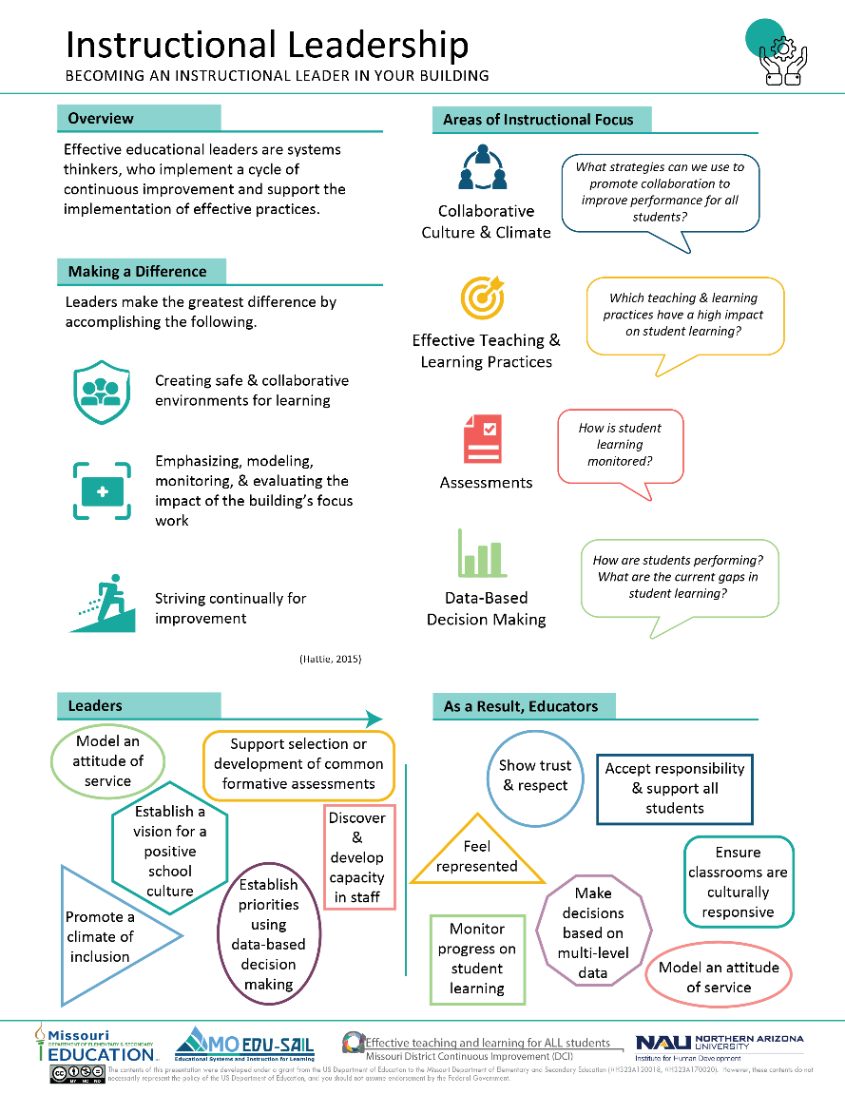
Infographic
Notes:
Handout #2
To Know
This is the infographic for Instructional Leadership
To Do
Make sure the participants have a copy of Handout #2 which is the infographic for Instructional Leadership.
To Say
Handout #2 is the infographic for Instructional Leadership. Please take a few moments to review it. Pay particular attention to the Areas of Instructional Focus and Key Actions because they summarize our content for the day. You may want to keep it handy for the training so you can use as a reference.
Reference
MoEdu-SAIL. (n.d.). Becoming an instructional leader of your building infographic. Missouri Department of Elementary and Secondary Education: Northern Arizona University, Institute for Human Development. https://www.moedu-sail.org/leadership-materials/

Slide 21
Overview and Impact of Instructional Leadership
Jodi, the logo is wrong here, as well.
Notes:
To Know/To Say
We will now start the overview and discuss the impact of Instructional Leadership.

Slide 22
Areas of Instructional Focus for Leaders
Collaborative Culture and Climate
Effective Teaching and Learning Practices
Assessments
Data for Decision Making
Notes:
To Know
This training is intended to be a “getting started” package to develop skills enabling educators to become instructional leaders of their buildings. The focus is on strategies to develop a collaborative building working in four areas that have been shown to have a positive impact on school performance and student outcomes. This training takes educational leaders through the initial steps necessary to develop collaborative schools that know how to use effective teaching/learning practices and assess and use that data to inform decision making to guide instruction. This session is in no way intended to serve as a comprehensive leadership training package.
To Do
Clarify the intent of this as a “getting started guide,” not a comprehensive leadership program.
To Say
The focus of this presentation is on strategies to develop a collaborative building working in these four areas of instructional focus that have been shown to have a positive impact on school performance and student outcomes. Refer to the Infographic and Practice Profile (Handouts 2 & 3).
This session takes educational leaders through the initial steps necessary to develop collaborative schools that know how to use effective teaching/learning practices and assess and use that data to inform decision making to guide instruction. This session is intended to serve as a “getting started” presentation for educational leaders, breaking down the complex task of being the instructional leader of the building into smaller, actionable steps to begin building structures to create a collaborative building. The work included in this learning package is aligned with and designed to feed into the larger leadership development continuum within the Missouri Department of Elementary and Secondary Education. As we all know, getting started is often the hardest part of any endeavor. This learning package will guide the actions of a building leader to begin developing a building that works collectively to improve teacher practice and ultimately increase student achievement.
References (adapted from)
Hattie, J. (2008). Visible learning: A synthesis of over 800 meta-analyses relating to achievement. Routledge.
Hattie, J. (2015). High impact leadership. Educational Leadership, 72(5), 36-40. http://kendrastantoine.weebly.com/uploads/5/4/2/8/54285355/high_impact_leadership_-_hattie_(1).pdf
Telfer, D.M. (2011). Moving your numbers: Five districts share how they used assessment and accountability to increase performance for students with disabilities as part of district-wide improvement. University of Minnesota, National Center on Educational Outcomes. http://www.cehd.umn.edu/NCEO/OnlinePubs/MovingYourNumbers.pdf

Slide 23
Read & Reflect
High Impact Leadership
Review the article High Impact Leadership by John Hattie.
Mark with a star 1-2 items in the article that are powerful to you.
Share your starred items along with why you think they are so important with your team.
Each team summarize your take-aways and share with the whole group.
http://kendrastantoine.weebly.com/uploads/5/4/2/8/54285355/high_impact_leadership_-_hattie_(1).pdf
Notes:
To Know
Be familiar with the pre-session reading, High Impact Leadership, an article by Dr. John Hattie.
To Do
Facilitate a discussion around Dr. John Hattie’s article High Impact Leadership. Group participants into teams of 3 or 4.
To Say
We will now reflect on the pre-reading article, High Impact Leadership, sent to you prior to this session. The article, by Dr. John Hattie, provides great insight into what makes an effective instructional leader. Review the article and put a star by one or two items that you thought were powerful and had great meaning. Next, have each team member share their key take aways along with its importance. The last person sharing can then summarize the most important ideas gleaned by the team and share with the whole group.
Reference
Hattie, J. (2015). High impact leadership. Educational Leadership, 72(5), 36-40. http://kendrastantoine.weebly.com/uploads/5/4/2/8/54285355/high_impact_leadership_-_hattie_(1).pdf

Slide 24
Effect Size
A way to quantify the differences between two groups
Effect size of d = 1.0 means advancing achievement by 2-3 years
Typical impact is d = 0.20 to
d = 0.40
Above average impact is
d > 0.4
Excellent impact is d > 0.60
(Hattie, 2008)
.40
Notes:
To Know
What “effect size” is and how it is calculated. Dr. Hattie uses Cohen’s D for his effect size calculation. Please gauge the knowledge of your participants. Some may not need this detailed information.
To Do
Explain what effect size is and how Dr. John Hattie applies effect size in his work.
To Say
A term used by Dr. John Hattie is “effect size” which is a term that will referenced during this presentation. Effect size is a common expression of the magnitude of study outcomes for many types of outcome variables, such as school achievement. An effect size of d=1.0 indicates an increase of one standard deviation on the outcome (a standard deviation increase is typically associated with advancing children’s achievement by two to three years, improving the rate of learning by 50%, or a correlation between some variable and achievement of approximately r=0.50). In implementing a new program, a d=1.0 would mean that, on average, students receiving the treatment would exceed 84% of students not receiving the treatment.
On the right is a simple graphic representation of Hattie’s effect size calculation. An effect size of .40 is equivalent to one year’s growth. This is the minimum for which we should be strive.
References
Corwin. (2021, August). Visible learning meta x. Corwin Visible Learning Plus. https://www.visiblelearningmetax.com/
Hattie, J. (2008). Visible learning: A synthesis of over 800 meta-analyses relating to achievement. Routledge.
Hattie, J. (2021, August). Global research data base, all influences. Corwin Visible Learning Plus. https://www.visiblelearningmetax.com/Influences

Slide 25
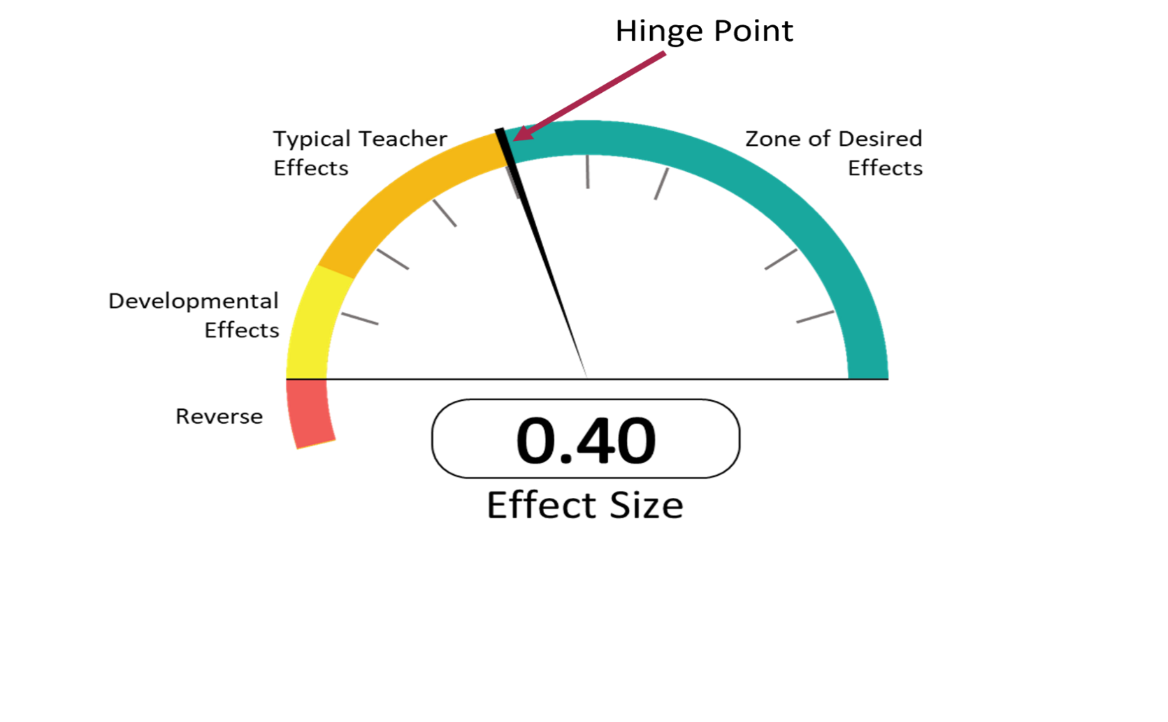
Effect Size
(Hattie,2021)
Notes:
To Know/To Say
Dr. John Hattie has conducted over 1850 meta-analysis (study of studies) to collect evidence on what works best in education. He uses this barometer graphic to visually explain effect size of influences on student achievement. The hinge point, 0.40 represents one year’s growth within one year’s time. Practices above the hinge point of 0.40 are most effective. These are in the Zone of Desired Effects since they result in greater outcomes. Some influences that are far below the hinge point and are in the negative range can have a reverse effect student achievement. Training instructional staff and implementing practices with an effect size greater than .40 is where we should be spending the bulk of our time and effort.
NOTE: Prior knowledge of participants may affect the detail of “To Say”
To Do
Explain Dr. John Hattie’s barometer graphic and the significance of the .40 marker.
References
Corwin. (2021, August). Visible learning meta x. Corwin Visible Learning Plus. https://www.visiblelearningmetax.com/
Hattie, J. (2008). Visible learning: A synthesis of over 800 meta-analyses relating to achievement. Routledge.
Hattie, J. (2019). Visible learning: 250 influences on student achievement. Corwin Visible Learning Plus. https://xyofeinstein.files.wordpress.com/2019/11/250_influences_chart_june_2019-2.png
Hattie, J. (2021, August). Global research data base, all influences. Corwin Visible Learning Plus. https://www.visiblelearningmetax.com/Influences

Slide 26
Specific Leadership Practices with High Effect Sizes
Leaders who believe their major role is to evaluate their impact (ES=.91)
Leaders who get everyone in the school working together to know and evaluate their impact (ES=.84)
Leaders who learn in an environment that privileges high-impact teaching and learning (ES=.77)
Leaders who set appropriate levels of challenge and who never retreat to “just do your best” (ES=.57)
(Hattie, 2015)
Notes:
To Know
One of the major points made by Dr. John Hattie, in his Visible Learning work, is that all practices in education work to some degree. With regard to leadership, the same premise applies. All practices work, but not all practices are equal in terms of impacting student achievement.
To Do
Review the statements on this slide which are taken directly from the pre-reading for this presentation, High Impact Leadership.
To Say
As we know from Dr. John Hattie’s work in Visible Learning, not all practices are equal. While almost everything in education works, the real question is to what degree and is that degree of improvement acceptable? Regarding leadership, we know with a high degree of certainty that some practices have more impact on improving student achievement than others. As you learned from the pre-reading for this package, Hattie’s work reveals those leadership practices that have a high effect size. Leaders who create safe and collaborative environments for learning, emphasize and model monitoring and evaluation of the impact that the focus work of the building is having, and continually strive for improvement make the most difference.
Reference
Hattie, J. (2015). High impact leadership. Educational Leadership, 72(5), 36-40. http://kendrastantoine.weebly.com/uploads/5/4/2/8/54285355/high_impact_leadership_-_hattie_(1).pdf

Slide 27
Instructional Leadership
https://youtu.be/9UYGrk1VpcQ
(Hattie,2012)
Notes:
To Know
Video, 5:58 minutes, John Hattie elaborates on the practices typically associated with different types of educational leadership.
To Do
Facilitate conversation about how much time building leaders spend on practices that have a greater impact on improved teacher practice and increased student achievement. Click on the link to view the video.
To Say
As a building leader, it is crucial to consider what percentage of time is spent on leadership practices that focus on daily management issues as opposed to practices focused on issues directly related to instruction, assessment, and increased student outcomes. There is no doubt that both types of practices are necessary; however, the effect on student outcomes supports a focus on certain practices over others. Dr. Hattie discusses the issue in this video.
After the video, ask participants to discuss this question:
What is the difference between a transformational and instructional leader?
(Transformational leaders lead around a common vision… instructional leaders primarily look at impact. Are we having an impact? What is the impact? What is the evidence? How can the impact be even more powerful? Instructional leaders are the lead change agent.)
Reference
Hattie, J. (2012). Instructional leadership, leaders in educational thought: Dr. John Hattie [Video file]. The Student Achievement Division, 1(2). https://www.youtube.com/watch?v=9UYGrk1VpcQ

Slide 28
10 Mindframes for Leaders
I am an evaluator of my impact on teacher/student learning.
I see assessment as informing my impact and next steps.
I collaborate with my peers and my teachers about my conceptions of progress and my impact.
I am a change agent and believe all teachers/students can improve.
I strive for challenge rather than merely doing my best.
(Hattie & Smith, 2020)
Notes:
Handout #4, 10 Mindframes for Leaders
To Know/To Say
In Visible Learning for Teachers (p. 159) Dr. Hattie claims that “the major argument in this book underlying powerful impacts in our schools relates to how we think! It is a set of mindframes that underpin our every action and decision in a school; it is a belief that we are evaluators, change agents, adaptive learning experts, seekers of feedback about our impact, engaged in dialogue and challenge, and developers of trust with all, and that we see opportunity in error, and are keen to spread the message about the power, fun, and impact that we have on learning.”
John Hattie believes that “teachers and school leaders who develop these ways of thinking are more likely to have major impacts on student learning.”
Each mindframe from John Hattie’s 10 Mindframes for leaders is contributed by a renowned thought leader including experts Peter DeWitt, Dylan Wiliam, Jenni Donohoo, and Jim Knight. These mindframes are backed by Visible Learning research and are attitudes of successful school leadership.
I am an evaluator of my impact on teacher/student learning. (Janet Clinton)
I see assessment as informing my impact and next steps. (Dylan Wiliam)
I collaborate with my peers and my teachers about my conceptions of progress and my impact. (Jenni Donohoo)
I am a change agent and believe all teachers/students can improve. (Michael Fullan)
I strive for challenge rather than merely ‘doing my best. (Zretta Hammond)
To Do
Explain the meaning and importance of mindframes. Review the first five mindframes on this slide and continue with the other five on the next slide. The name of the contributor for each mindframe is listed in the notes. Provide Handout #4, 10 Mindframes for Leaders.
Reference
Hattie, J. (2012). Visible learning for teachers: Maximizing impact on learning. Routledge.
Hattie, J., & Smith, R. (Eds.). (2020). 10 Mindframes for leaders: The VISIBLE LEARNING (R) approach to school success. Corwin.

Slide 29
10 Mindframes (cont.)
I give and help students/teachers understand feedback and I interpret and act on feedback given to me.
I engage as much in dialogue as in monologue.
I explicitly inform teachers/students what successful impact looks like from the onset.
I build relationships and trust so that learning can occur in a place where it is safe to make mistakes and learn from others.
I focus on learning and the language of learning.
(Hattie & Smith, 2020)
Notes:
To Know/To Say
(10 Mindframes continued)
Each mindframe from John Hattie’s 10 Mindframes for Leaders is contributed by a renowned thought leader, including experts Peter DeWitt, Dylan William, Jenni Donohoo, and Jim Knight. These mindframes are backed by Visible Learning research and are at of successful school leadership.
I give and help students/teachers understand feedback and I interpret and act on feedback given to me. (Peter DeWitt)
I engage as much in dialogue as in monologue. (Doug Fisher, Nancy Frey, D. Smith)
I explicitly inform teachers/students what successful impact looks like from the outset. (Laura Link)
I build relationships and trust so that learning can occur in a place where it is safe to make mistakes and learn from others. (Sugata Mitra)
I focus on learning and the language of learning. (Jim Knight)
To Do
Explain the remaining mindframes. The name of the contributor for each mindframe is listed in the notes.
Optional Activity
Ask participants to review the 10 mindframes and choose the one that is their greatest strength and one that is an opportunity for growth. With a partner, have them discuss why the chosen mindframe is a strength (What are you doing as a leader to make this a strength?). Also, discus steps that can be taken to strengthen mindframes that needs to grow.
Reference
Hattie, J., & Smith, R. (Eds.). (2020). 10 Mindframes for leaders: The VISIBLE LEARNING (R) approach to school success. Corwin.

Slide 30
Collective Leader Efficacy
Leadership teams working together for collective impact!
Beliefs
Positive change is possible when leaders and teams work collectively.
Action to create positive impact is a joint responsibility.
Empowering educators to develop skills and capabilities to impact student learning is the goal.
(DeWitt, 2021)
Notes:
To Know
Collective Efficacy is another factor that can positively impact overall student outcomes. For school teams to succeed, they need leadership, independence, meaningful collaboration, and a shared conviction that they have real power to enact actual change. Instructional leaders play a role in creating a culture that develops Collective Teacher Efficacy. An additional area of focus should be on developing leadership teams who have collective leader efficacy; meaning members of leadership teams also feel capable of deep collective impact on student learning and wellbeing.
To Do
Emphasize that the best school leaders approach their position as learners. Even the best leaders can learn a lot from other educators and should empower others to lead. Leadership teams need to focus their energies and conversations around learning.
To Do/ Say
Review and expand on the slide content. The school leader’s role should be more impactful than just setting up the building dynamics for others to collaborate. The most effective instructional school leaders are at the table “looking in” as learners themselves, giving voice to educators, and being a partner with their leadership team as they collectively assess their impact on student learning and achievement. School leaders, along with their leadership team who have collective leader efficacy are ones who possess these shared beliefs:
Positive change is possible when leaders and teams work collectively.
Nurturing growth through action to create positive impact is a joint responsibility.
Empowering educators to develop skills and capabilities to impact student learning is our goal.
Collective leader efficacy happens when a leadership team comes together, focuses on a learning goal, and does the work together to learn and achieve that goal.
Reference
DeWitt, P. (2021). Collective leader efficacy: Strengthening instructional leadership teams. Corwin Press.

Slide 31
Collective Leader Efficacy Drivers
Mindset
Well being
Context beliefs
Working conditions
Professional learning and development
Organizational commitment
Skills
Confidence
(Dewitt, 2021)
Notes:
To Know
Peter DeWitt identifies 8 specific drivers that contribute to the success of school leadership teams and which will help the them develop collective leader efficacy. These drivers work best within a school that promotes a cycle of inquiry where teachers are prepared to try new instructional strategies and students develop a desire to go deeper with their own learning.
Resource: In his video, Peter DeWitt provides background information for presenters on Collective Leader Efficacy and the drivers. https://youtu.be/VyTEj6hyg_Y (information on drivers is at 23:40)
To Do
Review the 8 drivers for successful leadership teams and expand on each.
To Say
These are the 8 drivers that Peter DeWitt identifies in his book as necessary to develop and advance Collective Leader Efficacy.
1. Mindset - It is necessary for school leaders and leadership teams to believe they can impact change and improvement. (Refer to Hattie’s 10 Mindframes)
2. Well-being – Leadership teams make the mental health of their school community and themselves a priority which affects the affective state of teams and individuals which impacts efficacy. (Bandura)
3. Context beliefs - Educators believe they are supported in their efforts.
4. Working conditions – The working environment must be conducive to collaborative work, which may also include consideration of low-impact process/work that we may not need to use. (de-implementation)
5. Professional learning and development – Leaders need to model engagement in professional learning. Viewing professional learning as a process of learning together as a collective that leads to action.
6. Organizational commitment – There is an organizational commitment to supporting the implementation. Building leaders and leadership teams must also be committed to the goals of the school/district.
7. Skills – Leaders and leadership teams strive to acquire skills to work effectively in collectives.
8. Confidence - Leaders and leadership team members strive to acquire experiences that enable them to improve their effectiveness and impact.
These drivers work best within a school that promotes a cycle of inquiry where teachers are prepared to try new instructional strategies and students develop a desire to go deeper with their own learning.
Why develop CLE?
Helps prevent leader and teacher burnout
Teacher voice is fostered which results in greater impact
Student learning goes deeper throughout the school
Reference
DeWitt, P. (2021). Collective leader efficacy: Strengthening instructional leadership teams. Corwin Press.

Slide 32
Moving Your Numbers
Key Practices Include
Use data well
Focus your goals
Select and implement shared instructional practices
Implement deeply
Monitor and provide feedback and support
Inquire and learn
(Fullan, 2008; Liethwood &Jantzi, 2008; Tefler, 2011)
What Matters Most: Key Practices Guide, National Center on Educational Outcomes
Notes:
To Know
Be familiar with the Moving Your Numbers document and the six key practices that are discussed in the document. http://www.cehd.umn.edu/NCEO/OnlinePubs/MovingYourNumbers.pdf
To Do
Group participants into small teams to facilitate discussion about the six key practices identified in the Moving Your Numbers document and the importance of instructional leaders engaging in them. Share out key ideas with the whole group.
To Say
The National Center on Educational Outcomes found that districts that have “moved their numbers” for all children have engaged in developing district-wide processes that allow for more collective use of relevant data to make smarter decisions, including the ongoing assessment of teaching and learning at the classroom, school, and district levels.
These key practices result in better outcomes: using data well; focusing goals; selecting and implementing shared effective evidenced based instructional practices; implementing those practices deeply; monitoring; and providing feedback and support as well asking questions about what is working in our schools… why, why not, and how can we improve?
Reflect on the importance of school leaders engaging in each of these practices and discuss the how and whys with your team.
References
Fullan, M. (2008). What’s worth fighting for in the principalship. New York: Teachers College Press.
Leithwood, K., & Jantzi, D. (2008). Linking leadership to student learning: The contributions of leader efficacy. Educational Administrator Quarterly, 44(4), 496-528.
Telfer, D.M. (2011). Moving your numbers: Five districts share how they used assessment and accountability to increase performance for students with disabilities as part of district-wide improvement. University of Minnesota, National Center on Educational Outcomes. http://www.cehd.umn.edu/NCEO/OnlinePubs/MovingYourNumbers.pdf

Slide 33
The Mirage Report Findings Concerning Teacher Development
More disciplined and coherent system for teacher development
Network-wide culture of high impact
Opportunities to “practice” teaching
Increased collaborative practice with other teachers
Shared sense of commitment
http://tntp.org/assets/documents/TNTP-Mirage_2015.pdf
(The New Teacher Project, 2015)
Notes:
To Know
Be familiar with the Mirage Report which documents findings and recommendations related to teacher development as well as examples of how to develop and support great teachers. The link to the Mirage Report is on the slide if you wish to go deeper.
To Do
Discuss the generalized recommendations from the Mirage Report concerning teacher development listed on this slide.
To Say
What works to support great teaching? That is the question the Mirage Report sought to answer. In addition to the findings above, “openness to feedback" and "ratings alignment" were significantly correlated with improved practice (in other words, teachers who were open to hearing ways to improve and teachers whose self-rating aligned with ratings from their evaluators). These two findings are part of a coherent system that promotes a culture of high expectations, increased collaborative practice, and a shared sense of commitment.
Reference
The New Teacher Project (2015). The Mirage: Confronting the hard truth about our quest for teacher development. http://tntp.org/assets/documents/TNTP-Mirage_2015.pdf

Slide 34
Where Should Time and Effort Be Focused?
Management
Focused Tasks
Instructional
Focused Tasks
Budget management
Building personnel
Building processes
Student discipline
Schedule targeted professional development
Meet with collaborative data teams
Ensure teacher collaboration
Provide necessary resources
(Hattie,2008, 2012, 2015)
Notes:
To Know
There are different types of practices typically associated with educational leadership, management focused tasks and instructional focused tasks. When we consider these tasks within the context of improving student achievement, some tasks are favored over others.
To Do
Facilitate a conversation that illustrates different examples of tasks associated with educational leadership.
To Say
The two lists shown here are examples of general leadership tasks - things that all educational leaders must perform to maintain daily operations within a school building.
Management Focused Tasks
Management of budgets
Management of building personnel
Management of building processes (lunch, bus, master schedules, etc.)
Manage student discipline
Instructional Focused Tasks
Schedule time for targeted, job-embedded professional development on non-content, research-based, key instructional practices to help teachers improve
Meet with collaborative data teams
Ensure that teachers to work collaboratively and support each other
Provide necessary resources
When we consider these tasks within the context of improving student achievement, some tasks are favored over others. As we have learned from Dr. Hattie, almost everything in education works to some degree. The real question is which practices are the most effective, so we know where to focus our efforts. It is about understanding not just the effectiveness of the practices, but rather the degree of effectiveness of these practices. Research provides the needed evidence for us to make those decisions. When we look at the research, we need to understand the “effect size” of the practices which reveals the magnitude or degree of significance. That’s where the real story can be found about what’s effective and where educational leaders should purposely focus their time and attention to ultimately increase student performance.
References
Hattie, J. (2008). Visible learning: A synthesis of over 800 meta-analyses relating to achievement. Routledge.
Hattie, J. (2012). Visible learning for teachers: Maximizing impact on learning. Routledge.
Hattie, J. (2015). High impact leadership. Educational Leadership, 72(5), 36-40. http://kendrastantoine.weebly.com/uploads/5/4/2/8/54285355/high_impact_leadership_-_hattie_(1).pdf
Hattie, J., Masters, D., & Birch, K. (2016). Visible learning into action: International case studies of impact. Routledge.
Hattie, J. & Yates, G. (2014). Visible learning and the science of how we learn. Routledge.
Telfer, D.M. (2011). Moving your numbers: Five districts share how they used assessment and accountability to increase performance for students with disabilities as part of district-wide improvement. University of Minnesota, National Center on Educational Outcomes. http://www.cehd.umn.edu/NCEO/OnlinePubs/MovingYourNumbers.pdf

Slide 35
Where Do You Spend Your Time?
Management
Create master building schedule
Manage building budget
Instructional
Ensure alignment of curriculum to MO Teaching Standards
Engage in classroom walkthroughs
Notes:
Handout #5, Management or Instructional Tasks
To Know
There are different types of tasks a building leader may perform to ensure daily operation of the school building.
To Do
Facilitate a conversation to help building leaders examine what types of tasks they engage in and how often.
To Say
This slide gives examples of different types of tasks in which a school building leader would be engaged and under what category of practice, management or instructional, that activity might fall. For example, creating a master building schedule and managing the building budget fall under management practices. Ensuring alignment of curriculum to Missouri Teaching Standards and engaging in classroom walkthroughs are more closely aligned with instructional practices.
Spend 5 minutes brainstorming what your typical day looks like – do the tasks fall under management or instructional? Look at your calendars and write down tasks that appear on the handout. Tally each task as either management or instructional to gain a percentage of time spent in each type of management style. Repeat this exercise a couple times over the next few weeks to see if the percentage stays the same or changes.

Slide 36
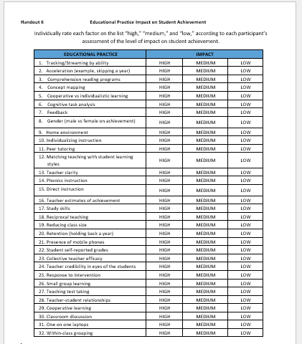
Activity
Test Your Knowledge About What Works!
Influences on Achievement
What impact
(high, medium, or low) does each factor have on
student achievement?
(Corwin, 2021; Hattie, 2021)
Notes:
Handout #6, Activity: Educational Practice Impact on Student Achievement
Handout #7, Answer Key: Educational Practice Impact on Student Achievement
To Know
This activity provides an opportunity to reflect on educational practices and their impact on student achievement using John Hattie’s latest research. It is often an eye opener to see the actual impact certain practices have or don’t have. This awareness can move participants into discussions about how this impacts the leadership practices in their own buildings.
To Do
Facilitate an activity to help participants become familiar with the research regarding the effectiveness of specific practices often seen in education.
Distribute the Handout #6, Activity: Educational Practice Impact on Student Achievement to each participant.
Pose the question: What impact does each of these factors have on student achievement?
Then have participants rate the each of the practices as having a high, medium, or low impact on student achievement.
After the activity handout is completed, provide the answer key, Handout #7, Answer Key: Educational Practice Impact on Student Achievement.
Participants can then compare their results with the actual Hattie 2021 effect sizes. Encourage participants to discuss the results with each other in small groups, sharing what they find surprising and why. The facilitator should then ask each small group to share the highlights of their discussion.
To Say
Test your knowledge based on John Hattie’s research regarding specific practices often seen in education and their impact on student achievement. Reflect on each of the educational practices listed on the handout. Mark the level of student impact you think each practice has…. high, medium, or low. Once finished, you will be given another handout with the effect size for each practice based on John Hattie’s research. Discuss the findings and your thoughts with a partner or small group.
Now that we have had a chance to review what the research says about the effectiveness of these practices. Are you surprised by the results? How does this impact you as the instructional leader of your building?
References
Corwin. (2021, August). Visible learning meta x. Corwin Visible Learning Plus. https://www.visiblelearningmetax.com/
Hattie, J. (2021, August). Global research data base, all influences. Corwin Visible Learning Plus. https://www.visiblelearningmetax.com/Influences

Slide 37
High-Impact Influences & Effect Sizes Related to Student Achievement
Teacher estimates of achievement, 1.46
Collective teacher efficacy, 1.36
Self-reported grades, 1.33
Cognitive task analysis, l.29
Piagetian levels (prior knowledge/background), 1.28
Math problem solving, 1.16
Response to intervention, 1.09
https://www.visiblelearningmetax.com/content/influence_glossary.pdf
(Corwin, 2021; Hattie 2021)
Notes:
To Know
These educational practices (influences) are those that John Hattie has identified as having the greatest impact on student achievement. These practices are reflected in DCI work as they address the four instructional focus areas that will be discussed (collaborative culture, effective teaching/learning practices, assessment, data-based decision making). Be familiar with the definition of these terms so they can be clarified for the audience. The link to the Meta Influence Glossary is on the slide if you wish to show the definitions while explaining them.
To Do
Explain that these are educational practices with the highest effect sizes based on Hattie’s 2021 research findings. Define any terms that need clarification using the link to the Meta Influence Glossary. Discuss instructional focus areas these high impact influences are associated with (collaborative culture, effective teaching/learning practices, assessment, data-based decision making).
To Say
These are some of the influences Hattie’s research has identified as having the greatest impact on student achievement. These practices are associated with DCI and the four instructional focus areas (collaborative culture, effective teaching/learning practices, assessment, data-based decision making). Which, if any, of these practices is a focus for your school?
References
Corwin. (2021, August). Visible learning meta x. Corwin Visible Learning Plus. https://www.visiblelearningmetax.com/
Hattie, J. (2021, August). Global research data base, all influences. Corwin Visible Learning Plus. https://www.visiblelearningmetax.com/Influences
Hattie, J. (2021, August). Meta influence glossary. Corwin Visible Learning Plus. https://www.visiblelearningmetax.com/content/influence_glossary.pdf

Slide 38
More High-Impact Influences Associated with DCI Practices
Outcomes based education, .97
Feedback (with reinforcement and cues), .92
Success criteria, .88
Micro teaching - video review of lessons, .88
Integrate with prior knowledge strategies, .86
Transfer strategies, .86
Classroom discussion, .82
(Corwin, 2021; Hattie 2021)
Notes:
To Know
These are more high-impact educational practices (influences) identified by John Hattie’s 2021 research. These practices are reflected in DCI work as they address the four instructional focus areas that will be discussed (collaborative culture, effective teaching/learning practices, assessment, data-based decision making). Be familiar with the definition of these terms so they can be clarified for the audience. Also be familiar with their connection to DCI practices.
To Do
Explain that these high-impact educational practices are based on Hattie’s 2021 research findings. Define any terms and discuss instructional focus areas they are associated with (collaborative culture, effective teaching/learning practices, assessment, data-based decision making). The Meta Influence Glossary can again be accessed if needed.
To Say
These are some of the influences Hattie’s research has identified as having the greatest impact on student achievement. Which, if any, of these practices is a focus for your school?
References
Corwin. (2021, August). Visible learning meta x. Corwin Visible Learning Plus. https://www.visiblelearningmetax.com/
Hattie, J. (2021, August). Global research data base, all influences. Corwin Visible Learning Plus. https://www.visiblelearningmetax.com/Influences
Hattie, J. (2021, August). Meta influence glossary. Corwin Visible Learning Plus. https://www.visiblelearningmetax.com/content/influence_glossary.pdf

Slide 39
Low- or Negative-Impact Influences Related to Student Achievement
Programmed instruction, .23
Within class grouping, .18
Reducing class size, .18
One-on-one laptops, .16
Tracking/Streaming, .10
Multi-age-grade classes, .04
Lectures, - .18
Suspension, - .20
Retention, - .32
(Corwin, 2021; Hattie 2021)
Notes:
To Know
These are some of the influences Hattie’s research has identified as having low- or negative-impact.
To Do
Explain that these educational practices with low- or negative-impact are based on Hattie’s 2021 research findings. Define any terms that need clarification. The Meta Influence Glossary may be used again. Encourage discussion around the implications of these finding and how they might affect decisions school leaders make.
To Say
These are some of the influences Hattie’s research has identified as having the lowest, or even a negative-impact on student achievement. What are implications for school leaders around these findings?
References
Corwin. (2021, August). Visible learning meta x. Corwin Visible Learning Plus. https://www.visiblelearningmetax.com/
Hattie, J. (2021, August). Global research data base, all influences. Corwin Visible Learning Plus. https://www.visiblelearningmetax.com/Influences
Hattie, J. (2021, August). Meta influence glossary. Corwin Visible Learning Plus. https://www.visiblelearningmetax.com/content/influence_glossary.pdf

Slide 40
Global Research Data Base John Hattie Visible Learning https://www.visiblelearningmetax.com/Influences
(Corwin, 2021; Hattie 2021)
Notes:
To Know
The Visible Learning Global Research Data Base provides quick access to Hattie’s most recent meta-analysis studies of educational practices. It includes the practice (influence), domain, number of meta-analysis and studies, effect size, and confidence level. A definition and overview of the practice is provided by clicking the influence. If you wish to access a separate meta-analysis glossary from the Visible Learning X website go to https://www.visiblelearningmetax.com/content/influence_glossary.pdf.
To Do
Share the Visible Learning Global Research Data Base with John Hattie’s recent research findings on what works in education. Provide participants time to peruse the site to see educational influences and their effect sizes. Point out that an overview and definition of each practice is provided when the influence name is clicked.
To Say
Take a few minutes to peruse Visible Learnings Global Research Data Base. You can John Hattie’s most recent research findings. The website lists influences, the number of meta-analysis and studies for each, along with their effect size and impact. Just click the influence and you will see an overview and definition for the educational practice.
References:
Corwin. (2021, August). Visible learning meta x. Corwin Visible Learning Plus. https://www.visiblelearningmetax.com/
Hattie, J. (2021, August). Global research data base, all influences. Corwin Visible Learning Plus. https://www.visiblelearningmetax.com/Influences
Hattie, J. (2021, August). Meta influence glossary. Corwin Visible Learning Plus. https://www.visiblelearningmetax.com/content/influence_glossary.pdf

Slide 41
Critical Actions for an Instructional Leader of the Building: How to Get Started
JODI, wrong logo.
Notes:
To Know
The four areas of building instructional focus are: collaborative culture and climate, highly effective teaching and learning practices, assessment, and data-based decision-making.
To Do
Facilitate the “getting started” process for building leaders to develop or sharpen skills to help them become the instructional leaders of their building.
To Say
We have learned the importance of focusing efforts on practices taken by the building leader that are directly linked with instructional issues (collaboration among staff, use of highly effective teaching/learning practices, formative assessment, and using the results of the formative assessment to make instructional decisions. In this section, we will discuss the nuts and bolts of how to begin developing or, in some cases, sharpening skills that create strong building instructional leaders.

Slide 42
Steps to Get Started
Know the critical areas of INSTRUCTIONAL FOCUS
Notes:
To Know
Be aware that as the instructional leader of the building or district, efforts must be focused. Often, instructional focus is lost amid an array of initiatives, programs, and other efforts. All the work seems to be important; however, when focus is lacking, nothing seems to be done well. When efforts are focused on a small number of areas supported by research, substantial change can occur.
To Do
Start the conversation to identify the four areas of instructional focus.
To Say
To get started, you must first define the areas of instructional focus for the building. In other words, identify the key instructional areas where the leader will focus time and effort. Instructional focus is often lost amid an array of initiatives, programs, and other projects. All the work seems to be important; however, when focus is lacking, nothing seems to be done well. When efforts are focused on a small number of areas supported by research, substantial change can occur.

Slide 43
AREAS OF INSTRUCTIONAL FOCUS
1. Collaborative Culture and Climate
2. Highly Effective Teaching/Learning Practices
3. Assessment
4. Data-Based Decision Making
(Hattie, 2021, 2015, 2012; Hattie, Master, & Birch, 2016; Telfer, 2011)
Notes:
To Know
Be aware of the four areas of instructional focus (collaborative culture and climate, highly effective teaching and learning practices, assessment, and data-based decision making).
To Do
Identify and discuss the four areas of instructional focus.
To Say
Based upon the research we know that the four instructional areas listed on this slide should be the focus of the building work.
As an instructional leader, knowing these areas allows you to direct resources and energy into the tasks required to develop these areas.
Focus Area #1: Collaborative Culture and Climate: How can we work in an environment that promotes collaboration to improve performance for all students?
Focus Area #2: Highly Effective Teaching/Learning Practices: What are the teaching/learning practices that are known to be highly effective and have a high impact on student learning?
Focus Area #3: Assessment: How is student learning monitored?
Focus Area #4: Data-Based Decision-Making: How are our students performing? What are the current gaps in student learning?
References (adapted from)
Hattie, J. (2012). Visible learning for teachers: Maximizing impact on learning. Routledge.
Hattie, J. (2015). High impact leadership. Educational Leadership, 72(5), 36-40. http://kendrastantoine.weebly.com/uploads/5/4/2/8/54285355/high_impact_leadership_-_hattie_(1).pdf
Hattie, J. (2021, August). Global research data base, all influences. Corwin Visible Learning Plus. https://www.visiblelearningmetax.com/Influences
Hattie, J., Masters, D., & Birch, K. (2016). Visible learning into action: International case studies of impact. Routledge.
Hattie, J., & Smith, R. (Eds.). (2020). 10 Mindframes for leaders: The VISIBLE LEARNING (R) approach to school success. Corwin.
Telfer, D.M. (2011). Moving your numbers: Five districts share how they used assessment and accountability to increase performance for students with disabilities as part of district-wide improvement. University of Minnesota, National Center on Educational Outcomes. http://www.cehd.umn.edu/NCEO/OnlinePubs/MovingYourNumbers.pdf

Slide 44
Steps to Get Started
Know the critical areas of INSTRUCTIONAL FOCUS
Identify KEY ACTIONS of a building instructional leader
Notes:
To Know/To Say
Now you have identified and defined the areas of instructional focus. You know the key instructional areas where you will focus most of your time and effort. Next, we must identify the key actions to be taken by the instructional leader to implement research-based, effective practices.
What critical actions are needed from the building leader to begin building collaborative structures and ensure instructional staff are trained in the use of effective teaching/learning practices alongside regular assessment and to use data to inform instructional decision-making?
To Do
Start the conversation to identify the key actions of a strong building instructional leader.

Slide 45
5 KEY ACTIONS OF A BUILDING INSTRUCTIONAL LEADER
Establish a collaborative culture and climate
Set time for implementation
Establish expectations
Ensure resources
Monitor for implementation and collaboration
(Hattie, 2015; Hattie & Smith, 2018)
Notes:
To Know/To Say
These are the 5 critical actions key to addressing a school’s instructional focus areas.
Establish a collaborative culture and climate
Set time for implementation
Establish expectations
Ensure resources
Monitor for implementation and collaboration
These actions are used to accomplish the following.
Build collaborative structures
Ensure that instructional staff are trained in the use of effective teaching/learning practices
Use effective assessment practices
Collect and analyze data to inform instructional decision making
(These are the instructional focus areas.)
We will begin by looking more closely at key action #1, which is Establish a collaborative culture and climate..
To Do
Identify and discuss the 5 Key Actions of a building instructional leader.
References (adapted from)
Hattie, J. (2015). High impact leadership. Educational Leadership, 72(5), 36-40. http://kendrastantoine.weebly.com/uploads/5/4/2/8/54285355/high_impact_leadership_-_hattie_(1).pdf
Hattie, J., & Smith, R. (Eds.). (2020). 10 Mindframes for leaders: The VISIBLE LEARNING (R) approach to school success. Corwin.

Slide 46
Establish Collaborative Team Structures
Building Leadership
Team
Collaborative Teams
(Hattie, 2015; Hattie & Smith, 2020; Lynch, 2020)
Notes:
To Know/To Say
We will now take a close look at the first key action which is establishing a collaborative climate and culture through building leadership teams and grade level/content area collaborative teams. These two collaborative team structures are essential in developing collaboration within a school.
Both teams analyze data and use this analysis to inform future actions. The teams may differ in the levels of data examined and the types of future actions taken, but both teams work to improve school and student outcomes.
A building leadership team is typically comprised of individuals who represent different departments, grade levels, and roles within the organization. This team works interdependently toward common goals in order to create and successfully sustain school improvement efforts. They analyze building and classroom level student data as well as strengths and weaknesses related to instruction and social-behavioral needs.
Grade level/content collaborative teams are typically comprised of teachers of the same grade level and/or content area and should include all instructional staff on at least one team. These teams maintain unity throughout curriculum, instruction, and assessment to align and implement the standards within each content area for the specific grade level and/or content area. They analyze building and classroom level student data and well as strengths and weaknesses related to instruction and social-behavioral needs to determine instructional effectiveness and student learning. These teams use data to inform future instruction.
To Do
Discuss and expand on the importance and roles of the building leadership team and collaborative teams in developing a collaborative school culture.
References (adapted from)
Hattie, J. (2015). High impact leadership. Educational Leadership, 72(5), 36-40. http://kendrastantoine.weebly.com/uploads/5/4/2/8/54285355/high_impact_leadership_-_hattie_(1).pdf
Hattie, J., & Smith, R. (Eds.). (2020). 10 Mindframes for leaders: The VISIBLE LEARNING (R) approach to school success. Corwin.
Lynch, M. (2020, July 6). Creating effective leadership teams in schools. The Edvocate. https://www.theedadvocate.org/creating-effective-leadership-teams-in-schools/

Slide 47
Team Membership Configurations
Building Leadership Team
School principal
Teachers
Instructional coach
Support staff
Collaborative Teams
General education teachers
Special education teachers
Support staff
(Lynch, 2020)
Notes:
To Know/To Say
A building leadership team and grade level/content area collaborative teams are two types of collaborative team structures. This is how they are usually configured:
Building Leadership Team
School principal
Teachers (regular, special education, library/art/music)
Instructional coach
Support staff (paraprofessionals, interventionists, counselors, etc.)
Collaborative Team
General education teachers from a grade level
Special education teacher(s) from a grade level
Support staff (paraprofessionals, interventionists, counselors, etc.)
This slide suggests specific collaborative team membership configurations. Building instructional leaders should consider the grade level structures and staff make-up in their building to ensure ALL instructional staff participate on at least one collaborative team and, at some point, can serve on the building leadership team.
To Do
Discuss the configurations of both building leadership teams and collaborative teams. Expand on the details if each as noted above.
Reference (Adapted from)
Lynch, M. (2020, July 6). Creating effective leadership teams in schools. The Edvocate. https://www.theedadvocate.org/creating-effective-leadership-teams-in-schools/

Slide 48
Building Leadership Team Configurations
Elementary Example
Secondary Example
School leader/Principal
PK and primary grade representation
Intermediate grade level representation
Non-core teacher representation
Student support staff representation
School leader/Principal
Department staff representation
Student support staff representation
(Lynch, 2020)
Notes:
To Know/To Say
This slide illustrates building leadership team configurations at both elementary and secondary levels. Team composition may differ slightly according to building grade level/class structure.
Elementary Example
School leader/Principal
PK and primary grade representation
Intermediate grade level representation
Non-core teacher representation
Student support staff representation (Interventionists, Special Education, Counselors, Etc.)
Secondary Example
School leader/Principal
Department staff representation (Core and Non-core)
Student support staff representation (Interventionists, Special Education, Counselors, Etc.)
To Do
Discuss various building leadership team configurations. Expand on the details using information in the notes.
Reference (Adapted from)
Lynch, M. (2020, July 6). Creating effective leadership teams in schools. The Edvocate. https://www.theedadvocate.org/creating-effective-leadership-teams-in-schools/

Slide 49
Reflect & Discuss
Is a leadership team already established in your building? Functions? Roles/responsibilities?
Are collaborative teams established across grade/content areas? Functions? Roles/responsibilities?
Are all staff on at least one collaborative team?
Are collaborative teams running efficiently and effectively? How is that ensured?
Notes:
To Know
Be familiar with the collaborative team structures (building leadership and grade level/content area) discussed in this section.
To Do
Prompt participants to review building collaborative team structures that currently exist or that need to be established. Provide an opportunity for partner or small group discussion of these questions.
To Say
Consider the questions listed on this slide regarding both leadership and grade/content level collaborative teams. Reflect on and discuss these questions with a partner or team members.
Is a leadership team already established in your building? Functions? Roles/responsibilities?
Are collaborative teams established across grade/content areas? Functions? Roles/responsibilities?
Are all staff on at least one collaborative team?
Are collaborative teams running efficiently and effectively? How is that ensured?

Slide 50
5 KEY ACTIONS OF A BUILDING INSTRUCTIONAL LEADER
Establish a collaborative culture and climate
Set time for implementation
Establish expectations
Ensure resources
Monitor for implementation and collaboration
(Hattie, 2015; Hattie & Smith, 2018)
Notes:
To Know/To Say
Again, these are the five critical actions key to addressing a school’s instructional focus areas.
Next, we’ll look more closely at key action #2, Set time for implementation.
To Do
Review the five key actions and begin focus on #2, Set time for implementation.
References (adapted from)
Hattie, J. (2015). High impact leadership. Educational Leadership, 72(5), 36-40. http://kendrastantoine.weebly.com/uploads/5/4/2/8/54285355/high_impact_leadership_-_hattie_(1).pdf
Hattie, J., & Smith, R. (Eds.). (2020). 10 Mindframes for leaders: The VISIBLE LEARNING (R) approach to school success. Corwin.

Slide 51
Key Action: Set Time For Implementation
Teachers need time during the school day set aside for collaboration that includes the following:
Training/professional development
Data collection
Data analysis
Team planning
Notes:
To Know
Providing time for teacher collaboration regarding professional development, data collection/analysis, and team planning is a key responsibility of school leaders to facilitate and build a collaborative culture in schools.
To Do
Expand on the slide information by providing more details about the types of events and activities that will require specific time reserved to implement.
Activity
Next, have participants work with a partner or team to reflect on how time can be set aside (job embedded) for each element: training/PD, data collection, data analysis, and team planning.
Have partners/teams list all topics on a piece of chart paper. Ideas for setting aside time for each can be discussed and recorded. Charts can be shared with the whole group as a gallery walk.
To Say
Here are examples of events and activities for which teachers need job-embedded time reserved to attend and participate. These types of events and activities are vital to collaborative culture building. (Review and expand on the slide information.)
Now, reflect on how time can be set aside for each. Record your ideas on chart paper. Be prepared to share ideas with the whole group.
References (adapted from)
Hattie, J. (2015). High impact leadership. Educational Leadership, 72(5), 36-40. http://kendrastantoine.weebly.com/uploads/5/4/2/8/54285355/high_impact_leadership_-_hattie_(1).pdf
Hattie, J., & Smith, R. (Eds.). (2020). 10 Mindframes for leaders: The VISIBLE LEARNING (R) approach to school success. Corwin.

Slide 52
5 KEY ACTIONS OF A BUILDING INSTRUCTIONAL LEADER
Establish a collaborative culture and climate
Set time for implementation
Establish expectations
Ensure resources
Monitor for implementation and collaboration
Notes:
To Know/To Say
Again, these are the five critical actions key to addressing a school’s instructional focus areas.
Next, we will look more closely at key action #3, Establish expectations.
To Do
Review the five key actions and begin focus on #3, Establish expectations.
References (adapted from)
Hattie, J. (2015). High impact leadership. Educational Leadership, 72(5), 36-40. http://kendrastantoine.weebly.com/uploads/5/4/2/8/54285355/high_impact_leadership_-_hattie_(1).pdf
Hattie, J., & Smith, R. (Eds.). (2020). 10 Mindframes for leaders: The VISIBLE LEARNING (R) approach to school success. Corwin.
Lynch, M. (2020, July 6). Creating effective leadership teams in schools. The Edvocate. https://www.theedadvocate.org/creating-effective-leadership-teams-in-schools/

Slide 53
Key Action: Establish Expectations
Develop and communicate high expectations Collaboratively, with your staff, discuss and develop the following.
“What is our vision for our students?”
“How do we make this happen?”
Ensure a consensus from the entire staff.
(Hattie, 2015; Hattie & Smith, 2020; Lynch, 2020)
Notes:
To Know
Establishing high expectations is a non-negotiable for both the building and for all teachers.
Sitting down with staff and having a collaborative conversation about the collective vision for students as well as the path to make that vision a reality are important steps necessary for establishing high expectations for the building.
To Do
Review the information on the slide and stress its importance.
To Say
High expectations set the overall building tone and communicate to staff practices instructional leaders expect to see all instructional staff engaged in across the school building.
References (adapted from)
Hattie, J. (2015). High impact leadership. Educational Leadership, 72(5), 36-40. http://kendrastantoine.weebly.com/uploads/5/4/2/8/54285355/high_impact_leadership_-_hattie_(1).pdf
Hattie, J., & Smith, R. (Eds.). (2020). 10 Mindframes for leaders: The VISIBLE LEARNING (R) approach to school success. Corwin.
Lynch, M. (2020, July 6). Creating effective leadership teams in schools. The Edvocate. https://www.theedadvocate.org/creating-effective-leadership-teams-in-schools/

Slide 54
Key Action: Establish Expectations
All educators
Accept responsibility for all students in all grade levels
Participate in at least one meaningful collaborative teacher team to focus on the following.
Effective teaching practices
Analyzing assessment data
Evaluating processes and student outcomes
Encourage and support each other to be successful implementers of effective practices.
(Hattie, 2015; Hattie & Smith, 2020; Lynch, 2020)
Notes:
To Know/To Say
It is essential for building leaders to establish high expectations for all educators. They include the following list of non-negotiables:
Accept responsibility for all students in all grade levels. The success of every student in the building is the collective responsibility of all staff.
Participate in at least one meaningful collaborative teacher team that focuses on learning and implementing effective teaching/learning practices and analyzes common formative assessments to evaluate the teaching/learning process. This includes content area/grade level teachers as well as music, P.E., art, counselor, paraprofessionals, etc.
Encourage and support each other to be successful learners and implementers of effective practices. All staff work together as a team to help each other achieve positive outcomes.
To Do
Review the key points on the slide regarding establishing high expectations for all educators. Expand on each.
References (adapted from)
Hattie, J. (2015). High impact leadership. Educational Leadership, 72(5), 36-40. http://kendrastantoine.weebly.com/uploads/5/4/2/8/54285355/high_impact_leadership_-_hattie_(1).pdf
Hattie, J., & Smith, R. (Eds.). (2020). 10 Mindframes for leaders: The VISIBLE LEARNING (R) approach to school success. Corwin.
Lynch, M. (2020, July 6). Creating effective leadership teams in schools. The Edvocate. https://www.theedadvocate.org/creating-effective-leadership-teams-in-schools/

Slide 55
Reflect & Discuss
What are the high expectations for…
my district?
my building?
educators in my building?
How are these expectations infused into the culture and communicated across all levels of the system?
Notes:
To Know
These are questions school leaders need to reflect on. Discussion amongst school leaders will help generate additional ideas and considerations around these key questions regarding establishing high expectations in districts, buildings, and within individual educators.
To Do
Activity: Write each of these questions on chart paper. One question per chart paper. Post around the room.
What are the high expectations for my district?
What are the high expectations for my building?
What are the high expectations for educators in my building?
How are these expectations infused into the culture and communicated across all levels of the system?
Facilitate discussion around each of the questions. Have participants write responses on sticky notes and place on corresponding charts. Share responses that were generated and placed on the charts with the whole group.
To Say
Work with a partner or team to reflect on these questions, one at a time. Write responses on sticky notes and place them on the corresponding chart. Your responses will later be shared with the group.

Slide 56
5 KEY ACTIONS OF A BUILDING INSTRUCTIONAL LEADER
Establish a collaborative culture and climate
Set time for implementation
Establish expectations
Ensure resources
Monitor for implementation and collaboration
Notes:
To Know
Again, these are the five critical actions key to addressing a school’s instructional focus areas. Next, we’ll look more closely at key action #4, Ensure resources.
To Do
Review the five key actions and begin focus on #4, Ensure resources.
Discuss the need to ensure suggested resources are available and easily accessible to staff.
To Say
Next, we’ll look more closely at key action #4, Ensure resources. Understanding and providing the resources necessary to implement effective practices is sometimes overlooked. We will be looking at resources that need to be ensured.
References (adapted from)
Hattie, J. (2015). High impact leadership. Educational Leadership, 72(5), 36-40. http://kendrastantoine.weebly.com/uploads/5/4/2/8/54285355/high_impact_leadership_-_hattie_(1).pdf
Hattie, J., & Smith, R. (Eds.). (2020). 10 Mindframes for leaders: The VISIBLE LEARNING (R) approach to school success. Corwin.
Lynch, M. (2020, July 6). Creating effective leadership teams in schools. The Edvocate. https://www.theedadvocate.org/creating-effective-leadership-teams-in-schools/

Slide 57
Key Action: Ensure Resources
Effective building leaders ensure that these resources are available to staff:
People (internal/external)
Time (job-embedded)
Training/Professional Development
Materials
Money
(Hattie, 2015; Hattie & Smith, 2020; Lynch, 2020)
Notes:
To Know
Without easy access to important resources, educators will find it difficult to implement the work of the four instructional areas leaders are focusing on (collaborative culture, high effective instructional practices, assessment, data-based decision making).
To Do
Discuss different types of resources to consider when planning work in the four instructional areas.
To Say
It is the responsibility of the building leader to recognize what resources are needed to implement the practices learned through the professional learning across the four instructional areas of focus and ensure that those resources are available and easily accessible to staff. These are areas in which the building leader may need to ensure that appropriate resources are in place.
People (internal/external)
Time (job-embedded)
Training/Professional Development
Materials
Money
References (adapted from)
Hattie, J. (2015). High impact leadership. Educational Leadership, 72(5), 36-40. http://kendrastantoine.weebly.com/uploads/5/4/2/8/54285355/high_impact_leadership_-_hattie_(1).pdf
Hattie, J., & Smith, R. (Eds.). (2020). 10 Mindframes for leaders: The VISIBLE LEARNING (R) approach to school success. Corwin.
Lynch, M. (2020, July 6). Creating effective leadership teams in schools. The Edvocate. https://www.theedadvocate.org/creating-effective-leadership-teams-in-schools/

Slide 58
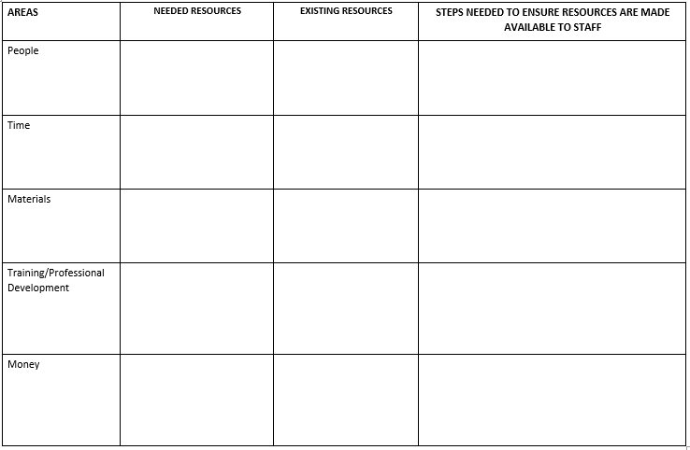
Ensuring Resources
Notes:
Handout #8, Ensuring Resources
To Know
This activity provides school leaders an opportunity to reflect on resources that are needed to implement the instructional work of the building and develop steps to ensure those resources are accessible to staff.
To Do
Assist participants to consider resources needed to facilitate and implement the instructional work of the building. Have school leaders work individually or with a partner to reflect on resources needed, currently available, and steps needed to ensure they are accessible to staff. Handout 8 is to be completed.
To Say
Consider what resources are needed to facilitate and implement the instructional work of the building. On the handout provided, or with a shoulder partner, reflect and briefly share your thoughts about these possible resources needed to do the instructional work of the building.

Slide 59
5 KEY ACTIONS OF A BUILDING INSTRUCTIONAL LEADER
Establish a collaborative culture and climate
Set time for implementation
Establish expectations
Ensure resources
Monitor for implementation and collaboration
Notes:
To Know
Again, these are the five critical actions key to addressing a school’s instructional focus areas.
We will now look more closely at key action #5, Monitor for implementation and collaboration. It is critical that monitoring takes place; when this work goes unmonitored, implementation of professional learning leading to improved teacher performance and improved student outcomes are left to chance which often results in unmet goals with little or no success.
To Do
Review the five key actions and begin focus on # 5, Monitor for implementation and collaboration.
Discuss the need to ensure suggested resources are available and easily accessible to staff. Discuss the need to monitor for implementation and collaboration.
To Say
Now we will look at the last key action #5, Monitor for implementation and collaboration. Monitoring implementation of practices learned though professional development in the four areas of instructional focus and how teachers are working collaboratively to help each other succeed ensures that work to improve instructional effectiveness and increase student outcomes is occurring as intended. When this work goes unmonitored, implementation of professional learning leading to improved teacher performance and improved student outcomes are left to chance which often results in unmet goals with little or no success.
References (adapted from)
Hattie, J. (2015). High impact leadership. Educational Leadership, 72(5), 36-40. http://kendrastantoine.weebly.com/uploads/5/4/2/8/54285355/high_impact_leadership_-_hattie_(1).pdf
Hattie, J., & Smith, R. (Eds.). (2020). 10 Mindframes for leaders: The VISIBLE LEARNING (R) approach to school success. Corwin.
Lynch, M. (2020, July 6). Creating effective leadership teams in schools. The Edvocate. https://www.theedadvocate.org/creating-effective-leadership-teams-in-schools/

Slide 60
Key Action: Monitor for Implementation and Collaboration
Monitoring Tools
Practice Profiles
Walk-throughs
Peer Observations
SAPPs
Surveys (CWIS)
Areas of Instructional Focus
Collaborative culture and climate
Highly effective teaching/learning practices
Assessment
Data-based decision-making
(MO Edu-Sail, 2022)
Notes:
To Know
There are a variety of tools available to ensure the areas of instructional focus are monitored so they are implemented with fidelity. Those tools include Practice Profiles, Self-Assessment Practice Profiles (SAPPs), Walk-through or Look-for Tools, Peer Observations, and Surveys such as the CWIS (Collaborative Work Implementation Survey). Be familiar with each of these monitoring tools.
Practice Profiles and Walk-through tools can be found on the MoEdu-Sail website at https://www.moedu-sail.org/mtss-facilitator-materials/
SAPP results can be found at https://apps.dese.mo.gov/DESEApplicationsSignin/Index
CWIS results can be found at http://cwis.missouripd.org/
To Do
Discuss the need to monitor for implementation and collaboration. Explain the purpose and features of each of these monitoring tools. Go to the sites and show participants samples of these tools and how to access them.
To Say
There are a variety of tools available to ensure the areas of instructional focus are monitored so they are implemented with fidelity.
(Explain each tool, its purpose and features).
The Practice Profiles and Walk-through Tools can be found on the MOEdu-Sail website under facilitator materials. Links to those and the other tools can be found on the Essential Planning Inventory (EPI) that we will soon be examining.
Reference
MOEdu-Sail. (2022). Professional learning materials. Missouri Department of Elementary and Secondary Education: NAU Institute for Human Development. https://www.moedu-sail.org/mtss-facilitator-materials/

Slide 61
Trust Based Observations Craig Randall
trustbased.com/
(Randall, 2018)
Notes:
To Know/To Say
Teacher observation/evaluation is another strategy educational leaders may use to reinforce and monitor expectations. Trust Based Observations is an educator evaluation model that is based on the understanding that people perform best when they feel safe and supported. Craig Randall explains the why and how of building trusting relationships with teachers through short frequent observations and collegial conversations to improve educator effectiveness resulting in greater impact on student performance. He emphasizes the importance of being frequently present in classes, asking reflective questions, taking time to notice and focus on teaching strengths, and then at the right time begin to work with teachers on areas of growth.
Please note this video is on the front page of Craig Randall’s website. You will need to click on the website link.
To Do/Say
Teacher observation/evaluation is another strategy educational leaders may use to reinforce and monitor expectations. Whether this is a walkthrough tool that is used to provide feedback or a more formal system such as trust-based observation. Trust Based Observations is an educator evaluation model that is based on the understanding that people perform best when they feel safe and supported. Craig Randall explains the why and how of building trusting relationships with teachers through short frequent observations and collegial conversations to improve educator effectiveness resulting in greater impact on student performance.
Show the video. Next, ask participants to reflect on these questions with a partner or small group:
How might such a model help promote Hattie’s Mindframes for Leaders?
How does Trust-Based Teacher Observations help to build collective teacher and leader efficacy?
Video (3:57 minutes), Trust Based Observations, trustbased.com/
Reference
Randall, C. (2018). Trust-based observations [Video]. https://trustbased.com/

Slide 62
Trust Based Observations
“Classroom observation can lead to telling teachers to do what I did, to advocating different ways of teaching, and to complying with accountability edicts.
Trust Based Observations starts where it matters, establishing trust, building on strengths, focusing on the impact of teachers on the learning lives of students, showing how to have open conversations about learning, and demonstrating collective teacher efficacy in action.”
John Hattie
Author of Visible Learning
(Randall 2020)
Notes:
To Know
Trust Based Observations, developed by Craig Randall, are aligned with Hattie’s leadership mindframes. Trust Based Observations is an innovative way to conduct teacher observations while helping to build relationships and trust with educators so that learning can occur in a place where it is safe to make mistakes. These observations build on teachers’ strengths, engage in collaborative dialogue, and provide actionable feedback that results in improved teaching and learning for all.
To learn more about Trust Based Observations, go to Craig Randall’s website, https://trustbased.com/
To Do
Read Hattie’s quote supporting Trust Based Observations. Use this quote to further the discussion on trust-based observation.
To Say
(Read Hattie’s quote.) Trust Based Observations are closely aligned with Hattie’s Leadership Mindframes and are a great example of how leaders can help develop educator growth mindset. They are an innovative and more effective way to conduct teacher observations. By using emotional intelligence when interacting with educators, relationships are built through trust so that learning can occur in a place where it is safe to make mistakes. These observations build on teachers’ strengths, engage in collaborative dialogue, and provide actionable feedback that results in improved impact on teaching and learning. Trust Based Observations also encourage risk taking so that teachers feel empowered and are more likely to try new and innovative approaches to teaching.
Are there words in this quote that stand out to you as an instructional leader when considering teacher observations?
Reference
Randall, C. (2022). Trust-based observations [Website]. https://trustbased.com/

Slide 63
Trust Based Observation Form
Learning targets
Teacher-student relationship
Classroom learning
Working memory
Questioning higher-order thinking skills
Formative assessment
Descriptive progress feedback
Specific differentiation
TBO Reflection Form (trustbased.com)
(Randall, 2022)
Notes:
To Know
These nine categories are on the Trust Based Observation form by James Randall. This is a free form when you sign up for it on his website: TBO Reflection Form (trustbased.com)
To Do
Please have the participants download this TBO Reflection Form for an activity.
To Say
The Trust Based Observation form gathers evidence around nine areas of good teaching (listed on slide). Craig Randall suggests that this observation form be used only after several teacher observations have first taken place to highlight teacher strengths and establish trust. This process does not rate/rank pedagogy but rather works to change mindset that promotes teacher self-assessment, reflection, and collaborative professional conversations to improve practice.
The form itself is also a teacher growth and learning resource for educators. In addition to the observation evidence, it provides learning resources to help build skills around the effective strategies.
Ask school leaders to download this form and share reflections regarding the level of trust and teacher growth that is generated by their current observation forms. Continue discussion around how they might develop observations that are more trust-based and the benefits of using an evaluation model such as Craig Randall’s Trust Based Observation.
Finally, ask school leaders to reflect on these two questions as they have follow-up with teachers.
What were you doing to help students learn?
If you had the opportunity to reteach the lesson, what, if anything, might you do differently?
Reference
Randall, C. (2022). Trust-based observations [Website]. https://trustbased.com/

Slide 64
Reflect & Discuss
How do you monitor teams for collaboration and fidelity of implementation for effective teaching/learning practices ?
Is your monitoring process running effectively and efficiently?
What tools or resources do you need to perform this task?
What can be done to improve your monitoring process?
Notes:
To Know
These questions will help building leaders assess their current monitoring systems and reflect on how they can be improved. Conversations with other leaders will help to generate more ideas on how these systems can be enhanced.
To Do
Encourage conversations among school leaders about their current monitoring systems to improve staff collaboration and implementation of effective practices.
Activity: After briefly reviewing the questions posed on the slide, ask participants to follow the Stand Up, Hand Up, Pair Up structure to partner up with another building leader to discuss each question.
Debrief the activity by having the whole group share key ideas discussed.
To Say
Consider any systems and processes your building already has in place to monitor collaboration and fidelity of implementation of effective practices by reflecting on each of these questions. You will have an opportunity to discuss each of these questions with another school leader to collaboratively generate ideas to improve your current monitoring systems.

Slide 65
Steps to Get Started
Know the critical areas of INSTRUCTIONAL FOCUS
Identify KEY ACTIONS of a building instructional leader
Employ the KEY ACTIONS of the building instructional leader ACROSS THE AREAS OF INSTRUCTIONAL FOCUS for the building
Notes:
To Know/To Say
Now you have identified the areas of instructional focus and the key actions you must take as the instructional leader of the building. Finally, you must learn how to apply those key actions across the areas of instructional focus to build a collaborative culture and climate where staff work together helping each other to implement effective teaching/learning practices together with formative assessment and use that data to inform teaching practices and student learning.
To Do
Explain to leaders that next we will look at how to use the key actions to implement essential tasks across the four areas of instructional focus.

Slide 66
Putting it All Together
Key Actions
Establish a Collaborative Culture
Set Time Aside
Establish Expectations
Ensure Resources
Monitor for Implementation
Areas of Instructional Focus
Collaborative culture and climate
Highly effective teaching/learning practices
Assessment
Data-based decision-making
Notes:
To Know
The key actions that effective instructional leaders perform need to be applied to the four areas of instructional focus. The Essential Planning Inventory (EPI) is a tool leaders can use to apply these key actions to the instructional focus areas. The Instructional Leader Next-Steps Action Planning Template is used in conjunction with the EPI for developing an action plan for implementing these key actions across the areas of instructional focus. These two documents will be examined in the following slides.
To Do
Review the content of the slide and explain how the key actions need to be applied to the four areas of instructional focus.
To Say
Now let’s look at how this all fits together. Instructional leaders need to apply the key actions to each of the four instructional focus areas.
(Review the key actions and the instructional focus areas.) Next, we will examine two documents that will help school leaders apply these key actions and develop a plan for instructional improvement.

Slide 67
Next Steps: Action Planning
Jodi, wrong footer
Notes:
To Say
We will now move to the next steps which will include taking an inventory of what is in place and not in place in your building. Then we will develop an action plan.

Slide 68
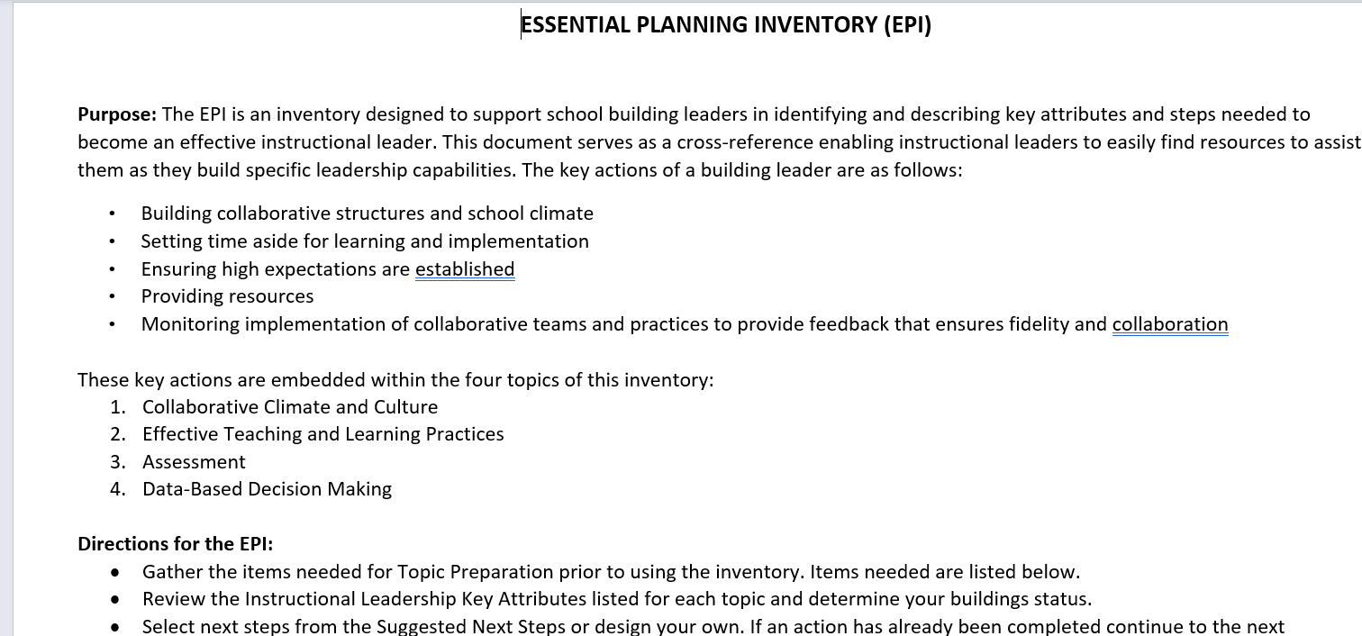
Moving Into Application Essential Planning Inventory (EPI)
Notes:
To Know
The Essential Planning Inventory (EPI) is an online tool leaders can use for reflection to determine next steps needed to apply the key actions to instructional focus areas. This tool is designed to address only initial critical actions needed to become the instructional leader of your building. Upon completion of the activities in the EPI, the building leader should use the actions employed to enrich and support more comprehensive leadership development programs and professional training.
To Do
Acquaint participants with the EPI and the way it is organized. Review the purpose of the tool. Show them how the tool is organized by the four instructional focus areas (collaborative culture, effective teaching/learning practices, assessment, and data-based decision making). Point out that the key leadership actions are addressed throughout the tool for each of the focus areas. Then provide time for participants to peruse the EPI.
To Say
The EPI is an inventory designed to support school building leaders in identifying and describing key attributes and steps needed to become an effective instructional leader. This document is organized by the four instructional focus areas and key leadership actions are addressed throughout the tool. (Review the headings and the way the tool is organized.) The EPI serves as a cross-reference enabling instructional leaders to easily find resources to assist them as they build specific leadership capabilities. (Review the features of the document.)
You will now have an opportunity to look more closely at the document yourself. (Allow time for participants to peruse the EPI.)
Reference
MOEdu-Sail. (2022). Essential planning inventory (revised). Missouri Department of Elementary and Secondary Education: NAU Institute for Human Development. https://www.moedu-sail.org/mtss-facilitator-materials/

Slide 69
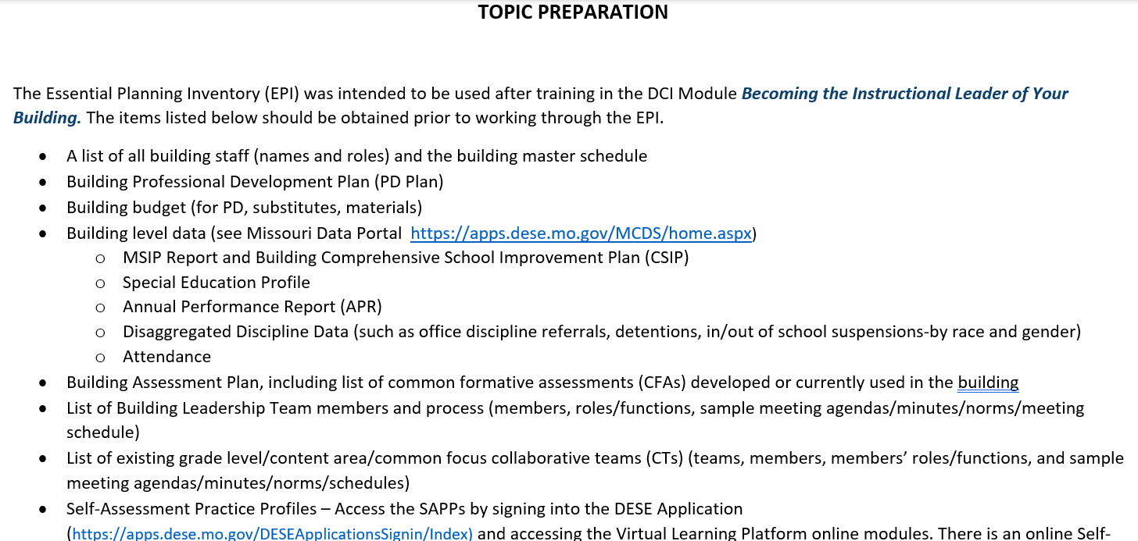
Preparation
Notes:
To Know
Be familiar with the items the participant will need to gather prior to working through the content of the Essential Planning Inventory (EPI) tool. It would be helpful if a list of these items was sent to participants prior to training so they are prepared for the action planning session.
To Do
Show a sample page from the Becoming the Instructional Leader of Your Building: Essential Planning Inventory (EPI) tool showing the items you will need to gather prior to working through the EPI. Ask them to gather as many of these items as possible.
To Say
The Becoming the Instructional Leader of Your Building: Essential Planning Inventory (EPI) tool was designed to guide building leaders into application of the key actions across the four areas of instructional focus and is the tool designed to assist you in identifying critical tasks needed as you move toward becoming the instructional leader of your building. Pictured on this slide is a sample page from the EPI that lists the items you will need to gather prior to working through the tool. To make your work more efficient, gather as many of these items as possible.
Reference
MOEdu-Sail. (2022). Essential planning inventory (revised). Missouri Department of Elementary and Secondary Education: NAU Institute for Human Development. https://www.moedu-sail.org/mtss-facilitator-materials/

Slide 70
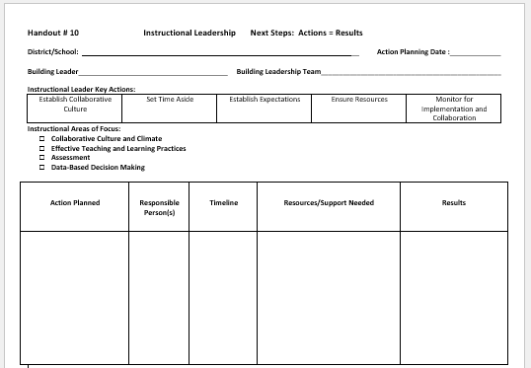
Action Planning with the EPI
Notes:
Handout #9, Instructional Leadership Action Planning Template
To Know
The action planning template is to be used in conjunction with the Essential Planning Inventory (EPI). The Instructional Leader Next-Steps Action Planning Template is used, with the EPI, for developing an action plan for implementing these key actions.
To Do
Introduce the action planning template and its features and organization. Finally, provide time for participants to begin using the EPI to action plan.
To Say
Now it’s time to for action planning and putting what you have learned into practice. The action planning template is to be used in conjunction with the Essential Planning Inventory (EPI) for developing an action plan for implementing these key actions.

Slide 71
Closing & Follow-Up
Wrong footer

Slide 72
Steps to Get Started
Know the critical areas of INSTRUCTIONAL FOCUS
Identify KEY ACTIONS of a building instructional leader
Employ the KEY ACTIONS of the building instructional leader ACROSS THE AREAS OF INSTRUCTIONAL FOCUS for the building
Notes:
To Know/To Say
Now that the steps to get started have been reviewed, and you have begun your work using the EPI, keep in mind that you can use the Instructional Leadership Practice Profile (shown on the next slide) to help track your progress as you move through implementation.
To Do
Summarize the steps that have been covered to get started with this work. Refer to the Practice Profile as a tool to monitor implementation.

Slide 73
Practice Profile
Notes:
To Know/To Say
Implementation with fidelity requires clearly described implementation criteria. This tool will be helpful to monitor implementation of instructional leadership practices.
To Do
Ask participants to refer to their Practice Profile, Handout #3 previously distributed.
References
Hall, G. E., & Hord, S. M. (2006). Implementing change: Patterns, principles, and potholes. Pearson/Allyn and Bacon.
MOEdu-SAIL. (2021). Becoming an instructional leader of your building infographic. Missouri Department of Elementary and Secondary Education: Northern Arizona University, Institute for Human Development. https://www.moedu-sail.org/leadership-materials/

Slide 74
Essential Questions
Why is it important to establish and support a collaborative school culture?
What are the benefits of implementing evidence-based effective teaching and learning practices throughout a school?
How can the strategic use of assessments improve instruction?
Notes:
To Know/To Say
We will revisit these Essential Questions. Please find a partner and answer these. If you need more information, please let me know. We can provide additional training and coaching.
To Do
Have participants reflect on these essential questions on this slide and the next slide. Have them discuss and answer/discuss them with a partner.

Slide 75
Essential Questions, cont.
How and why should data drive building decision making?
What are the key actions and steps the building leader should take to improve areas of instructional focus in your school?
Notes:
To Know/To Say
We will revisit these Essential Questions. Please find a partner and answer these. If you need more information, please let me know. We can provide additional training and coaching.
To Do
Have participants reflect on these essential questions on this slide and the previous slide. Have them discuss/answer them with a partner.

Slide 76
Closing
Trainer can customize this slide with contact information, etc.
Notes:
To Do
Provide closure to the PowerPoint.
To Say
We thank you for viewing this presentation and strongly encourage you to move to the Becoming the Instructional Leader of Your Building: Essential Planning Inventory (EPI) to help you get started.

Slide 77
References
Central Penn College. (2022, October 19). Assessment workbook. https://guides.centralpenn.edu/c.php?g=509428&p=4739506
Corwin. (2021, August). Visible learning meta x. Corwin Visible Learning Plus. https://www.visiblelearningmetax.com/
DeWitt, P. (2021). Collective leader efficacy: Strengthening instructional leadership teams. Corwin Press.
Fullan, M. (2008). What’s worth fighting for in the principalship. New York: Teachers College Press.
Hall, G. E., & Hord, S. M. (2006). Implementing change: Patterns, principles, and potholes. Pearson/Allyn and Bacon.
Harris, H. (n.d). Creating a culture of assessment. U.C. Riverside CA. https://studentdocs.ucr.edu/saar/Creating-a-Culture-of-Assessment.pdf
Hattie, J. (2008). Visible learning: A synthesis of over 800 meta-analyses relating to achievement. Routledge.
Hattie, J. (2012). Instructional leadership, leaders in educational thought: Dr. John Hattie [Video file]. The Student Achievement Division, 1(2). https://www.youtube.com/watch?v=9UYGrk1VpcQ
Hattie, J. (2012). Visible learning for teachers: Maximizing impact on learning. Routledge.
Hattie, J. (2015). High impact leadership. Educational Leadership, 72(5), 36-40. http://kendrastantoine.weebly.com/uploads/5/4/2/8/54285355/high_impact_leadership_-_hattie_(1).pdf
Hattie, J. (2019). Visible learning: 250 influences on student achievement. Corwin Visible Learning Plus. https://xyofeinstein.files.wordpress.com/2019/11/250_influences_chart_june_2019-2.png
Hattie, J. (2021, August). Global research data base, all influences. Corwin Visible Learning Plus. https://www.visiblelearningmetax.com/Influences
Hattie, J. (2021, August). Meta influence glossary. Corwin Visible Learning Plus. https://www.visiblelearningmetax.com/content/influence_glossary.pdf
Notes:
To Know
The next three slides contain references that were used in the development of this module.

Slide 78
References
Hattie, J., Masters, D., & Birch, K. (2016). Visible learning into action: International case studies of impact. Routledge.
Hattie, J., & Smith, R. (Eds.). (2020). 10 Mindframes for leaders: The VISIBLE LEARNING (R) approach to school success. Corwin.
Hattie, J. & Yates, G. (2014). Visible learning and the science of how we learn. Routledge.
Leithwood, K., & Jantzi, D. (2008). Linking leadership to student learning: The contributions of leader efficacy. Educational Administrator Quarterly, 44(4), 496-528.
Lynch, M. (2020, July 6). Creating effective leadership teams in schools. The Edvocate. https://www.theedadvocate.org/creating-effective-leadership-teams-in-schools/
Missouri Department of Elementary and Secondary Education. (2013, June). Leader standards. https://dese.mo.gov/media/pdf/oeq-ed-leaderstandards
MOEdu-Sail. (2022). Essential planning inventory (revised). Missouri Department of Elementary and Secondary Education: NAU Institute for Human Development. https://www.moedu-sail.org/mtss-facilitator-materials/
MOEdu-Sail. (2022). Professional learning materials. Missouri Department of Elementary and Secondary Education: NAU Institute for Human Development. https://www.moedu-sail.org/mtss-facilitator-materials/
MoEdu-SAIL. (2022). Blueprint for district and building leadership (6th ed.). Missouri Department of Elementary and Secondary Education: Northern Arizona University, Institute for Human Development.
MOEdu-SAIL. (2021). Becoming an instructional leader of your building infographic. Missouri Department of Elementary and Secondary Education: Northern Arizona University, Institute for Human Development. https://www.moedu-sail.org/leadership-materials/
Mullikin, J. (2020, February 20). 3 Tips to use data effectively. Edutopia. https://www.edutopia.org/article/3-tips-use-data-effectively

Slide 79
References
Randall, C. (2018). Trust-based observations [Video]. https://trustbased.com/
Randall, C. (2022). Trust-based observations [Website]. https://trustbased.com/
Rouda, R. (2018, March 28). A framework for effective data use in schools. Learning for Action. http://learningforaction.com/lfa-blogpost/data-matters-framework
Telfer, D.M. (2011). Moving your numbers: Five districts share how they used assessment and accountability to increase performance for students with disabilities as part of district-wide improvement. University of Minnesota, National Center on Educational Outcomes. http://www.cehd.umn.edu/NCEO/OnlinePubs/MovingYourNumbers.pdf
The New Teacher Project (2015). The Mirage: Confronting the hard truth about our quest for teacher development. http://tntp.org/assets/documents/TNTP-Mirage_2015.pdf
University of Maryland Eastern Shore. (2002). Creating a culture of assessment: Implementation of the student learning outcomes assessment process. https://www.umes.edu/uploadedFiles/_DEPARTMENTS/Academic_Affairs/Content/CREATING%20A%20CULTURE%20OF%20ASSESSMENT-Fin.pdf
Weiner, W. (2009). Establishing a culture of assessment. Academe Online. https://www.utoledo.edu/aapr/assessment/committees/CultureAssessmentElements.html

