Slide 1
You forwarded this message on Mon 6/7/2021 12:38 PM
You forwarded this message on Mon 6/7/2021 12:38 PM
MMindy Johnson <mjohnson@cast.org>
Mon 6/7/2021 9:30 AM
To:
Thanks for your request! Please send detailed information about where you’d like to use the UDL Guidelines graphic to David Gordon, Senior Director of Publishing & Communications at CAST: dgordon@cast.org.
Thanks again for contacting us!
Mindy Johnson, EdM
Director of Digital Communications & Outreach
Phone: 781-683-4265 | Twitter: @min_d_j
My pronouns: she, her, hers
CAST | Until learning has no limits® | cast.org
178 Albion St, Ste 210
Wakefield, MA 01880-3257
Phone: 781-245-2212 | Twitter: @CAST_UDL
From: Patti Stenger <Pattistenger@outlook.com>
Sent: Wednesday, June 2, 2021 10:49 AM
To: Udlguidelines <udlguidelines@cast.org>
Subject: copyright
How do I get copyright to use the udl guideline graphic?
Patti

Slide 2
Specially Designed Instruction Intended for General and Special Education Teachers
Improvement Consultants to provide this training at least once annually
(length of training to be determined)
Special education means specially designed instruction, at no cost to the parents, to meet the unique needs of a child with a disability. The Specially Designed Instruction module focuses on federal regulations associated with this type of instruction including what this instruction looks like, who it is intended to serve, and many other aspects.
Content from the Co-Teaching and Accommodations/Modifications modules will be embedded in the new Specially Designed Instruction (SDI) module.
Notes:
This is the information taken directly from the Consolidated Contract language.

Slide 3
Special Notes: Handouts & Activities
Modified Jigsaw: Dimensions of Specially Designed Instruction (excerpt from Co-Teach! (3rd ed. by M. Friend), hidden slides 20-22, is an optional activity that requires copyright guidelines on printing and sharing the text excerpt (see slide notes).
H.O. #3: SDI & MTSS, slide 55, as a link for presenter to open and share, while participants may access electronically.
H.O. #4: UDL, slide 62, has a link for presenter to open and share, while participants may access electronically.

Slide 4
Specially Designed Instruction
Updated: 6/28/21
Notes:
Materials for teachers to bring:
-a copy of student responses to assessment(s)
-IEP, Present Level and Goals
-Applicable grade level Priority Standards or access to (if available)

Slide 5
Specially Designed Instruction
SDI
What & Why of SDI?
How do I provide SDI?
Notes:
To Know: This is a transition slide

Slide 6
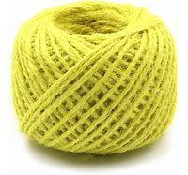
Synectics
Notes:
To Say:
The name Synectics combines Greek word parts and suggests, "the bringing together of diverse elements." Consider the images, which one best represents your current level of (collaborative) design of SDI for the students your serve.
Be prepared to share.
Need to Know: Prompt may vary depending on audience.
Note: Yellow Kaushan Script font indicates a processing/engagement activity.

Slide 7
Learning Intentions
Understand the federal and state requirements for SDI
Use assessment to determine SDI
Align SDI to prioritizing and unwrapping standards
Connect SDI to MTSS
Apply the process for implementing SDI
Notes:
State the intentions or have participants read them on their own.

Slide 8
Norms
Add your own norms/working agreements
Notes:
Add your own… Face to Face (F2F) or Virtual

Slide 9
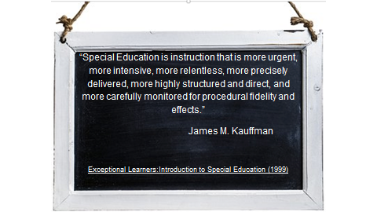
Specially Designed Instruction
Notes:
To Know: SDI is designed to ensure access to the general curriculum through instruction, adaptations, accommodations and modifications so that the student can meet the same academic standards as nondisabled peers and ensure progress toward meeting IEP goals.(--adapted from Central Ohio Special Education Regional Resource Center)
If you are virtual or f2f, participants can either annotate words or phrases that speak to them or call out (f2f)

Slide 10
SDI Addresses. . .
Instruction
Tailored and adjusted to meet unique learning
IEP goals
Friend, M, Barron, T. 2020
Notes:
To Say:
SDI addresses instruction and IEP goals. SDI is the “special education” that is required of student who have an IEP.

Slide 11
Federal Regulations re: SDI
(29) Special education
The term “special education” means specially designed instruction, at no cost to parents, to meet the unique needs of a child with a disability, including—
(A) instruction conducted in the classroom, in the home, in hospitals and institutions, and in other settings; and
(B) instruction in physical education.
Last modified on November 7, 2019 https://sites.ed.gov/idea/statute-chapter-33/subchapter-i/1401/29
Notes:
Need to Know/Do: Read or briefly discuss the federal regulations.

Slide 12
State Regulations re: SDI
Specially designed instruction means adapting, as appropriate, the content, methodology or delivery of instruction to address the unique needs of a child with a disability to ensure access of the child to the general curriculum, so that he or she can meet the educational standards of the public agency that apply to all children.
This pertains to ages 3-21.
https://www.wrightslaw.com/law/osers/fape.acad.content.close.gap.1117.2015.pdf Dear Colleague Letter, Nov. 16, 2015
https://dese.mo.gov/special-education/early-childhood-special-ed/ecse-services
Notes:
To Say:
This is the from the Federal Department of Education, Dear Colleague letter from Nov. 16, 2015. MO uses this language in supports and services for ages 3-21 (ECSE and School-age).

Slide 13
SDI Definition:
shared definition/community agreement
The delivery of specially designed instruction is the core job responsibility of special education teachers. IDEA regulations define “specially designed instruction” as “adapting, as appropriate to the needs of an eligible child under this part, the content, methodology or delivery of instruction (i) to address the unique needs of the child that result from the child’s disability; and (ii) ensure access of the child to the general curriculum, so that the child can meet the educational standards within the jurisdiction of the public agency that apply to all children.” (34 CFR Sec. 300.39(b)(3)
As explained in practical terms by Marilyn Friend,
“SDI is what makes special education ‘special.’” https://www.uft.org/teaching/students-disabilities/specially-designed-instruction: American Federation of Teachers
Notes:
Need To Know: Need an understanding of the shared definition. You could do an activity with the definitation, read the slide or let participants read the slide for themselves or in small groups and make either written or verbal responses/comments/questions.

Slide 14
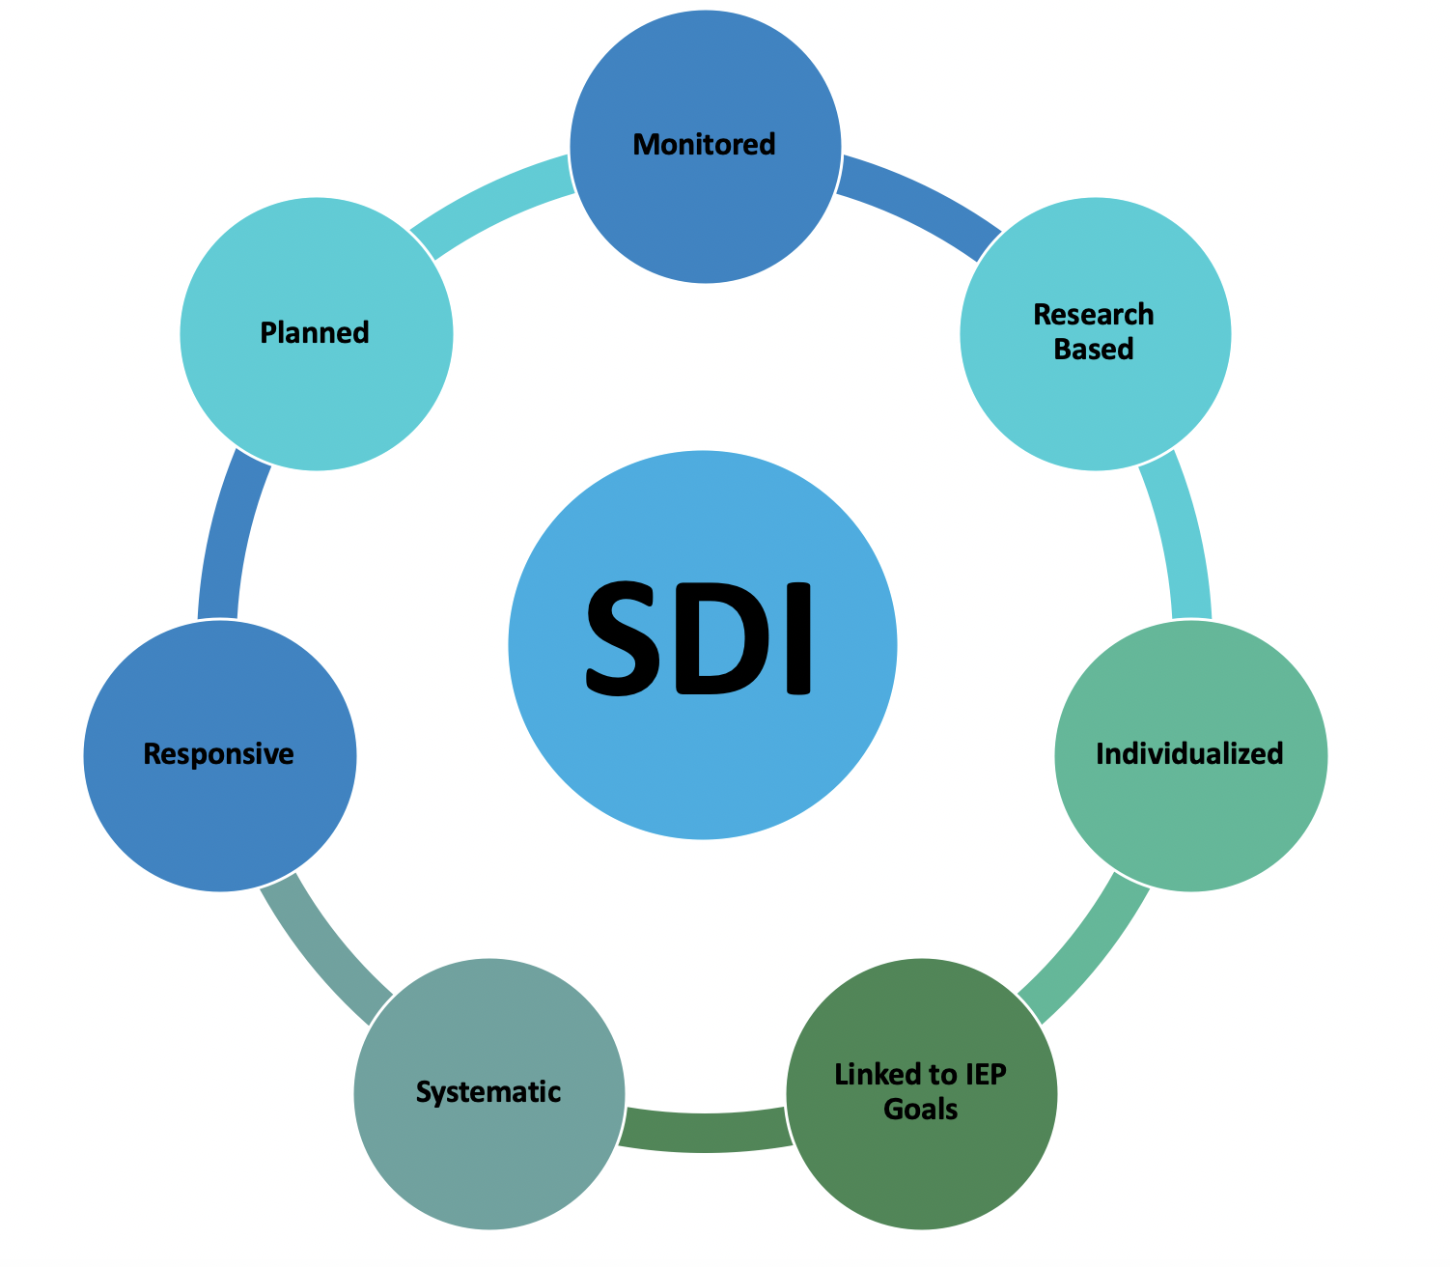
Notes:
To Say:
Specially Designed Instruction is defined by unique components that distinguish it from differentiated instruction. All students can benefit from DI. In order to qualify for special education, a need for specially designed instruction must be demonstrated. We will talk more about these unique components of SDI has we proceed through this training.

Slide 15
Key Words
What is SDI?
Specially designed instruction means organized and planned instructional activities typically provided by an appropriately qualified special education professional that modify, as appropriate the content, methodology, or delivery of instruction.
https://www.auburn.k12.ma.us/tsc_image.php?.../What%20is%20Specially%20Designed...
Notes:
To Say:
Read this definition and identify key words that stand out to you.
Be prepared to share.

Slide 16
What makes instruction truly individualized and specially designed for a student with a disability and different from what a general education student receives is how the instruction is linked to the student's IEP goals and objectives.
https://www.auburn.k12.ma.us/tsc_image.php?.../What%20is%20Specially%20Designed...
Notes:
To Say:
After reading the information asked for examples of what special instruction is given to students with disabilities.(SWD).

Slide 17
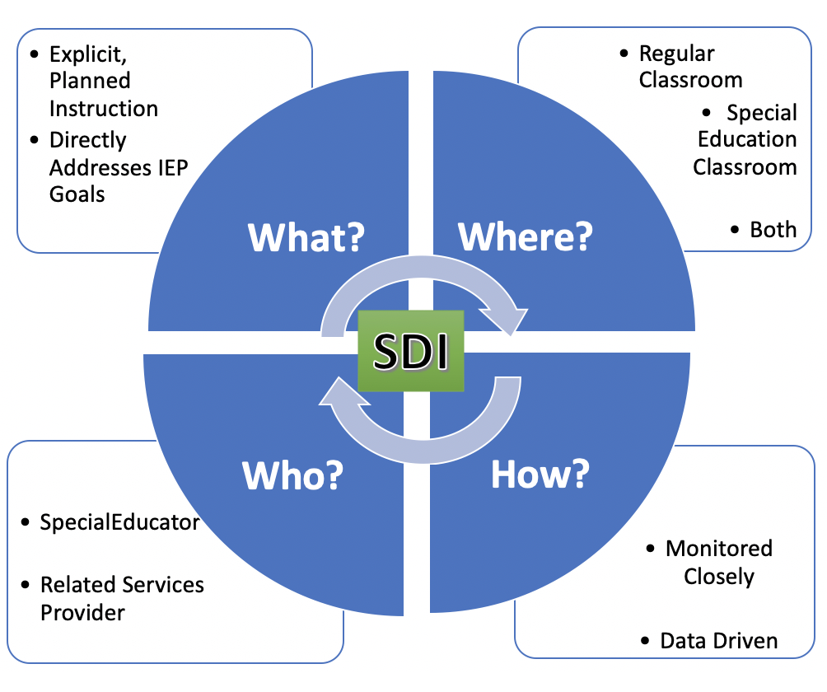
Notes:
To Say:
Some features of SDI: SDI is planned and organized, instruction delivered in an explicit and systematic manner. SDI is delivered by a special education teacher or related services provider. It can be provided in any location or multiple locations during the school day. Location is determined by the IEP team in the least restrictive environment. SDI directly addresses the student’s IEP goals. It is designed to enable the student to reach grade-level standards or close the learning gap. SDI is closely monitored to ensure the intended result (closing the learning gap) is being achieved. SDI can address any area of need including academic, behavioral, social, communication, health and functional deficits.

Slide 18
SDI May Occur in Any Instructional Domain
SDI beyond the academic domain iis sometimes overlooked
Special education is intended to address the whole student, including any domain that may be affecting that student’s educational performance (Friend, 2018)
Academics is just one dimensions of SPED instruction
-M. Friend, 2018. Co-Teach!

Slide 19
Domains for Specially Designed Instruction
Academic Functional
Organizational Physical/motor
Behavioral Sensory
Social Vocational
Emotional Technological
Communicative
Notes:
To Say: Marilyn Friend in her book Co-Teach!, 3rd Ed. 2018, identifies ten domains for SDI.

Slide 20
Key Concepts/Key Ideas
Individually read, Dimensions of Specially Designed Instruction, pp. 119-120 highlighting key concepts/key ideas
In small groups, each share a highlight that resonated with you.
Notes:
COPYRIGHT AND CORRESPONDENCE FROM DR. MARILYN FRIEND. THIS IS ONLY TO BE USED IN PERSON TRAINING. MUST HAND OUT PAGES AND COLLECT ALL PAGES AFTER ACTIVITY TO FOLLOW DR. FRIEND’S DIRECTIVES AND COPYRIGHT
To Say:
We will piggyback two strategies as we explore sn excerpt in Co-Teaching! Dimensions of Specially Designed Instruction.
The first strategy is Key Concepts, Key Ideas, which allows you to personally connect with the text and consider perspectives of others. As you read, highlight concepts and ideas that resonate with you. Then in small groups, share and dialogue several Key Concepts, Key Ideas.
Need to Know/Do: Copy pp. 117-120, in Co-Teaching! (2018)
If making copies, collect them following the activity (to honor copyright).

Slide 21
Modified Jigsaw by 7’s
#1, 2, 3 - read intro, of SDI Examples for Academics
-1’s read, Third grade..
-2’s read, Seventh grade...
-3’s read, Tenth grade...
#4, 5 - read intro. Of SDI Examples for Behavior
-4’s read, Fourth grade…
-5’s read, Ninth grade...
#6, 7, 8 - read intro, of SDI Examples for Social Skills
-6’s read, First-grade..
-7’s read, Eighth-grade...
Notes:
COPYRIGHT AND CORRESPONDENCE FROM DR. MARILYN FRIEND. THIS IS ONLY TO BE USED IN PERSON TRAINING. MUST HAND OUT PAGES AND COLLECT ALL PAGES AFTER ACTIVITY TO FOLLOW DR. FRIEND’S DIRECTIVES AND COPYRIGHT
To Say:
The next strategy is Modified Jigsaw. First, each read your designated section. (After reading, move to next slide for directions on the rest of the strategy.)
Need to Know/Do: Copy pp. 119-120, in Co-Teaching! For larger groups, a full Jigsaw allowing for like groups to dialogue prior to each teaching their designated section.

Slide 22
Modified Jigsaw by 7’s
Form groups of 7, and each share your assigned section
Lastly, discuss common themes that emerge from the specific examples of SDI.
Notes:
COPYRIGHT AND CORRESPONDENCE FROM DR. MARILYN FRIEND. THIS IS ONLY TO BE USED IN PERSON TRAINING. MUST HAND OUT PAGES AND COLLECT ALL PAGES AFTER ACTIVITY TO FOLLOW DR. FRIEND’S DIRECTIVES AND COPYRIGHT
To Say:
Next, form groups of 1-7 (NEXT SLIDE) to each teach your SDI example.
Need to Know/Do: Copy pp. 117-125, in Co-Teaching!

Slide 23
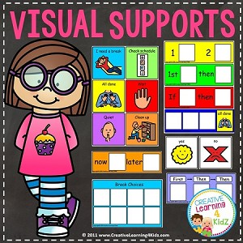
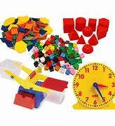
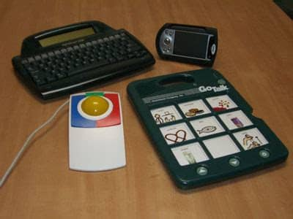
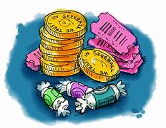
SDI Might Involve:
Notes:
To Say:
SDI may include any of these supports, but these are only examples. Have participants share additional examples.
Multi-sensory engagement
Manipulatives
Assistive technology
Visual supports
Task analysis
Scaffolding to gradual release
Explicit teaching
Anger management training
Positive reinforcers
SDI is certainly not limited to these supports. The IEP team should consider all of the unique educational needs of the student and design an individual plan to meet these unique needs.

Slide 24
Specially Designed Instruction
H #1
Modifications to Content | Research-Based Instruction | Delivery of Instruction | Progress Monitoring
What modifications are necessary to content? Modifications are determined by the IEP team. | What research-based methodology Included in the lesson in addition to the general lesson plan. Determined by teacher(s) | What is needed by an individual student, based on the impact of his/her disability, to access the general curriculum (ie resources, accommodations, strategy(ies))? How will the delivery be adapted for the student? Determined by teacher(s) | A description of how SDI will be monitored. Include: How often? By whom?
How is this instruction special? How is it direct
Notes:
To Say:
Please look at Handout #1. During the rest of this training we will be using this table format to practice designing SDI based on some data we will provide for you. You will consider the questions at the top of your handout.
Does this student’s disability impact his/her participation in the general education curriculum to a such a marked degree that grade level content will need to be modified? What modifications will be used ? In what content areas will they be necessary?
What research-based strategy(ies) will be used to address the students’ deficits?
What accommodations and resources will the student need to access grade level standards? How will the delivery of instruction be adapted for this student?
How will instruction be monitored? Who will monitor instruction?
How is this different from what is already being provided in the general education classroom?

Slide 25
Assessment and
SDI
Using the Data
Notes:
To Say:
Now we will begin to consider how various forms of assessment data are used to design SDI.
According to M. Friend, Co-Teaching, 3rd Ed., as final characteristic of SDI “requires the assessment, teaching, and evaluation knowledge and skills of the special educator or other specialist.”

Slide 26
Evaluation-Initial/Clinical
Evaluation is used to identify students who may be eligible for IDEA funds; supports and services.
The tools used to identify student strengths and challenges are not specific enough for instruction.
Notes:
To Say:
Read the first step in identifying students who may be eligible for IDEA supports and services.

Slide 27
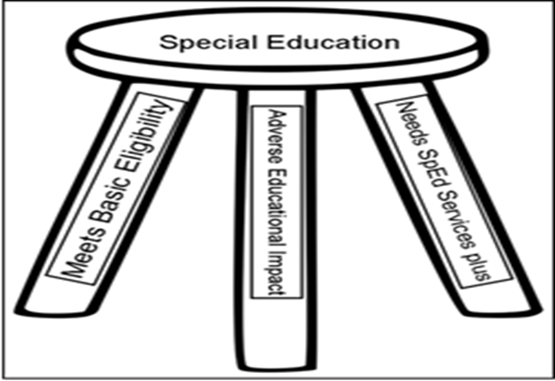
Who Qualifies for Special Education Services?
Notes:
To Say: DESE likes to talk about the 3-legged stool. To meet IDEA eligibility the student must meet the criteria but also has to REQUIRE special education.
Need to Know/Do: As a presenter you may want to share examples in the different identification categories-helpful but not necessary.

Slide 28
Evaluation vs Diagnostic Teaching
Evaluation/Assessment: IDEA Part C: Evaluation and Assessment Definitions; Establishing Eligibility (Evaluation) §303.321(a)(2)(i)
Evaluation means "the procedures used by qualified personnel to determine a child's initial and continuing eligibility..."
E
Notes:
Need to Know: Additional resources: https://www.teachthought.com/pedagogy/diagnostic-teaching-why-students-struggle/
§303.321(b)
"Procedures for evaluation of the child. In conducting an evaluation, no single procedure may be used as the sole criterion for determining a child's eligibility under this part. Procedures must include—
(1) Administering an evaluation instrument;
(2) Taking the child's history (including interviewing the parent);
(3) Identifying the child's level of functioning in each of the developmental areas in §303.21(a)(1) [PDF];
(4) Gathering information from other sources, such as family members, other caregivers, medical providers, social workers, and educators, if necessary, to understand the full scope of the child's unique strengths and needs; and
(5) Reviewing medical, educational, or other records."
https://www.asha.org/Advocacy/federal/idea/IDEA-Part-C-Evaluation-and-Assessment-Definitions/

Slide 29
Evaluation vs Diagnostic Teaching
Diagnostic Teaching: This type of teaching involves a constant interplay between assessment and instruction to evaluate learning abilities and teaching effectiveness, respectively. https://tophat.com/glossary/d/diagnostic-teaching/
The big idea behind Diagnostic Teaching is to illuminate and remove barriers to student understanding. When students have problems, you need to be able to systematically identify and fix them. https://www.teachthought.com/pedagogy/diagnostic-teaching-why-students-struggle/
Notes:
Need to Know:
Additional resources: https://www.teachthought.com/pedagogy/diagnostic-teaching-why-students-struggle/
§303.321(b)
"Procedures for evaluation of the child. In conducting an evaluation, no single procedure may be used as the sole criterion for determining a child's eligibility under this part. Procedures must include—
(1) Administering an evaluation instrument;
(2) Taking the child's history (including interviewing the parent);
(3) Identifying the child's level of functioning in each of the developmental areas in §303.21(a)(1) [PDF];
(4) Gathering information from other sources, such as family members, other care-givers, medical providers, social workers, and educators, if necessary, to understand the full scope of the child's unique strengths and needs; and
(5) Reviewing medical, educational, or other records."
https://www.asha.org/Advocacy/federal/idea/IDEA-Part-C-Evaluation-and-Assessment-Definitions/

Slide 30
Progress Monitoring of SDI
Determine student progress through the ongoing process of collecting and analyzing data.
Use this scientifically based practice to assess students’ academic, behavior, and social performance and to evaluate the effectiveness of instruction.
Notes:
To Say:
Progress monitoring involves: ongoing data collection on skills to estimate student rates of improvement, and to identify students who are not demonstrating adequate progress in order to alter or change instructional components to better meet the needs of individual students to improve student performance.
So, teachers may use progress monitoring to design more effective, individualized instructional programs for students with disabilities.
We will discuss the how later in the presentation.

Slide 31
Users & Uses of Assessment Data
Data | Uses | Users
Evaluative | Determine eligibility | Evaluation Team
Diagnostic/ Formative Assessment | Determine instruction | Instructional Provider
Progress Monitoring | Inform daily instruction | Instructional Provider Student
Notes:
To Say:
The Evaluation Team includes School Psychologist; related service providers; general education teacher; LEA; parent(s)/guardian. Note: While parents are a part of the Eval Team to help determine eligibility, they are not involved with instructional decisions.

Slide 32
Diagnostic:
aka Formative Assessment
Formative assessment refers to the ongoing process students and teachers engage in when they. Focus on learning goals. Take stock of where current work is in relation to the goal. Take action to move closer to the goal.
www.ascd.org › publications ›
Evidence-Based Analysis of Formative Assessment
ASHA reported in a study of formative assessments “students reported benefits of formative assessment which provides an ongoing and evidence-based analysis of learning skills” https://pubs.asha.org/doi/full/10.1044/ihe11.1.28
.
Notes:
Need to Know:
ASHA - American Speech-Language-Hearing Association. A speech and language organization

Slide 33
Triangulating Data
Includes multiple sources of data analysis)
Helps us move from questions to answers (inquiry to hypothesis)
It about discovery!
Discovery
Notes:
To Say:
This information comes from Got Data, Now What, by Bruce Wellman and Laura Lipton.

Slide 34
Kinds of Data to Triangulate
Quantitative
Numbers (i.e. standardized, non-standardized, benchmark(s), diagnostic assessments)
Qualitative
Descriptors (i.e. classroom formative assessments, scoring guides)
Intuitive
Perceptions (i.e. observations, judgements, anecdotes)
Discovery
Notes:
To Say:
Differentiate between Kinds (as above) - Sources (i.e. State; CBM; Benchmark; Student Files) - Types (behavioral; biography, performance)

Slide 35
Diagnostic Academic
Assessment & Teaching
READING:
-Letter / Sound Identification
-Phonological processing skills
-Phonics skills assessment
-Fluency and comprehension
WRITING:
-Orthography (Spelling) assessment
Notes:
To Say:
D. Kilpatrick refers to diagnostic assessment as “intervention-oriented assessment”: What specific skills does the student need additional instruction/intervention?
Resource: Essentials of Assessing, Preventing, and overcoming reading difficulties-David A. Kilpatrick (Wiley 2015)

Slide 36
Collaborative Learning Cycle
-Draw conclusions
-Verify explanations
-Solutions
-Progress monitoring
-Assumptions
-Predictions
-Questions
-Patterns, trends
-Surprise
-Affirmations
Adapted from L. Lipton & B. Wellman, 2004. Data-Driven Dialogue; 2012. Got Data, Now What?
Notes:
HANDOUT #2
To Say:
While Data Teams are ideal for analyzing benchmark data, the collaborative learning cycle is a framework that establishes a learning forum for group exploration of data. Structured engagement with information and fellow learners ignites the processes of inquiry and problem-solving. This question-driven model promotes specific cognitive processes and group-member interaction in three phases: (1) activating and engaging, (2) exploring and discovering, and (3) organizing and integrating. [Laura Lipton & Bruce Welman, 2012. Got Data, Now What: Creating and Leading Cultures of Learning]
Activating & Engaging - Develops emotional and cognitive readiness for collaborative work with data.
Exploring & Discovering - Invites thoughtful observations from multiple perspectives, producing a deep look at the data.
Organizing & Integrating - Groups selects key observations and generates possible causes for those results. After clarifying theories with additional data, the group then generates potential action plans.
HANDOUT #2 includes guiding questions
Let’s take a look at several key literacy diagnostic assessments that provide data to drive targeted next step instruction. (The most informative diagnostic assessments are face2face, not computer-based.)

Slide 37
1.RF.2.A.c - Develop phonemic awareness in the reading process by: recognizing the change in a spoken word when a specific phoneme is added, changed, or removed.
Notes:
To Say:
This is an example of a Phonological Awareness diagnostic screening test (PAST, free, by David Kilpatrick). Diagnostic in that a progression of skill development is specifically assessed, from syllable level to onset/rime level to the phoneme level. In addition to accuracy, automaticity is equally scored. Students who respond within two seconds are considered automatic. (Administration time: approx. 5 min)
Students struggling with reading and spelling, no matter what age, typically have a phonological deficit and would benefit from this foundational instruction. (Reference next slide.)
Correction on asmt date, should be 10-25-19. Side note: This student’s baseline assessment was 5-19 where he only tested to Level G, and SDI (ave. 2 hours per week) began in mid-July 2019. This assessment was administered beginning on 2nd quarter, 3rd grade.
Analysis: Syllable and initial sound deletion and initial substitution are accurate and automatic. Struggles with final deletion at the phoneme level. While advanced phoneme manipulation is accurate, it is not automatic for second-letter deletion and substitution; final substitution; and first-letter blend deletion and substitution.
Aligned to 1st grade standard even though this student is in the 3rd grade

Slide 38
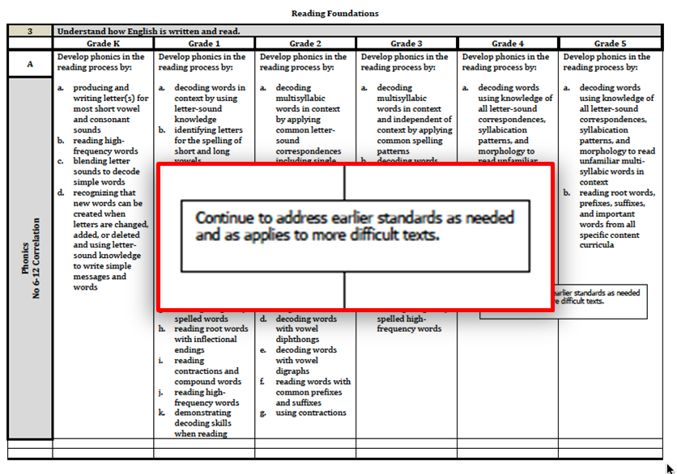
Notes:
To Say:
Even the GLEs emphasis that these foundational skills are not grade-bound.
“Continue to address earlier standards if the student has not achieved these skills.”

Slide 39
2.RF.3.A.b - Develop phonics in the reading process by: distinguish long and short vowels when reading regularly spelled one syllable words.
3.RF.3.A.e - decoding known and unknown words by spelling patterns
Notes:
To Say:
Pre-Post data from Beginning Phonics Survey, Really Great Reading. (Administration time: approx. 5 min)
NOTE: While baseline assessment occurred in May, end of 2nd grade, SDI (ave. only 2 hours per week) did not begin until mid-July 2019. This assessment reflects student growth after just 3 months of intervention and was administered at the beginning of 2nd quarter, 3rd grade.
Analysis: Remarkable gains in short vowel decoding of regular and nonsense words, although the student continues to segment blends and diagraph sounds when decoding. The student also self-corrects when reading sentences.

Slide 40
1.L.1.B.e.f - In written text: spell words using regular spelling patterns; spell words phonetically using phonemic awareness and spelling knowledge
Notes:
To Say:
Both the LETRS Spelling Inventory (as shown here) and Words Their Way are valid assessments for orthography/aka spelling. Spelling inventories are very telling assessments of decoding knowledge as it is transferred to spelling and writing.
This standard is below the students grade level.
Analysis: Strength with encoding CVC, VCe, initial diagraphs, beginning and ending blends. Struggles with -ck diagraph, vowel teams, vowel-r, and trigraphs.

Slide 41
Writing
Language
Notes:
To Say:
Writing sample from early September of 3rd grade. The composition with coaching took about 40 min. to complete, using syllable boards and cues for encoding multisyllabic words (i.e. sportsmanship. Note his first attempt at the word without the syllable boards.). There is repetitive use of high frequency and simple words, and phonetic spelling.

Slide 42
3.R.1.A.c - Develop and demonstrate reading skills in response to text by: summarizing a story’s beginning, middle, and determining their central message, lesson or moral.
3.RF.4.A.a - Read appropriate texts with fluency…: use context to confirm or self-correct word recognition and understanding, rereading as necessary
Notes:
To SAY and to KNOW:
DRA is an oral reading fluency assessment of leveled text that is designed to determine intervention, instructional, and/or independent reading level. It includes assessment of reading engagement, oral reading fluency, and comprehension (based on a verbal retelling in grades K-3, and written retelling grades 4+). Based on Fountas & Pinnell leveling, a 3rd grader in the fall should be reading on the instructional level 28.
Analysis: Given this student is in 3rd grade, his instructional level is at or below that of a late first grader/early 2nd grader. Even though the students struggles with decoding and reads word-by-word with some short phrases and with multiple errors, he has basic comprehension (especially with a leveled text with mixed syllable types for decoding and limited complexity of content). His strengths are in listening comprehension, teacher prompting, interpretation (background knowledge), and reflection (critical thinking). This is relatively typical of a student with characteristics of dyslexia (poor decoding and strong language comprehension).

Slide 43
Your Turn!
Collaborative Learning Cycle
HO #2
-Draw conclusions
-Verify explanations
-Solutions
-Progress monitoring
-Assumptions
-Predictions
-Questions
-Patterns, trends
-Surprise
-Affirmations
Adapted from L. Lipton & B. Wellman, 2004, Data-driven dialogue. 2012, Got Data, Now What?
Notes:
HANDOUT #2
Need to Know: Using own student responses to assessments, invite participants to engage in the data cycle, making brief notes for each part of the cycle. Then find a ‘Like’ Partner (same grade level) to briefly describe assessment tools used and then share their ‘predictions, surprises/trends/affirmations, and conclusions.
Activating & Engaging - Develops emotional and cognitive readiness for collaborative work with data. What assumption/predictions/questions might you have about the data?
Exploring & Discovering - Invites thoughtful observations from multiple perspectives, producing a deep look at the data. What were the validations and/or surprises?; What patterns/trends are evident?
Organizing & Integrating - Groups selects key observations and generates possible causes for those results. After clarifying theories with additional data, the group then generates potential action plans. What conclusions may be drawn from the data? What might be some root and current causes of data results? What is the next instructional/intervention step? How will it be monitored? How often?
HANDOUT #2 includes guiding questions

Slide 44
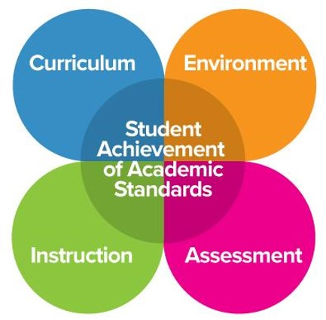
Notes:
To Say:
This graphic illustrates the key interconnections necessary for student academic success. In order to determine appropriate SDI, clarity of prioritized learning standards are essential. What is the learning expectation students must master?

Slide 45
Why Prioritize Standards?
ELA Grade 2:
56 standards (Reading & Reading Foundations)
39 Standards (Writing & Language)
8 Standards (Speaking & Listening)
Align SDI to priority standards
Notes:
To Say:
One of the hardest things about laying out the year’s curriculum is fitting in all the standards for all the subjects while maximizing student learning. It can be a bit overwhelming to teach and learn 28 (random number) different math standards and 54(random number) ELA standards, not including other content standards, as grade teachers are accountable for each year. Priority standards can help pair down what you need to accomplish and prioritize so that you get the maximum bang out of instruction and learning.
These Grade Level Expectations (standards) are applicable for SpEd students as well.

Slide 46
Why Prioritize Standards?
Priority - 3.RF.3.A.e - Develop phonics in the reading process by: decoding known and unknown words by spelling pattern.
Secondary - 3.RF.3.A.a - decoding multisyllabic words in context , and independent of context, by applying common spelling patterns
Tertiary or Introductory - 3.RF.3.A.b - decoding words that double final consonant when adding an ending
Notes:
To Say:
Prioritizing Standards should be a collaborative effort between grade level teachers and any one else supporting the child’s learning in that content/discipline area...SpEd teachers! When reg. Ed and SpEd teachers focus on the same priority standards, they ensure a smooth learning journey for the students. The last thing a student with learning difficulties needs, is to learn more standards than a typical learner.
While priority standards are the focused learning expectation, those standards will encompass the secondary and introductory standards. Just like the Milky Way is the galaxy that contains our Solar System.

Slide 47
DESE Drafted Priority Standards
K-12
Are intended to be used as a guide for districts, building, grade level teams.
Does not include secondary and tertiary standards
Not a replacement for locally established priority standard
https://dese.mo.gov/college-career-readiness/curriculum/academic-standards/priority-standards
Notes:
To Know: This slide is information for the presenter.

Slide 48
Criteria for Determining Priority Standards
Endurance
Over time
Leverage
Across disciplines
Prerequisite or Readiness
Underlying basic knowledge
What do your students need for success in life, school, and our state test?
Notes:
To Say:
There a certain combination of criteria that contribute to selection of priority standards, they are Endurance (standards that are utilized throughout school and life); Leverage (standards that are applicable across content areas and disciplines); Prerequisite or Readiness (standards that are necessary for acquisition of future learning); and lastly Life, School, and MAP (additional data on learning trends, which reflects curriculum and instruction effectiveness, should also be considered). Continued tracking of assessment data, may influence priority standard changes over time, as adjustments of curriculum and instruction increase mastery of P.S.

Slide 49
Unwrapping the Priority Standards and the underpinnings to determine learning targets
Notes:
To Say:
Once you have determined priority standards, the is essential to unwrap each of them for teacher clarity of specific skills/content embedded within the standard. This clarity will guide instruction and assessment.

Slide 50
"Unwrapping" the academic content standards is a technique to help educators identify from the full text of the standards exactly what they need to teach their students.”
-Larry Ainsworth, 2007

Slide 51
The Technique of ‘Unwrapping’
Underline the key concepts (noun / noun phrases)
Circle the skills (verbs) students must be able to do - when typing, CAPITALIZE
Standard: 3.RF.3.A.e
Develop phonics in the reading process by: decoding known and unknown words by spelling pattern.
Notes:
To Say:
The technique is simple, underlining and circling (or capitalizing)
CODING for ELA Standards: 3.RF.3.A.e = Grade Level.Reading Foundations. Strand 3. Concept A. Expectation e
The next slide illustrates what this entails.

Slide 52
Notes:
To Say:
Using the sample template, the standard is initially unwrapped at the top, then deconstructed further to specifically align each concept with each related skill. Each arrow connected to a skill identifies a Learning Target / instructional lesson.
Unwrapping is about breaking down the standard into manageable teaching and learning chunks!
Which skills is the student struggling with? What is the first next step of instruction and skill attainment?

Slide 53
Notes:
To Say: Another example-aligned to DRA reading comprehension retelling. Which component of the unwrapped standard is the student struggling with? What is the first next step for instruction and skill attainment?

Slide 54
Specially Designed Instruction Continuum
and
MTSS-Tiers I-III
Notes:
To Know: This is a transition slide

Slide 55
H #3
SDI in MTSS
How does specially designed instruction align with a multi-tiered system of support?
https://sss.usf.edu/resources/format/pdf/specially_designed_instruction.pdf
Notes:
HO#3 https://sss.usf.edu/resources/format/pdf/specially_designed_instruction.pdf
This Website was developed by the Florida Center for Interactive Media through a special project funded by the State of Florida,
Department of Education, Bureau of Exceptional Education and Student Services, through federal assistance under the
Individuals with Disabilities Education Act (IDEA), Part B.

Slide 56
Structures That Support SDI in the Regular Classroom
1.
Individualized Direct Instruction
2.
Small Group Instruction
3.
Co-Teaching Structures
4.
Universal Design for Learning (UDL) Practices
Notes:
To Say:
Classrooms that utilize differentiated instruction practices for all students will easily support SDI in the general education setting through individualized and small group instruction. Effective co-teaching practices will also ensure that SDI can be provided in the general education classroom.

Slide 57
Co-Teaching Provides
Increased
Instructional
Intensity Friend (2008)
Notes:
To Say:
The goal of co-teaching is to provide increased instructional intensity.

Slide 58
Co-Teaching Approaches
One Teach, One Assist
One Teach, One Observe
Teaming
Alternate Teaching
Parallel Teaching
Station Teaching
Friend (2008)
Notes:
To Say:
These are six common co-teaching approaches based on the work of of Marilyn Friend.

Slide 59
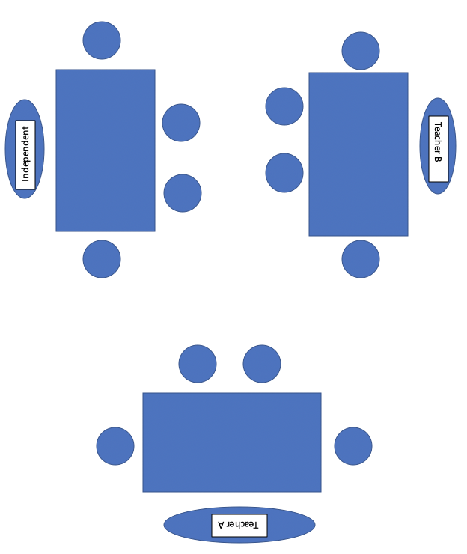
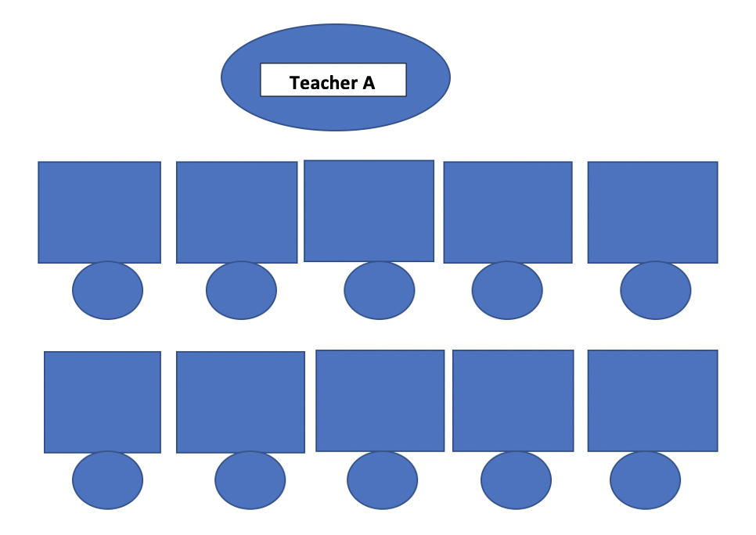
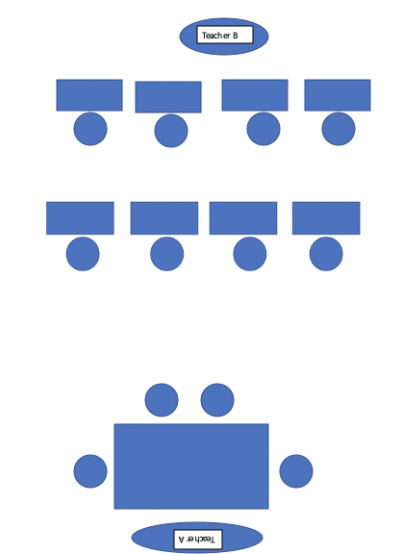
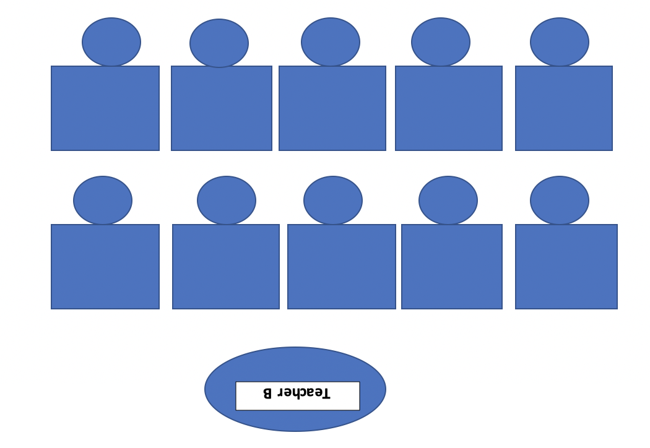
Co-Teaching Models that Support SDI
Parallel Teaching
Station Teaching
Alternate Teaching
Notes:
To Say:
Adapted from the work of Marilyn Friend and Lynne Cooke, St.Cloud State University
These diagrams of co-teaching models illustrate how two teachers can provide increased instructional intensity through effective co-teaching. Co-teaching models, such as parallel teaching, station teaching and alternate teaching can also provide opportunities for SDI in a general education setting.

Slide 60
Purpose of Co-Teaching
•To provide greater opportunities for students to receive differentiated instruction from qualified professionals.
•To ensure students with disabilities have access to the general education curriculum and specially designed instruction in the general education classroom.
Notes:
To Say:
One of the benefits of the co-teaching model is to allow students to be placed in a general education placement and still receive SDI.

Slide 61
Co-Teaching Best Practice
Level I – Whole Group Structures
Use no more than 30% of Co-Teaching time.
Contributes least intensity instruction.
One Teach + One (Support; Observe ) * Duet (Team Teaching)
Level II – Flexible Groups
Use at least 70% of Co-Teaching time .Contributes most intensity to instruction (reduces student to teacher ratio)
Parallel Teaching * Station Teaching * Alternative Teaching
Beninghof (2011)
Notes:
To Say:
This is based on Anne Beninghof’s work with co-teaching.Using Co-Teaching with the flexible grouping strategies provides a variety of ways to group students by skill, learning style, application needs or student interest. SDI will fit seamlessly into these classroom practices.
As the slide indicates, Level II use of flexible groups provides the most intensity of instruction possible.

Slide 62
Universal Design for Learning
CAST (2018). Universal Design for Learning Guidelines version 2.2. Retrieved from http://udlguidelines.cast.org
https://udlguidelines.cast.org/
Notes:
To Say: Universal Design for Learning Practices also support SDI in the regular classroom. Universal Design for Learning (UDL) is a way of thinking about teaching and learning that helps give all students an equal opportunity to succeed.
UDL offers flexibility in the ways students access material, engage with it and show what they know.
Developing lesson plans this way helps all kids, but it may be especially helpful for kids with learning and thinking differences.
The UDL Guidelines are a tool used in the implementation of Universal Design for Learning, a framework to improve and optimize teaching and learning for all people based on scientific insights into how humans learn.The UDL Guidelines can be used by educators, curriculum developers, researchers, parents, and anyone else who wants to implement the UDL framework in a learning environment. These guidelines offer a set of concrete suggestions that can be applied to any discipline or domain to ensure that all learners can access and participate in meaningful, challenging learning opportunities. Learn more about the Universal Design for Learning framework from CAST.

Slide 63
Is / Is Not
SDI in a Separate Setting
Separate Setting
Specially Designed Instruction
Notes:
To Say:
There is a misconception that if a student is receiving services in a special education setting they are automatically receiving SDI.
Processing Activity: Consider the components of SDI that we have discussed today. Then consider instruction you have observed in a special education classroom. Take a minute to write down some non examples of SDI you have observed in a SPED classroom. When I call time, please share those with your table group.

Slide 64
Implementing
SDI
Notes:
To Know: This is a transition slide.

Slide 65
Where Is SDI Documented?
Adaptations to the content of SDI may be described in:
Present Levels of Academic and Functional Performance (PLAAFP)
Annual goals and objectives
Supplemental aids and services
The identified course of study
Selected modifications
Least Restrictive Environment (LRE) justification
Lesson plan and/or related service provider plan of care

Slide 66
Where Is SDI Documented?
Adaptations to the methodology of SDI may be described in:
PLAAFP
“Given” statement of goals and objectives
Supplemental aids and services
Selected accommodations and/or modifications
LRE justification
Lesson plan and/or related service provider plan of care
Notes:
To Say:
These are some of the places to document SDI in the IEP.

Slide 67
Where Is SDI Documented?
Adaptations to the delivery of SDI may be described in:
Service delivery description in the IEP; must document each area of SDI that aligns with IEP goals
LRE justification
Supplemental aids and services
Lesson plan and/or related service provider plan of care
Notes:
To Say:

Slide 68
Numbered-Heads-Together
Number off 1-4 to form small groups.
Individually, identify 1-2 specially designed practices that you mostly use or see.
Heads-together, define the qualities that identify the practices as SDI and choose one that best represents SDI.
One number will share with the group.
Notes:
To Say:
Let’s connect what you are learning about SDI to your practices.

Slide 69
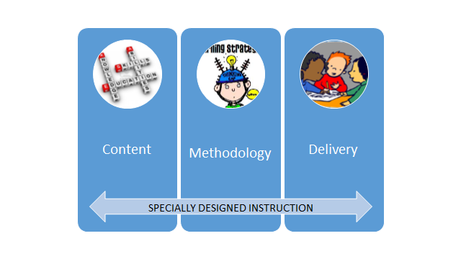
Putting SDI into Practice
Notes:
To Say:
Content: what is being taught--the knowledge and skills that a student with a disability has that are different from those typical students
Methodology: different instructional strategies and approaches being used to teach content, ie: Wilson vs fountas and pinnell
Delivery: the way instruction is delivered, ie. small group, individual, more intensive, etc

Slide 70
Specially Designed Instruction
Modifications to Content | Research-Based Instruction | Delivery of Instruction | Progress Monitoring
What modifications are necessary to content? Modifications are determined by the IEP team. | Research-based methodology Included in the lesson in addition to the general lesson plan. Determined by teacher(s) | What is needed by an individual student,based on the impact of his/her disability, to access the general curriculum (ie resources, accommodations, strategy(ies))? How will the delivery be adapted for the student? Determined by teacher(s) | A description of how SDI will be monitored. Include: How often? By whom?
Statement describing the difference between the classroom instructional strategy and the SDI.
Notes:
To Say:
Please look at Handout #1. During the rest of this training we will be using this table format to practice designing SDI based on some data we will provide for you. You will consider the questions at the top of your handout.
Does this student’s disability impact his/her participation in the general education curriculum to a such a marked degree that grade level content will need to be modified? What modifications will be used ? In what content areas will they be necessary?
What research-based strategy(ies) will be used to address the students’ deficits?
What accommodations and resources will the student need to access grade level standards? How will the delivery of instruction be adapted for this student?
How will instruction be monitored? Who will monitor instruction?
How is this different from what is already being provided in the general education classroom?
Let’s take a look at several examples in the next few slides.

Slide 71
Barry is a third grade student with a learning disability in basic reading skills [with decoding deficits] that impacts his ability to read grade level text.
Modifications to Content | Research-Based Instruction | Delivery of Instruction | Progress Monitoring
None | Phonemic manipulation Phonics - 6 syllable types reinforced with decodable texts Spelling (encoding) in daily work -orthographic mapping Specific focus on: -vowel teams -vowel -r -multisyllabic | Small group / one-on-one Multisensory, systematic Content reading materials are presented at student’s instructional reading level Peers/staff read materials to student Student uses flashcards with pictures for frequently used words
How this differs from general instruction
What are some ways to progress monitor this goal?
Notes:
To Say:
Specific skill deficits with decoding. Reference slide 16 (RGR Diagnostic Phonics Survey)
Analysis: Remarkable gains in short vowel decoding of regular and nonsense words, although the student continues to segment blends and digraph sounds when decoding. The student also self-corrects when reading sentences.
Participants generate: What are some ways to progress monitor this goal?

Slide 72
Monica is a 4th grade student with the disability of OHI due to ADHD, which impacts her acquisition of knowledge and skills in the classroom.
Modifications to Content | Research-Based Instruction | Delivery of Instruction | Progress Monitoring
None | Positive Behavior Interventions and Supports Direct Instruction on procedures and daily routines | Engagement strategies-multiple opportunities to respond with movement Post routines on the student’s desk Use visual cues to remind student of a specific routine Activity sequencing with choice | What are some ways to progress monitor this goal?
While PBiS may be implemented school-wide, the specific components the child needs have been identified and defined. The IEP team has determined SDI is needed for behavior support.
Notes:
What are some ways to progress monitor this goal?

Slide 73
JD is a 5th grade student with a learning disability in the area of math calculation.
Modifications to Content | Research-Based Instruction | Delivery of Instruction | Progress Monitoring
Multiplication problems limited to 1-2 digits but not ready for grade-level 3 digits | Chunk individual pieces of information and group them into larger units | Steps of multistep word problems are bulleted Use of calculator Extended time | What are some ways to progress monitor this goal?
While the teacher may allow any student to use a student to use a calculator at times, JD requires it for math calculation when doing grade level standards. The teacher may also instruct students to deconstruct math word problems into bulleted steps, however JD must receive word problems in that format.
Notes:
What are some ways to progress monitor this goal?

Slide 74
Your Turn!
Use Handout # 5 to complete the chart below based on the provided information.
H #5
Modifications to Content | Research-Based Instruction | Delivery of Instruction | Progress Monitoring
Notes:
To Do: With a partner, use handout #5, the following Case Scenario, and handout #1 (with the descriptions for each component) determine the appropriate SDI.
Need to Know/Do: Make a front/back copy of the Case Scenario and standards to distribute to teachers.

Slide 75
Case Scenario: Jason-Grade 3
Jason is successful in analyzing words (i.e. vowel sounds, blends, digraphs, and syllable types), and reading words in isolation, short phrases and sentences. When reading connected text, he reads word-by-word, pausing to sound out words. While he struggles with decoding, when reading below grade level text, he does demonstrate basic comprehension. Jason demonstrates proficiency in verbal vocabulary usage and listening comprehension. When writing he uses simple words and sentences, with some spelling inconsistencies.
H #6
Notes:
To Say: (Two-sided Handout #6) Consider the standards on the back of the Case Scenario.
3.R.1.A.c - Develop and demonstrate reading skills in response to text by: summarizing a story’s beginning, middle, and determining their central message, lesson or moral.
3.RF.4.A.a - Read appropriate texts with fluency…: use context to confirm or self-correct word recognition and understanding, rereading as necessary

Slide 76
Standards for Case Scenario, Jason
3.R.1.A.c - Develop and demonstrate reading skills in response to text by: summarizing a story’s beginning, middle, and determining their central message, lesson or moral.
3.RF.4.A.a - Read appropriate texts with fluency…: use context to confirm or self-correct word recognition and understanding, rereading as necessary
H #6
Notes:
(Two-sided Handout #6)

Slide 77
How Effective Was the SDI?
How would you progress monitor?
In what ways will the accommodations, modifications, interventions impacting student learning
Is the student making progress?
How are you closing the learning gap?
Notes:
To Say:
Considerations for determining the effectiveness of the SDI on student growth and learning.

Slide 78
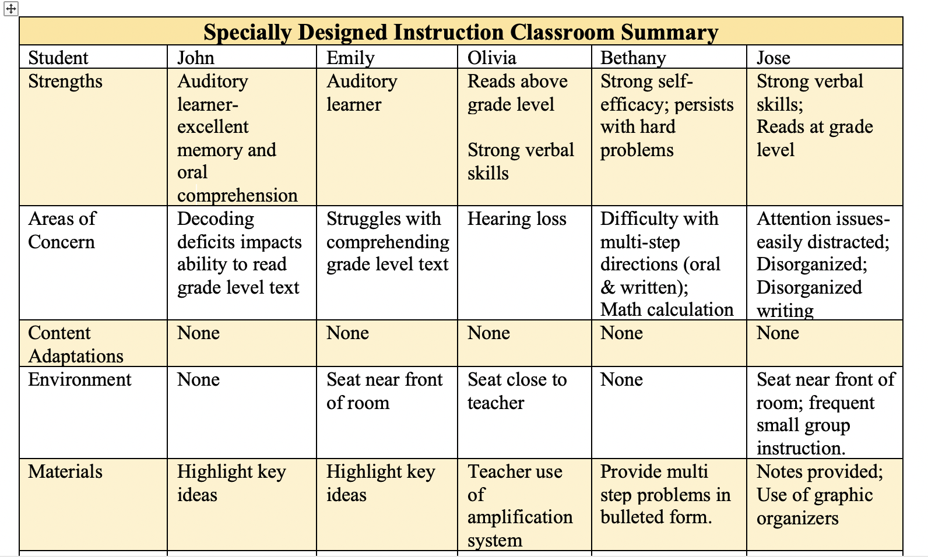
7
H #7
Notes:
To Say: (Handout #7)
This is a sample organizational tool for SDI in the classroom.

Slide 79
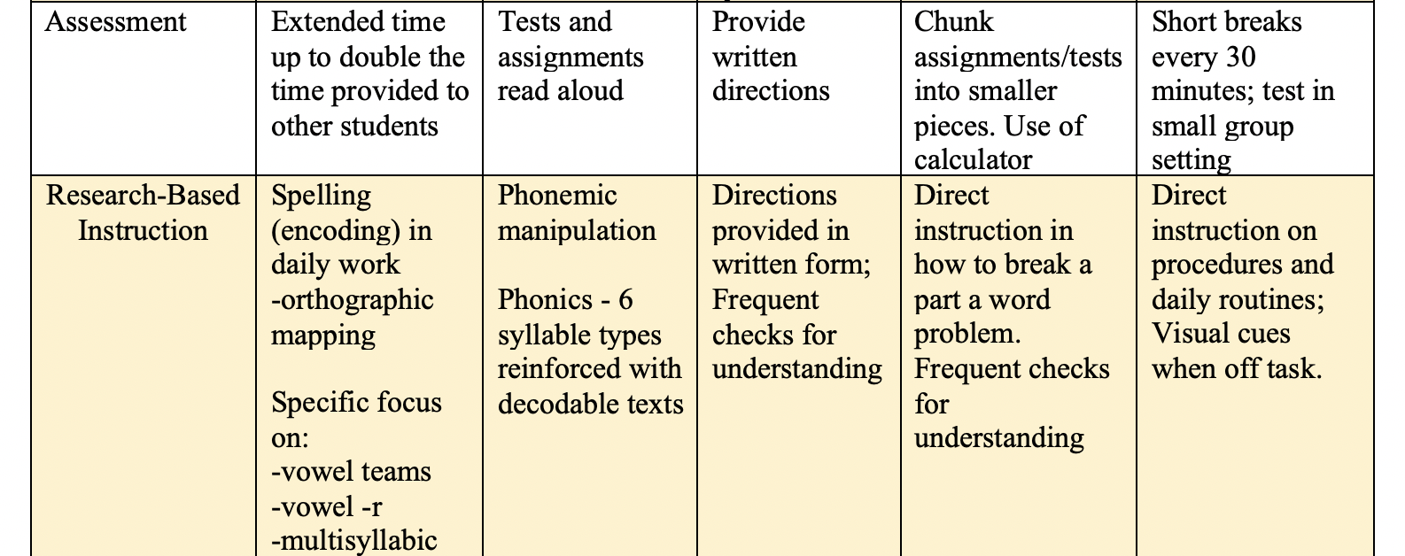

Slide 80
Accomodations
and Modifications
-Accommodations are applicable for ALL students.
-Modifications are only applicable for students with IEPs.
Notes:
To Know: This is a transition slide

Slide 81
Accommodations vs Modifications
H #8
Notes:
Handout #8
To Say:
Take a minute to consider Handout #8. What questions do you have regarding the differences between accommodations and modifications?

Slide 82
Accommodations vs Modifications

Slide 83
Accommodations/Modifications
Notes:
To Say:
This is the process for successfully providing accommodations and modifications to students with disabilities.

Slide 84
Notes:
To Say:
General and special education teachers working as a team for the benefit of students with disabilities:
1. Promotes understanding of general and special education teacher roles and responsibilities
2. Provides opportunities to gain new skills (e.g., general educator’s knowledge of content—special educator’s knowledge of specialized instructional techniques)
3.Serves as a support building process that fosters the creation of a collaborative school culture

Slide 85
Select Accommodations
Notes:
To Say:
General and special education teachers working as a team for the benefit of students with disabilities:
1. Promotes understanding of general and special education teacher roles and responsibilities
2. Provides opportunities to gain new skills (e.g., general educator’s knowledge of content—special educator’s knowledge of specialized instructional techniques)
3.Serves as a support building process that fosters the creation of a collaborative school culture

Slide 86
Select Accommodations
Data from multiple sources guides the selection of accommodations:
student assessments
present level of performance
teacher-documented observations
student input
Missouri Learning Standards
Notes:
To Say:
Accommodations and modifications are always informed by data. Members of the IEP team consider student data that includes multiple student assessments, the student’s current level of performance in relationship to grade level standards and current observations. Student input should be considered.

Slide 87
Involve Students
Involve students in selecting, using, and evaluating accommodations/mod and SDI.
The more input students have in selecting their accommodations, the more likely the accommodations will be used.
Students should see accommodations as adding value to their daily life—not only in school—but for postsecondary, career, and community life.
Notes:
To Say:
It is critical for students with disabilities to understand their disabilities and learn self-advocacy strategies for success in school and throughout life. Some students have had limited experience expressing personal preferences and advocating for themselves. Speaking out about preferences, particularly in the presence of “authority figures,” may be a new role for students, one for which they need guidance and feedback. Teachers and other IEP team members can play a key role in working with students to advocate for themselves in the context of choosing and using accommodations.
The more that students are involved in the selection process, the more likely the accommodations will be used, especially as students reach adolescence and the desire to be more independent increases. Self-advocacy skills become critical. Students need opportunities to learn which accommodations are most helpful for them, and then they need to learn how to make sure those accommodations are provided in all of their classes and wherever/whenever they need them outside of school.

Slide 88
Student Self-Advocacy
Is the student able to utilize accommodations to access the curriculum easily and confidently, understand the need to utilize accommodations, and ask for them when necessary?
Is the student able to share if they feel the accommodations are not effective, ie: needs to be changed either by adding or taking away?
Notes:
To Say:
When a student is ready to graduate high school, the skills necessary for successful post-secondary education should be in place. Here are some questions to ask and guide the development of self advocacy skills.

Slide 89
Implement Accommodations
Teachers will:
support the student in learning how to use the accommodation independently.
document the use of the accommodation; recording where, when, how and who is involved with the use of the accommodation, making sure staff is trained in the implementation of the accommodations.
consistently implement the accommodation across settings and content areas.
Notes:
To Say:
All of these steps are important for successful implementation.

Slide 90
Evaluate Accommodations
IEP team reviews the data documenting the effectiveness of the accommodation:
Consider the IEP, formative assessments, rubrics, charts and tables.
Compare student data with and without the accommodation.
Notes:
To Say:
Useful information is obtained from members of the IEP planning team when the team reviews the data for determining the effectiveness of the accommodation. Remember, evaluation is a team effort. Use formative evaluations to “turn over useful information quickly to make improvements” in accommodation use.
Evaluating accommodations is a part of continuous quality improvement.

Slide 91
Why Evaluate the Use of Accommodations?
Optimize and ensure the student’s participation and success in the curriculum, instruction and assessments.
Use data to monitor the impact of the accommodation on student learning.
Determine the continued implementation of the accommodation.

Slide 92
Alter Accommodations As Needed
Based on the review, decide whether the student should:
Continue using an accommodation(s) “as is”
Make changes to the accommodation(s)
Determine how the accommodation is faded out
Have an accommodation discontinued
Add accommodation(s)
Notes:
To Say: This is the fourth and final step in the process.

Slide 93
Case Scenario: Dominic
H #9
Dominic is a high school student who has an identified intellectual disability. In his Algebra class, Dominic often makes mistakes when multiplying or dividing large numbers with decimals. After documenting classroom observations and collecting in-class and homework examples of Dominic’s work, his teacher suggested that he use a calculator. Since using this tool, Dominic is having more success in arriving at correct answers, and solving complex math problems.
Notes:
Handout #9
To Say:
Use this Case Scenario to determine accommodations and modifications for Dominic

Slide 94
Pairs-Square!
Addressing Dominic’s Needs
Follow the process for selecting and implementing the accommodation
Follow the process to evaluate the accommodation
Notes:
To Say :
With your Case Scenario Partner, find another partnership and Pairs-Square to collaboratively select and evaluate accommodations generated.
Other Ways to accommodate Dominic’s Needs:
Provide him graph paper
Provide him with class notes with an example question available for student
Provide procedures explaining the step by step process
Peer tutor
Teacher monitors Dominic’s progress and checks his in-class work after every 2-4 problems.

Slide 95
Critical Questions
What research-based methodology will be used?
How and where will instruction be delivered?
How will be SDI be progress monitored?
What content will be adapted or modified?
Notes:
To Say:
Review the critical questions to be addressed when implementing SDI.

Slide 96
Done, Yet-to-Do
List SDI components that are
Done
Yet-to-Do
Determine the first next step!
Notes:
Say it: Given you affirmations and learning today, take a few minutes and list the SDI components that you are currently doing and ones that are yet-to-do. Lastly, determine your first next step to enhance your student’s SDI!

Slide 97
References
Specially Designed Instruction for Co-Teaching; Friend, M., Barron, T. ; July 2020; Marilyn Friend, Inc., Washington, DC. (book)
Friend, M. (2019). Co-Teach! Building and sustaining effective classroom partnerships in inclusive schools (3rd edition)
Kansas State Department of Education: Considerations for Specially Designed Instruction
Florida Department of Education Division of Public Schools; http://www.fldoe.org/ese
http://www.florida-rti.org/educatorResources/addRes.htm
https://www.auburn.k12.ma.us
SDI Summarized http://acentral.education/learning-library/specially-designed-instru

Slide 98
For Coaching and/or Technical Assistance
IC contact information

Slide 99
Citations
CAST (2018). Universal Design for Learning Guidelines version 2.2. Retrieved from http://udlguidelines.cast.org

