Slide 1
Standards-Based IEPs Linked to DLM Essential Elements
2020
Notes:
To Know: Title slide
Add presenter’s name

Slide 2
For Presenter Only
Missouri Department of Elementary and Secondary Education
http://dese.mo.gov/college-career-readiness/assessment/map-a
MAP-A Dynamic Learning Maps Essential Elements
www.dynamiclearningmaps.org/content/essential-elements
www.dlmpd.com
Handouts
Pre/Post Assessment
“Dear Colleague Letter-United States Department of Education, Nov. 16, 2015”
DLM Foundational Area Map
Guide to Foundational Map
Essential Elements/Self Reflection Organizer
Grade-Level Standard MAP-A/DLM Essential Element Linkage Levels
Sam’s IEP (make table copies)
Template for an IEP Smart Goal
Sam’s IEP Goal Pages (make table copies)
Practice Profile
Notes:
To Know: These are lists of materials needed for the presentation.
Additional materials: Chart paper, post it notes, markers, highlighters
Additional resources: DLM Foundational Area Map https://www.dynamiclearningmaps.org/sites/default/files/documents/ERP/foundational_maps-all_grades.pdf Guide to Foundational Map https://www.dynamiclearningmaps.org/sites/default/files/documents/ERP/Guide_to_Foundations_All_Grades.pdf Dear Colleague Letter - United States Department of Education, Nov. 16, 2015 https://sites.ed.gov/idea/files/idea/policy/speced/guid/idea/memosdcltrs/guidance-on-fape-11-17-2015.pdf
To Do: HIDE SLIDE FOR PRESENTATION

Slide 3
For Presenter Only
Table Copies
Sam’s Present Level
Sam’s Goal Page
Foundational Maps
ELA and Math Claims and Conceptual Areas
Make a chart where questions can be posted
Notes:
To Do: HIDE SLIDE FOR PRESENTATION
Print and laminate for table copies.
Have a piece of chart paper labeled, “Pre-Training Reflection Questions.”

Slide 4
For Presenter Only
Preparation Activity for Trainers
Missouri Department of Elementary and Secondary Education
http://dese.mo.gov/college-career-readiness/assessment/map-a
MAP-A Dynamic Learning Maps Essential Elements
www.dynamiclearningmaps.org/content/essential-elements
www.dlmpd.com
Dear Colleague Letter - United States Department of Education, Nov. 16, 2015 (this is used as a pre-read)
https://sites.ed.gov/idea/files/idea/policy/speced/guid/idea/memosdcltrs/guidance-on-fape-11-17-2015.pdf
Notes:
To Know: Trainers need to be familiar with the resources prior to training.
www.dlmpd.com has a module explaining how to link Essential Elements called, ”Individual Education Programs Linked to the DLM Essential Elements.”
This self-directed module focuses on the process of writing SMART Annual Goals and Short-Term Objectives or Benchmarks that are linked to the DLM Claims, Conceptual Areas, and Essential Elements. This module should be used in conjunction with information provided by each state education agency regarding IEPs.
To Do: HIDE SLIDE DURING PRESENTATION
Dear Colleague Letter – United States Department of Education, Nov. 16, 2015 focus on page five information. Copy the letter to read.
Students who are MAP-A Eligible will be using the EEs for access to grade level standards.
Have participants review and read MAP-A Essential Elements on DESE webpage.

Slide 5
For Presenter Only
Preparation Activity for Participants Email participants in advance of training and ask them to bring
A copy of one of their student’s IEPs. Remind them to bring an IEP of a student who has been determined eligible by an IEP team to participant in MAP-A.
Have them remove identifiable information for confidentially
This IEP will be used to give participants practice in this process.
Send a link for the pre-read
Notes:
To Do: HIDE SLIDE FOR PRESENTATION
Print and laminate for table copies.
Have a piece of chart paper labeled, “Pre-Training Reflection Questions.”

Slide 6
For Presenter Only
Preparation Activity for Participants
Presenter should consider how to make workshop relevant to participant’s context.
Will you be presenting to small school districts with one special education teacher, larger districts with more than one teacher, or a combination?
What will be the grade level/grade spans will be represented in your audience?
Notes:
To Do: HIDE SLIDE FOR PRESENTATION
Print and laminate for table copies.
Have a piece of chart paper labeled, “Pre-Training Reflection Questions.”

Slide 7
Standards Based IEPs Linked to DLM Essential Elements Virtual Structure
Standards Based IEPs Linked to DLM Essential Elements has six sections.
Presenters may choose how many sections to address in each virtual meeting.
Notes:
To Know: Slides 8 through 14 may be inserted into the face-to-face presentation to make it virtual.
Section 1: Opening and Introductions
Section 2: pre-assessment
Section 3: Why Standards Based IEP using Essential Elements are Important
Section 4: Overview of Missouri Learning Standards and Dynamic Learning Maps
Section 5: Navigating Six Steps to Successful Implementation of Essential Elements
Section 6: Standards Based IEP Using Essential Elements in Action through Closing and Follow-up

Slide 8
Virtual Working Agreements
Mute unless you are speaking.
Use your name and school district to identify yourself.
Utilize Chat to pose questions.
Keep in mind that chat comments can be seen by all participants.
Notes:
To Say: Mute unless you are speaking. Please utilize the CHAT BOX to pose questions.

Slide 9
Virtual Working Agreements
Use the tools to communicate
Chat
Reaction button
Breakout rooms
Notes:
To Say: Use the tools – Chat, Reaction button, Breakout rooms

Slide 10
Virtual Working Agreements
When returning from breaks, please be on time
Take care of yourself
Are there other norms that we need to include
Notes:
To Say: Be on time when returning from breaks and take care of yourself.

Slide 11
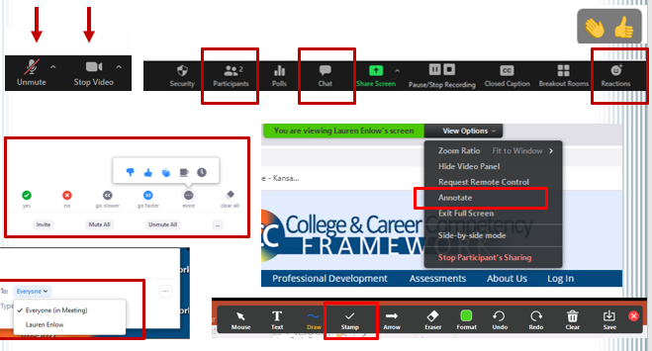
Zoom Features We Will Use Today
Notes:
To Know: Screen shot for Zoom features

Slide 12
Look for These Icons
Chat Box
Annotate
Polling
Breakout rooms
Reactions
Notes:
To Know: These are icons to use for virtual instruction.

Slide 13
Time to Stretch
Take a five minute break!
Notes:
To Know: It will be the presenters choice on where to place this slide and how long to break.
To Say:
To Do:

Slide 14
K – W - L
In Breakout rooms
Share what you already know about Standards Based IEP using Essential Elements.
Share what you want to know about Standards Based IEP using Essential Elements.
Post a know and a want to know in Chat.
Notes:
To Know: This could be used to learn what your participants know about Standards Based IEP Using Essential Elements.
To Say:
To Do: Have participants either post in a breakout room or Chat box one thing they know about Standards Based IEP Using Essential Elements and one thing they would like to know.

Slide 15
Main Theme
The activities at the end of each section should be included in the breakout room.
The theme will be the name of the section.
Participants can post their discussion in Chat or have one person report out to the main group.
Notes:
To Know: Section 5 has Six Steps for Implementation. Each step could be used as a theme.

Slide 16
K – W - L
Once you return to your breakout rooms
Share what you learned about Standards Based IEPs Linked to DLM Essential Elements.
Post one of your collective learnings in chat.
Notes:
To Know: This is one way to check for understanding.

Slide 17
Standards Based IEPs Linked to DLM Essential Elements
Consultant Name/Info
2020
Notes:
To Do: Individualize this slide using consultants information.

Slide 18
Opening and Introductions
Notes:
To Know: Transition slide Section 1

Slide 19
Sessions At-A-Glance
Section 1: Opening and Introductions
Section 2: Pre-Assessment
Section 3: Why Standards Based IEP Using Essential Elements are Important
Section 4: Overview of Missouri Learning Standards and Dynamic Learning Maps
Section 5: Navigating Six Steps to Successful Implementation of Essential Elements
Section 6: Standards Based IEP Using Essential Elements in Action
Closing and Follow up
Notes:
To Know: Adjust break and times as needed.
To Say: This is the agenda for the day. It is divided into six sections. Please take a minute to skim today’s agenda. Are there any questions?
We will take a break in the morning and afternoon. Lunch break is set before Step 4.

Slide 20
Missouri Teacher Standards
Understanding Essential Elements address the following Missouri Teacher Standards
Standard 2: Student Learning, Growth and Development
Standard 3: Curriculum Implementation
Standard 7: Student Assessment and Data Analysis
http://dese.mo.gov/educator-quality/educator-development/missouri-model-standards
Notes:
To Say: This training will align to the following Missouri Teacher Standards.

Slide 21
Welcome and Introductions
Welcome
Introductions
Housekeeping
Notes:
To Do: Welcome participants
Conduct Introductions
Introductions can be presenter choice. Use your preference. Each person could introduce themselves or they can interview and introduce another person. Time should be considered in this choice.
Review Housekeeping Items: Share information such as location of restrooms, approximate break times, lunch arrangements, if applicable, etc.

Slide 22
Learning Objectives
As a result of today’s learning you will be able to
Gain an understanding of Essential Elements in ELA and Math
Develop awareness of the Linkage Level Progression
Use the Unique Educational Needs (UEN) of the student to develop SMART Goals
Become familiar with Dynamic Learning Maps (DLM) and Missouri Learning Standards as a resource
Notes:
To Know: You may use either the Learning Objectives or the Essential Questions
To Do: State the objectives for the day
To Say: The purpose of this workshop is to help you develop background knowledge of MAP-A Essential Elements. The claim and conceptual areas are embedded in understanding MAP-A Essential Elements.

Slide 23
Essential Questions
What are Essential Elements?
Where are your students in relation to the Essential Element Linkage Levels?
What are the components of a SMART Goal related to Unique Educational Needs of students?
Where are the Dynamic Learning Maps and Missouri Learning Standards resources located?
Notes:
To Know: You may use either the Learning Objectives or the Essential Questions.
To Do: Read slide
What are the steps to navigate Essential Elements?
What are Linkage Levels and Nodes?

Slide 24
Norms
Be present
Set cell phones to silent
Minimize sidebar conversations
Ask questions
Take care of your personal needs
Have fun
Notes:
To Know: The content of this slide is flexible. If you would prefer a different set of norms, you may use them.
To Do: Go over the suggested norms.

Slide 25
Pre-Assessment
HO #1
Notes:
To Know: Section 2 - This can be given as a paper and pencil test or have participants use an online assessment tool of your choice.
To Do: Give the pre-assessment at this point. A copy of the pre-/post-test and answer key are in the presenter resources.
Handout #1 Pre-/Post Assessment or use an, i.e. Kahoots, Google Forms, Socrative

Slide 26
Pre-Training Reflection Questions
Notes:
To Know: Materials Needed: Chart paper, sticky notes, and writing utensil. Can also make a chart with sticky notes.
To Do: Have a piece of chart paper labeled, “Pre-Training Reflection Questions.”
To Say: As a part of the pre-training exercises you were asked to bring one question or idea about Essential Elements to the training session. Please write your question on a post-it note. Read your question as you place it on the “Pre-Training Reflection Questions” chart.
On a second sticky note ask something you WANT to know about EE/IEP. Place your sticky notes on the chart in the front of the room.

Slide 27
Why Standards Based IEPs Using Essential Elements Are Important
Notes:
To Know: Transition slide begins Section 3

Slide 28
Standards-Based Reforms
IDEA 1997
No Child Left Behind Act of 2001
IDEA 2004
Every Student Succeeds Act 2015 (ESSA)
Notes:
To Know: Since the 1980’s, education reform has been driven by an interest in setting and meeting educational standards. Beginning with IDEA 1997, the law required that specific attention be paid to how students with disabilities were provided access to and involvement in the general education curriculum. The 1997 IDEA legislation also required the inclusion of students with disabilities in state and district assessment programs.
The No Child Left Behind Act of 2001 required each state to develop an aligned system of standards and assessments for all students, and it required reporting of Adequate Yearly Progress at the school, local, and state levels. The language of No Child Left Behind was reinforced by IDEA 2004, which re-emphasized the need for students with disabilities to be involved in and make progress in the general education curriculum.
The Every Student Succeeds Act, the national education law, was signed into law on December 10, 2015. The Every Student Succeeds Act reauthorizes the Elementary and Secondary Education Act of 1965.
http://dese.mo.gov/communications/news-releases/missouri-board-education-weighs-every-student-succeeds-act
To Do: Summarize the information under, “To Know”
To Say: No Child Left Behind Act of 2001 has been revised into Every Student Succeeds Act (ESSA). Reminder to always keep current with Missouri State Plan for Special Education.

Slide 29
Why Connect to the Standards/Essential Elements?
IDEA 2004 Requires It
Statue Section 614(d)(I)(A)(i) states
“An IEP must include…a statement of annual goals, including academic and functional goals, designed to meet the child’s needs that result from the child’s disability to enable the child to be involved in and make progress in the general education curriculum.”
Notes:
To Say: We know that students must be involved in the general education curriculum. What we often forget is that IDEA also requires that we provide whatever is necessary for them to also make PROGRESS in the general education curriculum.
Adequate progress in the general education curriculum will not happen if the student’s Individualized Education Program (IEP) is not geared toward the general education content standards AND if the student is not receiving instruction in the general education classroom on the curriculum as a general education student.
It is important to have a mindset of student achievement for all students including students with an IEP and those who have been identified by the IEP team as eligible for alternate assessment.
Essential Elements are a progression for students who are eligible for MAP-A.
Grade level Missouri Learning Standards are the starting point for all students.

Slide 30
Why Connect to the Standards/Essential Elements?
Individuals with Disabilities Education Act (IDEA) states
“An IEP means a written statement for each child with a disability that is developed, reviewed and revised in a meeting in accordance with Sec. 300.320 through 300.234.” 34 CFR §300.320(a).
Including “a statement of measurable annual goals both academic and functional designed to meet the child’s needs that result from the child’s disability to enable the child to be involved in and make progress in general education curriculum.” 34 CFR §300.320(a)(2)(i)(A).
Notes:
To Do: Emphasize information on slide.
To Say: IEPs are mandated by law for all students receiving special education services in our public schools. The regulations state that an IEP is a written statement for each child with a disability that is developed, reviewed, and revised in a meeting that follow certain rules and regulations.
An IEP must include a statement of the child’s present levels of academic achievement and functional performance, including: (a) How the child’s disability affects the child’s involvement and progress in the general education curriculum (i.e., the same curriculum as for nondisabled children); or (b) For preschool children, as appropriate, how the disability affects the child’s participation in appropriate activities. The IEP must also include a statement of measurable annual goals, including academic and functional goals designed to meet the needs that result from the child’s disability to enable the child to be involved in and make progress in the general education curriculum. For children with disabilities who take MAP-A (Alternate Assessments) the law also requires that the IEP include a description of either benchmarks or short-term objectives.

Slide 31
ACTIVITY
Pre-read Dear Colleague Letter-United States Department of Education, Nov. 16, 2015
Read and discuss letter
Share out one fact
HO #2
Notes:
To Know: It presents the importance and the “why”
To Do: Have table copies available. Have participants read, “Dear Colleague Letter – United States Department of Education, Nov. 16, 2015.” Focus on and discuss page five.

Slide 32
Overview of Missouri Learning Standards and Dynamic Learning Maps
Notes:
To Know: Transition Slide Begins Section 4

Slide 33
Missouri Learning Standards
Notes:
To Know: The Missouri Learning Standards could be optional or summarized quickly depending on your audience. You will need to know your participants and their needs. This section gives an overview of MLS and item specifications.
To Say: In writing a Standards-Based IEP, we must consider the knowledge of our teachers in accessing grade and course level standards. What resources or understandings do they have in reference to the standards? Are they seated at the table when teachers work on curriculum? How are the focus of the standards communicated to the special education staff?

Slide 34
Access to Standards
Special Education teachers cannot teach the entire set of standards for every subject and grade. Therefore, it is imperative for the classroom teacher to communicate what is the priority for the grade/subject. That is where the focus for specialized instruction is needed.
Notes:
To Say: What are the priority standards for each grade or class? That should be a number one priority upon entering the work with each student a teacher is responsible for in the learning process. Then the instruction can be differentiated or specialized to meet the students needs.

Slide 35
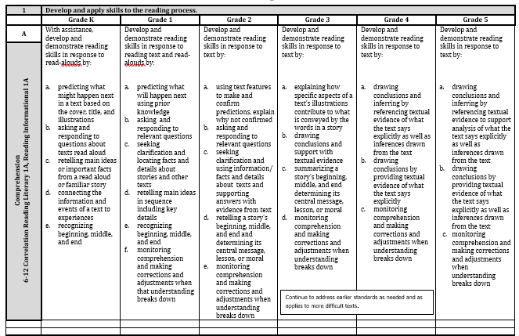
English Language Arts Missouri Learning Standards
https://dese.mo.gov/college-career-readiness/curriculum/english-language-arts
Notes:
To Say: The link will take you to the English Language Arts Missouri Learning Standards for Elementary or Middle School/High School. You can download these as a pdf or as a word document if you are someone who likes to cut and paste the standards into your work.
This section is from our Elementary Reading Standards.
What does this little red box say? (advance to the next slide to clarify).

Slide 36
This Little Box Says
Continue to address earlier standards as needed and as applies to more difficult texts.
Notes:
To Say: Have you seen this before? Have your teachers seen this?
This little box reminds us of the importance of knowing underlying standards across grades in efforts to create learning for students that address their needs. This box helps us when considering what students might need support or instruction for when trying to access grade level standards.

Slide 37
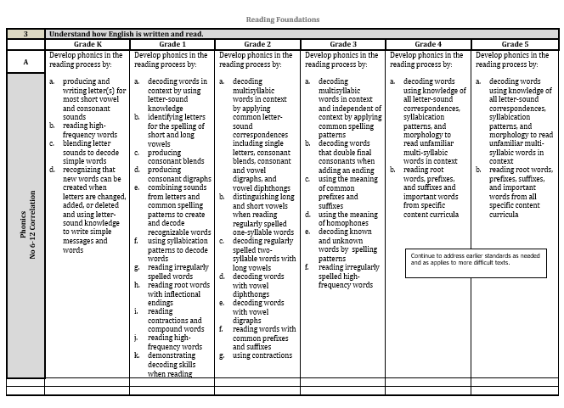
Which Standards Are These?
Reading Foundations
Notes:
To Say: Which standards are these? They are our Reading Foundations. The foundations that must be in place for reading instruction to be successful for students. Do you see that same box?
What does this have to do with reading and what teachers need to understand about reading development? Only students with autism will not learn to read using phonics and phonemic awareness instruction.

Slide 38
This Same Little Box Says
Continue to address earlier standards as needed and as applies to more difficult texts.
Notes:
To Say: This same little box directs us in our general education classrooms; our title classrooms; or in special education classrooms to be mindful of the learning that might need to be scaffold for students if there are gaps or standards that might be foundational for others. This box provides us with affirmation in teaching skills that have not been mastered for some groups of students or individuals that might need re-teaching whether through small group or Multi-Tiered System Support (MTSS).

Slide 39
Grade Level Math Expanded Expectations
https://dese.mo.gov/college-career-readiness/curriculum/Mathematics#mini-panel-Math1
Notes:
To Say: Math Expanded Expectations were created by Missouri educators to provide classroom teachers a more descriptive version of the Mathematics Grade and Course Level Expectations (GLEs and CLEs). They were developed to make it clearer to Missouri educators as to what the standard is intending.

Slide 40
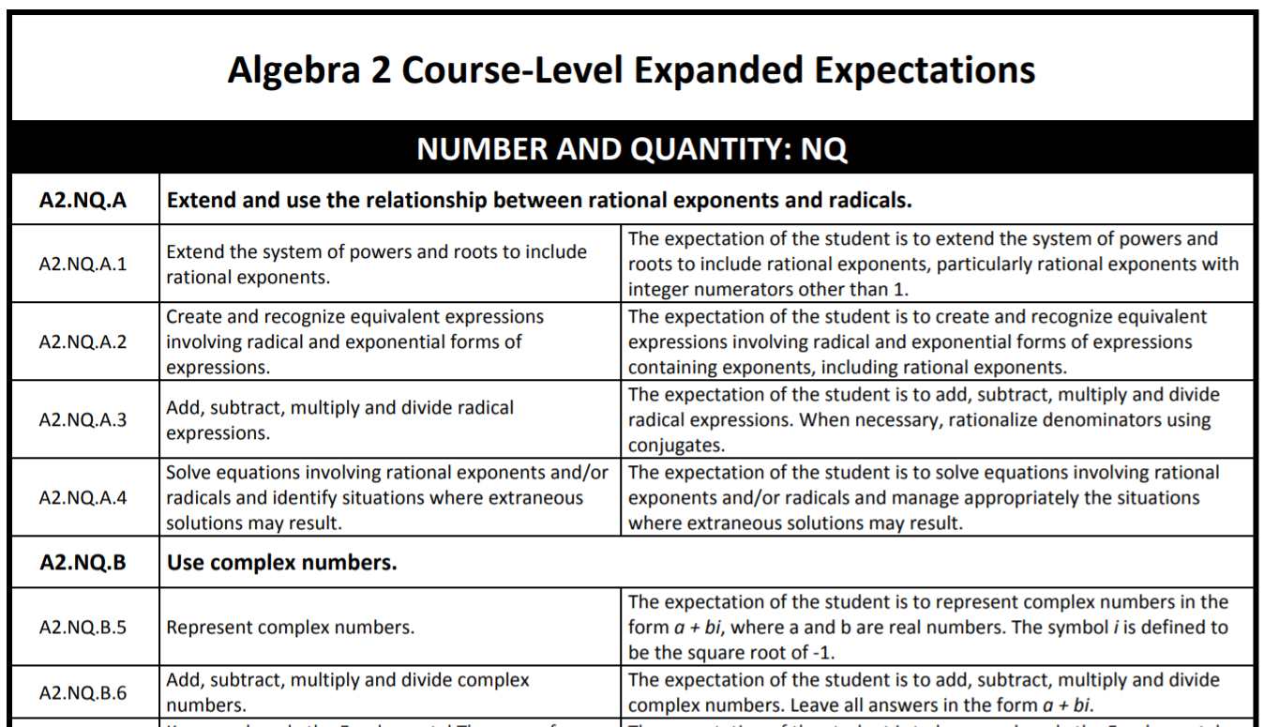
All Math Course Level is Expanded
https://dese.mo.gov/college-career-readiness/curriculum/Mathematics#mini-panel-Math1
Notes:
To Say: All Missouri Expectations for Math across grade and course levels are defined in expanded expectations.

Slide 41
Item Specifications
Math
ELA
Science
Social Studies
Notes:
To Know: https://dese.mo.gov/college-career-readiness/curriculum/
Click on Assessment Resources then scroll down to Item Specifications.
To Say: We have tools to help us with what teachers need to use to implement and TO DEVELOP GOALS. Math, ELA, science and social studies have Item Specification documents on their content webpage under a tab. Teachers may use these documents to access standards.
The assessments to measure these IEP goals need to have questions they will see on MAP. How we ask verbally or in writing needs to mirror what will be expected or we are not having them access standards.

Slide 42
Notes:
To say: Let’s take a minute to look at how to read the Item Specification documents. The standards is referenced at the top of each in coding for the grade and content.
The Expectations Unwrapped are separated out as individual subskills in more user-friendly terms. (Click to bring in the red box for each section as you address it.)
The DOK Ceiling tells us what is the highest level of DOK that this will be asked.
Item Format defines how the items will be represented in the assessment. This one will always be selected response.
Text Types defines which types of texts are fair game for this type of question. This reminds us that we might want to look at the texts in which we ask these types of questions. Do we access these standards across other types of texts or are our students only asked to answer this type of question in one type of text?

Slide 43
Notes:
To Say: There are two other portions in this document that can help us in our goal setting and assessment of access to the standards. Content Limits/Assessment Boundaries help us to focus in.
In the far right corner are the sample question stems that are on the MAP. We must be using these verbally and in writing if we are developing a standards-based quality IEP.
This will help us provide access. Even if a student orally reads at a third grade reading level, is the teacher asking questions that are on the grade level in which they will be tested?

Slide 44
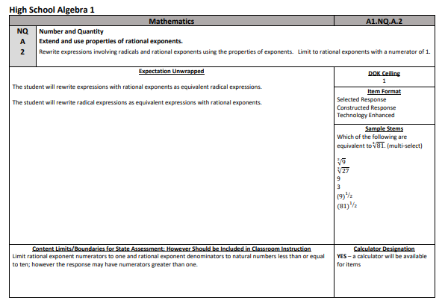
Notes:
To Say: Here is high school Algebra 1 and you see the same format. Every grade and high school EOC have item specifications for us to use in goal setting and the assessments with which we will define success.
Do our teachers know about these?
This is one way to ensure that we are asking questions that access grade level questions that they will see on the MAP tests.

Slide 45
Dynamic Learning Maps
Notes:
To Know: Transition slide

Slide 46
Learning Map
Claims
Conceptual
Areas
Essential Elements
Linkage Levels
Notes:
To Know: This is the graphic adapted from DLM resources.
To Say: This is the dynamics of the Learning Map. A description of each level will be presented in the following slides.

Slide 47
What is a Learning Map?
Think of a learning map as a common road map. Although students may share the same destination, they all begin their journeys from different starting points on the map. For parents and educators who hope to guide students to their destinations, that road map provides a wealth of information. A map shows where a student is starting from, as well as the main route, which is the shortest, most direct way to reach the destination. However, a good road map does more than show a single route. It also shows several alternate routes in case the main route cannot be taken. Finally, the map shows all the places students must travel through to get to their destinations.
http://dynamiclearningmaps.org/content/what-learning-map-model
Notes:
To Know: This slide is optional. Know your audience.
To Do: Have the participants read the information on this slide and then share out.

Slide 48
Claims
Claims are broad statements about what students are expected to learn and to be able to demonstrate within content areas.
Four claims and nine conceptual areas in English Language Arts
Four claims and nine conceptual areas in Mathematics
Adapted from http://dynamiclearningmaps.org
Notes:
To Know: This slide is optional.
To Say: English Language Arts and Mathematics have claims.

Slide 49
Conceptual Areas
Conceptual Areas are subparts of Claims organized around common cognitive processes
Regions within the learning map that contain nodes which are directly related to Essential Elements
These areas are comprised of clusters of connected concepts and skills the students may acquire
Adapted from http://dynamiclearningmaps.org
Notes:
To Say: Read slide

Slide 50
English Language Arts
Major Claims | Conceptual Areas
Claim 1. Students can comprehend text in increasingly complex ways | CA1.1 Determining critical elements of text
 | CA1.2 Constructing understandings of text
 | CA1.3 Integrating ideas and information from text
Claim 2. Students can produce writing for a range of purposes and audiences | CA2.1 Using writing to communicate
 | CA2.2 Integrating ideas and Information in writing
Claim 3. Students can communicate for a range of purposes and audiences | CA3.1 Using language to communicate with others
 | CA3.2 Clarifying and contributing to discussion
Claim 4. Students can investigate topics and present information | CA4.1 Using sources and information
 | CA4.2 Collaborating and presenting ideas
http://dlmpd.com/dlm-claims-and-conceptual-areas
Notes:
To Know: DLM Module Claims and Conceptual Area http://dlmpd.com/dlm-claims-and-conceptual-areas
To Say: ELA Claim 4 are further defined into specific conceptual areas as seen on this chart.

Slide 51
Codes for ELA Essential Elements
RL | Reading Literature | These EEs are assessed using stories.
RI | Reading Information | These EEs are assessed using informational texts.
L | Language | These EEs are assessed in stories, informational texts and writing test-lets.
W | Writing | These EEs are assessed in writing test-lets.
http://dynamiclearningmaps.org/content/essential-elements
Notes:
To Know: Optional slide
To Do: Discuss codes for ELA http://dynamiclearningmaps.org/content/essential-elements

Slide 52
Mathematics
Major Claims | Conceptual Areas
Claim 1. Students demonstrate increasingly complex understanding of number sense. | M.C1.1 Understand number structures (counting, place value, fraction)
 | M.C1.2 Compare, compose, and decompose numbers and sets
 | M.C1.3 Calculate accurately and efficiently using simple arithmetic operations
Claim 2. Students solve increasingly complex Mathematical problems, making productive use of algebra and functions. | M.C2.1 Use operations and models to solve problems
 | M.C2.2 Understand patterns and functional thinking
Claim 3. Students demonstrate increasingly complex spatial reasoning and understanding of geometric principles. | M.C3.1 Understand and use geometric properties of two- and three-dimensional shapes
 | M.C3.2 Solve problems involving area, perimeter, and volume
Claim 4. Students demonstrate Increasingly complex understanding of measurement, data, and analytic procedures. | M.C4.1 Understand and use measurement principles and units of measure
 | M.C4.2 Represent and interpret data displays
http://dlmpd.com/dlm-claims-and-conceptual-areas
Notes:
To Know: DLM Module Claims and Conceptual Area http://dlmpd.com/dlm-claims-and-conceptual-areas
To Say: Math claims are further defined into specific conceptual areas as seen on this chart.

Slide 53
Guide to Mathematics Essential Element Codes
A-CED | Creating equations |  | F-IF | Interpreting functions
A-SSE | Seeing structure in equations |  | G | Geometry
BF | Building functions |  | G-GMD | Geometric measurement and dimension
CC | Counting and cardinality |  | G-MG | Geometry; modeling with geometry
EE | Expressions and equations |  | G-GPE | General properties and equations
F-BF | Basic fractions |  | MD | Measurement and data
Notes:
To Know: Optional slide
To Do: Discuss codes for Math

Slide 54
Guide to Mathematics Essential Element Codes Continued
NBT | Numbers and operations in base ten |  | OA | Operations and algebraic thinking
N-CN | Complex number system |  | RP | Ratios and proportional relationships
NF | Numbers and operations-fractions |  | S-IC | Statistics and probability-making inferences/justifying conclusions
N-RN | Real number system |  | S-ID | Statistics and probability-interpreting categorical and quantitative data
NS | Number systems |  | SP | Statistics and probability
N-Q | Number and quantity
Notes:
To Know: Optional slide
To Do: Discuss codes for Math http://dynamiclearningmaps.org/content/essential-elements

Slide 55
Essential Elements
Essential Elements are specific statements of knowledge and skills that are linked to the grade‐level expectations and stand on their own as important learning targets for students with the most significant cognitive disabilities. Essential Elements were developed to align with College and Career Readiness standards at each grade level.
Adapted from http://dynamiclearningmaps.org
Notes:
To Know: It is important to consider this connection to the following slides with regard to the intent of the law.
To Do: Emphasize information on slide.

Slide 56
Essential Elements: Design Priorities
Define essential differences from grade to grade in
cognitive demand
content knowledge
skills-based expectations
Identify the key elements essential for each grade level
Not necessarily a one-to-one relationship with Missouri Learning Standards
Aligned across and between grades
Notes:
To Do: Participants share out
To Say: IEP is a fluid process from grade to grade level.
Ask participants, “How do you identify key elements for each grade level?”

Slide 57
Missouri Learning Standards and Essential Elements Crosswalks
Assessment
Curriculum
Quick Links: Missouri Learning Standard
Alternate
Crosswalk
Notes:
To Know: https://dese.mo.gov/college-career-readiness/curriculum/missouri-learning-standards#mini-panel-mls-standards8
The Dynamic Learning Maps Essential Elements for English Language Arts and Mathematics are specific statements of knowledge and skills linked to Missouri Learning Standards: Grade Level Expectations. The purpose of the DLM Essential Elements is to build a bridge from the content in the general education English Language Arts and Mathematics framework to academic expectations for students with the most significant cognitive disabilities.
https://dese.mo.gov/sites/default/files/curr-mapa-ela-k-12-crosswalk.pdf
https://dese.mo.gov/sites/default/files/curr-mapa-math-k-12-crosswalk.pdf
To Do: Walk participants through the process of finding crosswalk. You can have table copies of ELA and Math Crosswalks for participants to view.

Slide 58
Essential Elements are Not
Replacements for the College and Career Readiness Standards
Downward extensions
Statements of functional skills
Restated as IEP goals or benchmarks
http://dese.mo.gov/college-career-readiness/assessment/map-a
Remember!
Notes:
To say: As you begin to explore the MAP-A Essential Elements, it is important to understand what they are not. For example, the Essential Elements are NOT replacements for grade level College and Career Readiness Standards nor are they downward extensions of those standards. They are NOT statements of functional skills. Certainly, students should learn to apply the academic skills they acquire in meaningful, personally relevant, functional ways, but the Essential Elements do not address functional skills directly. The Essential Elements do not create a curriculum. Importantly, for those of us who teach students with significant cognitive disabilities, the Essential Elements also are not simply restated as goals or benchmarks on students’ Individual Education Plan (IEP) but can serve as a resource to IEP teams in aligning IEP goals with individual targets for working toward grade level standards. Essential Elements are also NOT separate from grade level College and Career Readiness Standards. They align directly with those standards.

Slide 59
Every Essential Element has Multiple Nodes
What is a Node?
Represent discrete knowledge, skills, and understandings that were drawn from Mathematics and English Language Arts research.
***Every box on the Mini-Map is a Node of learning.
http://dynamiclearningmaps.org/content/educator-resource/
Notes:
To Say: Every box on a learning map represents a NODE of learning.
These could be thought of as the parts we identified in a’ Task Analysis’ of the targets required in Essential Elements. In order to arrive at target there are multiple ways to get there but the Foundational Nodes are the beginning of all the tasks needed.

Slide 60
Five Linkage Levels for ELA and Math
Initial precursor
Distal precursor
Proximal precursor
Target (at the Essential Element level)
Successor (Getting closer to Grade Level Standard)
Notes:
To Say: Read the slide

Slide 61
FINDING the Linkage Level and Nodes
www.dese.mo.gov
Assessment tab
MAP-A tab
Resources (scroll down to tab)
Click on DLM Resources: ELA or Math
Click on ELA or Math icon
Currently tested Essential Elements
https://dynamiclearningmaps.org/erp_ie
Notes:
To Know: This is one way to access the linkage level and nodes. After clicking on DLM Resources, you will be redirected to DLM page, or give the participants this web site: https://dynamiclearningmaps.org/erp_ie.
To Say: Follow directions to access Node levels per grade level EE or use the Dynamic Learning Maps link. Have participants explore a grade level in ELA and math. What did you discover about your linkage level?
To Do: Practice finding the Linkage Level and Nodes – Be sure to check this prior to training.
https://dese.mo.gov/college-career-readiness/assessment/map-a
Essential Elements website: https://dynamiclearningmaps.org/erp_ie

Slide 62
What Are Blueprints?
Describes which Essential Elements for ELA and Mathematics are tested in MAP-A.
Notes:
To Know: NOTE: This slide is subject to change – always keep abreast of new terminology. Blueprints may disappear or change in the future.
Educators will have prior knowledge with regard to Blueprints if they participated in the MAP-A new and/or MAP-A experienced modules.
To Say: Only a small portion of the EE are on the blueprint. These are the EEs that are available for testlets to be delivered to students.
To Do: Review slide and ask participants to think about individual students. How do you use the Blueprints to address students’ needs?
Stress to participants that IEP goals are a TEAM decision.

Slide 63
Foundational Nodes
Skills students must be able to do to learn academic skills
Can pay attention
Understand object names
Identifies objects
Can respond
**150 Foundational Skills
HO #3 and HO #4
http://www.dynamiclearningmaps.org/sites/default/files/documents/ERP/foundational_maps-all_grades.pdf
Notes:
To Know: Foundational skills provide the foundation for academic skills. They provide learning progressions by including multiple and alternate pathways through which students develop content knowledge. As of June 2020, ELA map includes more than 2000 nodes and math map has more than 2300 nodes. DLM Test Administration Manual 2020-2021 v. IE. 7/23/2020 page 20.
To Say:
What do you notice?
What do you see?
Report out at table.
To Do: Make and laminate table copies of Foundational Maps for the participants to view. Have them discuss what they see and learned (Handout #3 and #4). These 150 Foundational Skills are what all the nodes link back to as the base of learning or the Foundation of learning. Some of these are linked to each other, as well, but they are the basic lowest subset of all the skills required.
http://www.dynamiclearningmaps.org/sites/default/files/documents/ERP/foundational_maps-all_grades.pdf

Slide 64
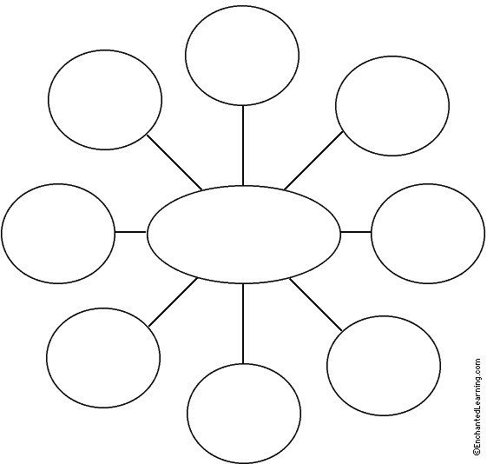
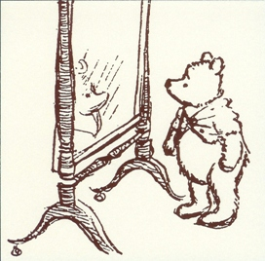
Self Reflection
HO #5
Notes:
To Say: Use the handout provided to reflect upon the previous section.
To Do: Give participants HO #5 and have them complete a space on the page to document a new and/or important point from the training.

Slide 65
Unpacking Essential Elements
Notes:
To Know: Transition slide Section 5 begins.

Slide 66
Six Steps to Successfully Navigating Essential Elements
Adapted from Dynamiclearningmaps.org/
Notes:
To Know: Transition slide

Slide 67
Review the grade of record of Essential Elements.
Examine data to determine where student is functioning relative to the Essential Elements.
Use Claims and Conceptual Areas to help set priorities.
Develop present level of academic achievement and functional performance reflecting student strengths and needs with consideration of Essential Elements.
Develop SMART annual goals.
For each SMART annual goal, develop Benchmarks or short-term objectives that align with the Essential Elements.
1
2
3
4
5
6
Notes:
To Know: This slide could be laminated and put on tables so that participants can have a guide to follow through the six-step process. It could also be printed as an additional (optional) handout.
To Say: Read slide and discuss. Writing the section of the IEP that links to the MAP-A Essential Elements involves six steps. Each of these six steps will be described in detail.

Slide 68
Step One
Review the grade of record of Essential Elements
What are Essential Elements?
Specific statements of content and skills that are
Aligned/linked to English Language Arts (ELA) and Mathematics in Missouri Learning Standards (K-12)
Created for students with the most significant cognitive disabilities
https://dese.mo.gov/college-career-readiness/assessment/map-a
Notes:
To Know: This slide is subject to change – always keep abreast of new terminology.
To Say: Always use the student’s grade level of record to choose Essential Element. Remember linkage levels represent a path toward the standard.
To Do: Look at EE on the website. Look at EE grade level mini map with a specific student in mind. Have participants use the IEP they brought and identify the grade level of their student.

Slide 69
Getting to Know the Process of Linking Curriculum to EEs
Know the intent of the content elements relative to your curriculum.
Think in terms of what the student must know and be able to do
Is selected EE linked to daily instruction.
Use Claims and Conceptual Areas to set priorities with EEs.
Which elements are priority for your student’s long term success?
Notes:
To Know: All teachers need to work with and be familiar with the grade level standards.
To Say: Follow the bullet points in the process to ensure understanding by:
putting student needs first
look at the standards in relation to the priorities within a grade or course in their district. Ask participants to think of which standards are ‘essential/priority’ or most important for the particular grade or course level.
think – LONG term– what the student will need for success over time
To Do: Have participants read the slide.

Slide 70
Determine Where the Student is Functioning in Relation to the EEs
What is expected within the target of the EE?
What instructional strategies or approaches have been or are being used to access the EE?
Has the student been provided appropriate instructional scaffolding to attain these targets?
What results have been documented for this student?
Notes:
To Say: Determine what the student is doing now.
Consider:
--The vision or desired outcomes
--What we know about the expectations of the curriculum (and specifically the Essential Elements)
--What will keep this student from being able to accomplish the vision or desired outcomes?
The process involved in Step 4 folds into Step 5, Present Level
--Description of what the student CAN do (in the context of what is expected)
--Conversation to identify the gaps between skills/knowledge essential to the vision/desired outcome and what the student can do (in context of what is expected)

Slide 71
Step Two
Examine data to determine where student is functioning relative to the grade level Essential Elements.
Notes:
To Do: Review slide.

Slide 72
Possible Data Sources to Determine Student Functioning
Think Pair Share
Where do you find your student’s information?
Notes:
To do: Give participants time to share their ideas on where to find data. Participants could write their ideas on chart paper and then have a gallery walk for everyone to view the ideas and discuss.

Slide 73
Possible Data Sources to Determine Student Functioning
Progress monitoring results (reviewing of achievement of previous IEP goals)
Classroom observations
Student work samples
Formal and informal assessments
Parent and student input
Individual Score Reports
Notes:
To Know: Be familiar with how to locate individual score reports and explain the purpose.
To Say: This list is not all inclusive.
Most recent Evaluation Report
Review strategies, accommodations or assistive technology that have already shown success
Classroom observation
Student work samples
Formal and informal assessments
Parent and student input
Transition Information
Progress monitoring results (review of achievement of previous IEP goals)

Slide 74
Self Reflection
HO #5
Notes:
To Do: Using HO #5 that they started - have participants add additional new/important information from today’s training.

Slide 75
Step Three
Use claims and conceptual areas to help set priorities.
Notes:
To Do: Read slide

Slide 76
Consideration of the Essential Element
Determine the
Claim and Conceptual Area where the Essential Element is situated in order to develop the annual goal
Knowledge and skills needed to meet the Essential Element
Notes:
To Say: Determine the Claim and Conceptual Area where the Essential Element is situated in order to develop the annual goal. Also determine the knowledge and skills needed for the student to meet the targeted Essential Element. Determine the methods for showing what the student knows and can do relative to the Essential Element. Remember to build on strengths of the student and their unique educational needs. Step 5 will provide you with a couple of examples.

Slide 77
With Essential Elements in Mind
Use your student’s Unique Educational Needs (UEN) to set priorities and think about
Student Data
Claims and Conceptual Areas
Blueprints
Linkage Levels and Nodes
Individual Student Reports
HO #6
Notes:
To do: Have participants reflect upon their student Unique Educational Needs (UEN).
Optional Activity: Use Grade-Level Standard MAP-A Essential Element Linkage Levels HO #6
Discuss the similarity and differences of the linkage nodes.

Slide 78
For Each Child Assessed With the MAP-A
You might find it helpful to have a folder that contains the following
The Blueprint pages for the student in ELA and Math documenting the Essential Elements chosen for instruction
The Linkage Level progression information for that student that coordinates to the Essential Elements chosen from the Blueprints
Individual Student Year-End Report Performance Profile
Goal pages from the IEP
This information could also be kept electronically
Notes:
To Know: Blueprints may change each year using updated terminology.
To Say: How do you share this information with your parents? Discuss.
Remember grades 3-8, and 11 are accountable for state purposes in ELA and Math.
When other grades are chosen, it is a district decision.
To Do: Use MAP-A resources

Slide 79
Traditional v. EE-linked IEPs
Traditional IEP Focused on basic academic and/or functional skills. Little relationship to a specific standard or grade-level expectations. | EE-Linked IEP Directly tied to the DLM Essential Elements Both the students present level of academic and functional performance and the annual IEP goals are aligned with and based on the DLM Essential Elements
Notes:
To Say: DLM Essential Elements include goals that are directly tied to the grade-level expectations in addition to goals tied to other important functional skills and concepts. An IEP linked to the DLM Essential Elements will include present level of performance statements and annual IEP goals that are aligned with and based on the grade-level Essential Elements. This results in an individual education program that is aimed at getting the student to a proficient level on grade-level expectations
To Do: Read slide

Slide 80
Notes:
To Know: You determine lunch break. This slide can be hidden.
To Say: After lunch we will start with putting the content in practice.

Slide 81
Step Four
Develop present level of academic achievement and functional performance reflecting strengths and needs with consideration of the Essential Elements.
Notes:
To Say: Keep in mind your Student’s Unique Individual Needs
Is your student data current?
Is your IEP Standards Based?
To Do: Review slide

Slide 82
Present Level of Academic Achievement and Functional Performance
Statement
A comprehensive statement describing the student’s current performance in relation to grade of record Essential Elements.
Notes:
To say: The statement of present level of academic achievement and functional performance is a critical step in the Essential Elements linked IEP process. It is the step upon which all the other steps are built. The statement of present level of academic achievement and functional performance should be data‐based and specific enough to serve as a baseline for developing IEP goals, as well as for determining accommodations, supplementary aids and services, and program supports.
Serves as the basis for determining
-measurable annual goals and objectives/benchmarks
-accommodations/modifications
-supplementary aids and services
-program supports
-provides baseline

Slide 83
Present Level of Academic Achievement and Functional Performance
Present levels must be
Observable – use terms that are measurable, specific, and based on evidence
Understandable – use clear language that can be understood by all members of the IEP team
Adapted from http://dynamiclearningmaps.org/
Notes:
To Say: Use data to summarize the Present level. The Present level answers the question: “What is the student doing now?”
This is the foundation – what is unique to the child?
What is needed to keep them learning and accessing what other students access in public education?
- Directs the goals and objectives
- Allows an understanding for Accommodations or validates Modifications
- Indicates what is unique that might need other services
When writing the statement of present level of academic achievement and functional performance remember that it must be observable and understandable. General statements based on opinion are not acceptable. For example, statements like, “Pat’s performance in reading comprehension is greatly improved” does not provide sufficient information for members of the IEP team. The term “improved” can mean different things to different people. Improved does not convey a measurable or observable quantity, nor does it convey how Pat’s reading comprehension has improved. Statements of present levels of performance must describe the student’s current functioning using terms that are observable, specific, evidence-based, and clearly articulated.

Slide 84
Present Level of Academic Achievement and Functional Performance
Components
Strengths specific to the knowledge/skills that are needed to achieve the grade of record Essential Elements
Unique Educational Needs related to the skill sets the student requires to access and make progress toward achieving the grade of record Essential Elements
Impact Statement describing how the student’s disability affects (impacts) his/her progress toward achieving the grade of record Essential Elements
Notes:
To say: Lets review some of our present levels. Does the Present Level (PL) help a teacher to know where to begin and move forward? Think in terms of essential characteristics:
Imagine you are describing the student to a new teacher
- What does the new teacher need to know to be prepared to teach the student?
- The present level should describe the essential characteristics through the UENs so clearly that the teacher would know what materials to pull from the shelf the first time the student and the teacher interact.
- Essential Characteristics should be addressed using clear, easily understood language that provides a snapshot of the student’s needs and strengths.
- Essential Characteristics must be written in terms that are observable, specific, and based on evidence.
Baseline is not required in the PL, however, it is best practice because you must know the current performance level of your student. IDEA has requirements for what must be included in the statement of present level of academic achievement and functional performance. Three of those requirements are impacted by the MAP-A Essential Elements.
Strengths: They are the statements of: student strengths, student needs, and how the student’s disability impacts participation in the general education curriculum. Student strengths should relate specifically to the grade-level Essential Elements. The statement of student strengths should clearly describe what the student can do. The statement of need should detail what skills are missing in order for the student to be able to achieve the grade­‐level Essential Element.
Needs: The need statement should clearly describe what the student needs to learn in order to close the gap between his/her knowledge/skills and the grade-­level expectations detailed in the Essential Elements. Students with the most significant cognitive disabilities will likely present with a broad range of needs. Not all of them have to be addressed in goals and objectives. IEPs can also document additional support the student will require in the supplementary aids and services section of the IEP.
Impact: The final component of the statement of present level of performance is the impact statement. This component clearly describes how the student’s disability or disabilities affect progress toward grade level expectations. This statement of impact should not simply name the disability itself but rather describe how the characteristics of the disability impact participation in the general education curriculum. For example, the impact statement might read, “Pat’s limited understanding of symbols and symbolic language combined with weaknesses in memory and communication affect her progress in achieving grade‐level Essential Elements in reading.” It would be incorrect to write a general statement such as, “Pat’s significant cognitive disability affects her progress in reading.”
Adapted from http://dynamiclearningmaps.org/

Slide 85
Process the Present Level
Components
Strengths
Unique Educational Needs in relation to Essential Elements
Impact Statement
What is the student doing now
What is unique to this child
HO #7
Notes:
To Know: Materials needed: HO #7, highlight tape or markers.
Disclaimer: This IEP is not a perfect model and it is for training purposes only!
To Say: Read the slide.
To Do: Handout laminated copies of Sam’s IEP Handout #7. Highlight these components of present level.
Participants may do this activity in pairs, use arrows, or highlight tape. It’s your choice.

Slide 86
Process the Present Level
Use your own student’s present level to locate the following
Strengths
Unique Educational Needs in relation to Essential Elements
Impact Statement
What is the student doing now?
What is unique to this child?
HO #7
Notes:
To Say: Using your student IEP that you brought, find these components: strengths, UEN to EE and child, impact statement, and academic and functional achievement.
Is this as easy when it is a student you know? Try to remember to write each present level in a manner that ‘stranger eyes’ could find all the elements easily and know this student and where they are headed. Think about good examples of transfer IEPS and those that have been more frustrating. Have you sent good examples or frustrating examples to others when a student has transferred? In Missouri, are we doing compliance as well as best practice commitment to our students and their families?
To Do: Individually repeat this activity with their own present level.

Slide 87
Self Reflection
HO #5
Notes:
To do: Using the HO #5 they have started - have participants continue their self-reflection process focusing on Step 3 and 4.

Slide 88
Step Five
Develop SMART annual goals.
Notes:
To say: This is the acronym we will use today.
- Specific to a particular skill or behavior
- Measurable can be counted or observed
- Attainable can be reasonably accomplished within the duration of the IEP
- Results-oriented describes how the goal will be measured
- Time Bound generally will happen over the course of one year.

Slide 89
IEP Goals
Measurable annual goals include Academic and Functional goals
To meet individualized needs so the student can be involved and make progress in the General Education curriculum
To meet individualized education-related needs that result from disability
For students participating in Alternate Assessments, all IEP goals must include benchmarks or short-term objectives
Notes:
To Do: Have participants read slide.

Slide 90
Measurable Goals Aligned with Grade-Level Essential Elements
Goals and objectives should build on current strengths and address specified needs of the student.
Goals and objectives are informed by and linked to grade-level Essential Elements
Not a restatement of the Essential Element
Does not take the place of the curriculum
General and life skills may also be targeted
Adapted From http://dynamiclearningmaps.org
Notes:
To Say: The goals and objectives or benchmarks that are developed for a student builds upon current strengths and needs identified in statements of present level of academic and functional performance. IEP goals and objectives also do not take the place of or comprise the curriculum for an individual student. The law requires that all students have access to the grade-level standards. That means all students are receiving instruction that targets the entire set of grade-level Essential Elements. The IEP goals and objectives detail the specialized instruction students will require to be successful. Finally, the goals and objectives that are linked to the Grade-Level Essential Elements are not the only goals and objectives to include in a child’s IEP. When appropriate, goals and objectives that reflect general, functional, or life skills are targeted.

Slide 91
Developing SMART IEP Goals
Specific – based on the student’s Present Level of Academic Achievement/Functional Performance
Measurable – progress is objectively determined at frequent data points
Attainable – realistic, related to the most critical needs
Results oriented – developed with a standards’ outcome in mind
Time-bound – clearly defined beginning and ending dates
HO #8
MO Standards and Indicators, 200.810.b
Notes:
To Say: Missouri Standards and Indicators, 2019 describe SMART IEP goals as: the IEP includes goals that: 200.810.a. Demonstrate consistency with the content of the present level of performance. 200.810.b.
Are written in terms that are: 200.810.b.(1) Specific to a particular skill or behavior to be achieved. 200.810.b. (2) Measurable. 200.810.b.(3) Attainable (can reasonably be accomplished within the duration of the IEP). 200.810.b.(4) Results oriented. 200.810.b.(5) Time-bound (generally happen within one year.)
To Do: Give participants “Developing SMART IEP Goals” HO #8
For this workshop, here are ways we will be defining the SMART Goals

Slide 92
Specific
Target areas of academic achievement
Clear descriptions of the knowledge and skills that will be taught
How the child’s progress will be measured
Notes:
To Say: What will the child be able to do? The goal is specific to a particular skill or behavior to be achieved.
To Do: Read slide

Slide 93
Specific
Which one is Specific?
Tom will increase study skills for academic success.
Tom will create note cards listing critical information for the test.
Notes:
To Do: Have participants come to consensus at their table which is specific.
Number 2 is specific.

Slide 94
Measurable
Count or observe it
Allows you to know how much progress the child has made
Allows you to know when the child has reached the goal
Notes:
To Say: Progress measured from last performance. To what level or degree will the student demonstrate achievement
To Do: Read the slide

Slide 95
Measurable
Which is measurable and observable?
Owen will improve his reading skills.
Given second grade material, Owen will read a passage of text orally at 110-130 wpm with five errors or less.
Notes:
To Do: Have participants come to consensus at table on correct answer.
Correct answer is 2.

Slide 96
Attainable
Components that must be in measurable terms
Direction of behavior
Area of need
Level of attainment
“The child will be able to…”
Notes:
To Say: Given what? Setting, situation, materials related to most critical need. Such as Behavior – increase, decrease, maintain
Area of need – reading, writing, mathematics, behavior level of attainment - grade level, words per minute.

Slide 97
Attainable
Which of these goals is specific, measurable, and achievable?
Betsy will decrease her punctuation errors when writing a paragraph from 10 to 0 on five collection periods.
Betsy will decrease her punctuation errors when writing a paragraph on five collection periods.
Notes:
To Do: Have participants choose and display answer by using thumbs up or down.
Number 1 Correct
What is the situation?

Slide 98
Results Oriented
Address the child’s unique needs that result from their disability
Notes:
To Say: What methods will be used to measure progress? What data will be collected to measure student progress?
To Do: Read slide

Slide 99
Results Oriented
Which of these goals is specific, measurable, and results oriented?
Given a prompt during a writing program, Kelsey will demonstrate improved writing skills in five collection periods.
Kelsey will write a five sentence paragraph that includes a topic sentence, a minimum of three details, and a conclusion with 80 percent accuracy in five collection periods.
Notes:
To do: Discuss these statements and choose the correct one.
Correct statement is 2.

Slide 100
Time Bound
What does a child need to know and be able to do after one IEP cycle?
Time-bound goals and objectives enable you to monitor progress at regular intervals.
Notes:
To Say: Identify what can realistically be expected within one year focusing on challenging, yet attainable outcomes.
If previous data shows the student may not make the goal in one year, write a different goal. Time-bound is within what length of time? (It is the IEP year, unless otherwise noted.)

Slide 101
Step Six
For each goal, develop benchmarks or short-term objectives that align with SMART goals
Notes:
To do: Read slide

Slide 102
Benchmarks or Short-Term Objectives
Required ONLY for those students taking the MAP-A
ALL goals on IEP for a student taking the MAP-A must include benchmarks or short-term objectives
Including ALL related service goals
Notes:
To know: Missouri Standards and Indicators
200.810.f. For children taking alternate assessments, description of benchmarks or short-term objectives aligned to alternate achievement standards. This information may be shown under goals or in the Present Level Of Academic Achievement And Functional Performance.
NOTE: Measurable means written in terms that includes the skill or behavior and the level of attainment that will be achieved. IEP 200.820 Special education services to be provided: 34 C.F.R. §300.39, 34 C.F.R. §300.320(a)(4),(i); SP(IV) Documentation includes a statement of the special education services based on peer reviewed research to the extent practicable to be provided to the child or on behalf of the child to advance appropriately toward obtaining the annual goals: 200.820.a. Specific special education service(s). 200.820.b. Amount of time (e.g., minutes, hours, periods, percentage) to be committed to each service that must be: IEP
To do: Read information on slide and stress ALL related service goals for MAP-A students.

Slide 103
Benchmarks or Short-Term Objectives
Purpose
Specify intermediate progress toward the goal that allows you to determine whether progress is sufficient to meet the goal.
Notes:
To say: Including all related services
To do: Read and discuss.

Slide 104
Short-Term Objective
Is a sequential, progressive, intermediate measure of progress toward a goal
Is a restatement of the goal with a different criterion
Notes:
To Know: Examples for presenter to use: By the end of the first quarter Josie will retell a narrative story at the 7th grade level by including the main idea with 100 percent accuracy as measured by teacher created assessment. In nine instructional weeks, during group activities, Sally will attend to the speaker of the group for four minutes on three consecutive observations.
In 18 instructional weeks, during group activities, Sally will attend to the speaker of the group for six minutes on three consecutive observations.
In 36 instructional weeks, during group activities, Sally will attend to the speaker of the group for eight minutes on three consecutive observations.
To Do: Discuss statements in slide.

Slide 105
Benchmark
Are milestones that describe content to be learned or skills to be performed
Are distinct skills that are often independent of each other but must be combined to meet the measurable annual goal
Are used when progress is not easily quantified and is based on task analysis
Notes:
To know: Examples for presenter to use: In nine instructional weeks, when asked to count, Sally will count to three.
In 18 instructional weeks, when asked to count, Sally will count to five.
In 36 instructional weeks, when asked to count, Sally will count to eight.
To do: Discuss benchmark information on slide

Slide 106
Self Reflection
HO #5
Notes:
To Do: Using HO #5 they have started, have participants continue their self-reflection process.

Slide 107
Essential Elements in Practice
Notes:
To know: Transition slide

Slide 108
Activity in Writing Goals
Read and reflect upon Sam’s Goals
Read and reflect upon your Student’s Goal
HO #8 and #9
Notes:
To do: Handout laminated copies of Sam’s Goal pages HO #9
Use SMART Goal template HO #8 to reflect upon Sam’s goals
Next: Have participants fill in the SMART Goal template using their student information. Write goal and either benchmark or objectives. When a participant does not have their own student’s goal, then have them use MLS/EE Crosswalk to choose an objective to write a goal.

Slide 109
Standards Based IEP Using Essential Elements in Action
Notes:
To know: Transition slide Section 6 begins

Slide 110
Practice Profile
Foundations present in the implementation of each essential component: Commitment to the success of all students and to improving the quality of instruction.
Understanding Essential Elements
Essential Function |  | Exemplary Proficiency Ideal Implementation | Proficient | Close to Proficient (Skill is emerging, but not yet to ideal proficiency. Coaching is recommended.) | Far from Proficient (Follow-up professional development and coaching is critical.)
1 | Examine data to determine where student is functioning relative to the grade level Essential Element. | Uses multiple sources of data… Review of previous IEP goals Use progress monitoring results and other sources of data Use the student’s grade of record to choose Essential Elements Collaborate with grade level team to determine Essential Elements in relation to the priorities of grade level or course Use DLM linkage levels to determine to where student is functioning |  | At least 3 of the components. | Fewer than 3 of the components are included.
2 | Develop present level of academic achievement and functional performance reflecting strengths and needs with consideration of the Essential Elements. | PLAAFP includes… Baseline academic achievement information for the student. Student’s current functional performance. How the student’s disability affects involvement/progress in the general education curriculum. The unique educational needs of the student related to access and progress in the general education curriculum. How the student’s social and behavioral development affects their academic progress. |  | At least 3 of the PLAAFP components are included. | Fewer than 3 of the PLAAFP components are included.
PUT NEW PP HERE
HO #10
Notes:
To say: This is a screen shot of Practice Profile HO #10.
The Practice Profile template includes four pieces and is anchored by the essential functions. First, as a header is the foundation of implementation that philosophically grounds implementation. Then moving from left to right across the template are the essential functions of the practice, implementation performance levels, and lastly, evidence which provides data or documentation for determining implementation levels.

Slide 111
Assessment and Reflection
Notes:
To know: Transition slide

Slide 112
Post-Assessment
Take a moment to complete the post-assessment
HO #1
Notes:
To Do: Do in the same manner as the pre-test. Go over the correct answers shown on the next slide.

Slide 113
Post-Assessment Answers
1. Essential Elements
C - Provide a link to grade level Specific College and Career Readiness Standards
2. Essential Elements
B - Define what students should know and do
3. Goals on an IEP should always be written
D - After considering students unique educational needs and data in relation to Essential Elements
Notes:
To Do: Discuss answers to questions on post-assessment. Answers continued on next slide.

Slide 114
Post-Assessment Answers
4. The linkage levels for English Language Arts are
B- Initial Precursor, Distal Precursor, Proximal Precursor, Target, Successor
5. What are the components of an IEP goal that hold an educator accountable for individual student progress based data collection?
B- Specific, Measurable, Attainable, Results oriented, Time-bound
Notes:
To Do: Discuss questions 4 and 5 on post-assessment.

Slide 115
Closing and Follow Up
Notes:
To Do: Address questions from chart activity.

Slide 116
Information from Today
Three things I will take away from today and use this year
1.
2.
3.
Notes:
To Say: As we close for today, think about three items that you learned today and write them on a sticky note or share out.
To Do: Have participants use their self-reflection handout (#5) to reflect upon today’s information. Then have them write three items that they learned today or share out.

Slide 117
Acknowledgements
Special thanks to all contributors to the development of this module.
Marcia Clark, SE RPDC
Tammy Ratliff, NE RPDC
Susan See, NE RPDC
Thank you!
Notes:
To Do: Show slide and acknowledge contributors.

Slide 118
Recommended Resources
http://dese.mo.gov/college-career-readiness/assessment/map-a
Test Administration Manual http://dynamiclearningmaps.org/sites/default/files/documents/Manuals/tam_im_2016-17.pdf
Dynamic Learning Maps: Blueprints
http://dynamiclearningmaps.org/content/essential-elements
National Center for Learning Disabilities (2008). Advocacy Brief: Understanding the standards-based individualized education program (IEP). Retrieved from http://www.advocacyinstitute.org/resources/UnderstandingStandards-basedIEPs.pdf

Slide 119
Questions
Please contact
Consultant Information
Notes:
To Do: Add consultant information.

