Slide 1
Foundations of Systems Change
MO SW-PBS Foundations Training
Notes:
Trainer Notes:
To Know/To Say:

Slide 2
Developer Notes: Delete this Slide
Use this slide deck to develop the entire PLM (course)
Delete sections for lessons that will not be used
If there are not enough sections for the number of lessons required, create new lesson as appropriate and paste in slide templates
Right click on Lesson Section to change name to match the title of the lesson
Salmon colored slides are slides that will be personalized by the presenter
Incorporate at least one activity for every 10 minutes of instruction

Slide 3
Facilitator Notes: Delete This Slide
Handouts that will be needed for this PLM:
HO1 Guided Notes
HO2 NIRN Hexagon Tool
HO3 MO SW-PBS Action Plan Template
HO4 Strategies to Address Resistance to Change
HO5 The Cascade Model of Support
Materials for the Carousel Activity in Lesson 3:
6 pieces of chart paper (write 1 question per chart paper)
6 markers for writing on the chart paper
timer

Slide 4
Foundations of Systems Change
MO SW-PBS Foundations Training
Notes:
Trainer Notes:
To Know/To Say:

Slide 5
Working Agreements
Be Respectful
Be an active listener—open to new ideas
Use notes for side bar conversations
Be Responsible
Be on time for sessions
Silence cell phones—reply appropriately
Be a Problem Solver
Follow the decision making process
Work toward consensus and support decisions of the group
Notes:
Trainer Notes:
To Know/To Say: “These will be the Working Agreements we will honor during all our training sessions this year.”

Slide 6
Attention Signal
Notes:
Trainer Notes: Facilitator: Select an attention signal.
To Know/To Say: “One of our agreements is to follow the attention signal.”
“Your team will work with your school to develop an attention signal you will use in every setting.”
“In order to get all of you focused after discussions, activities or breaks,
I will ________________________________________.”
(Insert your attention signal here.)
“Your task will be to finish your sentence, quiet your voice and ____________________________.”
(Insert what you want participants to do.)

Slide 7
Introductions
Notes:
Trainer Notes: Facilitator: Select an introductions activity
To Know/To Say:

Slide 8
PLM Description
This module describes…
Implementation Phases
Resistance to Change
Managing Complex Change
Cascade Model of Support
Notes:
Trainer Notes:
To Know/To Say:
SW-PBS is a systems change framework to address school climate and culture. When you embark upon implementing SW-PBS at the district, school and classroom levels, you are undertaking a change in your system that will affect culture, climate, discipline, and behavior. It becomes a change in the way your district or school does business.
SW-PBS is a framework for enhancing the development and implementation of a continuum of evidence-based practices to achieve academically and behaviorally important outcomes for all students.¹
The ultimate goal of a District and/or Building Leadership Team is to create a common vision, which is translated into a limited set of proactive adult behaviors, implemented with fidelity, consistency, and equity, that create a common language and experience for all students. In doing so, the faculty and staff increase the probability that students will demonstrate expected behaviors more consistently than unexpected behaviors. Building Leadership Teams have a responsibility to create schoolwide and classroom environments where students experience greater levels of relatedness and multiple opportunities to exhibit autonomous actions. In this manner, schools and districts increase the likelihood the school and districtwide climate is both welcoming and healthy, creating places where all individuals belong and thrive. The efforts from the District and/or Building Leadership Team can improve your school and district climate, moving toward the goals you have established for all stakeholders.

Slide 9
PLM Outcomes
At the end of this session, you will be able to…
understand the six different implementation phases.
reflect on the building’s and/or district’s current implementation phase.
identify the fundamental components of efficient and effective change planning.
envision a model of an interconnected system of supports.
Notes:
Trainer Notes:
To Know/To Say:

Slide 10
Reflective Questions
How would you describe your current school climate and culture?
How might you build a growth mindset in administrators and staff?
What supports do staff, students, and administration need during a time of change?
How might alignment of initiatives increase efficiency and effectiveness of resources as you prepare for change?
Notes:
Trainer Notes:
To Know/To Say:

Slide 11
Teacher Leader Standards
Standard #3 Curriculum Implementation
Standard #5 Positive Classroom Environment
Standard #8 Professionalism
Standard #9 Professional Collaboration
Notes:
Trainer Notes:
To Know/To Say:
Standard #3 Curriculum Implementation. The teacher recognizes the importance of long-range planning and curriculum development. The teacher develops, implements, and evaluates curriculum based upon student, district and state standards data. [SB 291 Section 160.045.2 (1) Students actively participate and are successful in the learning process; (2) Various forms of assessment are used to monitor and manage student learning; (3) The teacher is prepared and knowledgeable of the content and effectively maintains students’ on-task behavior; (5) The teacher keeps current on instructional knowledge and seeks and explores teaching behaviors that will improve student performance.]
Standard #5 Positive Classroom Environment. The teacher uses an understanding of individual/group motivation and behavior to create a learning environment that encourages active engagement in learning, positive social interaction, and self-motivation. [SB 291 Section 160.045.2 (3) The teacher is prepared and knowledgeable of the content and effectively maintains students’ on-task behavior; (5) The teacher keeps current on instructional knowledge and seeks and explores changes in teaching behaviors that will improve student performance.]
Standard #8 Professionalism. The teacher is a reflective practitioner who continually assesses the effects of choices and actions on others. The teacher actively seeks out opportunities to grow professionally in order to improve learning for all students. [SB 291 Section 160.045.2 (2) Various forms of assessment are used to monitor and manage student learning; (5) The teacher keeps current on instructional knowledge and seeks and explores changes in teaching behaviors that will improve student performance; (6) The teacher acts as a responsible professional in the overall mission of the school.]
Standard #9 Professional Collaboration. The teacher has effective working relationships with students, parents, school colleagues, and community members. [SB 291 Section 160.045.2 (4) The teacher uses professional communication and interaction with the school community; (6) The teacher acts as a responsible professional in the overall mission of the school.]

Slide 12
Phases of Implementation
Foundations of Systems Change
Notes:
Trainer Notes:
To Know/To Say:

Slide 13
Session at a Glance
This lesson will build an understanding of the differences between the six implementation phases.
Notes:
Trainer Notes:
To Know/To Say:

Slide 14
Working Agreements
Be Respectful
Be an active listener—open to new ideas
Use notes for side bar conversations
Be Responsible
Be on time for sessions
Silence cell phones—reply appropriately
Be a Problem Solver
Follow the decision making process
Work toward consensus and support decisions of the group
Notes:
Trainer Notes: Hide or delete this slide if presenting the entire PLM
To Know/To Say: “These will be the Working Agreements we will honor during all our training sessions this year.”

Slide 15
Attention Signal
Notes:
Trainer Notes: Hide or delete this slide if presenting the entire PLM; Facilitator: Select an attention signal.
To Know/To Say: “One of our agreements is to follow the attention signal.”
“Your team will work with your school to develop an attention signal you will use in every setting.”
“In order to get all of you focused after discussions, activities or breaks,
I will ________________________________________.”
(Insert your attention signal here.)
“Your task will be to finish your sentence, quiet your voice and ____________________________.”
(Insert what you want participants to do.)

Slide 16
Introductions
Notes:
Trainer Notes: Hide or delete this slide if presenting the entire PLM; Select an introductions activity.
To Know/To Say:

Slide 17
Essential Questions
As you continue to learn about Positive Behavior Support, what external resources can help you acquire more information to assess the fit to your organization?
How will you increase staff buy-in throughout the early phases of implementation?
Notes:
Trainer Notes:
To Know/To Say:

Slide 18
Lesson Outcomes
At the end of this session, you will be able to…
understand the six different implementation phases.
reflect on your organization’s current implementation phase.
Notes:
Trainer Notes:
To Know/To Say:

Slide 19
Importance of the Implementation Phases
Notes:
Trainer Notes:
To Know/To Say:
Implementation is a process, not an event. In other words, the implementation of SW-PBS is a marathon, not a sprint. Implementation will not happen all at once nor always proceed smoothly, particularly at first. This lesson focuses on developing an understanding of the various phases of implementation, starting with exploration and adoption and continuing through sustainability. Adoption of a new framework or practice often brings about resistance to change by some individuals. In this lesson, we will learn several strategies for dealing with resistance to change.
The field of education is ever-evolving, with new concepts, programs, strategies, and clever ideas offered almost daily. As we have discussed earlier, educators must use caution when introduced to these new ideas, and choose evidence-based practices to address district and school goals.
Knowing that implementing a new framework is a process, SW-PBS provides the opportunity to take time to plan and prepare before implementation. While clear progress is essential to sustain interest in the initiative, schools that work steadily and thoroughly through preparation activities prior to implementing experience the greatest success. An understanding of the complexity of change is important to manage the process and not become discouraged.
“School improvement will depend on principals who can foster the conditions necessary for sustained educational reform in a complex, rapidly changing society.”¹

Slide 20
Teacher Leader Standards
Standard #3 Curriculum Implementation
Standard #5 Positive Classroom Environment
Standard #8 Professionalism
Standard #9 Professional Collaboration
Notes:
Trainer Notes: Delete or hide this slide if presenting from the beginning of the module
To Know/To Say:
Standard #3 Curriculum Implementation. The teacher recognizes the importance of long-range planning and curriculum development. The teacher develops, implements, and evaluates curriculum based upon student, district and state standards data. [SB 291 Section 160.045.2 (1) Students actively participate and are successful in the learning process; (2) Various forms of assessment are used to monitor and manage student learning; (3) The teacher is prepared and knowledgeable of the content and effectively maintains students’ on-task behavior; (5) The teacher keeps current on instructional knowledge and seeks and explores teaching behaviors that will improve student performance.]
Standard #5 Positive Classroom Environment. The teacher uses an understanding of individual/group motivation and behavior to create a learning environment that encourages active engagement in learning, positive social interaction, and self-motivation. [SB 291 Section 160.045.2 (3) The teacher is prepared and knowledgeable of the content and effectively maintains students’ on-task behavior; (5) The teacher keeps current on instructional knowledge and seeks and explores changes in teaching behaviors that will improve student performance.]
Standard #8 Professionalism. The teacher is a reflective practitioner who continually assesses the effects of choices and actions on others. The teacher actively seeks out opportunities to grow professionally in order to improve learning for all students. [SB 291 Section 160.045.2 (2) Various forms of assessment are used to monitor and manage student learning; (5) The teacher keeps current on instructional knowledge and seeks and explores changes in teaching behaviors that will improve student performance; (6) The teacher acts as a responsible professional in the overall mission of the school.]
Standard #9 Professional Collaboration. The teacher has effective working relationships with students, parents, school colleagues, and community members. [SB 291 Section 160.045.2 (4) The teacher uses professional communication and interaction with the school community; (6) The teacher acts as a responsible professional in the overall mission of the school.]

Slide 21
Unpacking Phases Of Implementation
Notes:
Trainer Notes:
To Know/To Say:

Slide 22
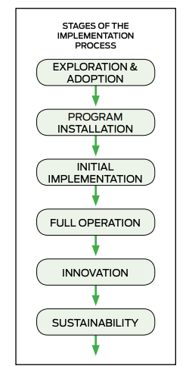
Six Stages of Implementation
(Adapted from Fixsen, Naoom, Blase, Friedman & Wallace, 2005)
Notes:
Trainer Notes:
To Know/To Say:
Extensive research has identified and validated six specific stages of the implementation process.² They are: 1) Exploration and Adoption, 2) Program Installation, 3) Initial Implementation, 4) Full Operation, 5) Innovation, and 6) Sustainability. Awareness of these phases can equip educators with the knowledge to make decisions about where to focus efforts.
Six Phases of Implementation:
EXPLORATION AND ADOPTION: The purpose of this phase is to assess the potential match between your school’s needs and the framework of SW-PBS. This typically begins by identifying the need for SW-PBS. The need is determined based upon discipline data, perceptual data, and other relevant information. What valued outcomes do you identify and why? Do your stakeholders and your data tell you that reducing ODRs is a valued outcome? Improving school climate? Addressing disproportionality? Creating consistent, supportive learning environments for all students? The result of the exploration stage is a decision to adopt well-aligned support, and an implementation plan with an understanding of the tasks and timelines for the installation and initial implementation of SW-PBS.
PROGRAM INSTALLATION: After the decision has been made to move forward with SW-PBS, there are tasks that need to be accomplished before implementation with students can occur. In MO SW-PBS, this is called the Preparation Phase. This stage is characterized by active preparation for doing things differently. Planning and development processes are put into place. This includes arranging for necessary funding, rallying active administrative support, creating a Leadership Team and effective team systems, developing systems for gathering and using data, establishing methods for engaging all staff, and providing professional learning opportunities to then begin the development of new practices and policies. When done well, all staff are thoroughly prepared and on board to begin implementation.
INITIAL IMPLEMENTATION: In this stage, work with students begins. It is essential that initial implementation be viewed as just that — an Initial Phase. Leadership must provide the support to staff that will ensure that the practices can move forward into full operation. The essence of implementation is behavior change. During initial implementation, a change in skills is required of all staff. Training, time to learn and grow, skills practice or role play, feedback, and support are essential. The difficult work of implementing something new, fear of change, inertia, and investment in the status quo can present barriers to success, and undermine confidence in the decision to adopt. The more staff that have been intimately involved in the planning and learning, and the more support provided during this stage, the greater the likelihood that effort will be sustained.
FULL OPERATION: Full implementation of SW-PBS can occur only when the new learning becomes integrated into the schools practices, policies, and procedures. At this point, SW-PBS becomes fully operational with fidelity. The processes and procedures for teaching, encouraging, and correcting clearly identified behaviors and the use of data to monitor implementation has become a routine function of how staff create student success. The innovation has become “accepted practice.” At this time, anticipated benefits or outcomes are being realized, and monitoring indicates fidelity at or above criterion levels. It is at this point that schools may initiate the process of exploration and adoption of Tier 2 or Tier 3 practices and systems while maintaining Tier 1 with fidelity.
INNOVATION: Successful adoption of an innovation depends on the degree to which initial and full implementation are done with fidelity before “tinkering” with the approaches. If attention to accurate or true implementation does not occur, program drift can result, and outcomes may be affected. When full implementation with fidelity has been achieved, then, and only then, can steps to refine and extend the practices begin. It is well established that adaptations made after a model has been implemented with fidelity are more successful than modifications made before full implementation. This is the Innovation Stage — the stage of refinement and extension.
SUSTAINABILITY: After the hard work of establishing SW-PBS, the effort is not done. SW-PBS needs to be sustained in subsequent years. Sustainability is the process of maintaining fidelity, through inevitable changes, so a practice continues to be effective in the long term. The goal during this stage is the long-term survival and continued effectiveness in the ever-present context of change. Leaders and well-trained staff will leave, new change efforts will be imminent, funding streams will be altered, requirements of schools will change, and new problems will arise. Sustaining SW-PBS requires the ongoing attention of the Leadership Team to monitor all aspects of implementation, train new staff and students, evaluate staff on their use of practices, and hire new staff with the attitudes and skill that match the program.³

Slide 23
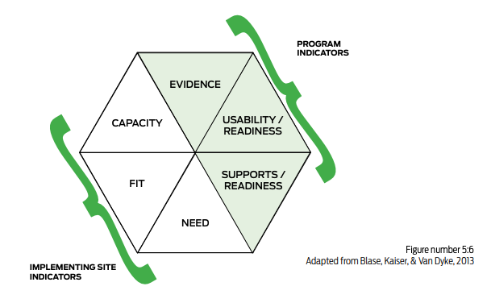
Phases of Implementation in Practice
Notes:
Trainer Notes:
To Know/To Say:
As your team documents the plan of what is to be implemented and provides information, resources, and incentives toward those efforts, you may gather information about and resources for additional programs and interventions that can enhance and more deeply develop your array of supports for all students.
A critical role of your Building Leadership Team will be to consider what, when, and how you might leverage additional programs or intervention practices to improve your programmatic outcomes. The National Implementation Research Network (NIRN) has developed The Hexagon Tool⁴ to help teams decide 1) is the intervention the right thing to do to improve our implementation and outcomes (i.e., program indicators), and 2) can we do the intervention in the right way (i.e., implementing site indicators)? For more information on using a systematic process such as the Hexagon Tool for program evaluation and planning, see “The Hexagon: An Exploration Tool”.⁵

Slide 24
Phases of Implementation in Action
Pause and Reflect:
In which implementation phase is your building &/or district?
What data would support that implementation phase?
What action steps would the building &/or district team need to take in order to move to the next phase?
How might the NIRN hexagon tool help your building &/or district team with adoption of initiatives &/or interventions?
Notes:
Trainer Notes:
To Know/To Say:

Slide 25
Phases of Implementation Closing and Next Steps
Notes:
To Know/To Say: So, let’s take a moment to briefly review where we’ve been, and where to next.
During this lesson, you learned about the six phases of implementation. You were also provided a tool to help determine whether an intervention or initiative is a good fit for your building and/or district.

Slide 26
Closing and Next Steps
Develop action steps for fulfilling the current implementation phase and/or moving to the next phase.
Consider:
How will you support your Building Leadership Team and administrators in increasing buy-in and support for SW-PBS implementation?
Notes:
To Know/To Say: During this lesson, you learned
How will you support your Building Leadership Team and administrators in increasing buy-in and support for SW-PBS implementation?
Next steps include updating your action plan. Develop action steps for fulfilling the current implementation phase and/or moving to the next phase.
In addition to the modules available on the Virtual Learning Platform, your team will be able to use the the MO SW-PBS Handbook for foundational information regarding the science of SW-PBS, the prevention logic of tiered intervention frameworks, and articulation of evidence-based practices that will help your school move from where you currently are to where you aspire to be. You can also access the MO SW-PBS Tier 1 Implementation Guide and the companion Tier 2 and Tier 3 Implementation Guides, which provide the step by-step guidance on how to plan and deploy systems of support, how to gather critical data for decision-making, and how to implement evidence-based practices with fidelity, consistency, and equity.

Slide 27
References
Fullan, M. (2009). The challenge of change. Thousand Oaks, CA: Sage.
Fixsen, D., Naoom, S.F., Blase, D.A., Friedman, R.M., Wallace, F. (2005). Implementation research: A synthesis of the literature. University of South Florida, Louis de la Parte Florida Mental Health Institute, The National Implementation Research Network.
McIntosh, K., Filter, K. J., Bennett, J., Ryan, C., & Sugai, G. (2010). Principles of sustainable prevention: Designing scale-up of school-wide positive behavior support to promote durable systems. Psychology in the Schools, 47, 5–21.
Blase, K., Kiser, L., & Van Dyke, M. (2013). The hexagon tool: Exploring context. Chapel Hill, NC: National.
Metz, A., & Louison, L. (2018). The Hexagon Tool: Exploring Context. Chapel Hill, NC: National Implementation Research Network, Frank Porter Graham Child Development Institute, University of North Carolina at Chapel Hill.
Notes:
Trainer Notes:
To Know/To Say:

Slide 28
Foundations of Systems Change
Handling Resistance to Change
Notes:
Trainer Notes:
To Know/To Say:

Slide 29
Session at a Glance
This lesson will introduce you to key insights to help lessen the impact of initiative fatigue. You will also learn strategies to help address resistance to change.
Notes:
Trainer Notes:
To Know/To Say:

Slide 30
Working Agreements
Be Respectful
Be an active listener—open to new ideas
Use notes for side bar conversations
Be Responsible
Be on time for sessions
Silence cell phones—reply appropriately
Be a Problem Solver
Follow the decision making process
Work toward consensus and support decisions of the group
Notes:
Trainer Notes: Hide or delete this slide if presenting the entire PLM
To Know/To Say: “These will be the Working Agreements we will honor during all our training sessions this year.”

Slide 31
Attention Signal
Notes:
Trainer Notes: Hide or delete this slide if presenting the entire PLM; Facilitator: Select an attention signal.
To Know/To Say:
“One of our agreements is to follow the attention signal.”
“Your team will work with your school to develop an attention signal you will use in every setting.”
“In order to get all of you focused after discussions, activities or breaks,
I will ________________________________________.”
(Insert your attention signal here.)
“Your task will be to finish your sentence, quiet your voice and ____________________________.”
(Insert what you want participants to do.)

Slide 32
Introductions
Notes:
Trainer Notes: Hide or delete this slide if presenting the entire PLM; Select an introductions activity.
To Know/To Say:

Slide 33
Lesson Outcomes
At the end of this session, you will be able to…
identify the fundamental components of efficient and effective change planning.
Notes:
Trainer Notes:
To Know/To Say:
Change can be defined as the adoption of an innovation (new practice, new idea) in order to improve outcomes for students and staff. Unfortunately, change is difficult, and waves of attempted change, sporadic projects not aligned to district/building mission and vision, change that is not evidence-based or fragmented efforts have resulted in feelings of overload by many schools and staff resulting in what has been termed “initiative fatigue.”

Slide 34
Importance of Handling Resistance to Change
There is no perfect formula for change…
unique cultures + unique practices + unique traditions = individual tailoring of change
Notes:
Trainer Notes:
To Know/To Say:
Before engaging in school improvement through SW-PBS, here are a few key insights that have been gathered from literature and years of change efforts that can help lessen the impact of initiative fatigue.
• There is no “quick fix” to discipline needs. Move slowly but certainly. Do it once, but do it thoughtfully and thoroughly.
• Schoolwide discipline is a process, not a product. It is a collaborative effort involving all staff in examining beliefs and gaining consensus on expectations and procedures. It is more than a matrix or collection of rules and consequences.
• Practices, to effect lasting change, must be used on a large enough scale to alter entire patterns of teaching and learning (the climate and culture). Changing student behavior requires changing staff behavior first.
• Professional learning must effectively combine content (behavioral or discipline strategies) with effective processes (engaging staff, gaining consensus, etc.).
• Staff learning makes the most difference in teacher behavior and student outcomes when the training and development process is schoolwide and involves all staff. A whole-school approach is necessary, with the need for shared decision-making and collaborative practices being paramount.
• Strong building leadership is essential for lasting change. The leadership style of the administrator will determine the types of change that are likely to occur together with the ultimate success of implementation and subsequent improvement in learning outcomes.
• Staff need clear expectations for their implementation of new strategies or procedures and an understanding that they will be evaluated on their contribution to achieving the vision.

Slide 35
Teacher Leader Standards
Standard #3 Curriculum Implementation
Standard #5 Positive Classroom Environment
Standard #8 Professionalism
Standard #9 Professional Collaboration
Notes:
Trainer Notes: Delete or hide this slide if presenting from the beginning of the module
To Know/To Say:
Standard #3 Curriculum Implementation. The teacher recognizes the importance of long-range planning and curriculum development. The teacher develops, implements, and evaluates curriculum based upon student, district and state standards data. [SB 291 Section 160.045.2 (1) Students actively participate and are successful in the learning process; (2) Various forms of assessment are used to monitor and manage student learning; (3) The teacher is prepared and knowledgeable of the content and effectively maintains students’ on-task behavior; (5) The teacher keeps current on instructional knowledge and seeks and explores teaching behaviors that will improve student performance.]
Standard #5 Positive Classroom Environment. The teacher uses an understanding of individual/group motivation and behavior to create a learning environment that encourages active engagement in learning, positive social interaction, and self-motivation. [SB 291 Section 160.045.2 (3) The teacher is prepared and knowledgeable of the content and effectively maintains students’ on-task behavior; (5) The teacher keeps current on instructional knowledge and seeks and explores changes in teaching behaviors that will improve student performance.]
Standard #8 Professionalism. The teacher is a reflective practitioner who continually assesses the effects of choices and actions on others. The teacher actively seeks out opportunities to grow professionally in order to improve learning for all students. [SB 291 Section 160.045.2 (2) Various forms of assessment are used to monitor and manage student learning; (5) The teacher keeps current on instructional knowledge and seeks and explores changes in teaching behaviors that will improve student performance; (6) The teacher acts as a responsible professional in the overall mission of the school.]
Standard #9 Professional Collaboration. The teacher has effective working relationships with students, parents, school colleagues, and community members. [SB 291 Section 160.045.2 (4) The teacher uses professional communication and interaction with the school community; (6) The teacher acts as a responsible professional in the overall mission of the school.]

Slide 36
Overview of Handling Resistance to Change
Notes:
Trainer Notes:
To Know/To Say:
We embrace change, yet something in our nature also resists it. Change, in many ways, is a social process. It begins at the individual level. Those involved in the change must go through a learning process to shift paradigms, appreciate the goals of change, make adaptations to new practices, be allowed to adequately prepare prior to attempting to implement the change and be supported as change is implemented. Understandably, with this complexity, some resistance will probably occur.

Slide 37
Unpacking Handling Resistance to Change
Notes:
Trainer Notes:
To Know/To Say:

Slide 38
Addressing Resistance to Change
Make a Difference
Support
Expectations
Shared Decision-Making
Respect
Prior Experiences
Knight, J. (2009)
Notes:
Trainer Notes:
See HANDOUT 4
To Know/To Say: Here are a few reasons for resistance to change and some strategies to help address it.
1. Teachers must believe the changes will make a difference.
• Leaders have verified the changes are evidence-based, supported by other practitioners, and can provide significant positive impact.
• The proposed changes match staff-identified needs.
• Support to learn, implement, and sustain the change must be assured.
2. Several types of support are needed.
• Provide high-quality, up-front professional learning.
• Provide ongoing skill-building training sessions.
• Break down new approaches into sequential steps.
• Provide opportunities for feedback and coaching.
• Make sure teachers know how to make the changes and are comfortable doing so.
3. Teachers and staff must see what is expected and believe it will work.
• Provide experiences and examples that demonstrate how and why SW-PBS works.
• Provide opportunities for modeling, visits to other MO SW-PBS schools, videos, question and answer sessions, study groups.
• Allow staff time to experiment and adjust before full implementation(preparation phase).
• Allow time for staff to make a commitment to the new initiative.
4. Stakeholders must be involved in the decision-making.
• Involve staff in making decisions that impact their work; utilize a variety of decision-making strategies.
• Respect teachers’ professional autonomy and work to incorporate it where appropriate.
• The Leadership Team should be representative of the staff.
• Involve staff in the generation of ideas before making decisions.
• Clarify decision-making — who makes what decisions and how they will be made—and share these structures with staff. Transparency will serve you well in the long term.
5. Respect the expertise of the staff.
• Recognize the expertise of staff members within the building, and make sure those who wish to contribute are asked to do so.
• Listen respectfully to staff questions and ideas.
• Consistently recognize staff contributions to the work.
• Provide staff with opportunities for reflection and to contribute to a shared vision.
6. Understand and improve upon prior experiences with change.
• When SW-PBS is being introduced, be sure adequate opportunities for input and practice have been built into the implementation plan.
• Have people identify how this change is similar and different from in the past.
• Allow time for implementation to be effective, using a variety of strategies that respect your stakeholders.
• Administrative leadership publicly supports implementation and the ongoing work to ensure success.
• Clarify that SW-PBS is a valued change and will be a long term commitment by all, and that it is worth the investment in time and resources to learn and implement.

Slide 39
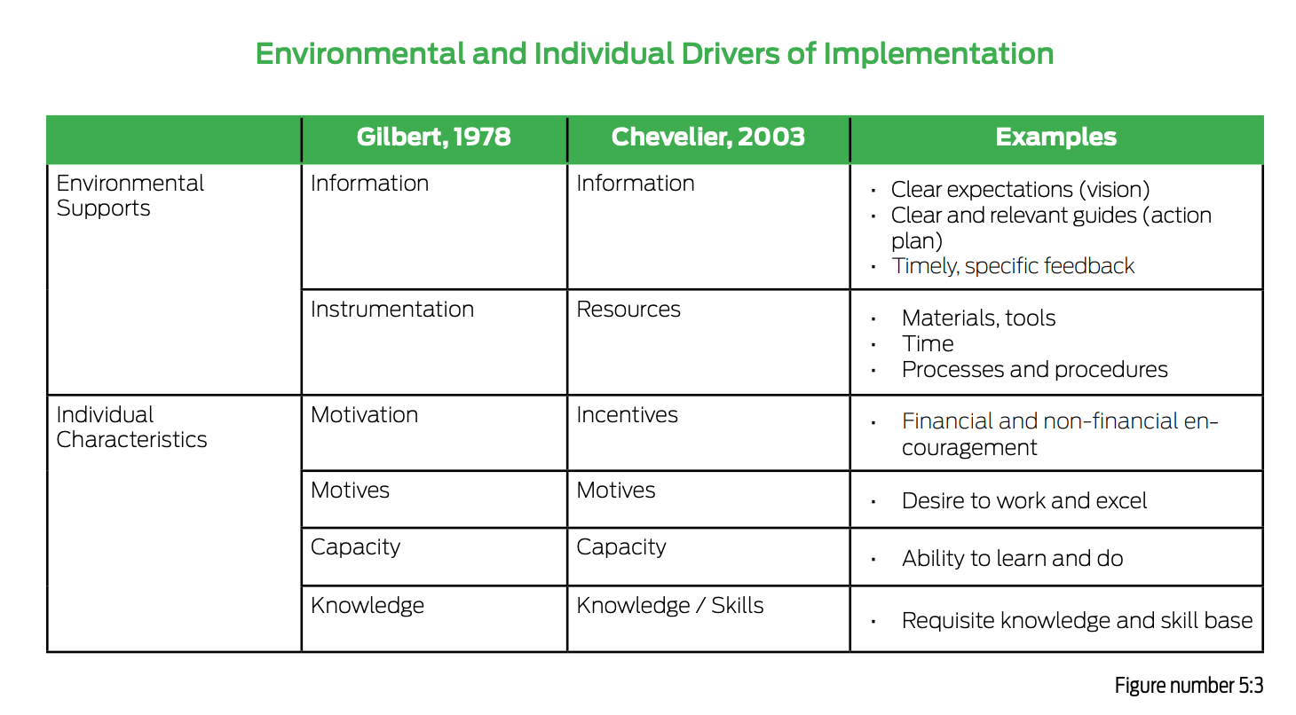
Organizational Performance Drivers
Notes:
To Know/To Say:
As you have learned, systems change is a process that takes time, commitment, and preparation. The most efficient method for changing organizations is to begin by addressing environmental supports. In his Behavior Engineering Model (BEM),³ Thomas Gilbert proposed a way to systematically identify drivers of organizational performance, which, when missing, present barriers to implementation. He put the drivers into two categories: environmental and individual. Gilbert’s model demonstrated that repeatedly providing individuals with the right information at the right time is the single most effective way to improve performance and to obtain valued outcomes. In 2003, Chevalier updated the categories to make them more scalable and comprehensive.⁴

Slide 40
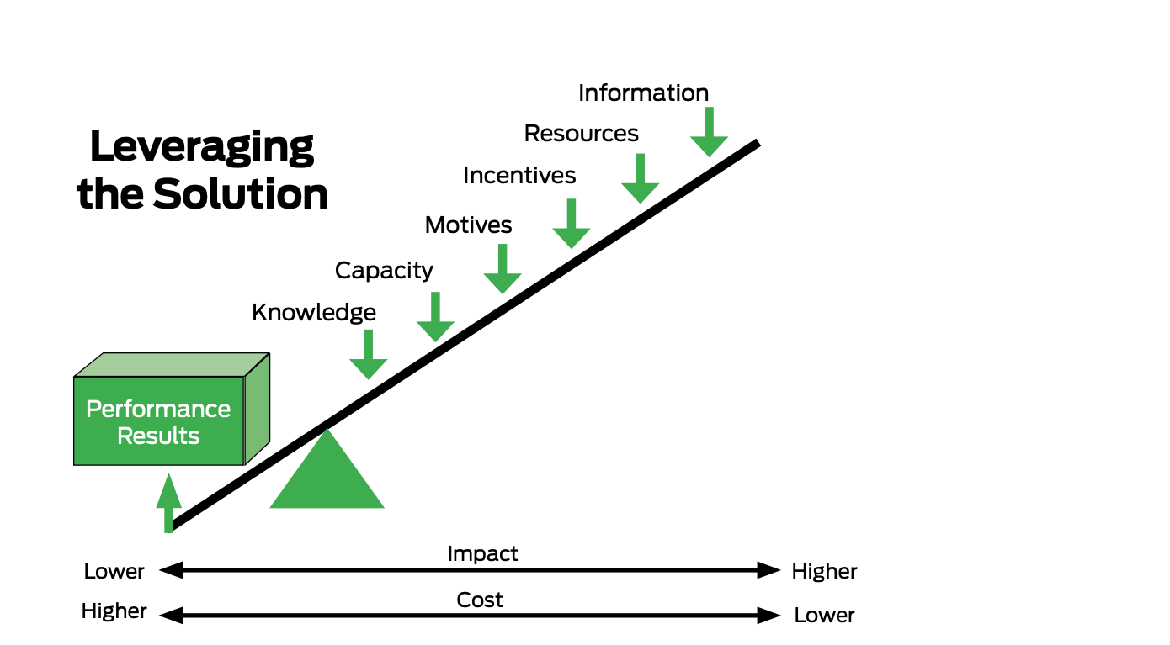
Notes:
Trainer Notes:
To Know/To Say: Your leadership team will need to balance the impact of the change desired with the cost of the supports you plan to provide. For instance, providing information systematically to all staff in the form of handbooks/guides and web-based resources that can be accessed 365 days a year, 24/7, may be relatively less expensive than providing individualized training and support, teacher by teacher. The support framework for teachers leverages the most impactful environmental components first, in a hierarchical fashion, such that the most intensive, individualized supports are saved for a limited number of your faculty.

Slide 41
Handling Resistance to Change in Practice
Notes:
Trainer Notes:
To Know/To Say:

Slide 42
Question to Consider:
In order to stay solution-focused, what action steps might your team need to create in response to the following concerns when your team is presenting an overview of MO SW-PBS to the staff?
Staff members voice a concern that SW-PBS won’t work.
Staff members hesitate to jump on board because they have seen numerous initiatives come and go in the past.
Staff members feel they will be losing autonomy in their classroom.
Staff members feel this initiative is being done “to them” instead of “with them”.
Notes:
Trainer Notes:
To Know/To Say:

Slide 43
Handling Resistance to Change in Action
Notes:
Trainer Notes:
To Know/To Say:

Slide 44
Discussion As a District Leadership Team or Building Leadership Team:
How will your team balance the information and resources to ensure all stakeholders are informed and supported throughout the change process?
How will your team increase stakeholder buy-in to lessen the resistance to change?
How will your team respond to individuals who are resistant to change?
Notes:
To Know/To Say:
Activity:
Connecting Around the Room: Activity/Movement for Participants
Give Directions: To complete our activity of Connecting Around the Room, when I read the first question from this list, you will find your first partner. Each of you will share how you might ensure all stakeholders are informed and supported throughout the change process. You will have 2 min. with your partner (1 min for each person to share). When I say, “Supporting Change,” bring your eyes back to me. I will then read the next question, and you will find a second/different partner to follow the same process to share your thoughts. You will repeat this process for the last question as well. These thoughts and connections will help as we move into action planning for academic and behavior outcomes.

Slide 45
Handling Resistance to Change Closing and Next Steps
Notes:
To Know/To Say: So, let’s take a moment to briefly review where we’ve been, and where to next.
During this lesson, you learned that change is a process and when greeted with strategic planning, clear expectations, support throughout the process, and open communication, stakeholders are less likely to resist the change.

Slide 46
Closing and Next Steps
Consider the following action steps:
analyzing building and/or district climate and culture,
increasing staff and administrator buy-in,
defining and communicating the “why” behind the change,
developing a process for two-way communication for feedback and input.
Notes:
To Know/To Say: During this lesson, you learned
How will you engage all staff and administrators throughout the systemic change process?
Next steps include updating your action plan. Develop action steps for analyzing building and/or district climate and culture, increasing staff and administrator buy-in, defining and communicating the why behind the change, and developing a process for two-way communication for feedback and input.
Additional information about increasing buy-in and creating a common purpose can be found in the MO SW-PBS Handbook and the MO SW-PBS Tier 1 Implementation Guide.

Slide 47
References
Fullan, M. (2009). The challenge of change. Thousand Oaks, CA: Sage.
Knight, J. (2009). What can we do about teacher resistance? Phi Delta Kappan, 90(7), 508-513.
Gilbert, T.F. (1978). Human competence: Engineering worthy performance. New York : McGraw-Hill.
Chevalier, R. (2003). Updating the behavior engineering model. Performance Improvement, 42(5), 8–14.
Notes:
Trainer Notes:
To Know/To Say:

Slide 48
Foundations of Systems Change
The Cascade Model of Support
Notes:
Trainer Notes:
To Know/To Say:

Slide 49
Session at a Glance
This lesson will introduce an interconnected systems of support
Notes:
Trainer Notes:
To Know/To Say:
While it is critical for your leadership team to understand the phases of systems change and how best to manage complex systems change, it is also important to understand your building’s school improvement efforts as a process taking place within interconnecting levels of educational support.

Slide 50
Working Agreements
Be Respectful
Be an active listener—open to new ideas
Use notes for side bar conversations
Be Responsible
Be on time for sessions
Silence cell phones—reply appropriately
Be a Problem Solver
Follow the decision making process
Work toward consensus and support decisions of the group
Notes:
Trainer Notes: Hide or delete this slide if presenting the entire PLM
To Know/To Say: “These will be the Working Agreements we will honor during all our training sessions this year.”

Slide 51
Attention Signal
Notes:
Trainer Notes: Hide or delete this slide if presenting the entire PLM; Facilitator: Select an attention signal.
To Know/To Say:
“One of our agreements is to follow the attention signal.”
“Your team will work with your school to develop an attention signal you will use in every setting.”
“In order to get all of you focused after discussions, activities or breaks,
I will ________________________________________.”
(Insert your attention signal here.)
“Your task will be to finish your sentence, quiet your voice and ____________________________.”
(Insert what you want participants to do.)

Slide 52
Introductions
Notes:
Trainer Notes: Hide or delete this slide if presenting the entire PLM; Select an introductions activity.
To Know/To Say:

Slide 53
Lesson Outcomes
At the end of this session, you will be able to…
envision a model of an interconnected system of supports.
Notes:
Trainer Notes:
To Know/To Say:

Slide 54
Overview/Importance of The Cascade Model of Supports
Notes:
Trainer Notes:
To Know/To Say:

Slide 55
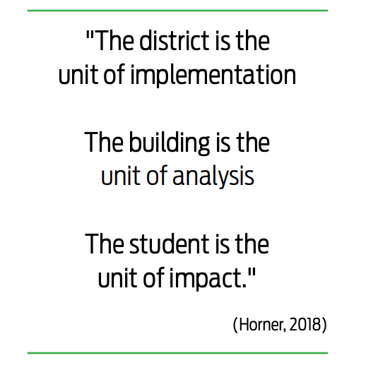
Notes:
Trainer Notes:
To Know/To Say: The stair step of a cascading system illustrates that there are units within educational systems that build upon each other and are connected through feedback loops and mechanisms of support.

Slide 56
Teacher Leader Standards
Standard #3 Curriculum Implementation
Standard #5 Positive Classroom Environment
Standard #8 Professionalism
Standard #9 Professional Collaboration
Notes:
Trainer Notes: Delete or hide this slide if presenting from the beginning of the module
To Know/To Say:
Standard #3 Curriculum Implementation. The teacher recognizes the importance of long-range planning and curriculum development. The teacher develops, implements, and evaluates curriculum based upon student, district and state standards data. [SB 291 Section 160.045.2 (1) Students actively participate and are successful in the learning process; (2) Various forms of assessment are used to monitor and manage student learning; (3) The teacher is prepared and knowledgeable of the content and effectively maintains students’ on-task behavior; (5) The teacher keeps current on instructional knowledge and seeks and explores teaching behaviors that will improve student performance.]
Standard #5 Positive Classroom Environment. The teacher uses an understanding of individual/group motivation and behavior to create a learning environment that encourages active engagement in learning, positive social interaction, and self-motivation. [SB 291 Section 160.045.2 (3) The teacher is prepared and knowledgeable of the content and effectively maintains students’ on-task behavior; (5) The teacher keeps current on instructional knowledge and seeks and explores changes in teaching behaviors that will improve student performance.]
Standard #8 Professionalism. The teacher is a reflective practitioner who continually assesses the effects of choices and actions on others. The teacher actively seeks out opportunities to grow professionally in order to improve learning for all students. [SB 291 Section 160.045.2 (2) Various forms of assessment are used to monitor and manage student learning; (5) The teacher keeps current on instructional knowledge and seeks and explores changes in teaching behaviors that will improve student performance; (6) The teacher acts as a responsible professional in the overall mission of the school.]
Standard #9 Professional Collaboration. The teacher has effective working relationships with students, parents, school colleagues, and community members. [SB 291 Section 160.045.2 (4) The teacher uses professional communication and interaction with the school community; (6) The teacher acts as a responsible professional in the overall mission of the school.]

Slide 57
Unpacking The Cascade Model of Supports
Notes:
Trainer Notes:
To Know/To Say:

Slide 58
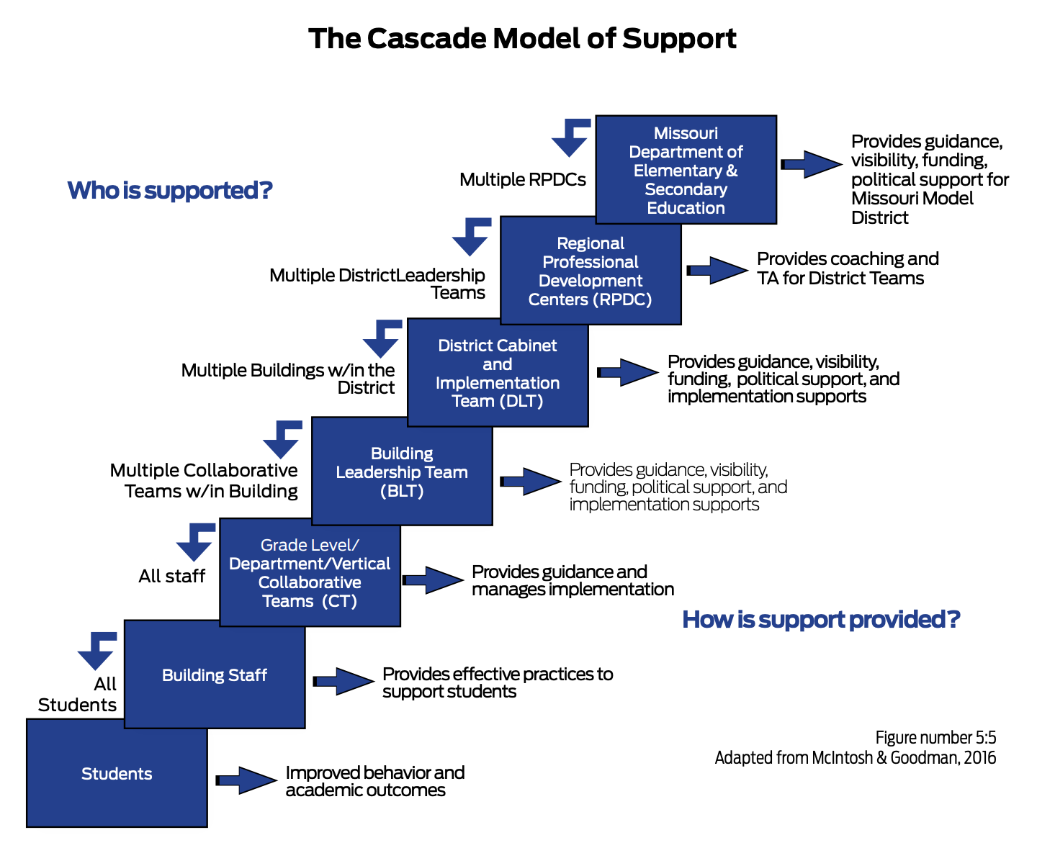
Notes:
Trainer Notes:
To Know/To Say: In the state of Missouri, the Department of Elementary and Secondary Education (MO DESE) provides guidance, visibility, funding and political support for Multi-Tiered Systems of Support (MTSS). MO DESE partners with Regional Professional Development Centers (RPDCs) that are located at state universities in nine geographical regions to provide a statewide system of support to Missouri’s 500 plus public and charter districts. These districts in turn provide guidance, visibility, funding, and implementation supports to over 2,000 public and charter schools in our state. Building Leadership Teams provide guidance and manage implementation through the use of collaborative teams. Collaborative teams include every teacher and are a part of a process to ensure that evidence-based, effective teaching and learning practices are delivered with fidelity, consistency, and equity to nearly 1 million school-aged students in the state of Missouri.
As the cascade model demonstrates, there should be connections that reach from individual classrooms up to the state department of education.

Slide 59
The Cascade Model of Support in Practice
Notes:
Trainer Notes:
To Know/To Say:

Slide 60
Group Carousel Activity
Notes:
To Know/To Say:
Materials:
6 pieces of chart paper
1 question at the top of each chart paper
1 marker per group for participants to record their thoughts onto the chart paper
Timer for 2 min.
Directions:
We are going to complete a Carousel activity to begin brainstorming what our Cascade Model of Support would look like. We are going to think through 6 questions. We will be getting into 6 groups. Each group will have 2 minutes to brainstorm and record their answers to the question on the chart paper before rotating. We will rotate clockwise around the room until every group has had a chance to discuss each question.
Advance to next slide for questions and the further directions

Slide 61
Use the following questions to help draw your personalized cascade of support:
1. Do you know what the vision of public education is from your department of education?
2. Are you aware of regional support centers in your area where your district leadership team or building leadership team can access support and information?
3. What are your district leadership team’s vision and goals?
4. Has your building leadership team connected your work to the goals set forth by your district leadership team?
5. What information, resources, or incentives has your district provided your building leadership team?
6. In turn, what has your building leadership team provided grade-or department-level collaborative teams and/or individual teachers in terms of information, resources, or incentives?
Notes:
Trainer Notes:
To Know/To Say:
Number off 1-6. Have each group go to the corresponding chart paper to start with. Set a timer for 2 min. After 2 min. is up, call attention and have each group rotate clockwise to the next chart. Continue in this process until all groups have been to every question.
After all groups have been through all 6 questions, have them return to their starting question. Read through the additional comments/thoughts. Have one person volunteer to be the reporter for their group. They can stay at the chart paper. All other participants may return to their seat. Starting with question 1, have the reporter share out to the whole group a summary of the responses for that question. Continue until all summaries have been shared.

Slide 62
The Cascade Model of Support in Action
Notes:
To Know/To Say:
Use Handout 5 (the blank Cascade Model Of Support Template) to complete in small groups. Can be the same groups as the carousel activity or new groups.

Slide 63
The Cascade Model of Support Closing and Next Steps
Notes:
To Know/To Say: So, let’s take a moment to briefly review where we’ve been, and where to next.
During this lesson, you learned there are units within educational systems that build upon each other and are connected through feedback loops and mechanisms of support.

Slide 64
Closing and Next Steps
Develop action steps for creating your cascade of support, sharing it with stakeholders and communicating with the stakeholders their placement within the cascade of support.
Notes:
To Know/To Say: During this lesson, you learned
How will you engage your leadership team in identifying your personalized cascade of support?
Next steps include updating your action plan. Develop action steps for creating your cascade of support, sharing it with stakeholders and communicating with the stakeholders their placement within the cascade of support.
Additional information about support and communication with stakeholders can be found in the MO SW-PBS Handbook and the MO SW-PBS Tier 1 Implementation Guide.

Slide 65
References
Horner, R. H. (October 2018). Closing remarks for a new beginning. Presentation conducted at the PBIS Leadership Forum, Chicago, IL.
McIntosh, K., & Goodman, S. (2016). Integrated multi-tiered systems of support: Blending RTI and PBIS. New York: The Guilford Press.
Notes:
Trainer Notes:
To Know/To Say:

Slide 66
Contact Information
Check Out MO SW-PBS on Social Media:
Facilitator Contact Information:
pbismissouri.org
facebook.com/moswpbs
@MOSWPBS

